Slide 1
General Permit for the Discharge of Stormwater and Dewatering Wastewaters from Construction Activities
2013

Slide 2


Introductions……
Paul Corrente
David Harms
Derek Kohl
Michael Fisher
Kimberly Lesay
David Cicia
Notes:
Paul Corrente to give brief intro and review of DOT’s involvement in the Hearing Process

Slide 3
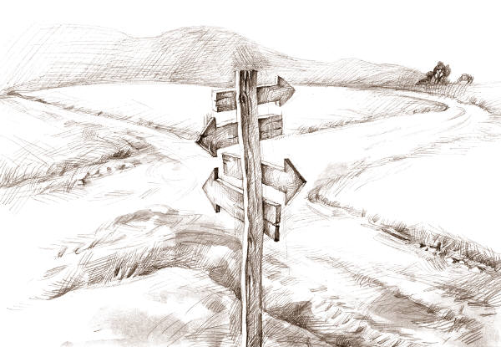
Agenda
Purpose of Training Today
History / Background
New Terms
Time Frames
Requirements
  8 appendices
LID
New Certification Requirements
Questions / BREAK
Registration Form Review
Public Comment
Questions / BREAK
Stormwater Pollution Control Plan
Questions / BREAK
Non-Linear Projects
Notes:
Quick run through agenda .need to give estimated timeframe. Allowing for two breaks and 2 Q & A sessions, which may have to be limited, however, follow up support will be offered.
We will be walking you through the registration form page by page…

Slide 4

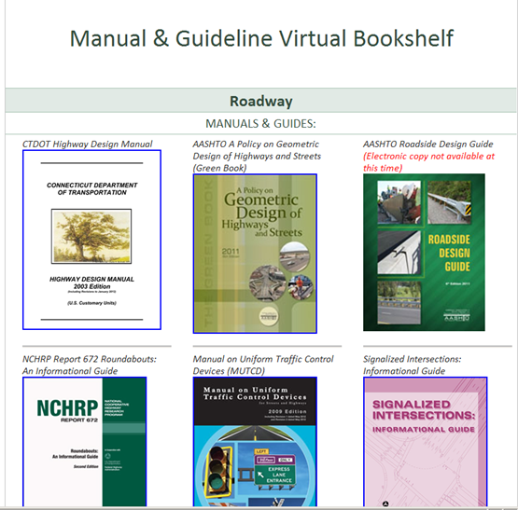
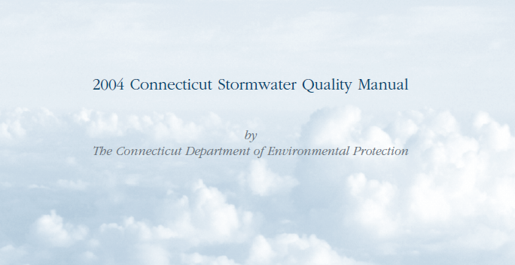
Resources
http://www.ct.gov/deep/soilerosionsedimentcontrol
http://www.ct.gov/deep/cwp/view.asp?a=2721&q=325704&deepNav_GID=1654#download
Notes:
Mention that there will be numerous references to the 2002 E & S Guidelines and the 2004 SWQ Manual. Knowledge of both is key. E & S is largely for DURING construction, and the 2004 Manual is for design of systems AFTER construction. It is important to know that when dealing with DEEP, to utilize the terminology found in both of these manuals, and that when you utilize these, that design truly meets the definitions. Ie..A wet swale, must truly be a wet swale..

Slide 5
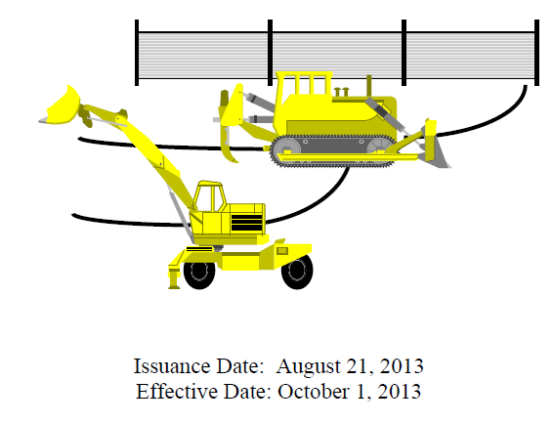
History / Background
The EPA has mandated a number of permit programs, administered by the Department of Energy and Environmental Protection (DEEP), to deal with stormwater pollution.
- Industrial, Commercial, MS4 and …..Construction
Federal Program handed down to the State
The General Permit for the Discharge of Stormwater and Dewatering Wastewaters from Construction Activities ("Construction General Permit") requires developers and builders to implement a Stormwater Pollution Control Plan to prevent the movement of sediments off construction sites into nearby water bodies and to address the impacts of stormwater discharges from a project after construction is complete. The Construction General Permit reissued without modifications on October 1, 2012 expired on September 30, 2013. On August 21, 2013, the Department reissued the Construction General Permit with modifications. This general permit became effective on October 1, 2013.
Notes:
Stormwater is water resulting from rain or snowmelt that runs off surfaces such as rooftops, paved streets, highways and parking lots. Along the way, the water may pick up and transport contaminants including motor oils, gasoline, antifreeze, and brake dust (commonly found on pavements), fertilizers and pesticides (found on landscaped areas), and soil sediments (from farms and construction sites). The water eventually flows into a local stream, river or lake, or into a storm drain and continues through storm pipes until it is released untreated into a local waterbody.
The federal Clean Water Act requires that all municipal, industrial and commercial facilities that discharge wastewater or stormwater directly from a point source (a discrete conveyance such as a pipe, ditch or channel) into a water of the United States (such as a lake, river, or ocean) must obtain a National Pollutant Discharge Elimination System (NPDES) permit. All permits are written to ensure the receiving waters will achieve their Water Quality Standards.
Different permits in CT:
Industrial -regulates industrial facilities with point source discharges that are engaged in specific activities listed in the permit such as Asphalt plants, airports, repair facilities, public works garages… The DOT commercial service plazas fall under this category
Construction – what we will deal with today
Commercial – malls, movie theaters, supermarkets, concentrates on Maintenance such as sweeping and cleaning of basins, (only in CT)
and Stormwater from Small Municipal Separate Storm Sewer Systems General Permit (MS4) which requires each municipality to take steps to keep the stormwater entering its storm sewer systems clean before entering water bodies and focuses on educational component

Slide 6
Terms
“Some people have a way with words, and other people...oh, uh, not have way.”
― Steve Martin

Slide 7
KEY Terms
Locally Approvable Project
Locally Exempt Project
Retention
Effective Impervious Cover
Water Quality Volume
Water Quality Flow
Low Impact Development
  Think: pre-development hydrology – managing at the source
Runoff Reduction Practices
  Think: reducing post development runoff volume
The “Site”
Total Disturbance
Notes:
Some key terms which we will cover today - some of which are new, and some what confusing…
Brief intro, to each, but assure these will be covered in pertinent sections again in more detail.
Pre-development means before your project, not when the pilgrims arrived.

Slide 8
TIME FRAMES
Time is what we want most, but what we use worst.
William Penn

Slide 9
General requirements
Total disturbance of one or more acres
  Regardless of phasing
  Including staging / storage / stockpiles
Locally Exempt Projects
  60 days for disturbed area between 1 and 20 acres
  90 days for
    More than 20 acres disturbed area
    discharge within 500 feet of a tidal wetland
    discharge to impaired waters
Locally Approvable Projects
  60 days prior to planned commencement of construction
Small Construction (Local Roads / FLBP / SLBP)
  Local municipal approval for projects between 1 and 5 acres – do not have to register if approved by local commission
Notes:
Locally Exempt – Will apply to most of you here today
Locally approvable does apply to projects managed by CTDOT via local roads, some projects in CE design which are initiated by the municipalities, and programs such as the Federal Local and State Local Bridge Programs.

Slide 10

Registration not required when:
100 year storm event can be retained both during construction and post construction

Slide 11
New Requirements
It is not the strongest of the species that survives, nor the most intelligent that survives. It is the one that is the most adaptable to change.
Charles Darwin

Slide 12
conformance with / consideration of:
Coastal Management Act
  Approval of Coastal permit or CAM approval
  Cover sheet of the coastal permit approval can be used in lieu of Appendix D and must be provided as Attachment B
Endangered and Threatened Species
  Outside of mapped area / Letter from NDDB - will be Attachment C
  If site is within a ¼ mile of a mapped area, it must be screened through OEP
  DOT will not be utilizing the Safe Harbor Provision, sign-offs good for 1 year
Aquifer Protection Areas
  Will be identified in Environmental Review process / mapping available
  Must be considered in SWPCP
    Prevent inadvertent pollution discharges / releases
    Do NOT infiltrate within APA’s unless off of a clean surface
Wild and Scenic Rivers Act
  Will be identified in Environmental Review process
  www.rivers.gov
Historic Preservation Review
  Will be identified in Environmental Review process
  Utilize OEP provided SHPO sign off
Notes:
All of these issues will be identified in the Environmental review process and / or via the permit need determination form both via OEP.
Many of these concerns are requirements for other permits, but are now also wrapped into the stormwater registration process.

Slide 13
Discharges to tidal waters
Any Post-construction discharge to within 500 feet of a tidal wetland shall be through a system designed to RETAIN and infiltrate the volume of stormwater runoff generated by 1 inch of rainfall on the “site”
Site Constraints must be documented if the above cannot be met
Where 1 inch of runoff cannot be retained, additional stormwater treatment to protect water quality must be designed, installed and maintained in accordance with the 2004 Stormwater Quality Manual.
Notes:
Retention – not detention
Very difficult to achieve, especially in urbanized areas
Do the best you can – if you can retain ¼ inch, do so, if you can retain ½, do so…do best you can for treatment of the rest.
Look for improvements over existing, pull back outfalls,
Primary treatment over secondary treatment. Secondary treatment is always a LAST option.
Site constraint examples will be covered in detail coming up..

Slide 14

Additional Considerations….
Runoff Reduction & LID Considerations
New Discharges to Impaired Waters (Section 303 (d))
  New outfall
  Same location but Increase in pipe size
  Same pipe but increase in Q
Notes:
LID & Runoff reduction will be covered in more detail under a separate section
Define what “new” discharge is

Slide 15
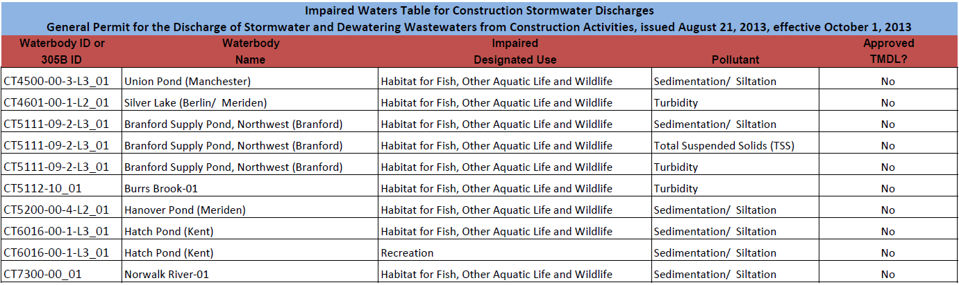
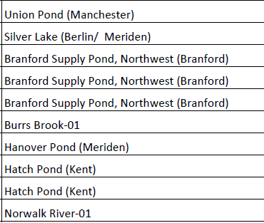
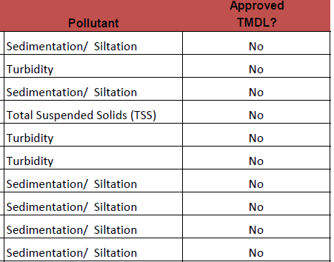
Impaired waters (Section 303 (d))
If the cause of the impairment is due to Sedimentation / Siltation / Turbidity
Notes:
This sounds horrifying, as there are many many impaired water bodies in the state, but this requirement applies only to those impaired by sediment, siltation or turbidity which narrows it down to 7 waterbodies
As you will see, this lines up with some of the tables in the registration form which we will review in detail later on
Note that right now, there are no approved TMDL’s for any of these waterbodies
TMDL = Total Maximum Daily Load
Under section 303(d) of the Clean Water Act, states, territories, and authorized tribes are required to develop lists of impaired waters. These are waters that are too polluted or otherwise degraded to meet the water quality standards set by states, territories, or authorized tribes. The law requires that these jurisdictions establish priority rankings for waters on the lists and develop TMDLs for these waters. A Total Maximum Daily Load, or TMDL, is a calculation of the maximum amount of a pollutant that a waterbody can receive and still safely meet water quality standards.

Slide 16
Discharges to Impaired waters
No more than 3 acres disturbed at any one time
If construction activity will be temporarily suspended to more than 14 days, temporary stabilization measures must be implemented within 3 days
For all areas, permanent stabilization shall be implemented within 30 days of disturbance
OR
Measures must be in place to ensure no discharge to the impaired waters from rain events up to a 2 year, 24-hour rain event during construction
OR

Slide 17
Impaired waters with an established TMDL:
X
X
X
The plan must document that there is sufficient remaining waste load allocation (WLA) in the TMDL
AND
Measures must be implemented to ensure the WLA will not be exceeded
AND
Stormwater discharges will be monitored for any indicator pollutant identified in the TMDL for every rain event that produces a discharge (this monitoring is in addition to regular requirements)
OR
The specific requirements for stormwater discharges specified in the TMDL are met.
Notes:
None of the impaired waterbodies have an established TMDL yet

Slide 18
What in the world is LID?

Slide 19
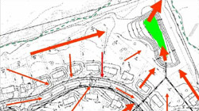
Conventional Stormwater Management
Direct all of the storm water to storm
drains to remove it from the site as
quickly as possible.
Typically designed to store and detain
runoff to reduce peak flows for the 10 year, 24-hour
storm. Controls are often not in place to reduce flows for
smaller, more frequent events.
Controls are not structured to address non-point source pollution problems or to recharge the groundwater.
These controls take up a significant portion of land.
Ponds require fencing, annual maintenance and can require long-term rehabilitation costs.

Slide 20
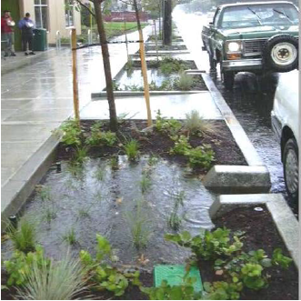
Low impact development
  Site design strategy that maintains, mimics or replicates pre-development hydrology through the use of site design principles and small scale treatment practices distributed throughout a site to manage runoff volume and water quality at the source.

Slide 21
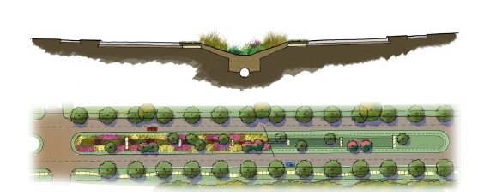
Most suitable for DOT Projects….
  Sheet flow to conservation areas, eliminate curbing
  landscape infiltration, infiltration islands
  grass swales, bio-swales, wet swales,
  stormwater ponds, stormwater wetlands, stormwater filtering systems,
  stormwater infiltration

Slide 22

LID USAGE - SITE CONSTRAINTS

Slide 23
Possible Site CONSTRAINTS
Explain in narrative
  Bedrock within 4 feet
  Elevated Groundwater within 4 feet
  APA’s, Public drinking supply wells
  Brownfields
  Capped Landfills
  Contaminated soils (AOEC’s)
  Contaminated groundwater
  Improper soil parent material…
Notes:
Have Dave provide brief explanation / handout of draft MOU at end of this slide

Slide 24
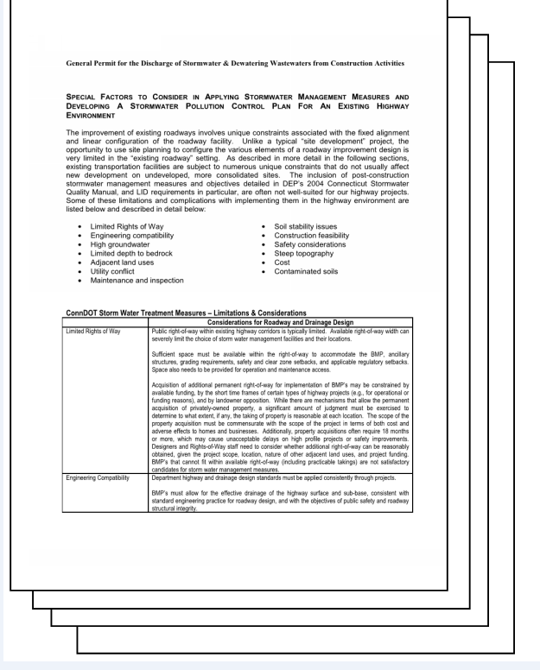
Previous Negotiations
Efforts previously put forth by Highway design during the development of the permit renewal
Notes:
Have Dave provide brief explanation / handout of draft MOU at this slide

Slide 25
Resources
Show due diligence and knowledge of your site…
Notes:
Introduce on-line resources

Slide 26
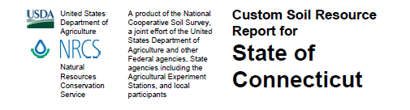
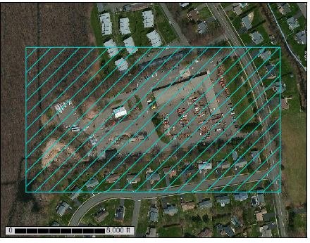
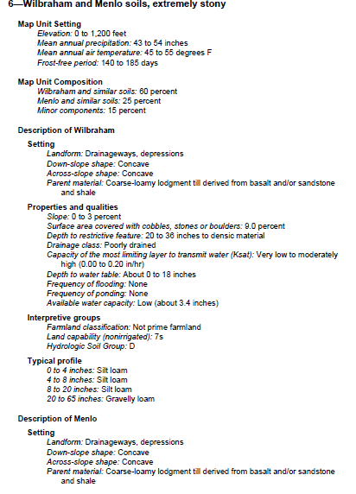
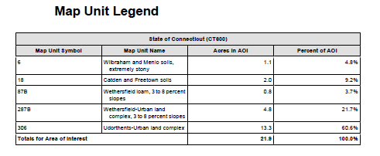
Notes:
Brief overview of website

Slide 27
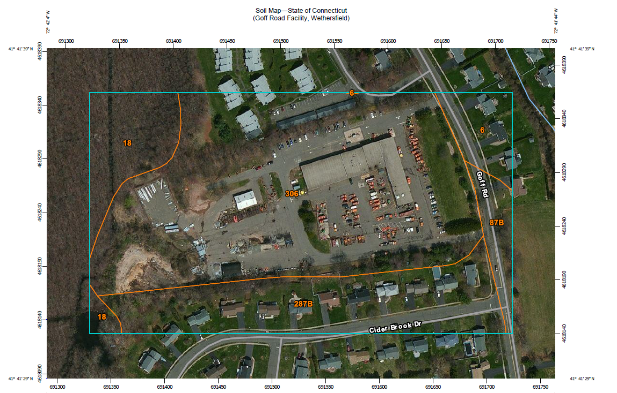
Notes:
Include ONLY the map in the registration form

Slide 28
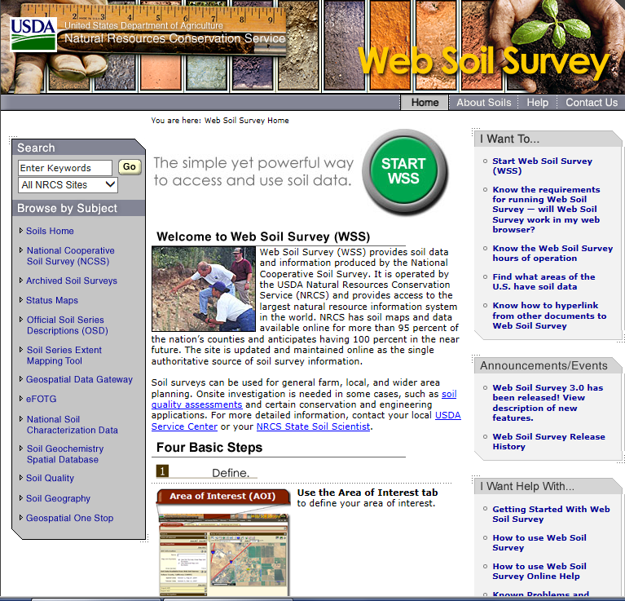
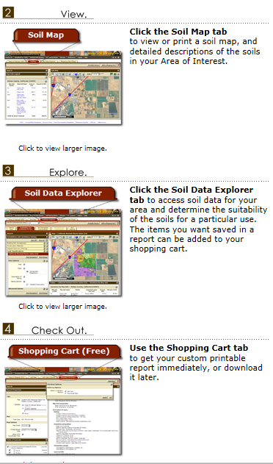
http://websoilsurvey.nrcs.usda.gov/app/
Notes:
Useful tool in showing due diligence in checking infiltration rates

Slide 29
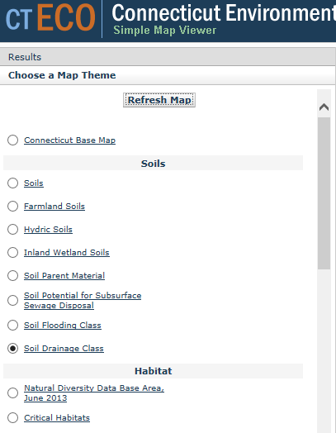
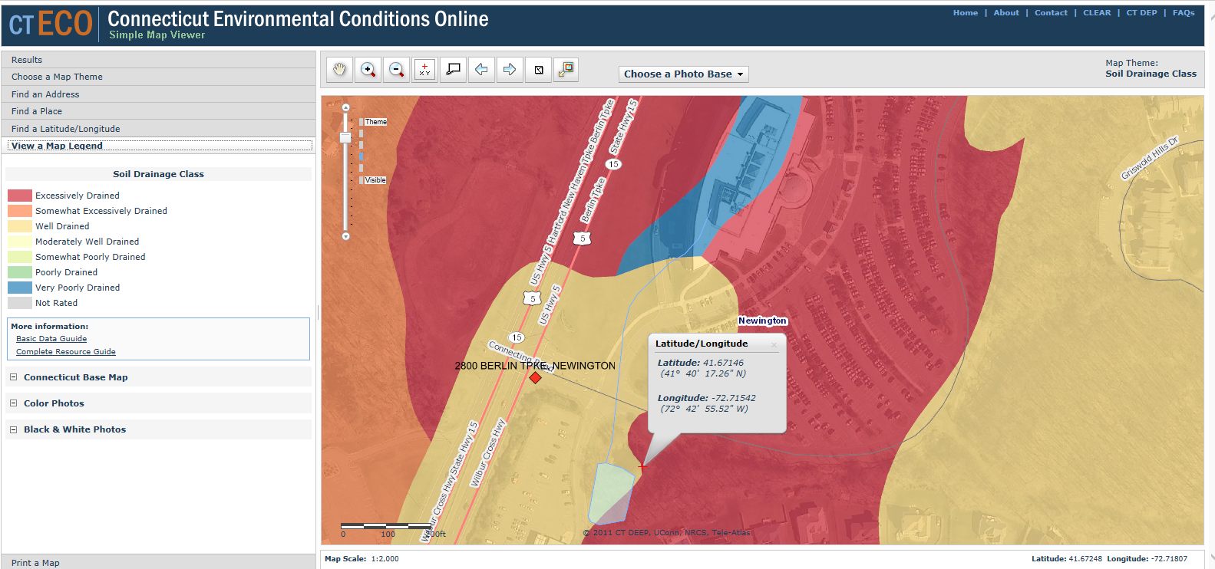
Choose a Map theme
Refresh Map
View Map legend

Slide 30
Certification Requirements

Slide 31
CERTIFICATION REQUIREMENTS FOR REGISTRANTS
The registrant and any other individuals responsible for preparing the registration and signing the certification shall have completely reviewed at a minimum; the general permit and:
    All information provided in the Registration Form
    The project site, based on a site inspection
    The Stormwater Pollution Control Plan (SWPCP)
    Any plans and any DEEP approvals regarding such SWPCP.
Notes:
Stress what should be reviewed before signing
Stress site inspection

Slide 32
SUBMISSION REQUIREMENTS
The registration must be submitted with:
  Registration form (www.ct.gov/deep/stormwater)
  Additional forms and information regarding consistency as required
  SWPCP
    - Plans
    - Narrative
  DOT - Currently paper registration with CD
    - future will be registration on CD with a URL
Notes:
Material not pertaining to stormwater management or erosion & sedimentation control should not be attached
Keep registration paperwork to a minimum.

Slide 33

PLEASE DO NOT INCLUDE
Hydraulic Reports
Specifications
The General Permit Itself
Copies of other permits
DEEP Site Inspection Report Form
X
Notes:
Material not pertaining to stormwater management or erosion & sedimentation control should not be attached
Keep registration paperwork to a minimum.

Slide 34




SPECIAL NOTIFICATIONS
Discharges within a Public water supply watershed or Aquifer Protection Area require that a copy of the registration and plan be provided to the water company
http://www.ct.gov/deep/lib/deep/aquifer_protection/wtr_co_contact_list.pdf
Notes:
OEP will provide name of water company

Slide 35

SPECIAL NOTiFICATIONS
Discharges to river components and tributaries designated as Wild and Scenic require that a copy of the registration and plan be provided to the applicable wild and scenic coordinating committee
  Farmington River
      www.farmingtonriver.org
  Eightmile River (Lyme, East Haddam, Salem)
      www.eightmileriver.org
  Pawcatuck River
    Awaiting Senate approval
      http://www.wpwa.org
  General info
      www.rivers.gov
Notes:
3. Other Proposed Federally Assisted Water Resources Projects (Agency Other than the FERC)
Refer to the section on “other proposed federally assisted water resources projects” under water
resources projects within the designated river corridor (Section I.A.3.).
B. Water Resources Projects Below, Above or on a Stream Tributary to the Congressionally
Authorized Study River Corridor
For 1 and 2 below, i.e., water resources projects below, above or on a stream tributary to the
congressionally authorized study river, the downstream/upstream project will be evaluated as to
whether the study river is invaded or the scenic, recreational, fish and wildlife values present on
the date of designation of the river for study are diminished.

Slide 36
QUESTIONS
To raise new questions, new possibilities, to regard old problems from a new angle, requires creative imagination and marks real advance in science.
Albert Einstein

Slide 37
BREAK

Slide 38
Navigating the registration form

Slide 39
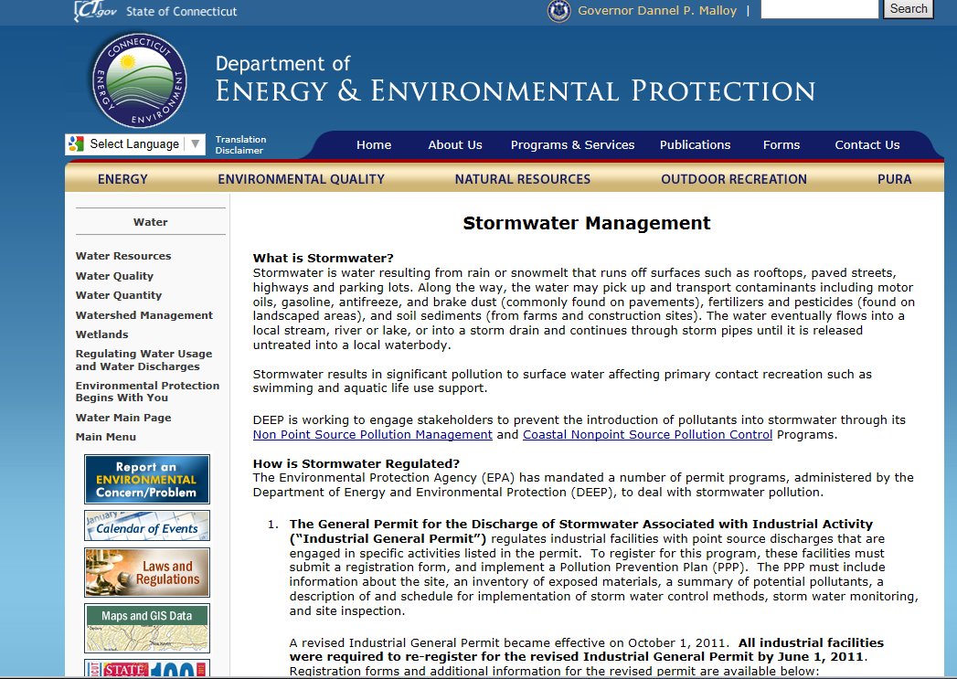
DEEP WEB PAGE
http://www.ct.gov/DEEP/stormwater
Notes:
From DEEP website, if you search stormwater, this is the first selection.
This page is very helpful
Has links to the 2003 Guidelines and to 2004 SWQ Manual as well

Slide 40
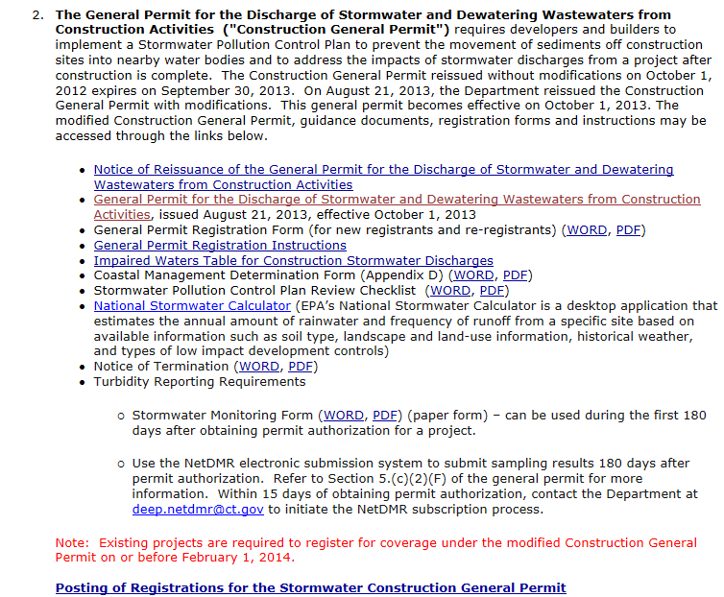
Actual Permit
Registration form
Form Instructions
Handy Checklist
Check your status
Notes:
Be sure to scroll down PAST the Industrial Permit info, until you reach the section for the Construction activities General Permit
Registration form itself is available here, both in word or PDF format
The links to both the Notice of Termination Form and Stormwater Monitoring Forms are also found here, and a blank is being requested to be provided by OEP as part of the registration submission..
Link to NetDMR is also here…NOT up and running yet
Postings -

Slide 41
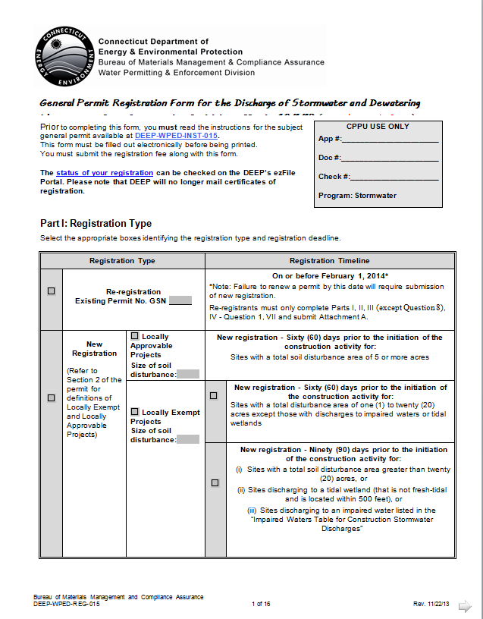

Project Type
New Registration
Select the Area
Erodible Area
Notes:
Re-registration ended February 1, 2014, all are now new.
Erodible Area based on soil disturbance, does not include mill & overlay, partial depth repair.

Slide 42
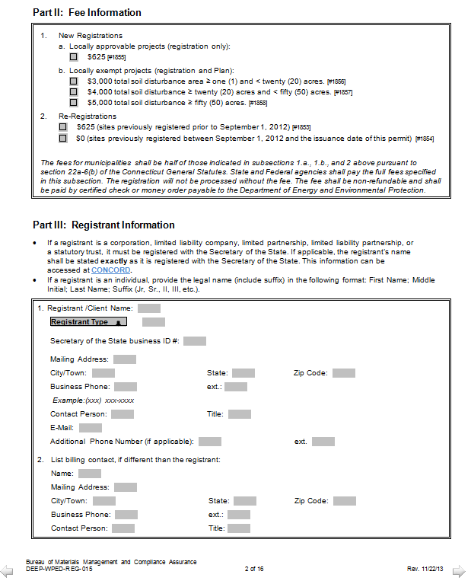
Connecticut DOT
District Engineer
N/A
Notes:
District Engineers
1: Ravi V. Chandran
2: Carl E. Nelson
3: Mark D. Rolfe
4: Kenneth E. Fargnoli

Slide 43
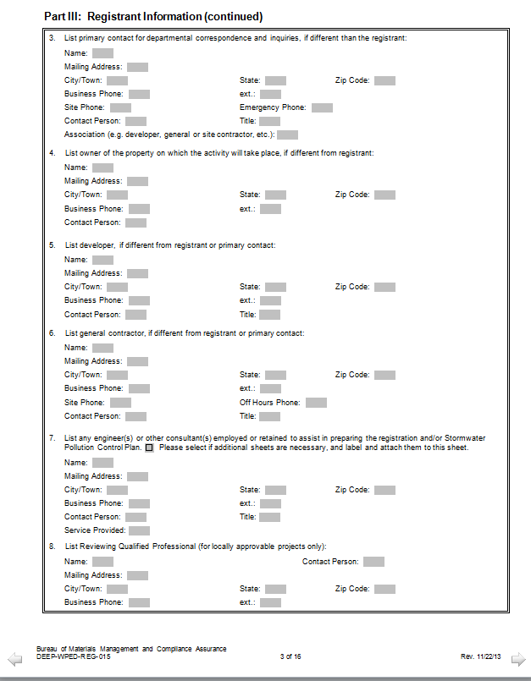
Notes:
All N/A except for this section if Consultant aids in prep

Slide 44
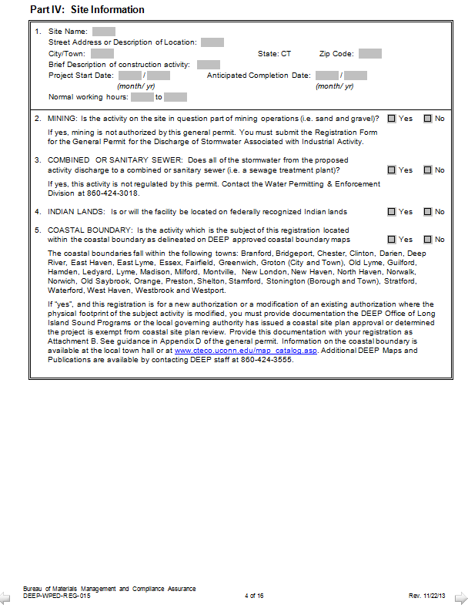
Project Information
Coastal Boundary
PNDF
CT ECO Website
Notes:
Project info, including start & stop dates, and hours of operation must be filled in. 7:30 – 4:00 typical.
2, 3, and 4 should always be NO
5 – are you within CAM boundary?...refer to PNDF or CT ECO.

Slide 45
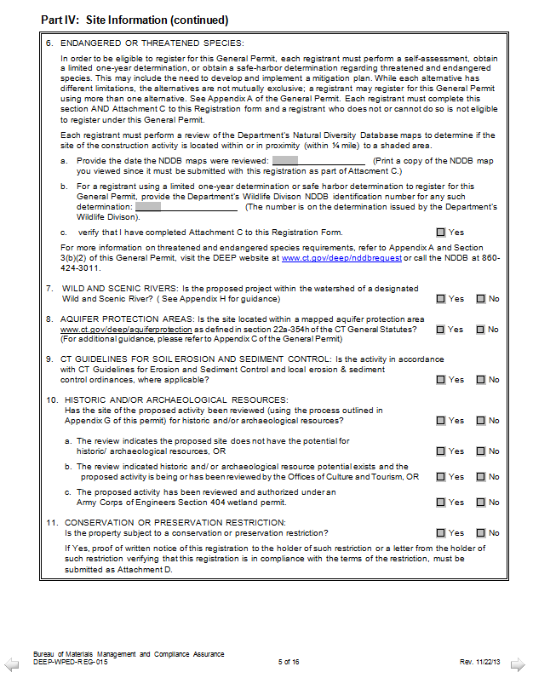
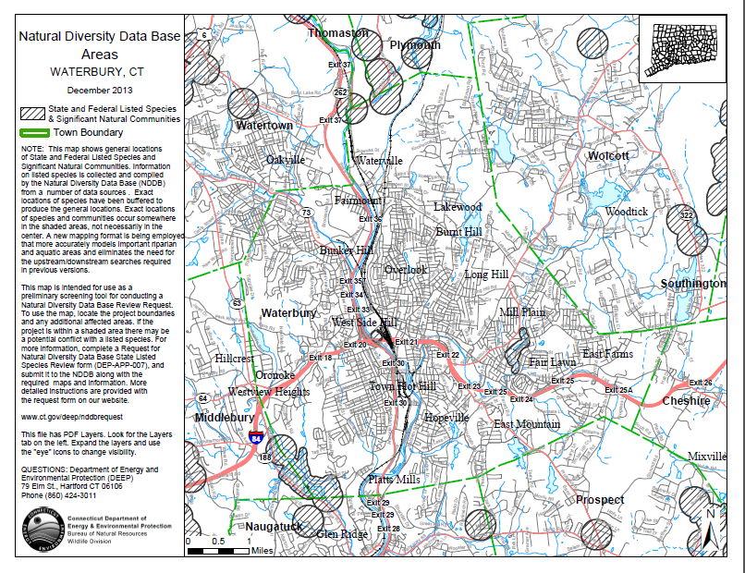
Updated Every 6 Months
In Attachment C
Environmental Review Form
Notes:
Note date of NDDB map (will be updated every June and December of each year) and include a copy of the NDDB map..
These are the consideration we reviewed previously, which will be screened and back up information provided by OEP.
Number 9 should always be YES

Slide 46

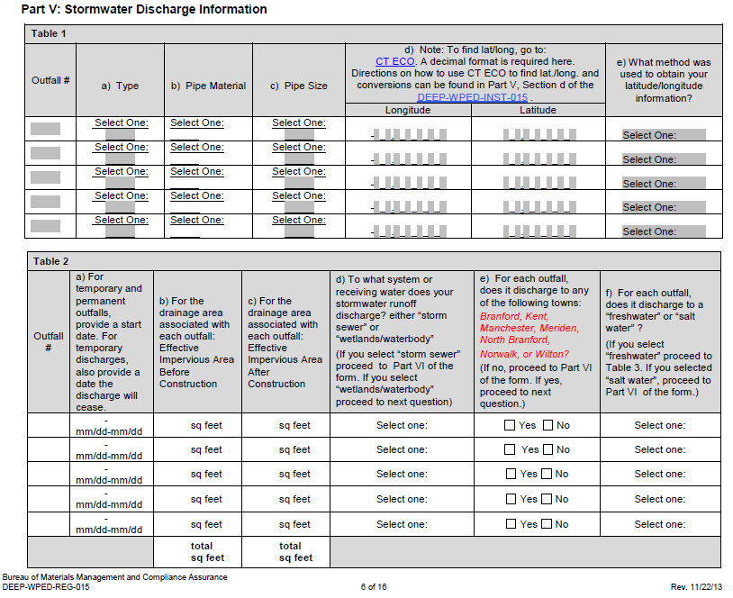
EO
TO
PO
Notes:
Table 1: List of all outfalls at the start of construction.
List by station or by general number, refer to in text, identify on plans
Table 2: List of temporary outfalls and all outfalls that will exist post-construction.
Dates should match with the construction sequencing narrative.
Define Effective Impervious Area.
Existing Outfall – EO
Temporary Outfall – TO
Permanent Outfall - PO

Slide 47
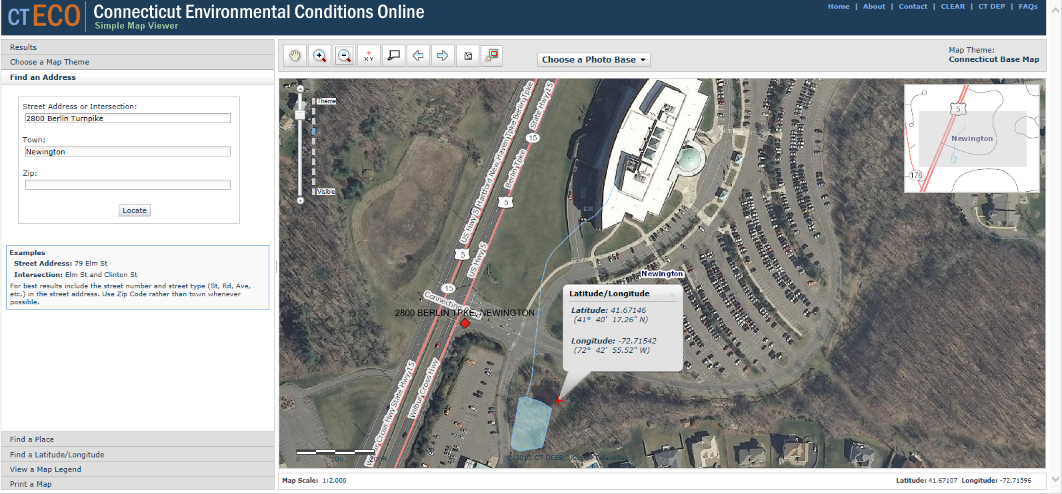
Find lat / long
Leaf on / Leaf off/ year
Find address
The Simple Map Viewer is best for Latitude/Longitude.
The Advanced Map Viewer also has Aerials, Watersheds, 2’ Contours, the Coastal Boundary, Soils Information, Impaired Waterbodies & More
Notes:
Have computer set up to walk through CTECO usage

Slide 48
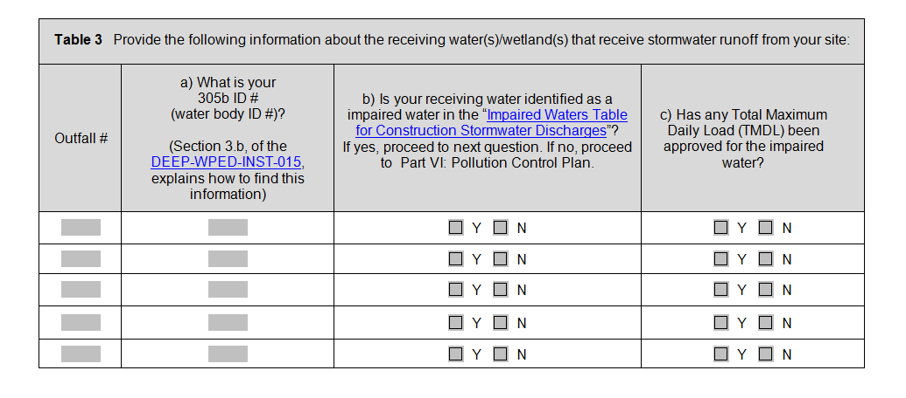
CT ECO
Advanced Map Viewer
Notes:
Table 3
305b ID on CT ECO site.
Need Impaired Waters Table.

Slide 49
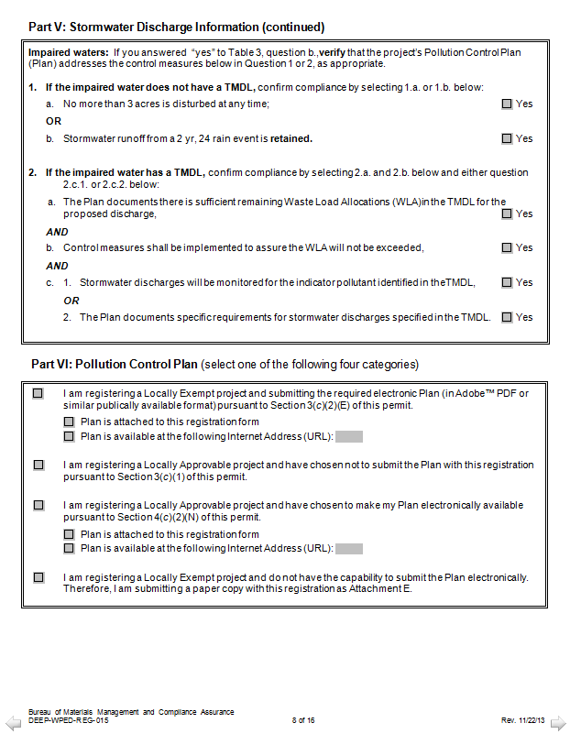
X
Type of Project
&
How is the Permit Submitted?
Notes:
Impaired Waters – recall, none of them have a set TMDL as of yet…..
Therefore must either have no more than 3 acres of disturbance at a time or RETAIN the 2 year storm
Part VI – Always locally exempt, indicate if submitted electronically or not…

Slide 50
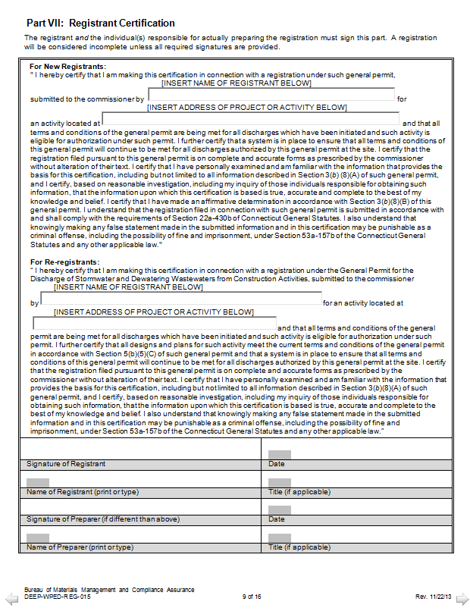
Registrant Certification
District Engineer
Was for Re-Registration
X
Signatures
Notes:
New Registration, not a re-registration

Slide 51
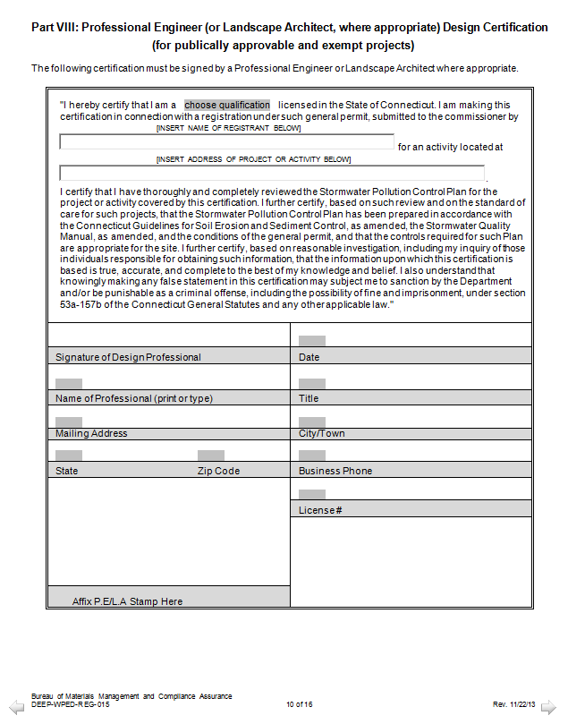
Engineer’s Name
Professional Engineer Information & Stamp
Notes:
This page needs to be completed
Professional Engineer vs. Landscape Architect on top.

Slide 52
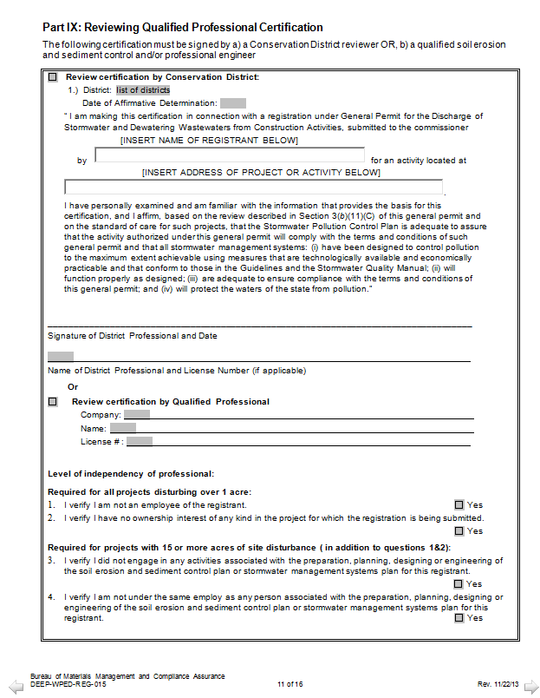
X
3rd Party Review
Not Required for CT DOT Projects
X
Notes:
3rd party review – not required for CDOT projects.

Slide 53
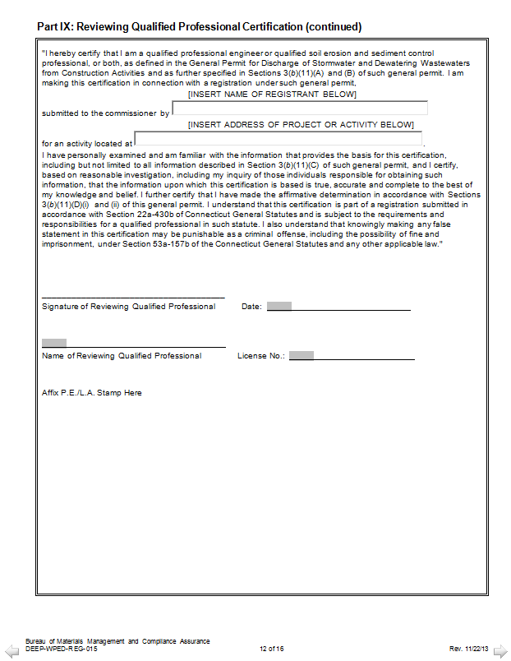
X
3rd Party Review
Not Required for CT DOT Projects
Notes:
3rd party review, continued.
Independent Certification - Locally approvable Projects over 15 acres ONLY

Slide 54
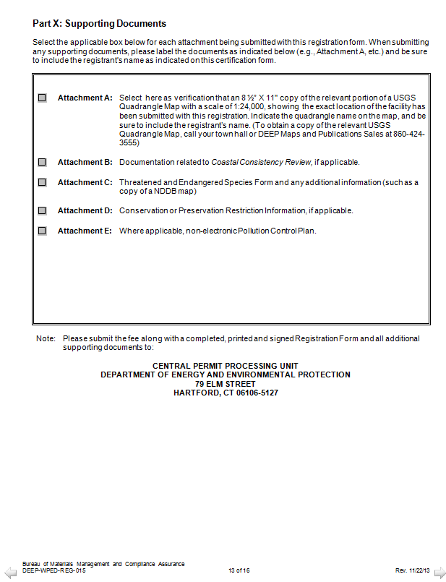
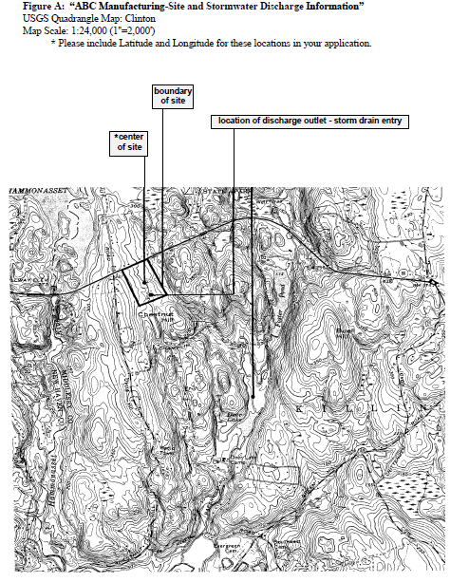
Supporting Documents
Attachment A – USGS Map
Attachment B – If required, should be prepared already
Attachment C – NDDB Map (and Next Few Sheets)
Attachment D – If required (Environmental Review)
Attachment E – SPCP
Notes:
Check applicable attachments
Attachment A: United States Geological Survey (USGS) Quadrangle Map
Submit, a 8 ½” x 11” copy of the relevant portion of a USGS Quadrangle Map, at a scale of 1:24,000, indicating the exact location of the project site and proposed activities.
The quadrangle name should be noted on the copy of the map submitted. See Figure A at the end of these instructions for an example of how a USGS map must be labeled when submitted.

Slide 55
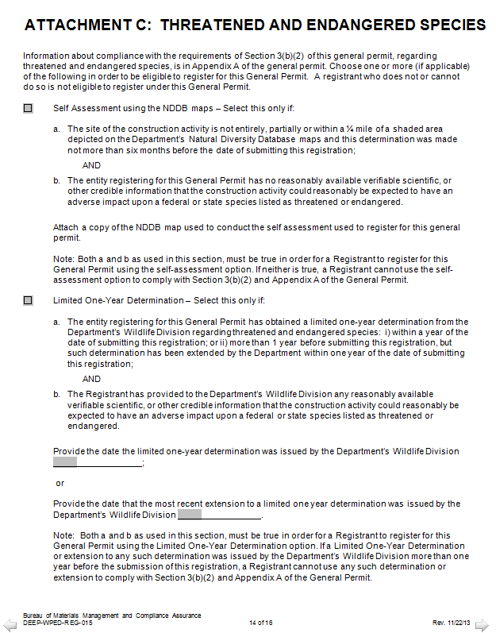
Attachment C: Additional NDDB Information
Not Within ¼ Mile
Info Submitted, Letter Received
Notes:
Endangered or Threatened Species: In order to be eligible to register for this General Permit, each registrant must perform a self-assessment, obtain a limited one-year determination, or obtain a safe-harbor determination regarding threatened and endangered species. This may include the need to develop and implement a mitigation plan. While each alternative has different limitations, the alternatives are not mutually exclusive; a registrant may register for this General Permit using more than one alternative. See Appendix A of the General Permit. Each registrant must complete this section AND Attachment C to this Registration form. A registrant who does not or cannot do so is not eligible to register under this General Permit.

Slide 56
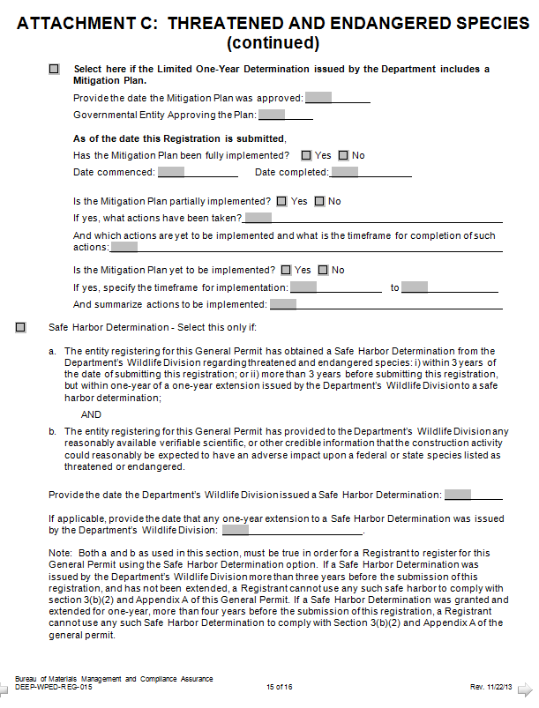
Info Submitted, Letter Received and Mitigation Required
X
Safe Harbor Determination
Not Utilized by DOT
Notes:
Safe Harbor not being utilized by CTDOT

Slide 57
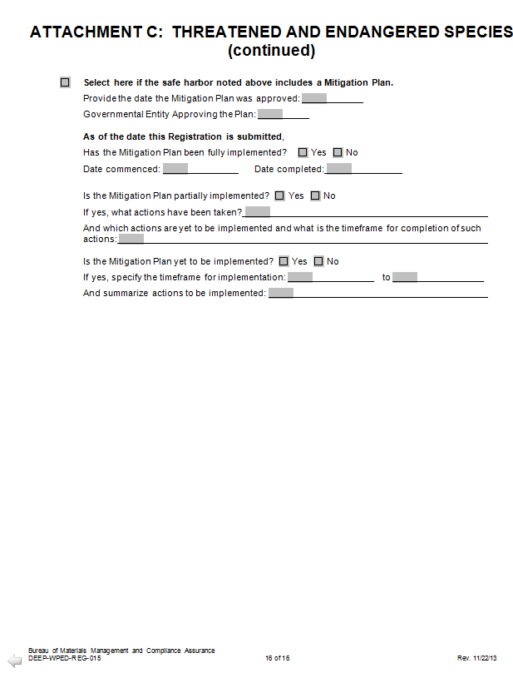
X
Safe Harbor Mitigation
Notes:
No Safe Harbor

Slide 58

Public involvement

Slide 59
Public comment
By the 15th day of each month the DEEP website shall post a list of registrations submitted the previous month
  Public may review and comment on a registration on or before 15 days from the posting
  If your plans were submitted electronically, the timeframe for public comment will run concurrent
  If your plan is NOT electronically available, the public may request a copy of the plan, and they then have 15 more days to comment from the date of receipt of the plan.
Notes:
Will not be processed until payment is received
➢ Locally exempt projects (registration and Plan):
$3,000 total (soil disturbance area ≥ one (1) and < twenty (20) acres).
$4,000 total (soil disturbance ≥ twenty (20) acres and < fifty (50) acres).
$5,000 total (soil disturbance ≥ fifty (50) acres).

Slide 60
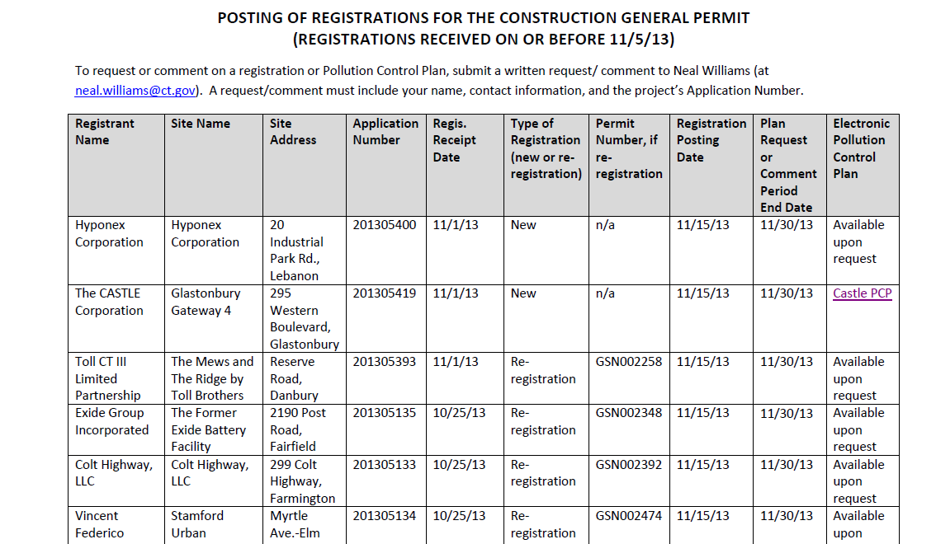
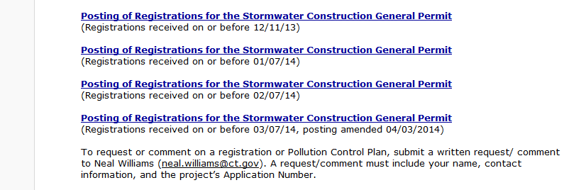
Notes:
Sample page of postings

Slide 61
Follow UP
The clock starts “ticking” once the
invoice is paid
Check your GSN & Application #’s
on-line
Submit Stormwater Monitoring Reports until project is awarded

Slide 62
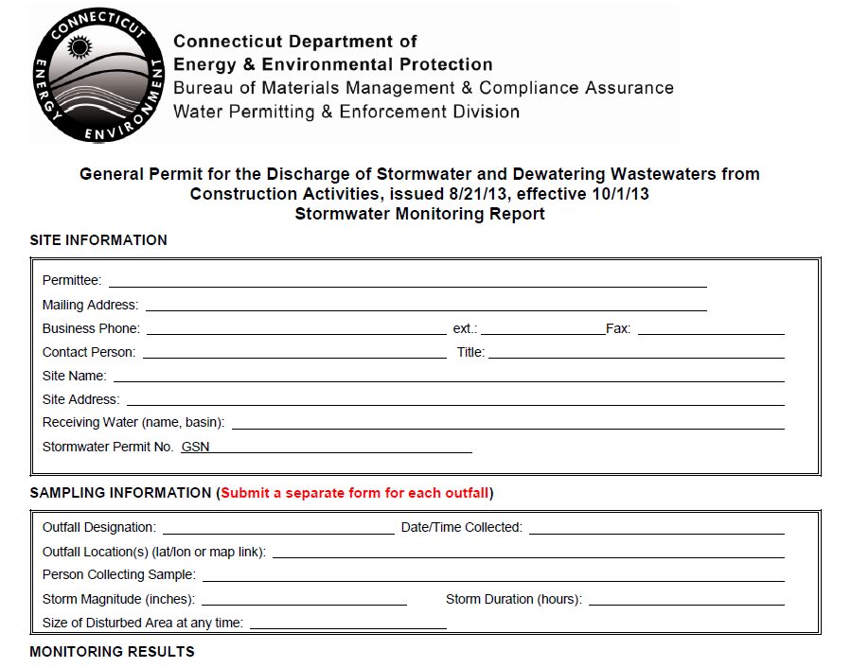
Monitoring Report Form – SMR’s
http://www.ct.gov/deep/lib/deep/permits_and_licenses/water_discharge_general_permits/storm_const_SMR.pdf

Slide 63
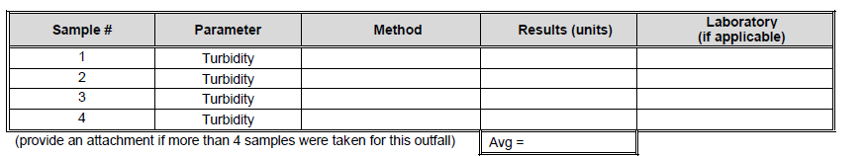
Stormwater Monitoring Reports
Designer is responsible for submitting a report to DEEP once a project is advertised, until it is awarded
Use “No Activity” in place of the monitoring results
Use the application #

Slide 64
QUESTIONS
To raise new questions, new possibilities, to regard old problems from a new angle, requires creative imagination and marks real advance in science.
Albert Einstein

Slide 65
BREAK

Slide 66
Stormwater pollution control plan
Plans are nothing; planning is everything.
Dwight D. Eisenhower

Slide 67
SWPCP
The Plan shall consist of site plan drawings and a narrative and be in conformance with
  2004 Stormwater Quality Manual
  Any other EPA or DEEP oversight, closure plan or other plan or permit required
And shall be designed to minimize
  Pollution caused by soil erosion & sedimentation during and after construction AND
  Stormwater pollution caused by use of the site after construction
Notes:
Plans and a narrative
Plans should only be those that depict relevant aspects of the project. Judgment must be utilized. ie…Details of electrical, MBR = not needed. Cross sections likely only needed if steep slopes or close to regulated area,

Slide 68
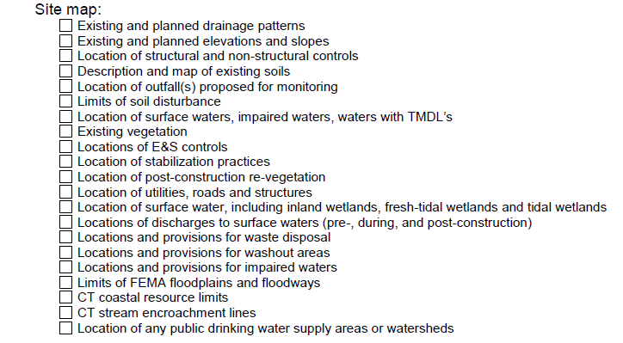
Site checklist
Drainage patterns
Slope limits
  Slopes 3:1 and steeper
Areas of soil disturbance
Structural control locations
Non structural control locations
Areas which call for stabilization
Areas of vegetation to remain / vegetation proposed
Location of discharges to surface waters
  Both during and post construction
Monitored outfalls**
Surface waters / wetlands / floodplains
Notes:
Overview of what belongs on a PLAN
** monitoring outfalls will be utilized during construction inspection

Slide 69
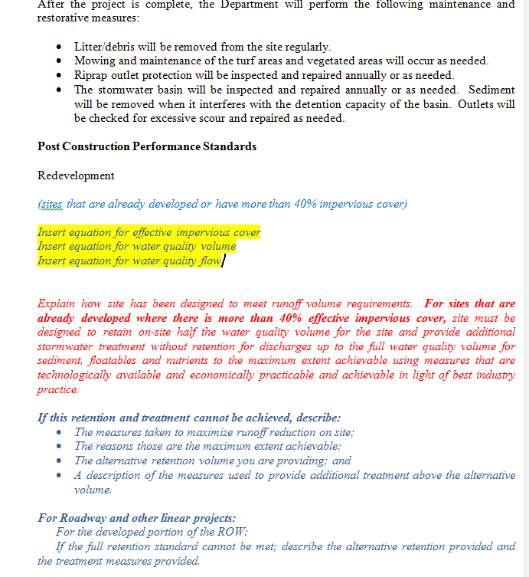
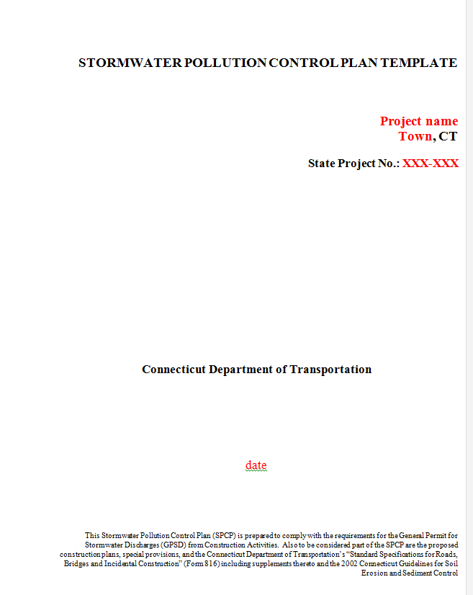
SWPCP - Narrative Requirements
Template developed for use is stored on the intranet
Notes:
Describe color coding in the template
Black – standard wording (stays)
Blue – Guidance
Red – fill out (project specific with guidance)

Slide 70
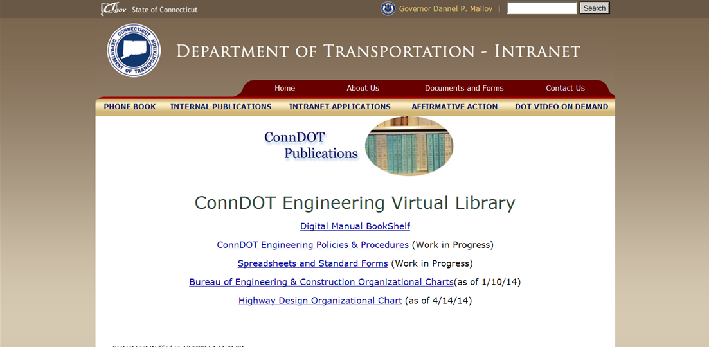
SWPCP Internal Resources

Slide 71
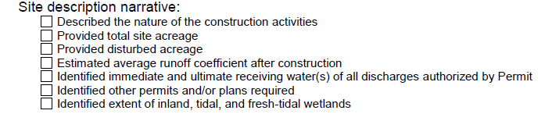
SWPCP - Narrative Requirements
Site Description
Notes:
Describe color coding in the template
Black – standard wording (stays)
Blue – Guidance
Red – fill out (project specific with guidance)

Slide 72


Construction sequencing
Expected sequence of major construction activities on the site and
Corresponding E & S controls
Estimated timetable for all construction activities
Depict limits of disturbance for each phase
  Wherever possible site shall be phased to avoid disturbance of over 5 acres at one point in time (or less for impaired waterbodies)

Slide 73
SWPCP - MEASURES DURING CONSTRUCTION

Slide 74

Stormwater Control measures
First things first!
  E & S Controls
    Soil stabilization and Protection
      Temporary and permanent practices for disturbed areas and stockpiles, including schedule for implementation
      Long term stabilization - winter season
      Reverse slope benching where required
Notes:
Temporary – sed fence
Permanent – permanent check dams, riprap outfalls

Slide 75

Next up - Structural Measures
Measures to divert flows away from
exposed soils and / or store flows
Sediment traps required for disturbed sites with a total contributing drainage area between 2 and 5 acres
Temporary sediment basin required for disturbed sites with a total contributing drainage area over 5 acres
The requirement for traps and basins does not apply to
    Flows from off site areas
    Flows from areas that are undisturbed or have undergone final stabilization
    Flows diverted around the trap or basin
KEEP CLEAN WATER CLEAN

Slide 76
Control measures con’t
Dewatering wastewaters
  Should always be in non-regulated areas (not in wetlands or floodway)
  Measures to prevent scour or erosion when discharging to surface waters is necessary
Maintenance
Notes:
Sometimes dewatering must occur within floodplain, but still should be minimized

Slide 77
SWPCP - MEASURES AFTER CONSTRUCTION

Slide 78

POST CONSTRUCTION performance standards
In conformance with the 2004 Stormwater Quality Manual and / or DOT Qualified Products List
http://www.ct.gov/dot/lib/dot/documents/dresearch/conndot_qpl.pdf
Notes:
Post construction, therefore, 2004 Manual
In order to qualify as a re-development project, must have 40% impervious cover existing

Slide 79
Important definitions
  Effective Impervious cover
    The total area of a site with a Rational Method runoff coefficient of 0.7 or greater (or other equivalent methodology) from which the stormwater discharges directly to a surface water or to a storm sewer system.
  Site
    Geographically contiguous land on which construction activity takes place. Non contiguous land or water owned by the same person shall be considered the same site if such land is part of a linear project or is otherwise connected by a ROW which such person controls.
Notes:
Since DOT’s ROW is linear and contiguous, ensure that project site limits are set so that existing impervious cover is 40 % or more

Slide 80
POST CONSTRUCTION performance standards
Differing Criteria for Runoff Reduction Practices
  Redevelopment - effective impervious cover of 40% or greater
    Linear Redevelopment
  Other Development – effective impervious cover of 40% or less
DOT Projects
Effective impervious cover
> 40%
< 40%
Re-Development
Other Development
Linear
Notes:
In order to qualify as a re-development project, must have 40% impervious cover existing

Slide 81

Redevelopment
For sites with effective impervious cover of 40% or MORE:
  Site shall be designed to retain half the water quality volume on site
  AND
  provide additional stormwater treatment for discharges up to the full water quality volume for sediment, floatables and nutrients (to the extent feasible / practicable / achievable)
  IF retaining ½ of the WQV is not feasible / achievable ; Retain runoff volume to the extent possible . Stormwater treatment up to the full water quality volume is still required and must be designed, installed and maintained in accordance with 2004 SWQM
Re-Development
Notes:
Walk through step by step

Slide 82
Redevelopment
  IF retaining ½ of the WQV is not feasible / achievable, the narrative must describe:
    The measures taken to maximize runoff reduction practices on site
    The reasons why these are the maximum possible
    The alternative retention volume provided
    Description of measures used to provide stormwater treatment above the alternate volume
Re-Development

Slide 83
Linear Redevelopment Projects
Roadway Reconstruction or Widening unable to comply with full retention standard for the developed portion of the ROW:
  Alternative retention and treatment provisions may be applied (Stormwater treatment up to the full water quality volume is still required and must be designed, installed and maintained in accordance with 2004 SWQM)
  - OR -
  For projects that will not increase the effective impervious cover within a given watershed, the permitee shall implement the stormwater treatment measures but will not be required to retain ½ the WQV.
    This is not a “DOT Exemption”
Re-Development
Linear
Notes:
Stress not jumping right to this as a solution, otherwise when compiling your narrative, you will not have the proper documentation..
Need to show you will not increase effective impervious cover

Slide 84
Other Development / Undeveloped Sites
For sites with effective impervious cover of 40% or LESS:
  Site shall be designed to retain the full water quality volume for the site
  IF not feasible / achievable ; Retain what you can & provide stormwater treatment designed, installed and maintained in accordance with 2004 SWQM
  DOCUMENT…. DOCUMENT.. what you can and cannot do!
Other Development
Notes:
Likely Facilities projects, New roads on new alignment…
More information for Facilities projects will be provided at the end of today’s presentation…

Slide 85

Calculations
  Drainage Area Maps for Post-Construction Outfalls
  Calculations for Stormwater Treatment Measures (80% removal goal – page 32 of permit – Section 7.4 of 2004 SWQM)
  Calculations for outlet protection
  Include Drainage Area Maps and Calculations within SWPCP Appendix
Notes:
Include Drainage Area Maps and calculations within SPCP Appendix
Drainage Area Maps
Outlet Protection Calculations

Slide 86
80% of What?
Section 7.4 (SWQM) – Pollutant Reduction – Improve Water Quality of Stormwater Discharge
  7.4.1 – Water Quality Volume used to Design:
    Detention and Retention Basins
    Underground Detention Areas
    Infiltration Trenches
    Stormwater Wetlands
    Forebays
    Water Quality Swales
  7.4.2 – Water Quality Flow used to Design:
    Grass Drainage Channels
    Proprietary Stormwater Treatment Devices (HDS, inserts, filters)
    Flow Diversion Structures
  80% Sediment Removal Goal Achieved by Using WQV and WQF in the Design of Stormwater Treatment Features
Notes:
Section 7.4 of Stormwater Quality Manual.
Pollutant Reduction is designed to improve the water quality of stormwater discharges by treating the Water Quality Volume or Flow.
80% of WQV/WQF, most use WQV.

Slide 87



WATER QUALITY VOLUME
Volume of 1 inch of rainfall on the site
Try to Decrease I!
Try to Decrease A!
Notes:
Amount of stormwater to be captured and treated to remove a majority of pollutants on an average annual basis.
First Flush concept: sand, salt, oils.

Slide 88
Water Quality Flow
Water Quality Flow (WQF) is the Peak Flow Rate associated with the water quality design storm
  Follow Appendix B of 2004 SWQM
  WQF is calculated utilizing the WQV.
  The WQV is converted to watershed inches, and is used as the runoff depth (Q)
Notes:
Water Quality Swales treat and attenuate the WQV and convey excess stormwater runoff.
Grass Drainage Channels are designed for conveyance only, with limited pollutant removal.

Slide 89

Calculating wqf
Based on TR-55 -
In Appendix B of SWQM
Step 2 : Compute CN
Use Equation or Figure
Step 1: WQV converted
to Inches = Q
Notes:
Appendix B of Stormwater Quality Manual.
Step 1

Slide 90
Calculating wqf
Step 3:
Compute Tc
Step 4: Use CN from Step 2 to Select Ia
Step 5:
Compute Ia/P
P = 1 inch!
Notes:
Keep Going

Slide 91

Calculating wqf
Ia/P used here
Finally!
qu: Step 6
Area in sq. miles
Q: Step 1
Tc used here
Step 6: Determine qu
Notes:
Keep Going

Slide 92
Other controls
Waste Disposal
Washout Areas (Concrete)
Off site vehicle tracking / dust control
Cleaning of construction sediment from post construction stormwater controls
Removal of silt fence
Chemical and petroleum product storage
Notes:
Back to Kim
Concrete washout – consider if required on your project
Petroleum product storage –
Covered in template – standard wording.

Slide 93
QUESTIONS
To raise new questions, new possibilities, to regard old problems from a new angle, requires creative imagination and marks real advance in science.
Albert Einstein

Slide 94
BREAK

Slide 95
NON-Linear Projects
Facilities

Slide 96

Runoff Reduction & LID
When your project is NOT linear
  Maintenance Facilities
  Airports
  Commuter Lots
  Rail Stations
Reduce the volume
you have to treat!

Slide 97
Other Development / Undeveloped Sites
For sites with effective impervious cover of 40% or LESS:
  Site shall be designed to retain the full water quality volume for the site
  IF not feasible / achievable ; Retain what you can & provide stormwater treatment designed, installed and maintained in accordance with 2004 SWQM
Notes:
Recap…these projects have a goal to retain the full water quality volume

Slide 98
SWPCP
Plans & Narrative –Need to identify:
  Slopes 3:1 & steeper
  Areas suitable/unsuitable for infiltration
    Infiltration rates
    Soils information – utilize NRCS soils survey map
      Check borings only if you think you can infiltrate (sandy soils)
  Areas with groundwater and soil pollution (AOEC’S)
  APA considerations
  Proper barriers around pollutant sources, maintenance areas, dumpsters

Slide 99
LID Possibilities
Engineered systems that filter storm water from parking lots and impervious surfaces, such as bioretention cells, filter strips, and tree box filters;
Engineered systems that retain (or store) storm water and slowly infiltrate water, such as sub-surface collection facilities under parking lots, bioretention cells, and infiltration trenches;
Modifications to infrastructure to decrease the amount of impervious surfaces such as curbless, gutterless, and reduced width streets;
Low-tech vegetated areas that filter, direct, and retain storm water such as rain gardens and bio-swales;
Innovative materials that help break up (disconnect) impervious surfaces or are made of recycled material such as porous concrete, permeable pavers, or site furnishings made of recycled waste;
Water collection systems such as subsurface collection facilities, cisterns, or rain barrels; and
Native or site-appropriate vegetation.

Slide 100




LID possibilities at facilities

Slide 101


Low Impact Development Measures
Measures that can reduce the impact of development and address stormwater quality issues
  Reforestation
  Disconnection of rooftop runoff
  Sheetflow
  Minimize impervious surface
  Rain gardens
  Grass swales
  Bio-swales
  Wet swales
  Landscape infiltration
  Stormwater ponds
  Stormwater wetlands
  Stormwater infiltration

Slide 102
Possible Site CONSTRAINTS
Explained in narrative and limits shown on plans
  Bedrock – within 4 feet
  Elevated Groundwater – within 4 feet
  Brownfields
  Capped Landfills
  APA’s, Public drinking supply wells
  Contaminated soils
  Contaminated groundwater
  Load requirements of paved surfaces

Slide 103
LID information resources
2004 Stormwater Quality Manual LID Appendix
  http://www.ct.gov/deep/lib/deep/water/nps/swgp/lid_apdx_ctstormwatermanual.pdf
2002 E & S Guidelines LID Appendix
  http://www.ct.gov/deep/lib/deep/water/nps/swgp/lid_apdx_ctsoilerosionguidlines.pdf
DEEP Low Impact Development Resources Factsheet
  http://www.ct.gov/deep/lib/deep/water/watershed_management/wm_plans/lid/lid_resources.pdf
EPA Stormwater Calculator
  http://www.epa.gov/nrmrl/wswrd/wq/models/swc/
Milwaukee River Basin Partnership. Protecting Our Waters: Streets and Roads.
  http://clean-water.uwex.edu/plan/streetsroads.htm

Slide 104
THANK YOU!

