Slide 1
CT Highway Safety Office REFERENCE GUIDE FOR DUI REIMBURSEMENT
Billing Period 1

Slide 2
STARTING THE REIMBURSEMENT PROCESS
THESE ARE THE TABS YOU WILL SEE WHEN YOU OPEN THE REIMBURSEMENT PACKAGE.

Slide 3
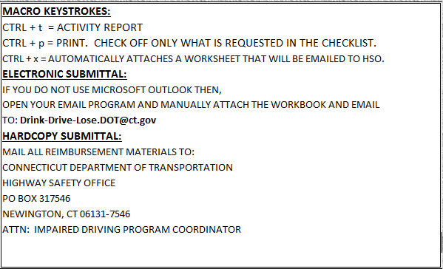
INSTRUCTIONS
THESE ARE THE INSTRUCTIONS INCLUDED IN THE REIMBURSEMENT PACKAGE. REFER TO THEM AS OFTEN AS NECCESARY.

Slide 4
COVER - 2nd PAGE
SELECT THE “CITY/TOWN OF” FROM THE DROP-DOWN, THE PROJECT NUMBER WILL APPEAR.

Slide 5
APPROXIMATE BALANCE (Optional) Appears on the 2nd page of the Cover sheet
ONLY ENTER THE DOLLAR AMOUNTS HIGHLIGHTED IN YELLOW. THE HIGHLIGHTED YELLOW WILL EXPAND AS THE BILLING PERIODS EVOLVE. THIS STEP IS OPTIONAL.

Slide 6
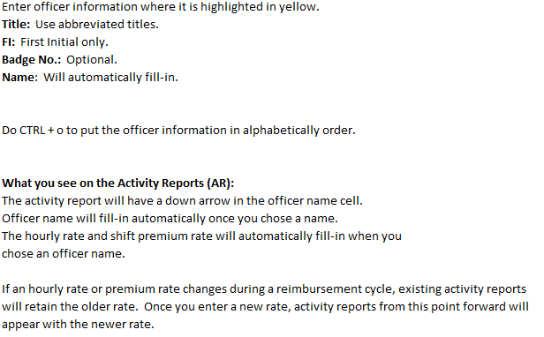
OFFICERS
ENTER IN OFFICERS BEFORE GENERATING ACTIVITY REPORTS.

Slide 7
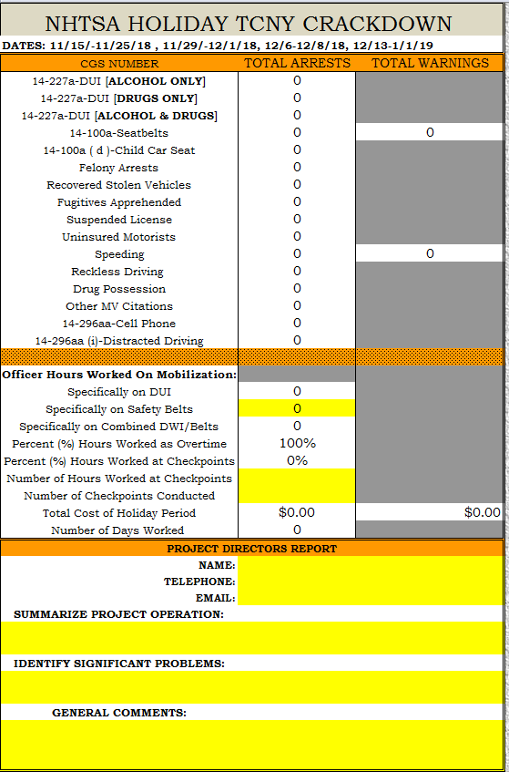
HOLIDAY SUMMARY
THIS SHEET AUTO-POPULATES FOR YOU LATER IN THE PROCESS. THIS HAPPENS WHEN ALL DATA IS ENTERED AND YOU CLICK “ALL REPORTS” IN THE “MACROS” TAB.
THIS IS HOLIDAY ACTIVITY ONLY. IF THERE IS NO HOLIDAY ACTIVITY PLEASE ENTER ZEROES.
MAKE SURE YOU SUPPLY INFORMATION BEFORE SUBMITTING TO HSO. N/A IS A TEMPORARY PLACEHOLDER SO YOU CAN CLOSE THE WORKBOOK. N/A SHOULD ONLY BE USED IF THERE WAS NO HOLIDAY ACTIVITY.

Slide 8
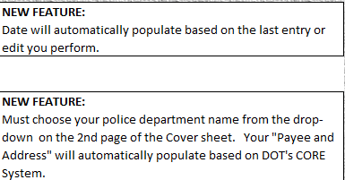
INVOICE
IF “#N/A” APPEARS, GO BACK TO COVER SHEET AND SELECT “CITY/TOWN OF” FROM THE DROP-DOWN.
THIS SHEET AUTO-POPULATES FOR YOU LATER IN THE PROCESS. THIS HAPPENS WHEN ALL DATA IS ENTERED AND YOU CLICK “ALL REPORTS” IN THE “MACROS” TAB.
THE ONLY FIELD YOU NEED TO FILL IN ON THE INVOICE SHEET IS THE “FRINGE” FIELD. DO NOT USE “NA”--IF NONE USE 0.

Slide 9
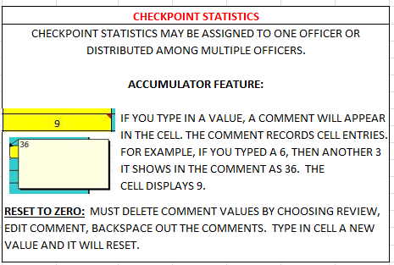
ACTIVITY REPORT
GENERATE ACTIVITY REPORTS BY PRESSING “CTRL + t”.

Slide 10
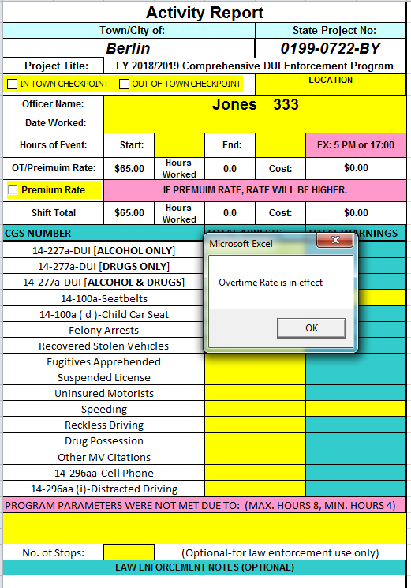
Activity Report
Premium Rate Checked:
Premium Rate Unchecked:

Slide 11
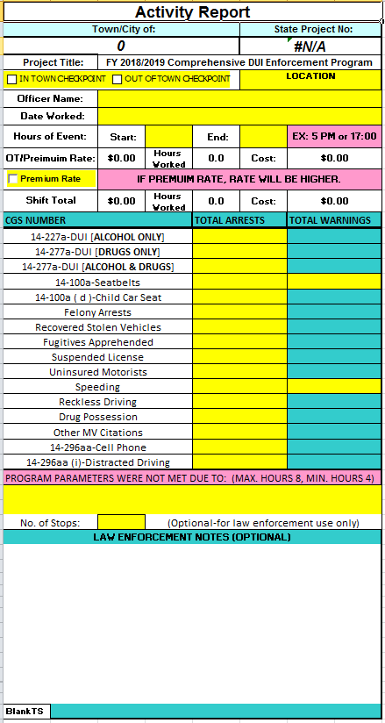
ACTIVITY REPORT
REQUIRED FIELDS:
OFFICER NAME (DROP-DOWN)
DATE WORKED (DROP-DOWN)
START AND END TIME
MUST BE ENTERED FOLLOWING THE EXAMPLE IN THE PINK BOX
HOURS WORKED:
AUTO POPULATES IF OFFICER IS WORKING AT OVERTIME RATE
AUTO POPULATES IF OFFICER IS WORKING AT PREMIUM RATE
ACTIVITY REPORTING (STATS)
OPTIONAL FIELD:
NO. OF STOPS
LAW ENFORCEMENT NOTES

Slide 12
NUMBER OF STOPS (Optional)
THIS STEP IS OPTIONAL
RECORDS THE NUMBER OF MOTORISTS WHO GET STOPPED DURING ENFORCEMENT.
STOPS ARE RECORDED IN THE STATS REPORT.
STATS REPORT GENERATED BY “ALL REPORTS” IN THE “MACROS” TAB.

Slide 13
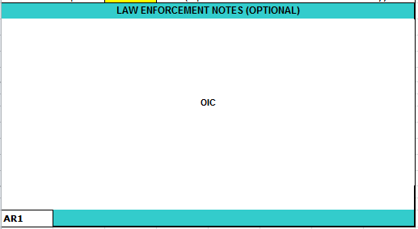
WHO REPORTS THE CHECKPOINT STATS?
ACTIVITY REPORT FOR CHECKPOINT
ONE OFFICER REPORTS THE STATS FOR THE GROUP (USE OIC—OFFICER IN CHARGE IN AR LAW ENFORCEMENT NOTES)
OR
EACH OFFICER REPORTS INDIVIDUAL STATS BASED ON THE DUTIES THEY PERFORMED DURING THE CHECKPOINT.

Slide 14
REGIONAL TRAFFIC UNIT (RTU)
HOST TOWN
STATS ARE CREDITED TO THE HOST TOWN
THE HOST TOWN SHOULD NOT SUBMIT ACTIVITY REPORTS FOR NON-GRANT FUNDED ACTIVITY.
NON-HOST RTU MEMBER
OFFICERS ACTIVITY REPORTS SHOULD REFLECT REFLECT SALARY AMOUNT AND HOURS WORKED.
STATS SHOULD BE BLANK.

Slide 15
ACTIVITY REPORT
CONFIRM ACTIVITY (ROVING) TYPE BY CHECKING STATS REPORT. THIS REPORT SHOWS THAT YOU DID NOT CHECK ANY BOXES.
INDICATES ROVING ENFORCEMENT
Stats Report generated by the “ALL REPORTS” in the Macros tab.

Slide 16
ACTIVITY REPORT
CONFIRM ACTIVITY (IN TOWN) TYPE BY CHECKING STATS REPORT. THIS REPORT SHOWS THAT YOU DID CHECK “IN TOWN CHECKPOINT” BOX.
INDICATES IN TOWN CHECKPOINT
Stats Report generated by the “ALL REPORTS” in the Macros tab.

Slide 17
ACTIVITY REPORT
CONFIRM ACTIVITY (OUT OF TOWN) TYPE BY CHECKING STATS REPORT. THIS REPORT SHOWS THAT YOU DID CHECK “OUT OF TOWN CHECKPOINT” BOX.
INDICATES OUT OF TOWN CHECKPOINT
Stats Report generated by the “ALL REPORTS” in the Macros tab.

Slide 18
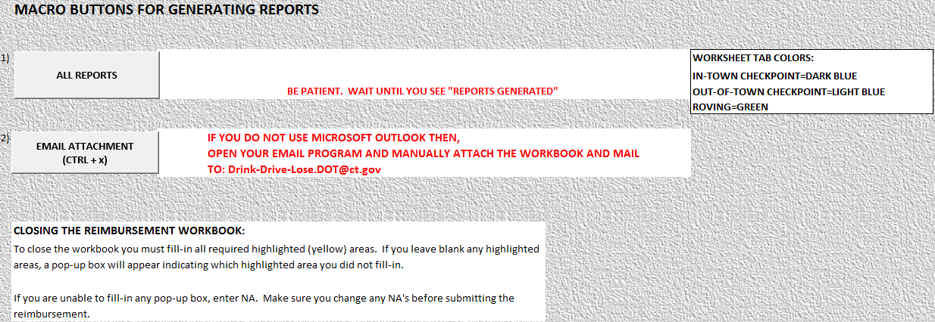
GENERATING REPORTS
GENRATE REPORTS WITH THE “ALL REPORTS” BUTTON ON THE “MACROS” TAB. THIS ACTION FILLS IN AUTO-POPULATED AREAS OF THE REIMBURSEMENT PACKAGE. REPORTS CAN BE GENERATED AT ANYTIME DURING THE ENFORCEMENT PERIOD.

Slide 19
“ALL REPORTS” BUTTON (EXAMPLE OF VISIBLE WORKSHEET TABS)
THESE ARE THE TABS YOU WILL SEE WHEN YOU GENERATE REPORTS. BP3 HAS ADDITIONAL REPORTS. BP4 HAS RECAP.

Slide 20
WHAT TO LOOK FOR BEFORE PRINTING & SIGNING SIGNATURE REPORTS
LOOK AT SUMMARY REPORT, IF YOU SEE $0.00 THEN YOU FORGOT TO FILL-IN THE START AND END TIME ON ACTIVITY REPORT.
LOOK AT SUMMARY REPORT, DO YOU HAVE ACTIVITY REPORTS THAT ARE BLANK? DELETE THESE ACTIVITY REPORTS AND THEN GENERATE REPORTS AGAIN (MACRO SHEET BUTTON—ALL REPORTS).
LOOK ON ACTIVITY REPORTS—DATE WORKED FORMATS—DAY OF WEEK, MONTH, DAY, YEAR. IF SUNDAY, MONDAY, TUESDAY, OR WEDNESDAY APPEARS YOU HAVE AN ISSUE. THESE DAYS OF THE WEEK ARE NOT APPROVED DATES (HOLIDAY ENFORCEMENT MAY HAVE APPROVED DATES OTHER THAN THURSDAY, FRIDAY, SATURDAY)
LOOK AT SUMMARY REPORT, ARE ALL DATES IN GRANT—IF YOU SEE DATE THAT DOES NOT MATCH YOUR GRANT, THEN SEE IF YOU HAVE EMAIL REQUESTING DATE CHANGE AND EMAIL CONFIRMING HSO APPROVAL.
LOOK AT SUMMARY REPORT, DO YOU SEE ANY HOURS OVER 8, IF SO REVIEW ACTIVITY REPORT AND SUPPLY AN EXPLANATION FOR EXCEEDING ALLOWABLE GRANT HOURS.

Slide 21
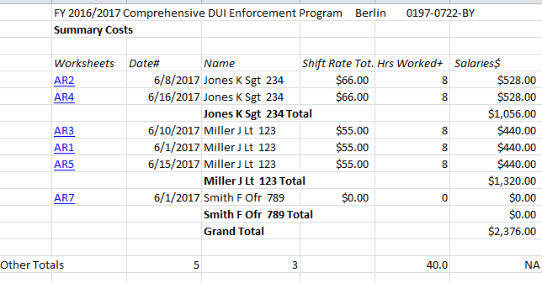
SUMMARY REPORT
CHECK TO SEE THAT THERE ARE NO PROBLEMS EVIDENT IN THE SUMMARY REPORT. SUMMARY REPORT WILL PRINT IN ALPHA ORDER.
SUMMARY REPORT NOW APPEARS WITH SUBTOTALS. “OTHER TOTALS” ARE NO. OF DAYS, NO. OF OFFICERS, AND TOTAL HOURS.
Summary Report generated by the “ALL REPORTS” in the Macros tab.

Slide 22
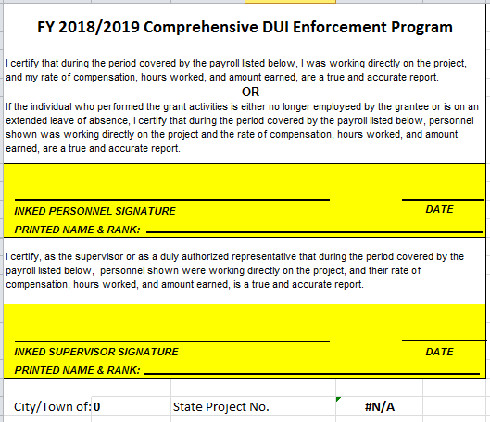
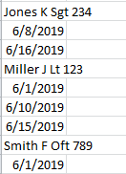
SIGNATURE REPORT
“ALL REPORTS” BUTTON GENERATES SIGNATURE PAGES.
THE “END” AND “START” TIME ON ACTIVITY REPORT IS MISSING.

Slide 23
SIGNATURE REPORT PRINTOUT
PRINTOUT OF SIGNATURE PAGES:
DO NOT PRINT DOUBLE SIDED
PRINTING IN COLOR IS OPTIONAL
ONE SHEET PER OFFICER
ALL COLUMNS ON ONE PAGE FOR PRINTING
SIGNATURE REPORTS PRINT IN ALPHA ORDER
TYPING SUPERVISOR NAME SAVES TIME

Slide 24
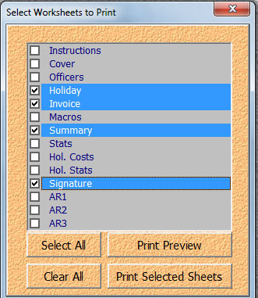
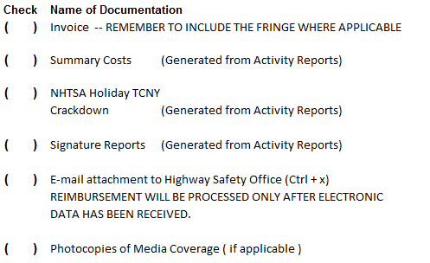
PRINTING HARDCOPIES
ONLY THE CHECKED BOXES NEED TO BE PRINTED AND SUBMITTED TO HSO. DO NOT PRINT DOUBLE SIDED.
(Ctrl + p)

Slide 25
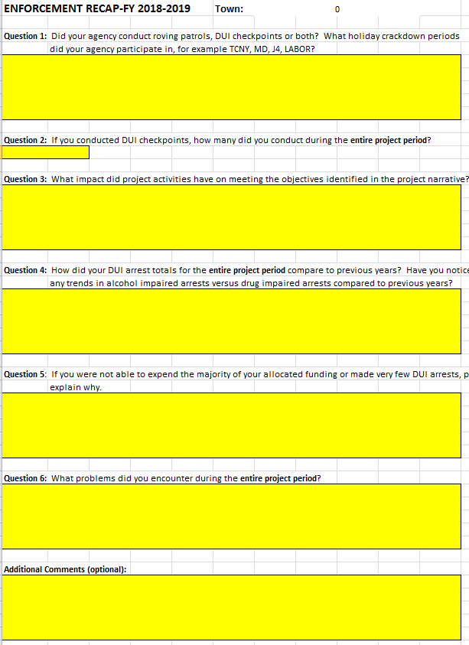
PRINTING HARDCOPIES

Slide 26
EMAIL SUBMITTALS
DO NOT USE THE BUTTON “EMAIL ATTACHMENT” IF YOU ARE NOT SETUP FOR MICROSOFT OUTLOOK. MANUALLY ATTACH THE WORKBOOK.
MAIL TO: Drink-Drive-Lose.DOT@ct.gov

Slide 27
EMAIL
THIS REPORT SHOWS THAT YOU USED THE “EMAIL ATTACHMENT” BUTTON.

