Slide 1
Connecticut Department of Transportation Office of Environmental Planning Water and Noise Compliance General Permit for Coastal Maintenance Issuance Date: October 26, 2015 Expiration Date: October 26, 2035

Slide 2
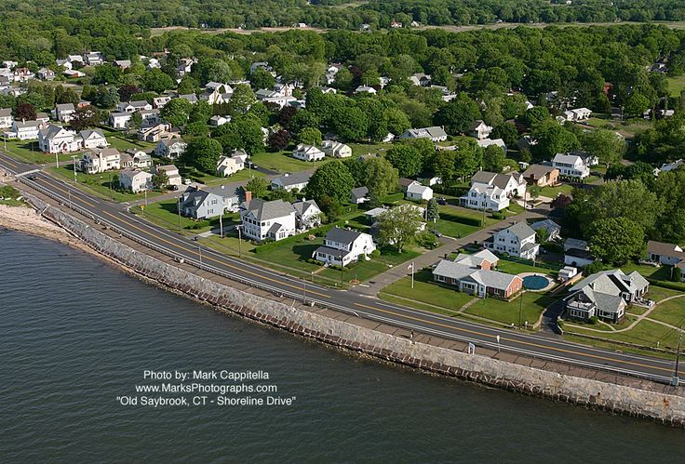
DOT Process
The process for permit determination and eligible transportation infrastructure activities under this authorization will be conducted as follows:
Design/Construction Projects: Determination during the design process will come from the Office of Environmental Planning (OEP) – Water & Natural Resources Unit via the Permit Need Determination Form (PNDF).
Office of Maintenance (Highways & Bridge): Determination for Highway and Bridge maintenance activities will come from the District Drainage Engineer via coordination with OEP’s Water & Noise Compliance Unit.
Office of Rail (Rails Maintenance): Determination for Rail maintenance activities will come from the Rails Project Engineer via coordination with OEP’s Water & Noise Compliance Unit.

Slide 3
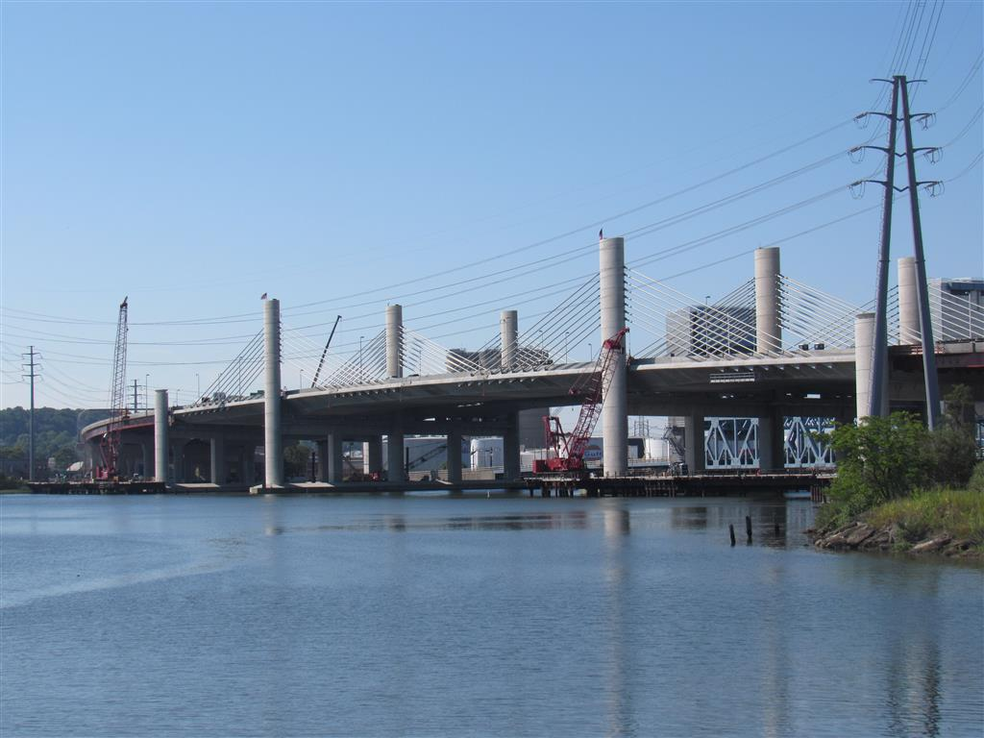
Eligible Activities Section 3(a)(5)
There are 13 eligible activities authorized under this permit:
Bridge Deck Drains
Bridge Painting
Bridge Mechanical, Electrical, and Operational Repairs
Bridge Superstructure
Bridge Decks
Bridge Supports
Bridge Scour
Walls and Abutments
Pipes and Culverts
Outlet Protection
Shoreline Protection
Access
Rail Infrastructure

Slide 4
Eligible Activities Section 3(a)(5)
(A) Bridge Deck Drains. Repair, rehabilitation, replacement and cleaning of bridge deck drains, scuppers and weeps, including the removal of accumulated sediment;
(B) Bridge Painting. Preparation of steel and painting including the placement of containment devices upon bridges;
(C) Bridge Mechanical, Electrical and Operational Repairs. Rehabilitation or replacement of appurtenances necessary for bridge safety and operation including lighting, fixtures, mechanical or electrical rooms or boxes, catenary support and wires, and signals and signal boxes;
(D) Bridge Superstructure. Rehabilitation, rinsing, repair or replacement of bridge superstructure components such as steel or timber members, plates or hardware, or bridge bearings, or the full bridge superstructure;
(E) Bridge Decks. Repair, rehabilitation or replacement of bridge decks membrane and bituminous wearing surfaces, joints, rails, ties, and fencing or other protective systems;
(F) Bridge Supports. Repair concrete superstructure or substructure elements including spalling, repointing or grouting of concrete, repairs to the joints, and application of protective coating;
(G) Bridge Scour. Manually placing grout bags within or immediately adjacent to the footprint of bridge substructure;

Slide 5
Eligible Activities Section 3(a)(5)
(H) Walls and Abutments. Repair of concrete wingwalls, endwalls or bridge abutments and pipe repair or replacement of such structures associated with such necessary wingwall, endwall or abutments;
(I) Pipes and Culverts. Removal of pipes and culverts, including the creation of open channels associated with the removal of such pipes and culverts;
(J) Outlet Protection. Repair, rehabilitation or expansion of an existing splash pad or plunge pool associated with an existing stormwater outfall or the installation of a new splash pad or plunge pool associated with the removal of a pipe of culvert;
(K) Shoreline Protection. Repair of previously protected shorelines including riprap and stone armoring including shaping, regrading, placement of bedding material and riprap or armor stone to the pre-existing contours, and repair of seawalls to pre-existing conditions including repointing, patching, resetting stones, and applying a skim coat to the face of the seawall;
(L) Access. Installation and use of low-impact temporary access structures including scaffolding, low ground pressure equipment, elevated trestle, scaffolding, ladders, and construction mats; and
(M) Rail Infrastructure. Repair, rehabilitation or replacement of ballast, ties, rails, catenary towers and wires, signal cable tray, signal conduits, signal box and foundation, and electrical substations.

Slide 6
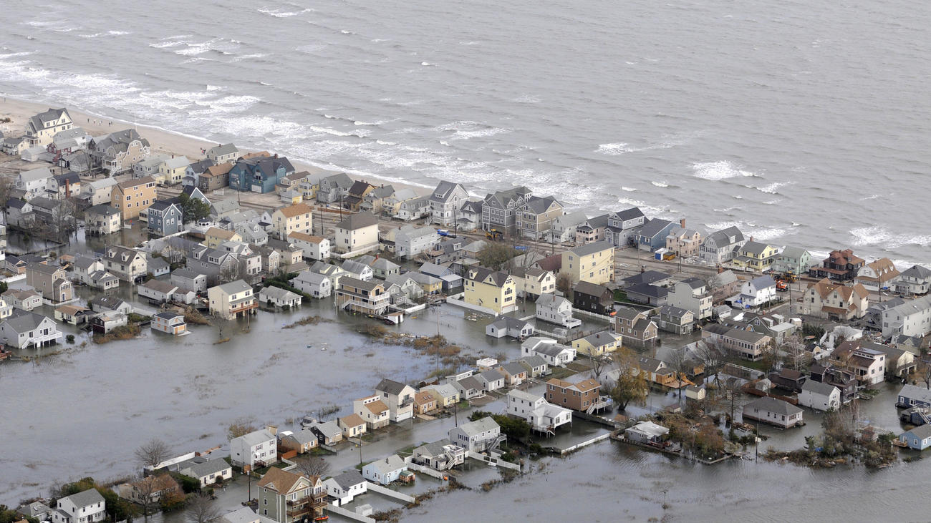
Special Conditions
In total, DOT has 19 Special Conditions that can be associated with an eligible activity. For Design/Construction, eligible activities and special conditions will be determined in advance of construction during the design/permitting process by OEP.
For Maintenance or Rails, you will be responsible to determine the eligible activities and special conditions. OEP will offer assistance whenever needed.

Slide 7
Special Conditions Section 5(e)
(1) In conducting any Department of Transportation Maintenance activities, the permittee shall follow any applicable Best Management Practices, design manuals and materials specifications published, used or adopted by the Connecticut Department of Transportation.
(2) In conducting the work authorized herein, the permittee shall not cause permanent impacts to tidal wetlands associated with the installation of temporary or permanent structures, staging, or storage.
(3) In conducting any bridge painting, preparation or cleaning activities authorized herein, the permittee shall install and utilize proper containment that prevents discharges into coastal waters or wetlands. The permittee shall ensure the containment system is in optimal operating condition until the work authorized herein is completed.
(4) Any debris associated with any activity authorized herein, including sediment or debris from drains, scuppers or weeps; residue from scraping, sandblasting, abrading or painting, shall be collected and disposed of at an approved upland site applicable for such debris.
(5) This authorization specifically does not allow for the increase of additional stormwater flows from the structures authorized herein.
The permittee shall stage any barges employed to complete the work authorized herein such that no more than 50% of the channel beneath any bridge is impeded at any time.

Slide 8
Special Conditions Section 5(e)
(7) Any debris containment systems employed by the permittee shall be designed so as to prevent impacts to navigation. Prior to commencement of work, the permittee shall obtain Advance Approval by the U.S. Coast Guard, when applicable
(8) The full superstructure replacement authorized herein shall not include the replacement of existing bridge piers or foundations or construction of new bridge piers or foundations, nor shall it include any expansion of the width of any superstructure that could increase the volume of stormwater associated with such work.
(9) Unless otherwise authorized in writing by the commissioner, the permittee, prior to the commencement of any bridge scour repair, shall install turbidity curtains or other appropriate containment extending from the water surface to the substrate around the work area. Such curtains shall be maintained in optimal operating condition until project completion at which time the erosion and sediment controls shall be removed to an upland location.
(10) Prior to the installation of any grout bags, the permittee shall consult with Department of Energy & Environmental Protection Inland Fisheries Division regarding necessary project modifications or restrictions to protect fisheries resources. Any such modifications or restrictions become binding.
(11) The permittee shall install any grout bags by hand. Such grout bags shall be located within the footprint of the existing footing and shall not extend further than two feet from the face of such footing. Such grout bags shall be placed in such a manner that they do not pose any adverse impact to navigation or fish passage.

Slide 9
Special Conditions Section 5(e)
(12) In conducting work to wingwalls, endwalls, abutments, pipes, culverts, outlet protection, or other shoreline armoring the permittee shall work during periods of low flow and low tide so as minimize sedimentation and impacts to coastal resources.
(13) In constructing any new outlet protection where a section of pipe has been removed, the permittee shall not exceed the area of the disturbance caused by the removal of the pipe.
(14) In conducting shoreline protection projects authorized herein, riprap or armoring shall not exceed the footprint of the protection originally in-place and shall be at the same grade and slope.
(15) Not later than 90 days subsequent to the completion of any shoreline protection project including rip rap, bedding material, or other shoreline armoring authorized herein, the permittee shall submit as-built drawings showing the project.
(16) In conducting any riprap work, the permittee shall place such riprap to its full course thickness in one operation to produce a reasonably well-graded slope without causing displacement of the underlying bedding material.
(17) Prior to the commencement or work authorized herein, the permittee has obtained approval from the commissioner from sections 25-68b through 25-68h, inclusive, of the General Statutes, and sections 25-68h-1 through 25-68h-3 of the Regulations of Connecticut State Agencies, inclusive, as applicable.

Slide 10
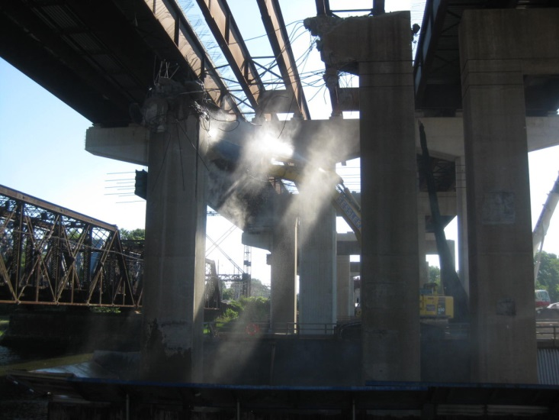
Special Conditions Section 5(e)
(18) Where construction requires heavy equipment operation in wetlands, the equipment shall either have low ground pressure or it shall be placed on construction mats that are adequate to support the equipment in such a way as to minimize disturbance of wetland soil and vegetation. Construction mats are to be placed in the wetland from the upland or from equipment positioned on swamp mats if working within a wetland. Dragging construction mats into position is prohibited.
(19) Not later than January 15 of any year following a year in which the Department of Transportation conducted work under this general permit, the permittee shall submit a Project Report to the commissioner. The Project Report shall specify which projects, and which components of such projects, were conducted under this general permit, and a summary of the total number of times in the reporting year that the Department of Transportation conducted work under this general permit.

Slide 11
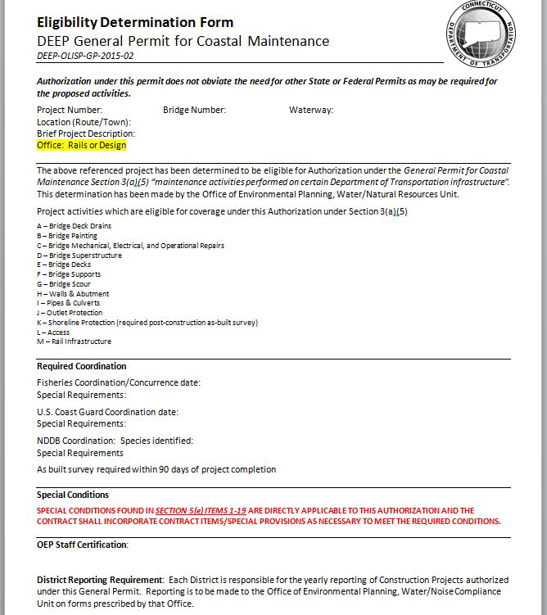
Design
Eligibility Determination Form and Reporting Form will be included into Contracts via the design process.

Slide 12
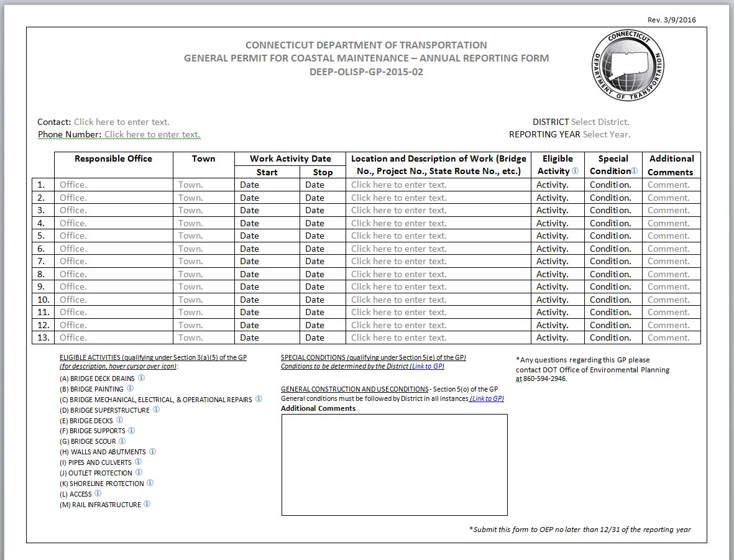
Reporting Form

Slide 13
General Information
All parties should be cognizant of Section 5(o) of the Coastal General Permit which outlines the General Construction and Use Conditions applicable to this General Permit.
The General Permit can be found via this link: http://www.ct.gov/deep/lib/deep/Permits_and_Licenses/LandUse_General_Permits/Long_Island_Sound_General_Permits/Coastal_Maintenance_gp.pdf
For additional information please contact OEP Water & Noise Compliance Section:

Slide 14
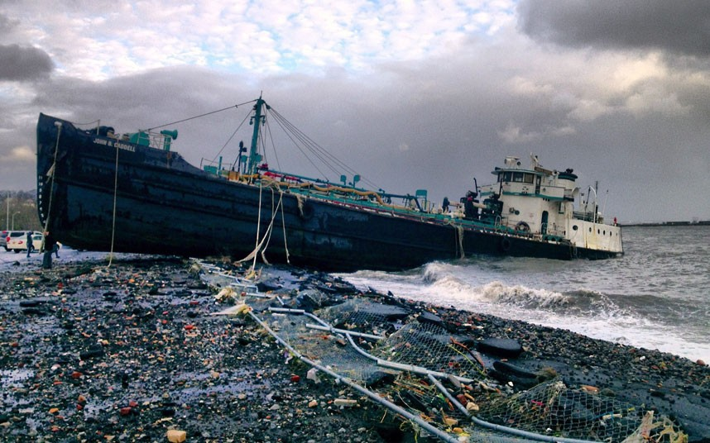
Questions?

