Slide 1
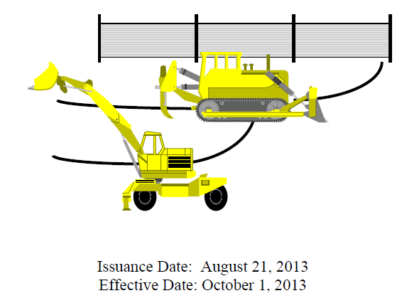
CT DOT 2014
Qualified Inspector Training
General Permit for the Discharge of Stormwater and Dewatering Wastewaters from Construction Activities

Slide 2
Key Terms
Grab sample
The “Guidelines”
NTU (Nephelometric Turbidity Unit)
Structural Measure
Engineered Measure
Non Engineered Measure
Qualified Inspector
Locally Exempt Project
Locally Approvable Project
NPDES / MS4
SWPCP / Plan
Normal Working Hours
  (minimum M – F 8 – 6)
Date of filing = the date received by the DEEP
*Permit file based on payment
Day = the calendar day.
  If a weekend or legal holiday, deadline is the next business day thereafter

Slide 3

Stormwater Permit History
National Pollutant Discharge Elimination System (NPDES) Permit
1972 – US Environmental Protection Agency (EPA)
  Section 402 of the Clean Water Act Created
  EPA required to issue NPDES Permits
1990 – US EPA
  Phase 1 of Stormwater Program
CT DEEP Construction General Permit
  1992 – General Permit Issued
  Revisions in 1997, 2002 and 2004
  Reissued without modifications in 2007 and 2012
  New October 2013

Slide 4

Stormwater Permit History
General Permit for the Discharge of Stormwater from Small Municipal Separate Storm Sewer Systems (MS4)
  Required by EPA through the NPDES Phase II Program via the Clean Water Act
  Administered and regulated by CT DEEP within the state
  Requires development and implementation of a Stormwater Management Plan and Program
  Plan and Program must utilize BMP’s to address six (6) minimum control measures outlined in the general permit

Slide 5
Stormwater Permit History
Six Minimum Control Measures
  Public Education and Outreach
    Tributary Signage
  Public Involvement / Participation
    Public Information Meetings
  Illicit Discharge Detection and Elimination
    Storm Sewer System Map
  Construction Site Runoff Control
    2002 CT Guidelines for Soil Erosion and Sediment Control
  Post Construction Stormwater Management
    Requirements for Structural and Non-Structural BMPs
  Pollution Prevention / Good Housekeeping
    Operation and Maintenance Program

Slide 6
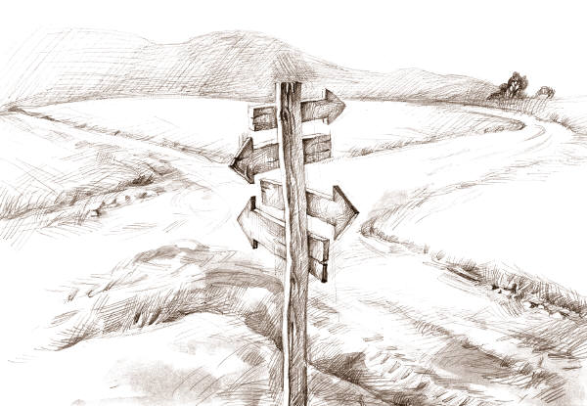
C-c-c-c-c-changes!
Submission Requirements / Opportunity for Public Comment
Certification Requirements
New Required Coordination
  8 new appendices
Stormwater Pollution Control Plan for every registration

Slide 7
Submission Requirements
Disturbance of one or more acres regardless of phasing
Locally Exempt Projects
  60 days for disturbed area between 1 and 20 acres
  90 days for
    More than 20 acres disturbed area
    Site over 1 acre discharging within 500 feet of a tidal wetland
    Site over 1 acre discharging to an Impaired Water Body
Small Construction (Local Roads / Federal Local Bridge)
  Local municipal approval for projects between 1 and 5 acres – do not have to register if approved by local commission

Slide 8

Submission Requirements
Effective Date of Authorization
  60 days / 90 days from date of public notice
  Notice to Proceed (NTP) contingent upon no public comment(s)
  If public comment(s), NTP will be delayed
Availability of Registration and Plan
  On the 15th day of each month
Electronic Filing
  Under development

Slide 9
Submission Requirements
  The registration must be electronically submitted with:
    Registration form (www.ct.gov/deep/stormwater)
    Additional forms and information regarding consistency
    Electronic copy of the SWPCP or a web address where the plan can be downloaded
  Should NOT include
    Material not pertaining to stormwater management or erosion & sedimentation control
  Discharges within a Public water supply watershed or Aquifer Area require that a copy of the registration and plan be provided to the water company
  http://www.ct.gov/deep/lib/deep/aquifer_protection/wtr_co_contact_list.pdf

Slide 10
Certification Requirements
The registrant and any other individuals responsible for preparing the registration and signing the certification shall have completely reviewed at a minimum; the general permit and
  All information provided in the Registration Form
  The project site, based on a site inspection
  The Stormwater Pollution Control Plan (SWPCP)

Slide 11
New Required Coordination Included Into The SWPCP:
Endangered and Threatened Species
Aquifer Protection Areas
Coastal Management Act
Historic Preservation Review
Wild and Scenic Rivers Act
New Discharges to Impaired Water Body
  New outfall
  Same location but Increase in pipe size
  Same pipe but increase in Q

Slide 12
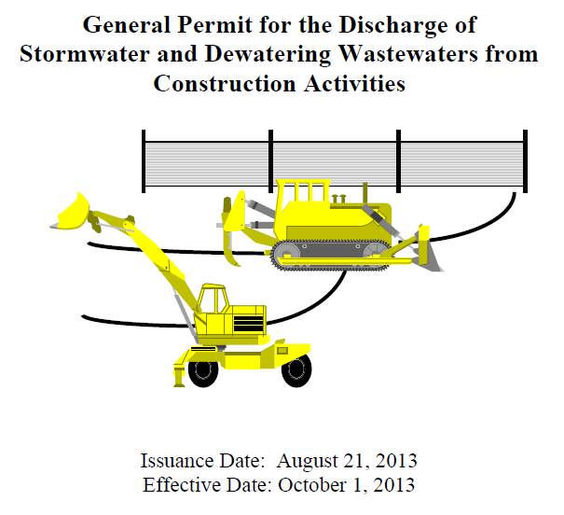
Registrations
New Requirements

Slide 13

Stormwater Pollution Control Plan (SWPCP)
……….What’s in there?

Slide 14
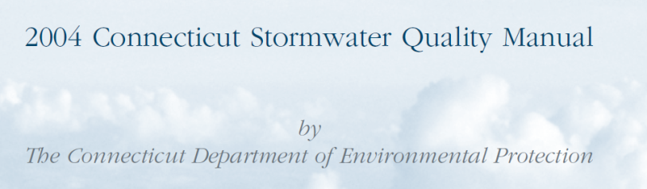
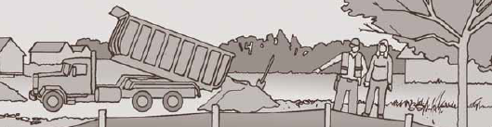
SWPCP – Big Picture
The Plan consists of site plan drawings and a narrative in conformance with
  CT DEEP Stormwater and Dewatering Wastewaters from Construction Activities General Permit
  2004 Stormwater Quality Manual / 2002 Guidelines
And shall be designed to minimize:
  Pollution caused by soil erosion & sedimentation during construction AND
  Stormwater pollution caused by use of the site post construction

Slide 15


What’s in the SWPCP ?
Plan will include:
  Site Plan / Site Specific Drawings
  Site Description
  Construction Sequencing
  Stormwater Control Measures
  Low Impact Development
  Inspections (Qualified Inspector, Routine Inspections)
  Inspection Reporting
  Keeping Plans Current
  Monitoring Requirements / Stormwater Monitoring Report
  Record Keeping Requirements
  Contractor Identification & Certification
  Termination Requirements

Slide 16
Site Plan
Site specific drawings indicating:
  Drainage patterns and approximate slopes after major grading activities
  Areas of soil disturbance
  Location of structural / non-structural controls
  Location of stabilization practices / landscaping
  Monitored outfalls
  Surface waters – impaired and high quality
  Wetlands – inland and tidal
  Location where stormwater will discharge to surface water (during and post construction

Slide 17

Site Description
Narrative including:
  Nature of construction activity
  Estimate of total area of the site and total area of expected soil disturbance
  Estimate of the average runoff coefficient of the site post construction
  Name of the immediate receiving water(s) and ultimate receiving water(s)
  Extent of wetland acreage

Slide 18
Construction Sequencing
  Expected sequence of major construction activities on the site
  Estimated timetable for all construction activities
  Limits of disturbance for each phase
    Unless specifically designed by the engineer the site shall be phased to avoid disturbance between 2 to 5 acres and greater than 5 acres at any one time
      Disturbance of 2 to 5 acres per discharge point requires a temporary sediment trap with capacity to handle 134 c.y. per acre disturbed
      Disturbance of greater than 5 acres per discharge point requires a temporary sediment basin with capacity to handle 134 c.y. per acre disturbed
    Disturbance for an Impaired Water Body is different

Slide 19
Stormwater Control Measures
Purpose
  Minimize = reduce or eliminate to the extent achievable using control measures that are technologically available and economically practicable and achievable in light of best industry practice
Typical Control Measures
  Temporary Stabilization
  Permanent Stabilization
  Structural Stabilization
Designed in accordance with:
  “Guidelines” (2002 E & S Guidelines)
  2004 Stormwater Quality Manual or
  CT DOT Qualified Products List
  Special Provisions
  CT DOT Form 816, as amended
  Engineered System

Slide 20
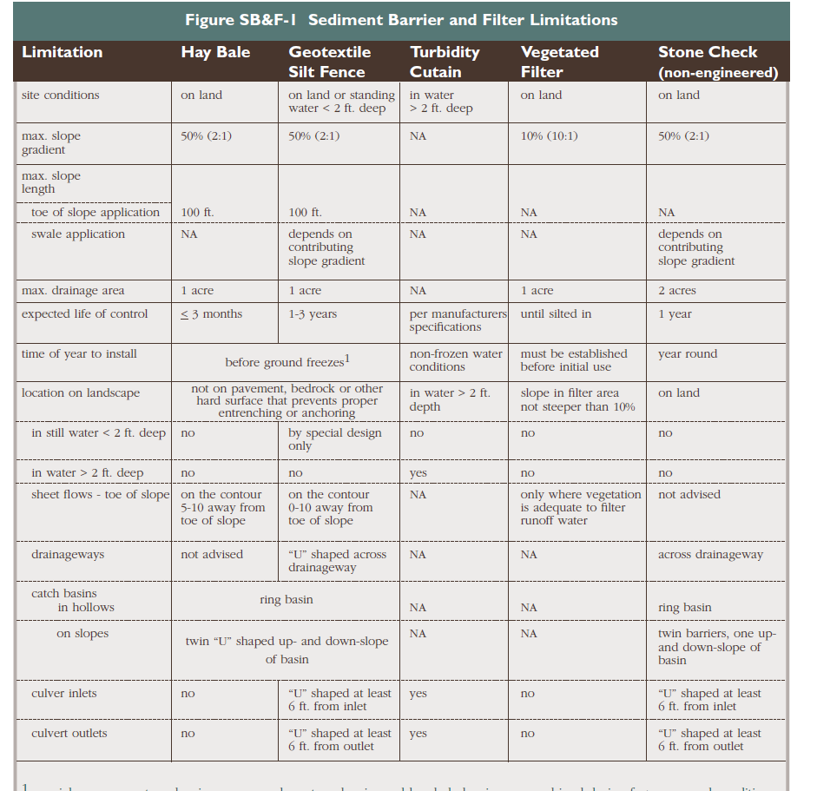
Stormwater Control Measures
Soil Stabilization and Protection
  Chapter 5 of the Guidelines
  Narrative and Drawings of Temporary & Permanent soil stabilization practices for managing disturbed areas and stockpiles, including a schedule for implementing the practices
  Temporary Stabilization
    Haybales
    Silt Fence
    Erosion Control Blanket
    Stone Slope Protection
    Seeding
  Permanent Stabilization
    Riprap slope
    Outlet Protection
    Surface Roughening
    Seeding / Landscape Planting

Slide 21
Stormwater Control Measures
Inactive Areas
  Where construction activities have permanently ceased or when final grades are reached in ANY PORTION of the site
    Implement stabilization and protection within 7 days
  Areas that will remain disturbed but INACTIVE for 30 days will receive temporary seeding or soil protection within 7 days or in accordance with the Guidelines
  CT DOT Form 816, Section 1.10 Environmental Compliance

Slide 22


Beyond the Seeding Season
Areas that will remain disturbed shall receive long term, non-vegetative stabilization and protection to protect the site through winter.
  In all cases, measures shall be implemented as soon as possible
  Hay Mulch / Erosion Control Matting

Slide 23
Stormwater Control Measures
When project encounters steep slopes, expect the following to be incorporated by the engineer:
  Any slope steeper than 3:1 (horizontal : vertical) that exceeds 15 feet vertically is required to have
    A reverse slope bench - or -
    Engineered slope stabilization structures - or -
    Detailed soil mechanics analysis
      Designed by a licensed CT PE
      With experience in geotechnical engineering or soil mechanics
Notes:
Reference 2002 E & S guidelines

Slide 24

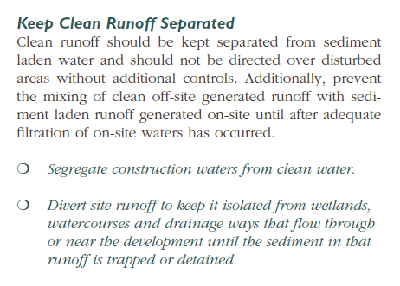
Stormwater Control Measures
Structural Measures
  Permanent Sediment Basin
  Outlet Protection
  CBs / Manholes
  HDS
Unless authorized by a regulatory permit (Inland Wetland / OLISP), all of these measures will be UPLAND

Slide 25
Stormwater Control Measures
Structural Measures
  Discharge from sites with an area of disturbance between 2 to 5 acres requires a temporary sedimentation TRAP to handle 134 c.y. per acre disturbed
    Non-Engineered
  Discharge from sites with area of disturbance over 5 acres requires a temporary sedimentation BASIN to handle 134 c.y. per acre disturbed
    Engineered
…until final stabilization of the contributing area as defined in the “Notice of Termination”
Notes:
Capacity to contain 134 cubic yards of storage per acre of runoff

Slide 26

Stormwater Control Measures
Structural Measures
  The requirements for sediment traps and basins does not apply to flows from off site that are either
    Undisturbed
    Have undergone final stabilization
    Where such flows are diverted around the trap or basin

Slide 27
Stormwater Control Measures
Maintenance of Measures
  Plan shall include narrative of procedures to maintain E & S measures, including vegetation in good and effective operating condition
  All in accordance with the Guidelines, or more frequently as necessary to “protect waters of the state” from pollution.

Slide 28
Stormwater Control Measures
Dewatering wastewaters
  Basins should always be in non-regulated (upland) areas (not in wetlands or floodway)
  Measures to prevent scour or erosion when discharging to surface waters is necessary
  May not contain suspended solids in amounts that would cause pollution
  Discharge shall NOT contain:
    a visible oil sheen,
    floating solids or
    foaming in the receiving water.

Slide 29
Stormwater Control Measures
Post Construction Stormwater Management
  SWPCP Must include plans and narrative describing:
    Measures that will be installed to control pollution POST construction
      In conformance with the 2004 Stormwater Quality Manual and / or CT DOT qualified products list
      Must be placed in UPLANDS unless permitted
    Long Term Maintenance of such structures

Slide 30
Stormwater Control Measures
Other Control Measures
  Waste Disposal
    Litter, debris, building materials, hardened concrete waste
  Concrete Washout Areas
  Offsite vehicle tracking
  Generation of Dust
  All structures must be cleaned of construction sediment
  Sed Fence Removal upon stabilization
  Chemical & Petroleum storage

Slide 31
Stormwater Control Measures
Other Control Measures
  Concrete Washout Areas
    Conducted outside of any buffers and at least 50 feet from any stream, wetland or sensitive resource
    Conducted in an entirely self-contained system
    Designated washout areas are to be clearly flagged
    All washwater is to be directed into a container or pit designed that no overflows can occur during a rain
    Hardened concrete is considered “Waste Disposal” and is to be removed from the project and disposed of at an approved facility

Slide 32
BREAK

Slide 33

Low Impact Development (LID)

Slide 34
What is LID?
  Low Impact Development: Site design strategy that maintains, mimics or replicates pre-development hydrology through the use of site design principles and small scale treatment practices distributed throughout a site to manage runoff volume and water quality at the source.
  LID meant for new roadway development/new facilities or when specific project conditions warrant LID applications
  Typically LID requirements are not meant for linear type of transportation projects
  Examples: Permeable Pavement / Vegetative Swales / Infiltration Techniques / Stormwater Ponds

Slide 35

Typical LID Stormwater Practices
LID measures that can reduce the impact of development and address stormwater quality issues on site
  Infiltrating
  Filtering
  Retaining stormwater
  “Divide and conquer”
  Conserving vegetation and soils
  Minimizing impervious surface
  Maintenance
  Education

Slide 36
Inspections

Slide 37

Inspectors
“Qualified Inspector”
  An individual possessing either
    A PE or certification by a professional organization recognized by the commissioner related to agronomy, civil engineering, landscape architecture, soil science AND two years of demonstrable and focused experience in erosion & sedimentation control plan reading, installation, inspection and / or report writing for construction projects in accordance with the guidelines – or –
    5 years of the same experience described above– or –
    Certification by the CT DOT

Slide 38

Inspections
All projects must be inspected initially (within 30 days) for Plan implementation and then weekly for routine inspections
  Plan implementation
    Within first days following start of construction activity, qualified construction inspector (YOU) must be contacted to inspect the site
    Site shall be inspected:
      At least once and no more than three times during the first 90 days to confirm compliance and proper initial implementation of all control measures for the initial phase of construction.

Slide 39

Routine Inspections – “The What”
Maintain a rain gauge on-site
At least once a week AND within 24 hours of the end of a storm that generates a discharge a Qualified Inspector shall inspect:
    Disturbed areas not finally stabilized
    All E & S measures
    All structural control measures
    Soil stockpile areas
    Concrete Washout areas
    Construction entrances / exits
…for evidence of or potential for pollutants entering drainage system and impacts to receiving waters…..

Slide 40
Storm Inspections – “The When”
For storms that end on a weekend, holiday or other time after which normal working hours will not commence within 24 hours, an inspection is required
  Within 24 hours for storms that equal or exceed 0.5 inches
For storms less than 0.5 inch;
  Inspection shall occur immediately upon start of subsequent normal working hours
Where sites have been temporarily or finally stabilized;
  Inspection shall be once a month for three months

Slide 41
Inspection Reporting

Slide 42
Inspection Reporting
Upon inspection, Qualified Inspector shall determine if it is necessary to install, maintain or repair controls / and / or practices to improve the quality of stormwater discharge
Construction Site Environmental Inspection Report (CSEIR) shall be prepared and retained as part of the Plan summarizing:
  Scope of inspection
  Names, dates, weather conditions, precipitation amount
  Major observations relating to E & S controls
  Description of discharges from the site
  Any water quality monitoring performed
Report must be signed by permittee or authorized representative

Slide 43
In Compliance / Out of Compliance
Report shall state that project is either in or out of compliance with the Plan and permit
OUT of Compliance
  Include summary of remedial actions required to be in compliance
  Non-engineered corrective actions shall be implemented on site within 24 hours and incorporated into a revised Plan within 3 calendar days of the date of inspection unless another schedule is specified in the guidelines
  Engineered corrective actions shall be implemented on site within 7 days and incorporated into a revised Plan within 10 days of the date of inspection…..

Slide 44
Out of Compliance
While corrective actions are being developed and have not yet been fully implemented; interim measures shall be implemented to minimize the potential for the discharge of pollutants from the site
Inspectors from CT DEEP may inspect the site for compliance with this General Permit at ANY TIME construction activities are ongoing and upon completion of construction activities to verify the final stabilization of the site and / or the installation of post-construction stormwater management measures
  CT DEEP can issue Field directives / violations on site

Slide 45
Out of Compliance
CTDEEP may notify the permittee at ANY TIME that the Plan site does not meet one or more minimum requirements of the general permit
  Within 7 days of such notice (or as specified in the notice), the permittee shall make the required change to the Plan and perform all actions as required by such revised Plan.
  Within 15 days of such notice (or as specified), the permittee shall submit a written certification that the requested changes have been made and implemented along with required supporting documentation requested.

Slide 46
Keeping Plans Current

Slide 47
Keeping Plans Current
The Plan shall be amended if / when:
  The actions fail to prevent pollution or otherwise comply with the general permit
  Whenever there is a change in contractors or subcontractors
  Change in design, sequence of construction, operation or maintenance at the site which has the potential for discharge of pollutants and which has not otherwise been addressed.

Slide 48


Keeping Plans Current
In no event shall failure to complete, maintain or update a Plan relieve a permitee of responsibility to implement any actions required to protect waters of the state and to comply with all conditions of the permit.

Slide 49
BREAK

Slide 50
Stormwater Monitoring Report (SMR) for Turbidity

Slide 51
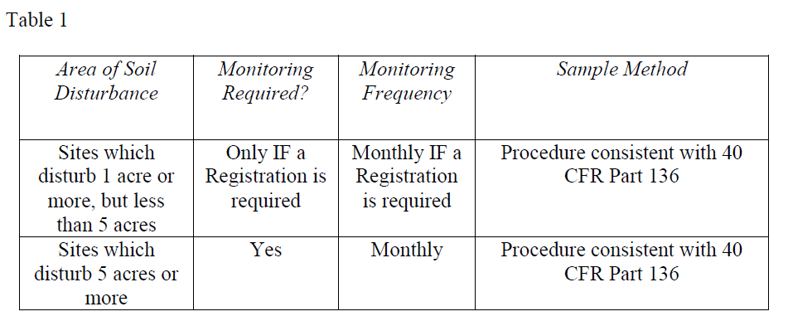
Monitoring Requirements

Slide 52
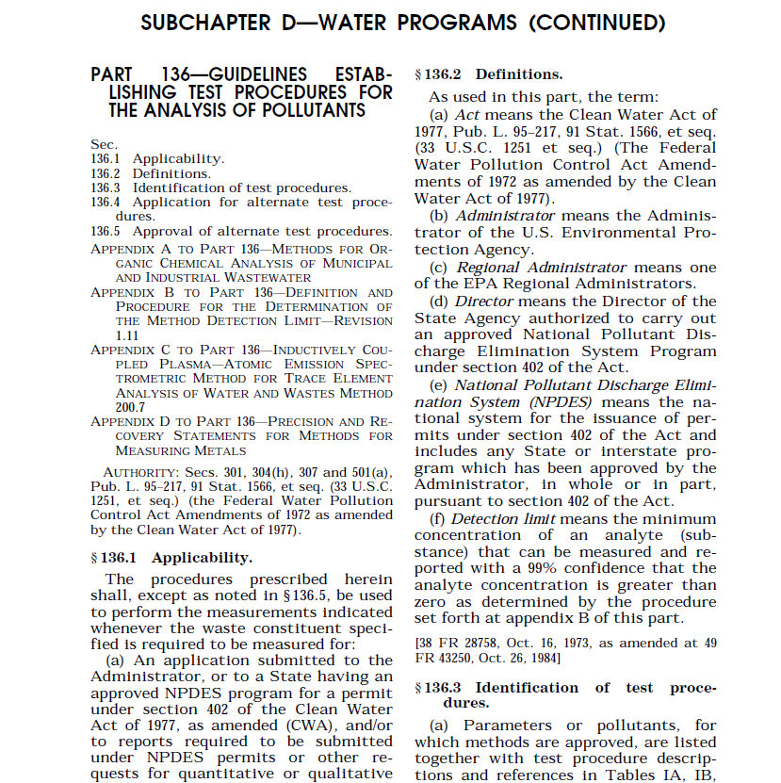
40 CFR Part 136
Turbidity ONLY
……(Phew!)
http://www.epa.gov/region9/qa/pdfs/40cfr136_03.pdf

Slide 53

Normal Working Hours
For the purposes of Monitoring, working hours are considered to be, at a minimum, Monday through Friday, between the hours of 8:00 am and 6:00 pm, unless additional working hours are specified by the permittee.
  If different… you can make a change, i.e. “Keeping Plans Current”

Slide 54
Monitoring Requirements
Sampling shall be conducted at least once every month when there is a discharge of stormwater from the site (for CT DOT = 0.1 inch) while construction activity is ongoing, until final stabilization of the drainage area associated with each outfall is achieved.
Samples are required to be taken during normal working hours, which must be identified in the Plan.

Slide 55
Monitoring Requirements
If sampling is discontinued due to the end of normal working hours, sampling must resume the following morning or the morning of the next working day following a weekend or Holiday, as long as the discharge continues
No stormwater discharge during month = no sampling BUT still must submit the SMR to DEEP regardless

Slide 56
Safety Considerations
Sampling may be temporarily suspended when such conditions exist that may reasonably pose a threat to the safety of the person taking the sample including:
  High winds
  Lightening
  Impinging wave or tidal activity
  Intense rainfall
Sampling resumes once unsafe condition is no longer present

Slide 57
Sample Collection
All samples must be collected from discharges resulting from a storm event that occurs at least 24 hours after any previous storm event generating a discharge
  Any sample containing snow or ice must note such on the SMR
  Sampling of snow or ice melt in absence of a storm event is not a valid sample

Slide 58
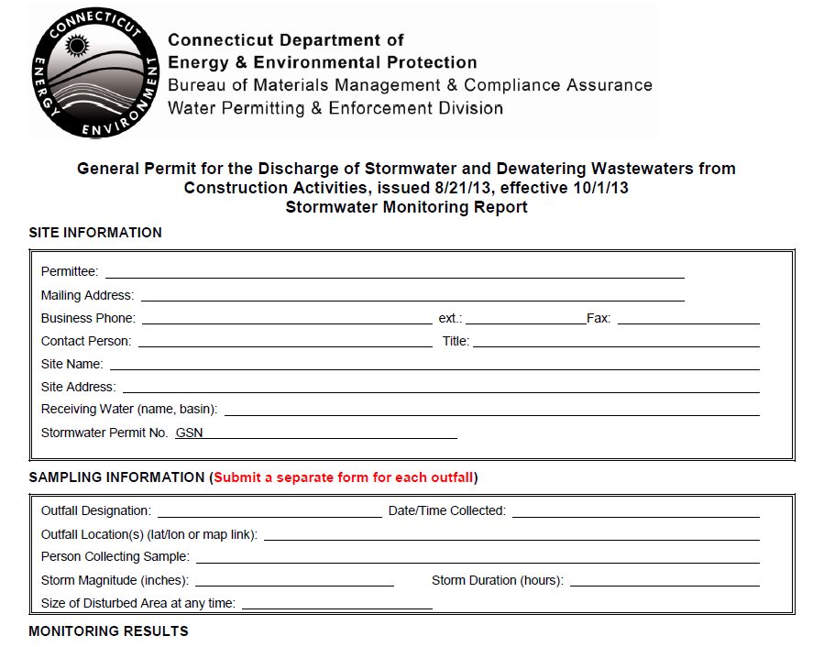
Monitoring Report Form – SMR’s
http://www.ct.gov/deep/lib/deep/permits_and_licenses/water_discharge_general_permits/storm_const_SMR.pdf

Slide 59
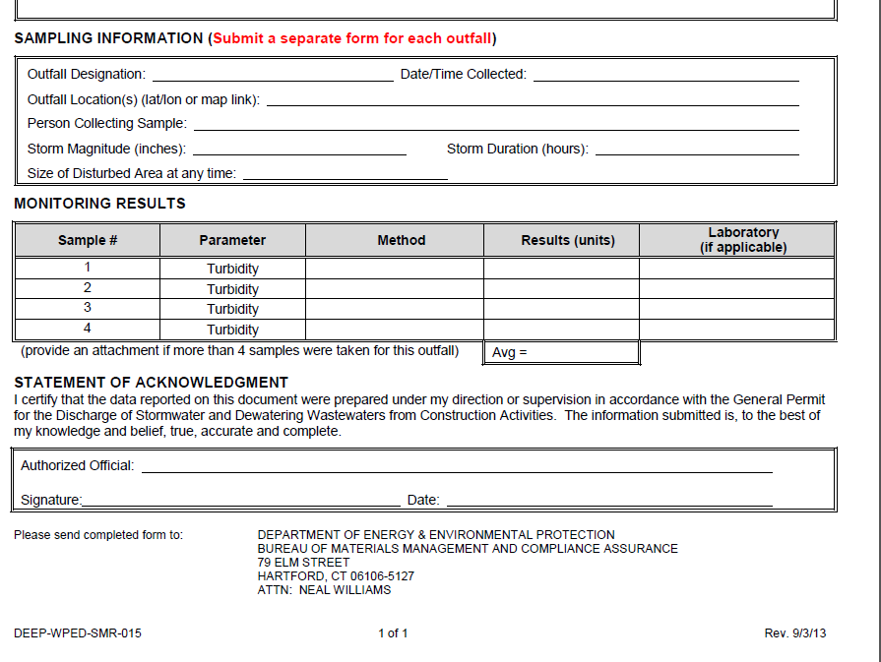
Monitoring Report Form

Slide 60
Storm Event Field Samples
Must be grab samples taken at least 3 separate times during a storm event and must be representative of the flow and characteristics of the discharge(s)
May be taken manually or by an in-situ turbidity probe or other automatic sampling device equipped to take individual turbidity readings
First sample must be taken within the first hour of the stormwater discharge from the site
  When storm begins outside of normal working hours, first sample must be taken at the start of normal working hours (if manual sampling)

Slide 61
Sampling Locations
All point discharges of stormwater from disturbed areas (except as may be modified for linear projects)
Two or more outfalls of substantially identical runoff may sample just one
  Similar exposed soils, slope, type of control used
  Report that the results also apply to the substantially identical discharge
  No more than 5 substantially identical outfalls may be identified for one representative discharge
  – EXCEPT -

Slide 62

Sampling Locations
For Linear Projects up to 10 substantially identical outfalls may be identified for one representative discharge
If the project continues for more than one year, the permittee must rotate the location of where the sample is taken twice a year (different representative discharge point every six (6) months)
All locations must be clearly marked in the field with a flag, stake or other visible marker and on the plans by Station.

Slide 63
Turbidity Values
Stormwater discharge value for each sampling point must be determined by taking the average of the turbidity values of all samples taken at that sampling point during a given storm

Slide 64
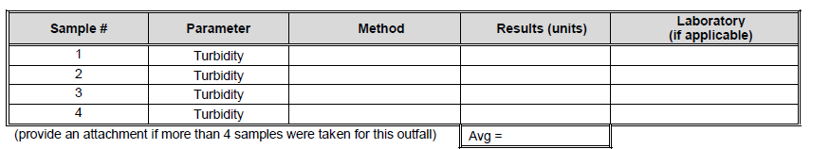
Stormwater Monitoring Reports
Stormwater sampling results must be entered on the SMR and submitted via DEEP within 30 days
If there is no discharge during the given month, submit the form with “No discharge” in place of the monitoring results to DEEP

Slide 65
Stormwater Monitoring Reports
If additional sampling is completed more frequently than what is required, results must be included in additional SMR’s for that month
If sampling protocols are modified due to limitations of normal working hours or unsafe conditions, a description / reason must be included with the SMR.
Be sure to reference representative / substantially identical discharge points (names & locations)

Slide 66
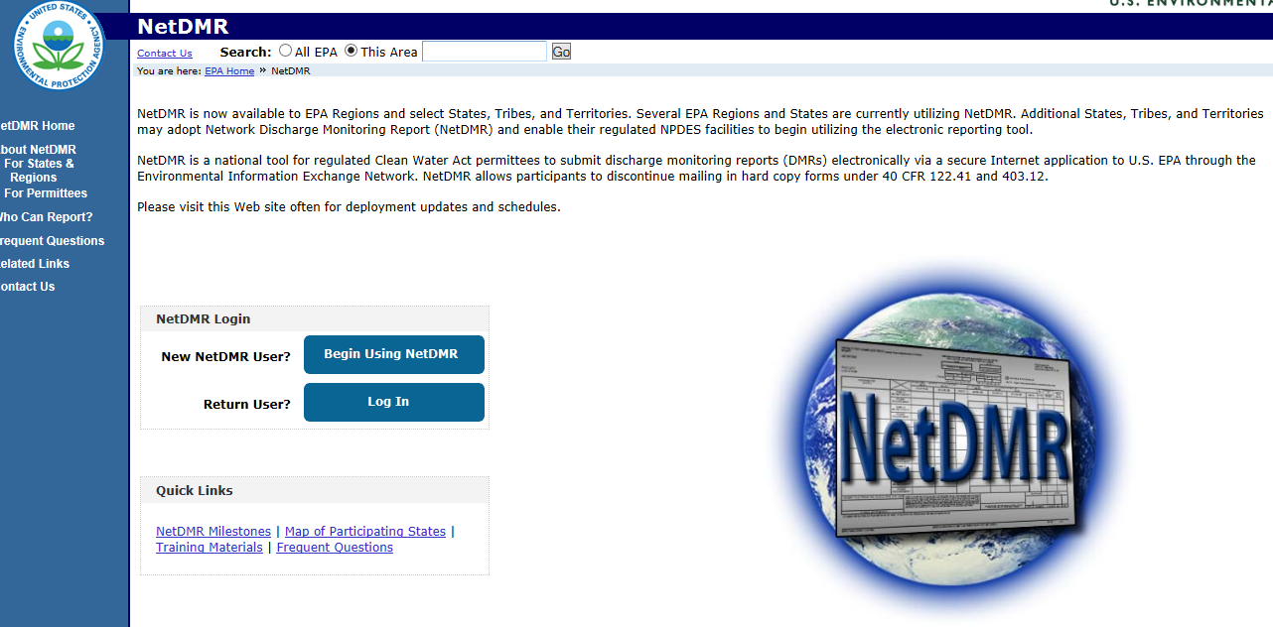
NetDMR
SMR’s must be submitted electronically (by the District Environmental Coordinator) to the DEEP no later than the 30th day of the month
Registration is required prior to login
http://www.epa.gov/netdmr/

Slide 67
Record Keeping Requirements

Slide 68
Record Keeping / Retention
Permitee must retain an updated copy of the Plan at the construction site from the date construction is initiated until the date construction is completed
Permittee shall retain for 5 years:
  Copy of the Plan
  All required reports
  Records of all data
  Inspection records (5 years after date of inspection)

Slide 69

Duty to Report
Upon learning of a violation of a condition of the general permit, permittee shall immediately take all responsible action to:
  determine the cause of such violation,
  correct and mitigate the results of such violation,
  prevent further such violation and
  Report in writing the violation and corrective action to the commissioner within 5 days of learning of such violation

Slide 70
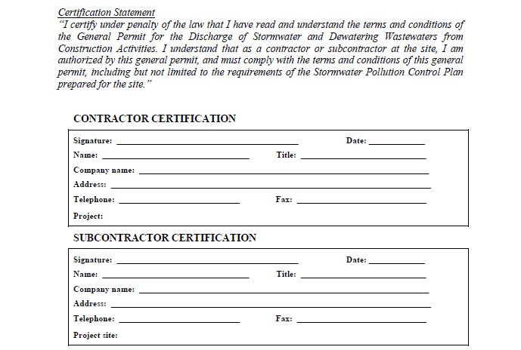
Contractor Certification
    Can be submitted after permit is approved

Slide 71
Termination Requirements

Slide 72
Notice of Termination
At the completion of construction, a Notice of Termination (NOT) must be filed.
A project is considered complete;
  After all post construction measures are installed, cleaned and functioning AND
  Site has been stabilized for at least 3 months following the cessation of construction activities
  A site is considered stable when there is no active erosion or sedimentation present and no disturbed areas remain… for all phases !

Slide 73
Final Stabilization Inspection
For all sites, once the site has been stabilized for at least three months, the registrant shall have the site inspected by a qualified inspector to confirm final stabilization
Compliance must be noted on the Notice of Termination Form
Termination Forms - http://www.ct.gov/deep/lib/deep/permits_and_licenses/water_discharge_general_permits/storm_const_termination.pdf

Slide 74


Links

Slide 75
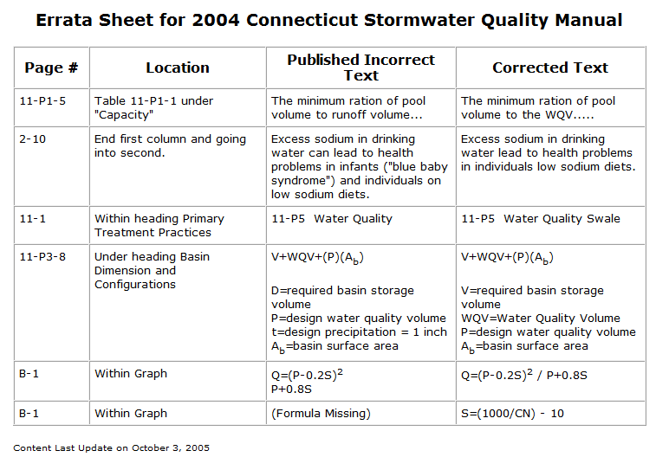
http://www.ct.gov/deep/cwp/view.asp?a=2721&q=325700

Slide 76
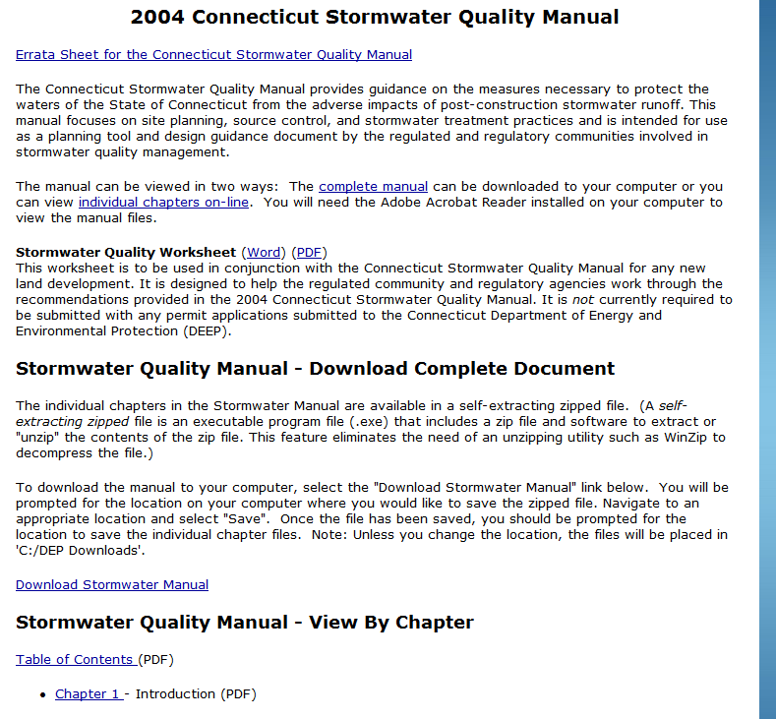
http://www.ct.gov/deep/cwp/view.asp?a=2721&q=325704&deepNav_GID=1654

Slide 77
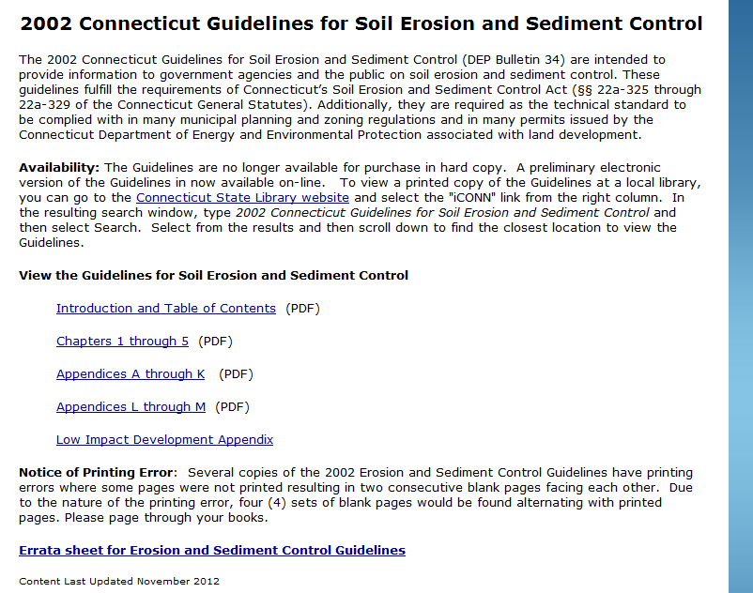
http://www.ct.gov/deep/cwp/view.asp?a=2720&q=325660&deepNav_GID=1654

Slide 78
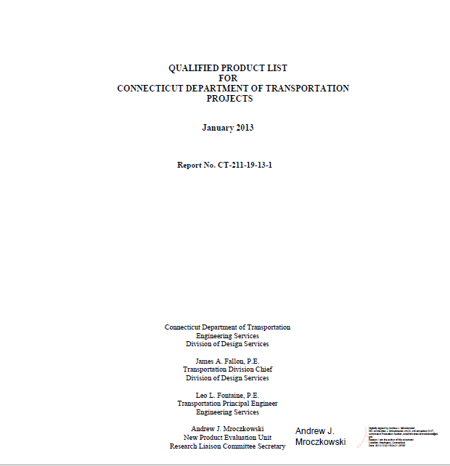
http ://www.ct.gov/dot/lib/dot/documents/dresearch/conndot_qpl.pdf

