Slide 1

Department of Transportation
Bureau of Policy and Planning
Office of Environmental Planning
Water & Noise Compliance Unit
2018 Environmental Training

Slide 2
Office of Environmental Planning (OEP) Water and Noise Complaint Unit
Vacant - Transportation Planning Director
Kim Lesay - Transportation Assistant Planning Director
Kevin F. Carifa - Transportation Supervising Planner
Paul Dickey - Transportation Planner 2
Andrew Piraneo - Transportation Planner 2
Christine A. Tedford - Transportation Planner
Mark D. Marseglia - Transportation Planner
Jeremy D. Willcox - Transportation Planner
Ashley Drda- Transportation Planner

Slide 3
2018 Environmental Training
  Annual Permit Review
  Permitting Changes
  In-Water Time Of Year Waivers
  Planting Plans and Seeding
  Invasive Removal Treatment
  Topsoil/Review for Invasive Species
  Pollinator
  Specifications
  BMP’s Section 1.10/E&S Controls
  Non-typical Projects
  MS4
  CMP Assessment
  Resource Center
  Questions

Slide 4
Annual Permit Review

Slide 5
Annual Permit Review
Permit Applications – All projects with permitted impacts should have a permit application in the Contract. If you don’t, contact the Design Engineer or OEP.
Permit Approvals
Environmental Permit Plan Set / Tidal Plates – Be familiar with your Project’s permitted footprint. (Working outside of permitted footprint is a violation!)
Keeping track of Permit Approval/Expiration dates – Start /Stop Notices
Coastal Maintenance General Permit
ACOE Permit
Construction Stormwater
  Permit set to expire September 2018 (Extension/Renewals of Existing Projects)
  Review of monitoring outfalls (Q&A)

Slide 6
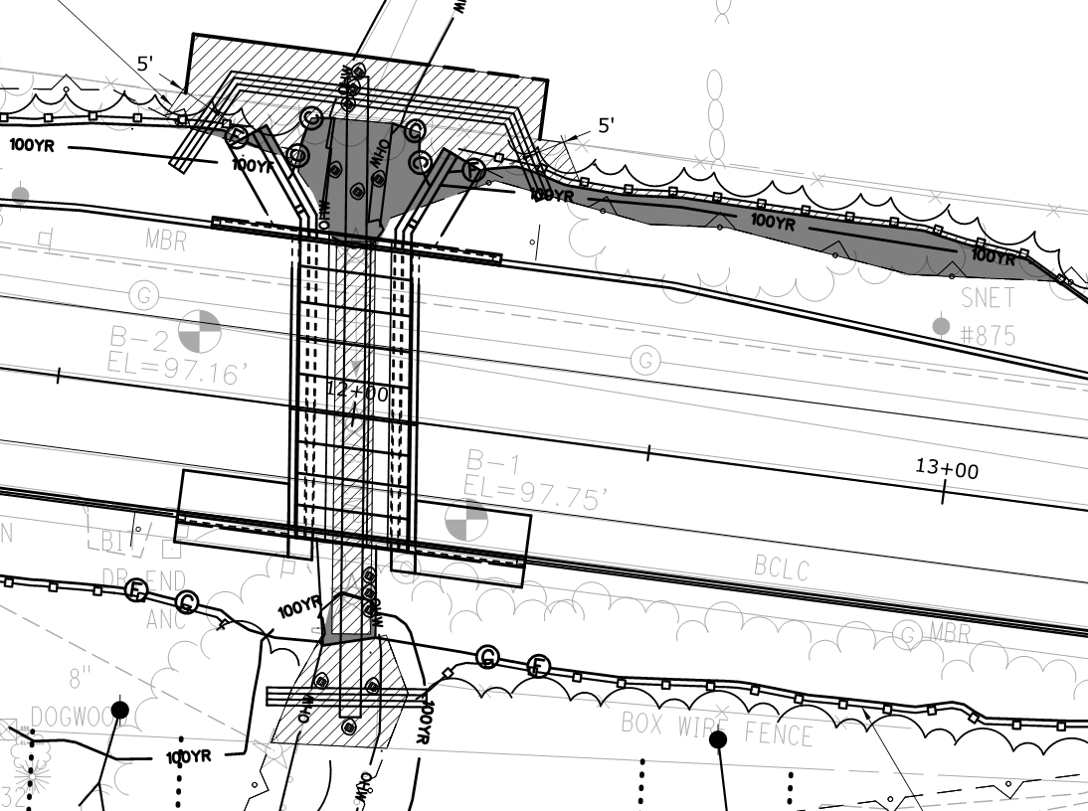
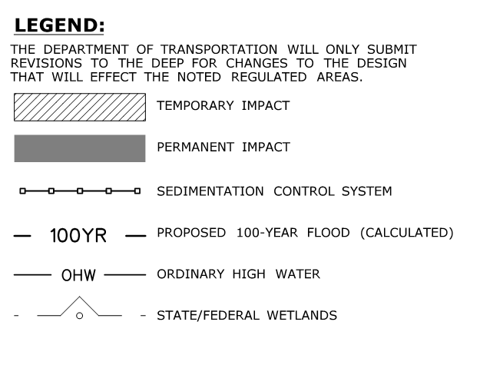
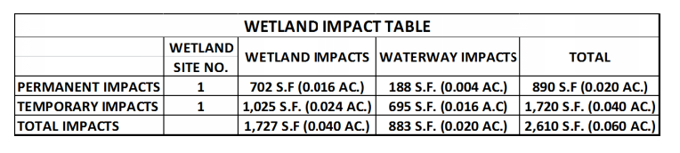
Environmental Permit Plan Set
Wetland Impact Sheet

Slide 7
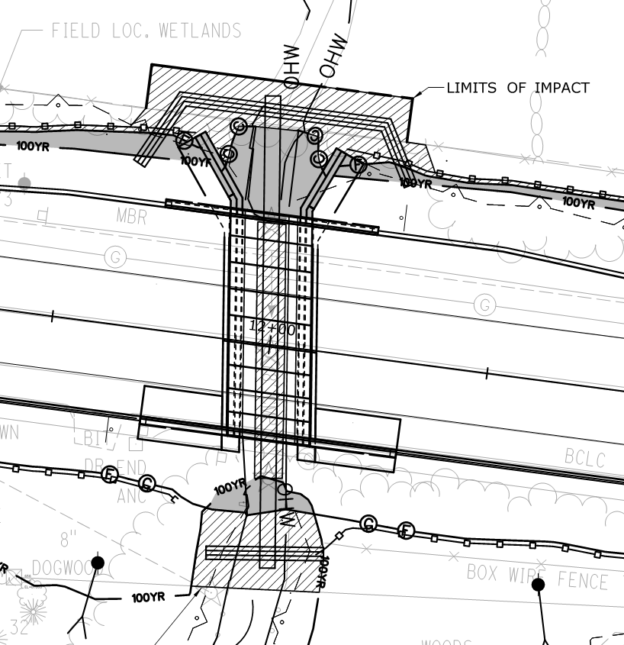
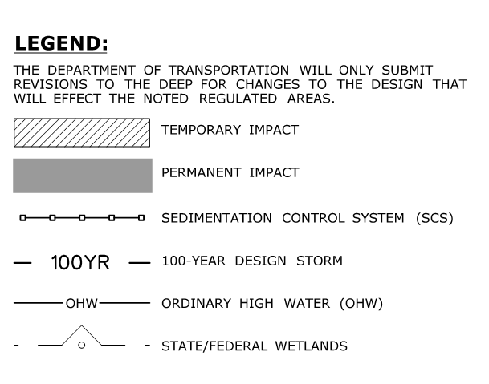
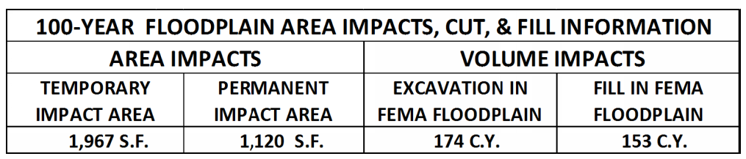
Environmental Permit Plan Set
Floodplain Impact Sheet

Slide 8
DEEP Land & Water Resources Division (LWRD)
Inland Wetland Permits:
Construction Water Resources (IW General)
Inland Wetland Individual Permit
Flood Management Certification
401 Water Quality Certificate / PGP Addendum Form
Dam Safety
Note: All projects should have the permit application and permit approval letter with special conditions as part of the Contract. The lone exception is the IW General which does not have a permit approval letter.
Tidal Wetland Permits:
Structures, Dredging and Fill
Tidal Wetlands
Certification of Permission
Coastal Consistency Review Form
401 Water Quality Certificate
Coastal Maintenance General Permit
Note: Inspection Staff should always read through the permit application as it may contain important information.

Slide 9
Department of Transportation (DOT)
DOT Issued Permits:
Flood Management General
Flood Management Memorandum of Understanding
DOT Coastal Consistency Review Form
Notes:
Flood Management General issued for minor work in floodplain.
FM-MOU for Municipal Projects only.
DOT CAM issued for projects with minor work within the coastal area management.
Coming Soon! DEEP Approval License Form

Slide 10
Coastal Maintenance General Permit

Slide 11
Coastal Maintenance General Permit
The process for permit determination and eligible transportation infrastructure activities under this authorization will be conducted as follows:
Design/Construction Projects: Determination during the design process will come from the Office of Environmental Planning (OEP).
Office of Maintenance (Highways & Bridge): Determination for Highway and Bridge maintenance activities will come from the District Drainage Engineer via coordination with OEP’s Water & Noise Compliance Unit.
Office of Rail (Rails Maintenance): Determination for Rail maintenance activities will come from the Rails Project Engineer via coordination with OEP’s Water & Noise Compliance Unit.
There are 13 eligible activities which the DOT is authorized under this permit.
DOT has 19 Special Conditions that can be associated with an eligible activity.

Slide 12
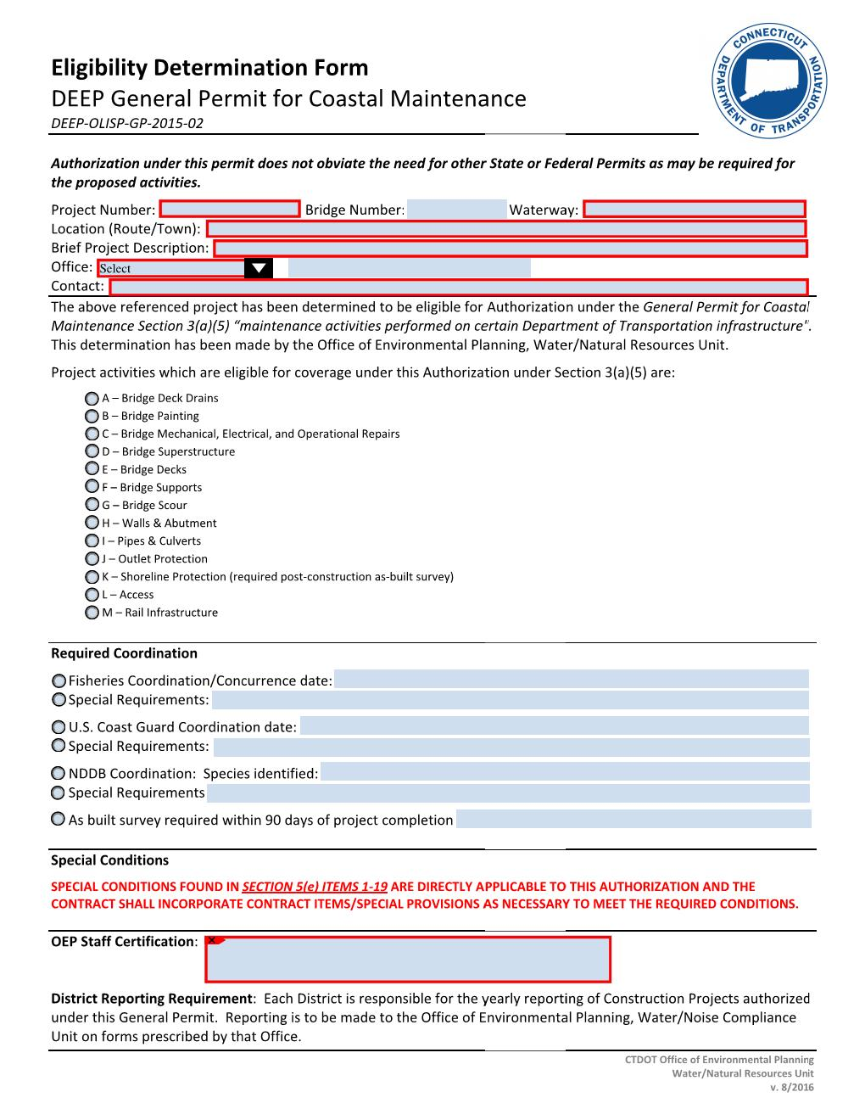
Coastal Maintenance General Permit
For Design/ Construction, eligibility Determination Form and Reporting Form will be included into Contracts via the design process.

Slide 13
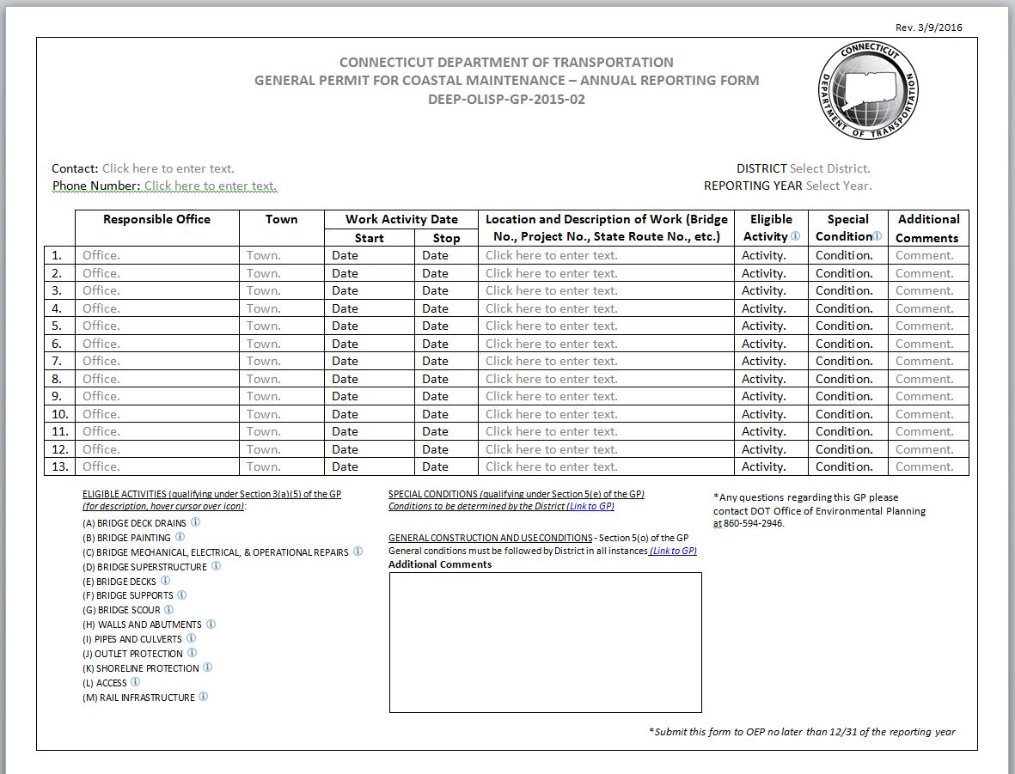
Coastal Maintenance
General Permit Reporting Form

Slide 14
Army Corps of Engineers (ACOE)
Army Corp General Permit issued 8/19/2016
  Self Verification (SV)
    New permit application form (“Appendix E – SV Notification Form”)
    Application form now includes location map and permit plans
    SV may or may not have an authorization letter
  Pre Construction Notification (PCN)
    PCN will always have an authorization letter with conditions
  Individual Permit (IP or 404)
    Projects will always have an authorization with special conditions

Slide 15
Miscellaneous Permits/Coordination
Construction Stormwater General Permit
(Any Disturbed Area Over 1 Acre)
Aquifer Protection Area
United States Coast Guard (Navigable Waters)
Department of Public Health
Environmental Protection Agency (Sole Source Aquifers)
DEEP Wildlife Division (Turtle Sweeps, Eagle Nesting, etc.)

Slide 16
Permitting Changes

Slide 17
Permitting Changes
Water-handling. (i.e. gravity pipe vs. bypass pumping)
Drainage. Max Q and Max V
Tidal projects
Floats/barges
Access roads
Questions?

Slide 18
In-Water Time of Year Waivers (Do’s and Don’ts)

Slide 19
In-Water Time of Year Waivers
“Confinement of a work area by cofferdam techniques using sand bag placement, sheet pile installation (vibratory method only), portadam, or similar confinement devices is allowed any time of the year unless specifically prohibited by a permit condition. The removal of such confinement devices is allowed any time of the year unless specifically prohibited by a permit condition. Once a work area has been confined, in-water work within the confined area is allowed any time of the year. The confinement technique used shall completely isolate and protect the confined area from all flowing water. The use of silt boom/curtain or similar technique as a means for confinement is prohibited.”

Slide 20
In-Water Time of Year Waivers
So what does this really mean? No other work, other than installing and removing of cofferdams and water-handling are permitted under this provision. It’s just that the installation and removal no longer meets the definition of in-water work.
There are exceptions when in-water activities will be not be permitted outside the June 1st to September 30 window. Some examples:
  The DEEP may have a special provision in the permit or language in an application specifically prohibiting in-water work outside the time of year.
  Installing or removing of sheet piles by impact, or any method involving excavation within the streambed.
  If there are fisheries or wildlife habitat, certain restrictions may prevent in-water activities outside the time of year.
If work is proposed outside the time of year either an activity not authorized in the definition or due to a specific restriction outlined in the permit a formal submittal is required from the Contractor to the District for submittal to OEP for review and approval.
If uncertain, please contact DEC or OEP.

Slide 21
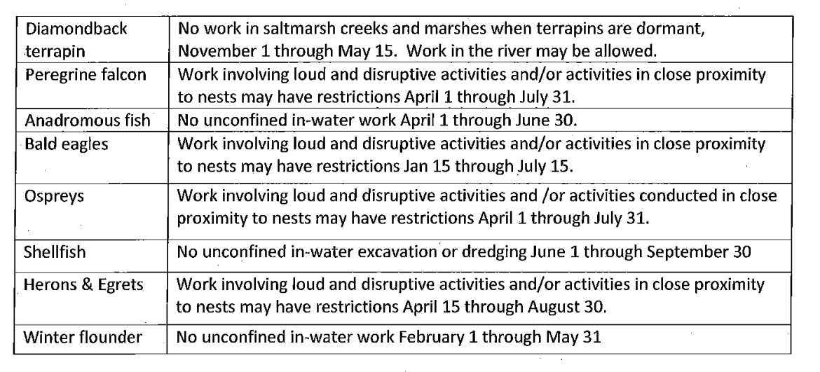
In-Water Time of Year Waivers
Tidal: different TOY restrictions if certain species are present within project area. (Cannot always put containment in any time of year)
Consult OEP for specific guidance if these species are present:

Slide 22
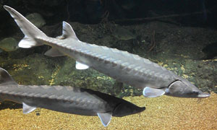
Atlantic Sturgeon
Critical Habitat Designation
Federal Endangered Species Act
Source: NOAA
Atlantic Sturgeon has been listed as an endangered species for many years and is known from many tidal waters in the state
In 2017, critical habitat was designated for the fish
  Critical habitat is areas which are essential to the conservation of the species and need special protection (breeding/spawning grounds, feeding areas, etc.)
  Critical habitat has the same protection as the fish under the ESA
  Housatonic River south of the Derby Dam to the L.I. Sound
  Connecticut River from L.I. Sound to the Mass. Border
Could mean special time of year restrictions, turbidity limitations, in-water turbidity/sediment controls etc.
You may see new specifications for projects in these areas

Slide 23
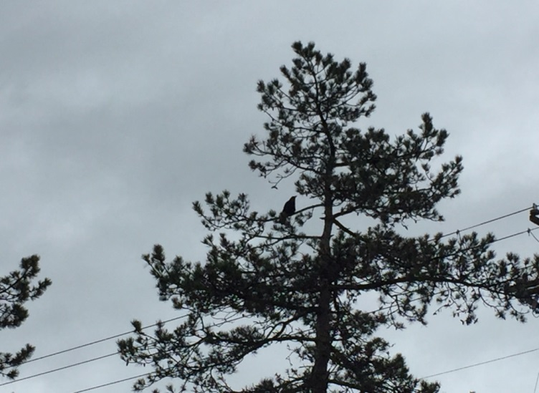
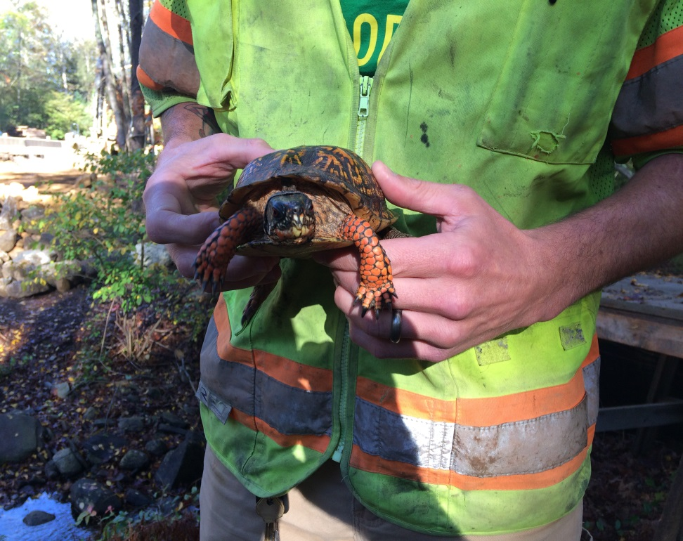
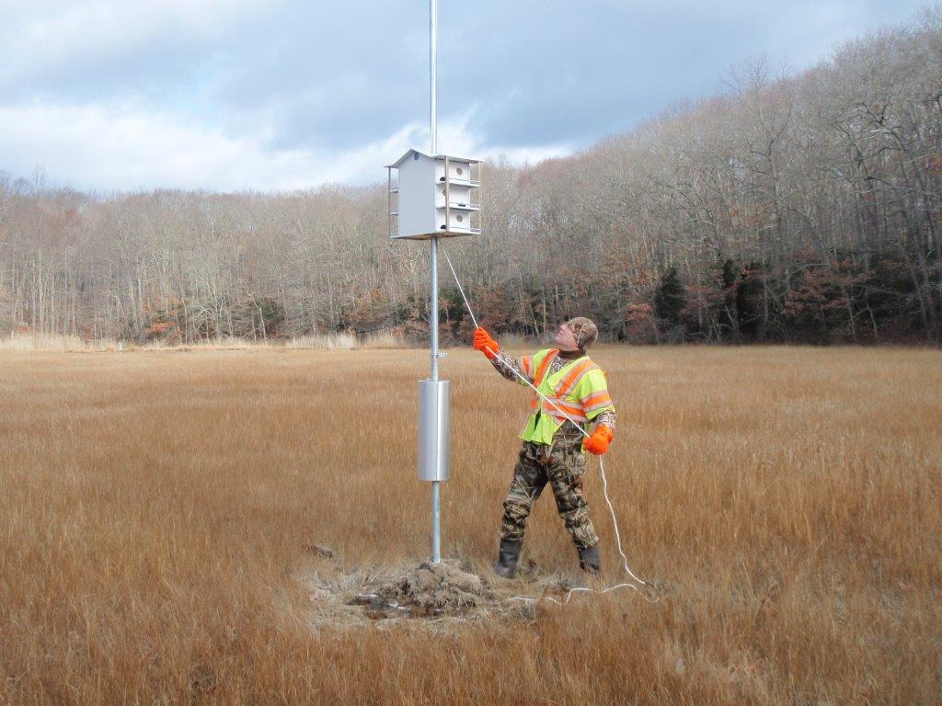
In-Water Time of Year Waivers
Raven
Eastern Box Turtle
Purple Martin House

Slide 24
In-Water Time of Year Waivers (Lessons Learned/Issues)
Winter BMPs
Clearing and Grubbing
Planting
Seeding
Invasive Species Removal
Turtle Sweeps
Fisheries Installs
Non Typical Projects

Slide 25
Planting Plans/Seeding

Slide 26
Planting Plans/Seeding
OEP and Landscape Design (LD) roles
LD plant approval from the nursey prior to delivery (with the source of supply).
OEP must have LD approval letter authorizing plant installs
Plant substitutions approvals prior to delivery
OEP/LD and Contractor must perform walk-through prior to planting
Advanced notification to conduct plant layout. OEP or LD personnel MUST be on-site
Planting dates (optimal time of year to plant)
1 year warranty / 2 year warranty
Seeding. Pull tags – Conservation/Wetland Seed mixes (seed mixes must be reviewed in advance prior to purchase and delivery on-site

Slide 27
Invasive Removal Treatment

Slide 28
Invasive Removal Treatment
OEP and Landscape Design (LD) roles
Contractor submittal for review/approval
Optimal time of year to treat invasive with herbicide vs mechanical removal (i.e. how to treat during plant dormant season).
OEP and Contractor must perform walk-through prior to treatment
Notify OEP of treatment time and date with advance notice
Stripping topsoil onsite with invasive species
1 year / 2 year warranty

Slide 29
Topsoil Inspection/Review for Invasive Species

Slide 30
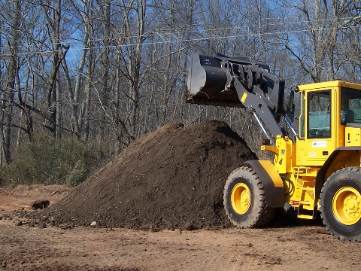
Topsoil Inspection/Review for Invasive Species
Inspector/Environmental Coordinator to visually inspect topsoil. If invasive species present – treatment required or pile to be rejected.
http://www.backtothegarden.us/images/100_0725%20Medium%20Web%20view.jpg

Slide 31
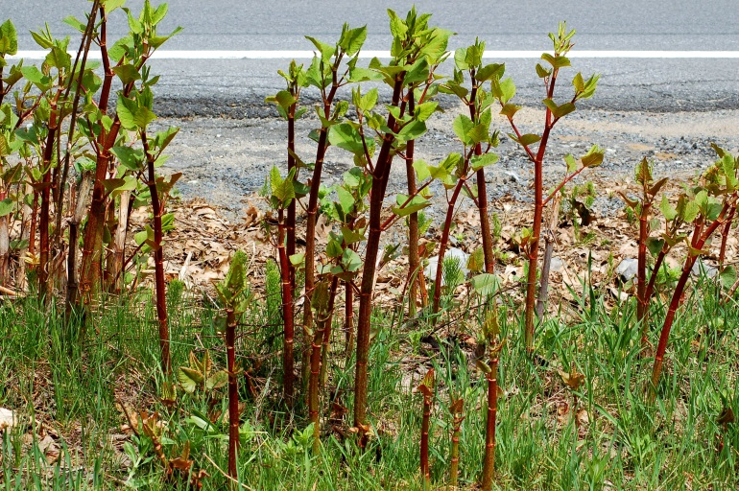
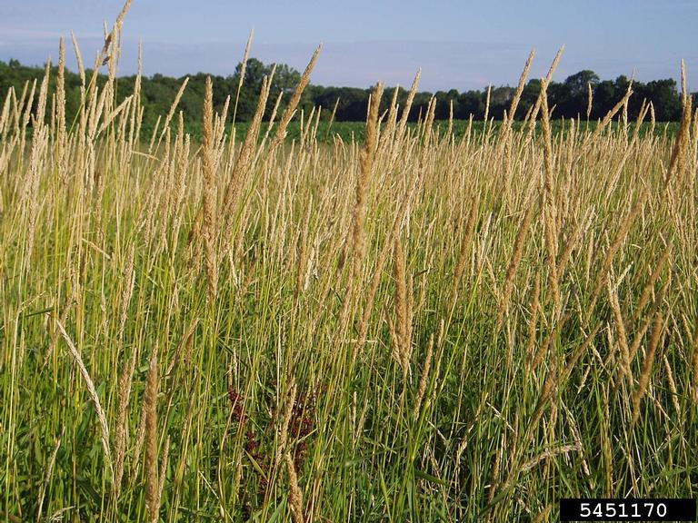
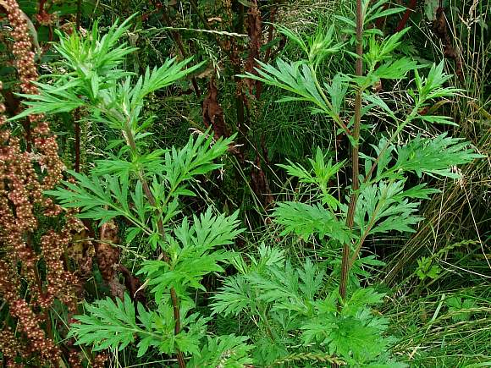
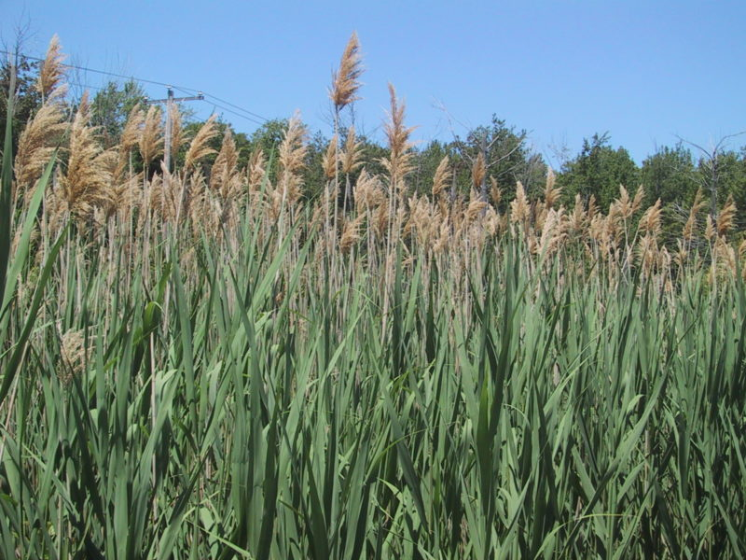
Topsoil Inspection/Review for Invasive Species
https://fthmb.tqn.com/JmBYYXppkiW1KggaqeGCp69Q_Bk=/3008x2000/filters:fill(auto,1)/Japanese-knotweed-stand-big-56a585e55f9b58b7d0dd4307.jpg
http://msue.anr.msu.edu/uploads/news/_in_article/Reedcanarygrass1.jpg
Knotweed
Reed Canary Grass
http://wildflowerfinder.org.uk/Flowers/M/Mugwort/Mugwort_2007_07_11_AppleyBridge_AshurstsBeacon_Parbold_524p8.jpg
http://grotonlakes.com/wp-content/uploads/2016/06/phragmites-800x600.jpg
Mugwort
Phragmites

Slide 32
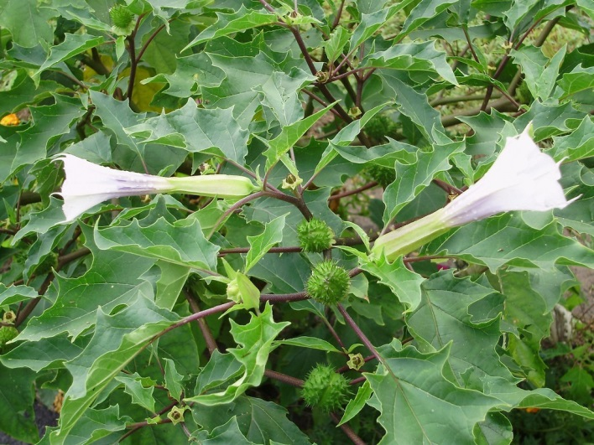
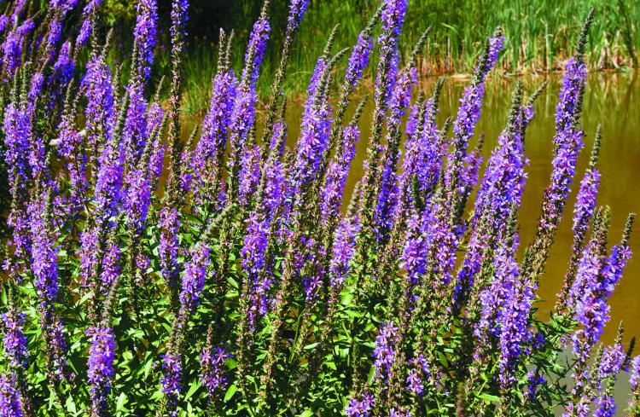
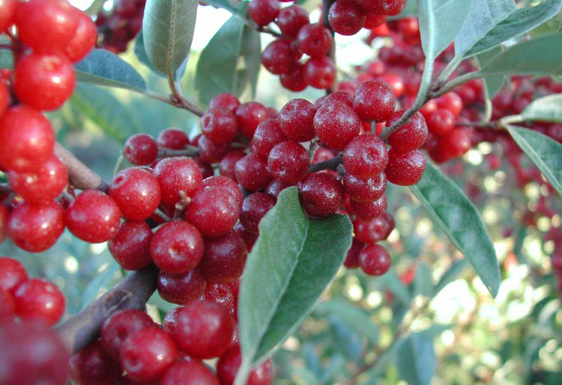
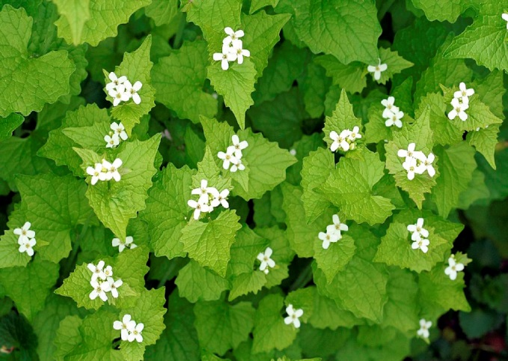
Topsoil Inspection/Review for Invasive Species
https://maxpull-tlu7l6lqiu.stackpathdns.com/wp-content/uploads/2013/09/jimsonweed.jpg
https://mdc.mo.gov/sites/default/files/styles/centered_full/public/media/images/2010/07/purple_loosestrife1cmyk2.jpg?itok=G7r2ePfr
Jimson Weed
Purple Loosetrife
https://northernwoodlands.org/images/articles/olive.jpg
http://www.nyis.info/user_uploads/files/2146038_garlic_mustard_flowers(1).jpg
Autumn Olive
Garlic Mustard

Slide 33
Pollinators

Slide 34
Pollinators
REPORT AS REQUIRED BY PUBLIC ACT 16-17; SECTION 12 AN ACT CONCERNING POLLINATOR HEALTH

Slide 35
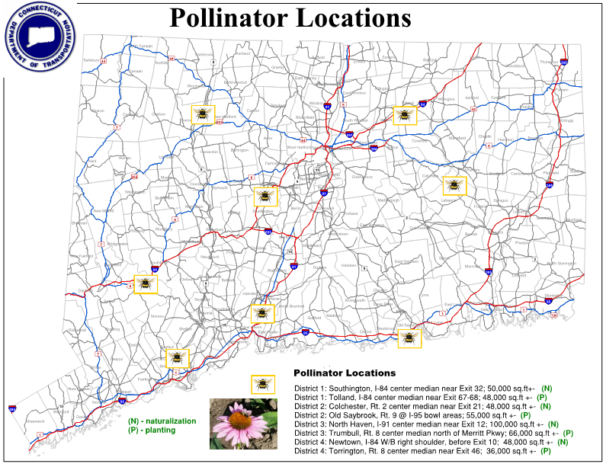

Slide 36
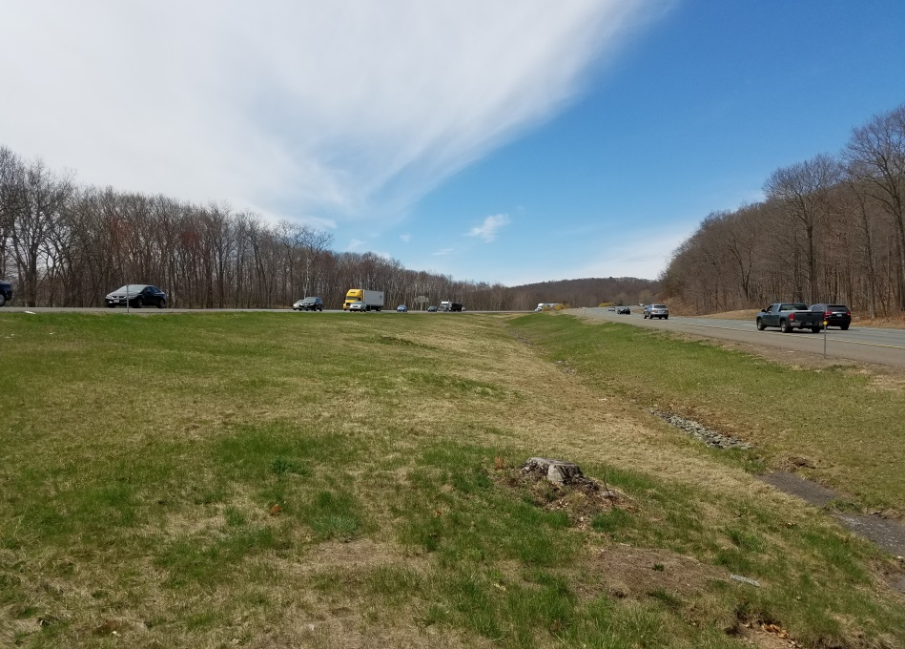
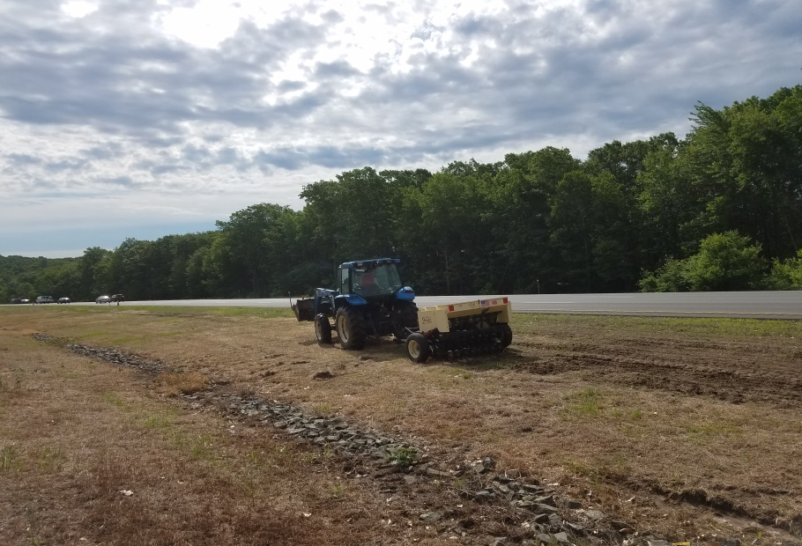
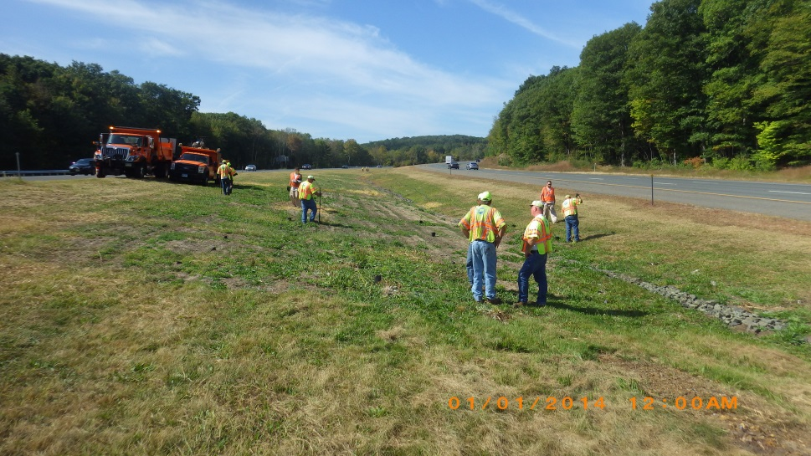
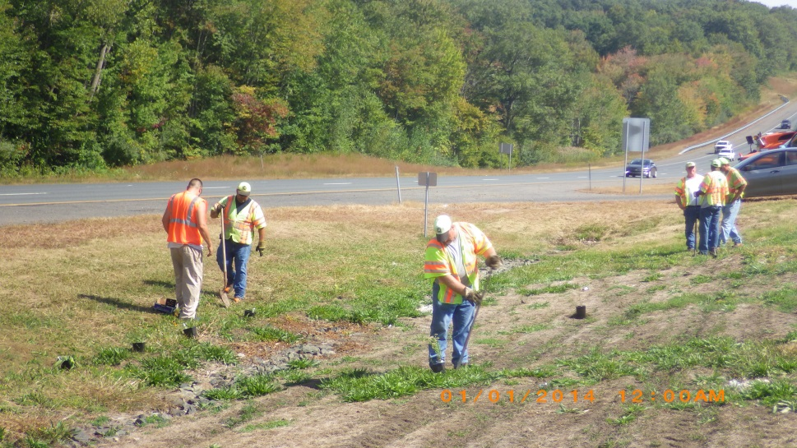
Pollinators
Tolland I-84 before Exit 68 approx. 50,000 sq. ft. area

Slide 37
Specifications

Slide 38
Specifications
Updated specs (seeding, fisheries, Section 1.10, excavation and reuse of existing natural streambed, supplemental streambed material, rounded riprap, etc.)
Owned special provision webpage
Engineering and Construction Directives/Bulletins
Construction Manual Volume 2 – Chapter 1 Environmental Protection Section 2.106B-Site Preparation (Engineer responsible for contacting OEP)

Slide 39
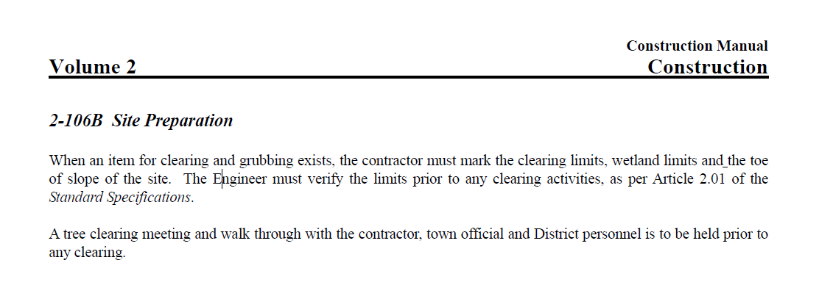
Specifications
Existing Language:

Slide 40
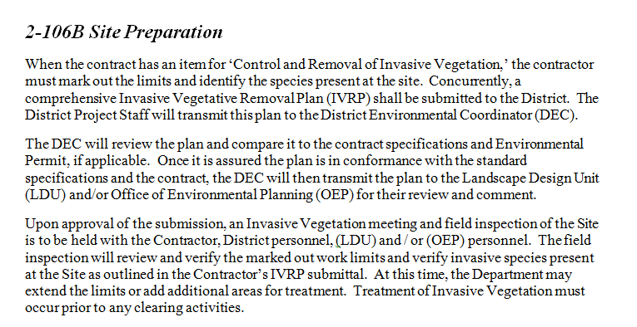
Specifications
Proposed Language:

Slide 41
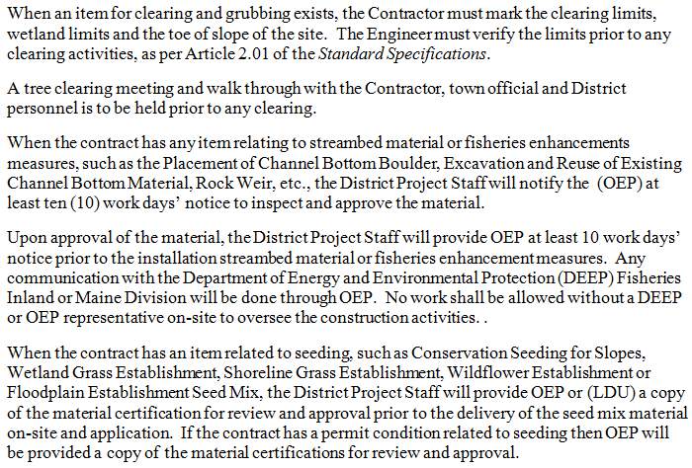
Specifications
Proposed Language (Continued):

Slide 42
BMPs Section 1.10/ E&S Controls

Slide 43
BMPs Section 1.10/ E&S Controls
Review BMPs
Concrete Washout
Taking water from stream
Common E&S deficiencies…timeframe to correct deficiencies
Staging and storage areas (APA, watershed areas) and floodplain area

Slide 44
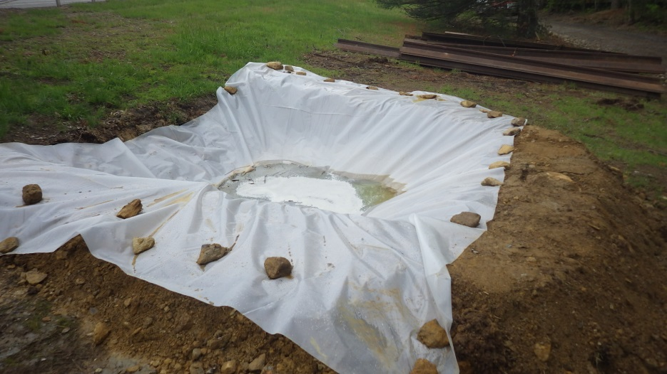
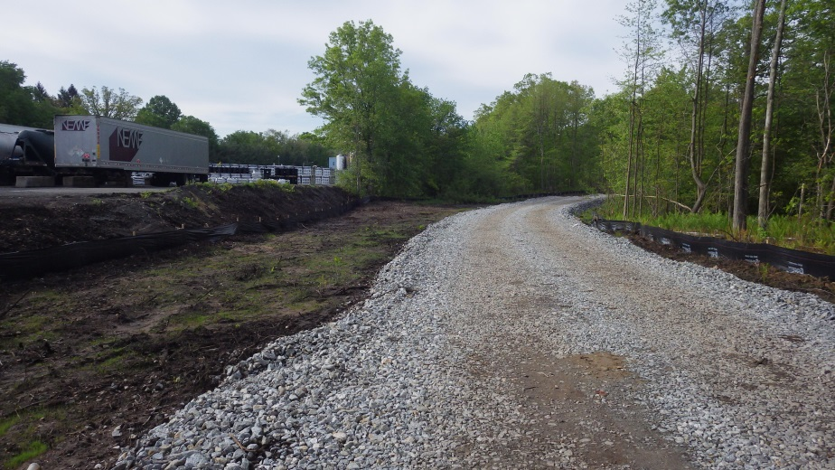
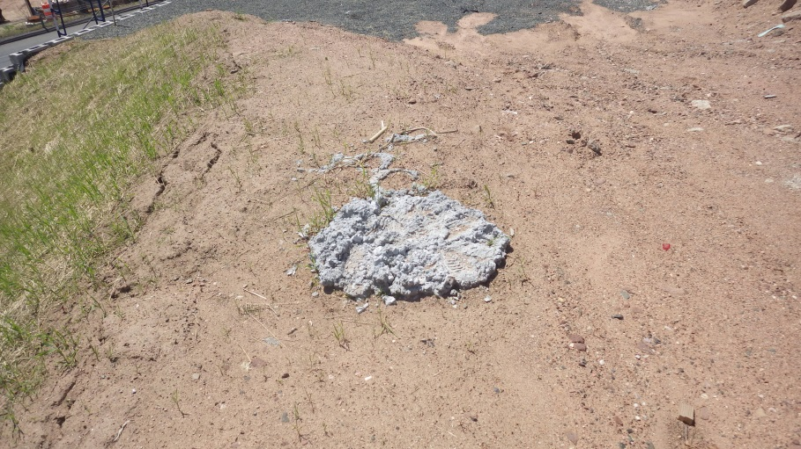
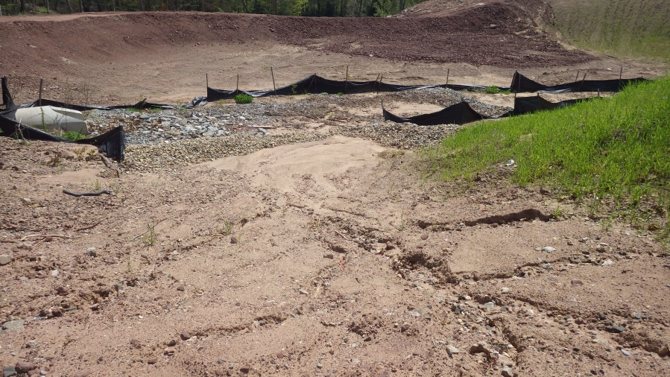
BMPs Section 1.10/ E&S Controls
Great Concrete Washout
Great E&S Controls
Not So Good Concrete Washout
Not So Good E&S Controls

Slide 45
Non-typical Projects

Slide 46
Non-typical Projects
ABC – Accelerated Bridge Construction
Design Build
Projects with weekend closures or short duration

Slide 47
MS4 Update

Slide 48
MS4 Update
Permit to go in effect July 1, 2019
This permit will give us the ability to track drainage interconnections with private entities and towns
If any illicit discharge is detected on any of your projects please notify OEP and we will pursue the issue with our MS4 protocol

Slide 49
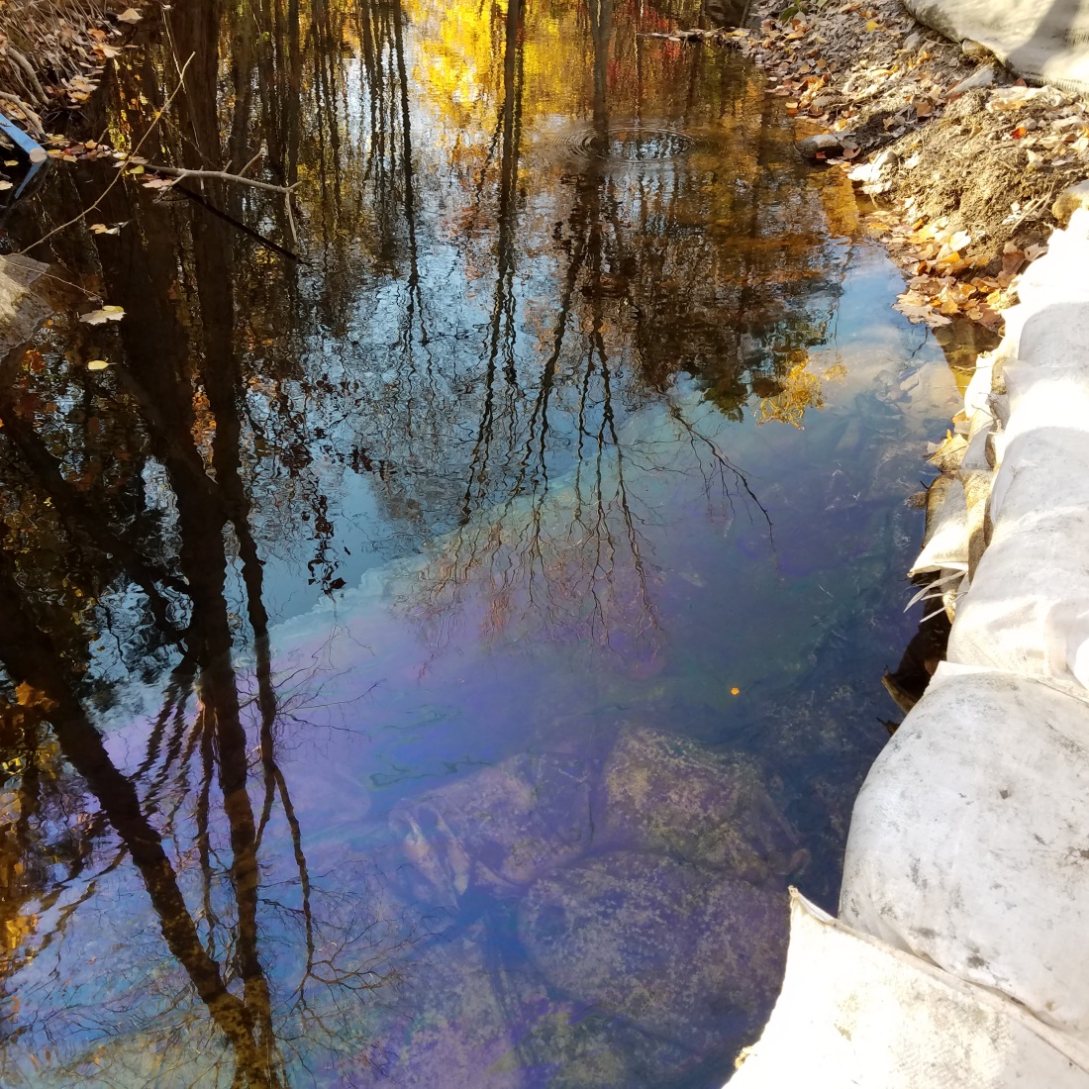
MS4 Update
Example of an Illicit Discharge….

Slide 50
CMP Inventory Update

Slide 51
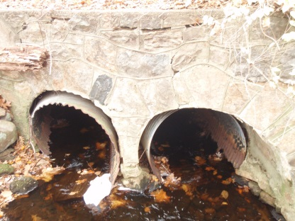
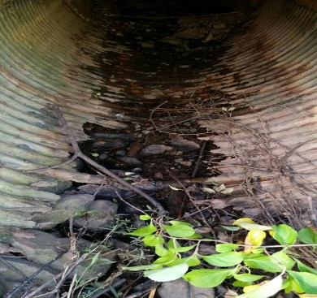
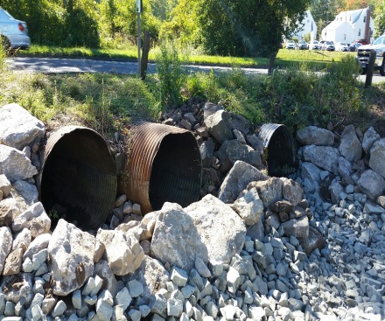
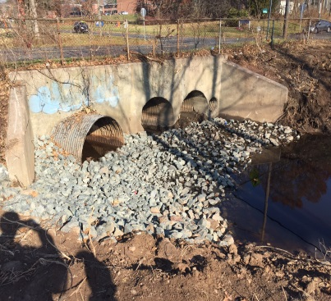
CMP Inventory Update
DOT has numerous corrugated metal pipes (CMP) (< 6 feet diameter) with no bridge identification and no Bridge Safety biannual inspection review
Many of the CMPs were installed a long, long time ago, in a galaxy far far away… And are in dire need of identification, inspection, possible repair, or even replacement
Expensive Emergency Declarations have pushed this initiative forward
Program developed to help inventory pipes and provide preliminary assessments of conditions
All Districts have began utilizing the program - expect this program to continue to be developed and implemented for winters to come.

Slide 52
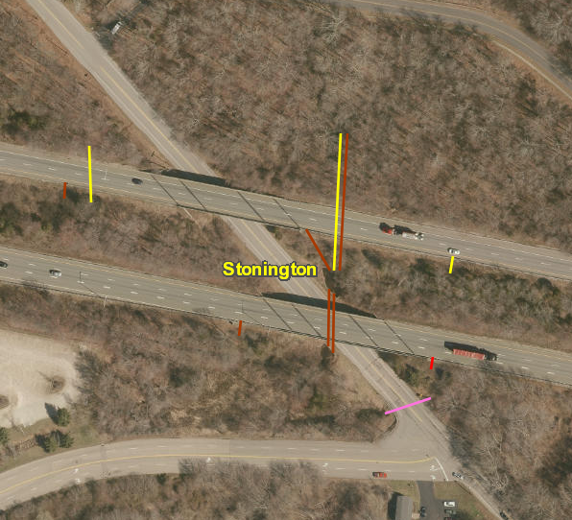
CMP Inventory Update
7,307 pipes have been spatially located and digitized in the GIS Mapper.
922 pipes have been assessed in the field by DOT personnel.
Pipe assessments will continue based on staff availability and weather conditions.
http://ctdot.maps.arcgis.com/home/webmap/viewer.html?webmap=fff94d6a75d948548eb6835d33d515c0
ArcGIS Mapper

Slide 53
Resource Center
The Office of Environmental Planning has two websites on the DOT Internet with helpful information for Department personnel.
  Water & Natural Resources: www.ct.gov/dot/cwp/view.asp?a=3530&Q=551478
  Water & Noise Compliance: www.ct.gov/dot/cwp/view.asp?a=3530&q=560976

Slide 54
Questions?

