Slide 1
ProjectWise Basics
The Connecticut Department of Transportation
Making Great Transportation
Engineering Applications
April 2015

Slide 2
Objectives
Define ProjectWise (PW) and its uses
Learn about basic PW functions
Overall objective is to retrieve PW documents

Slide 3
ProjectWise Topics
Logging in PW
Navigating around the PW interface
Opening/Checking Out documents
Closing/Checking In documents
Exporting documents
Project Properties vs. Document Attributes
Searching and Sorting
Creating email links to PW Documents

Slide 4
ProjectWise Definition & Applications
Distributed Engineering
On the cloud
Access from anywhere
Document Management System
Database
Information about projects, folders, documents
Applications – Projects and Assets
Projects (State and Consultant Design) – Active & Legacy
Bridges (State-owned, Town-owned (under 20’)
Traffic Signals
Sign Supports
State Traffic Administration (formerly STC)
Document
Creator
Highways
Bridge
Original
Document
Traffic
Facilities

Slide 5
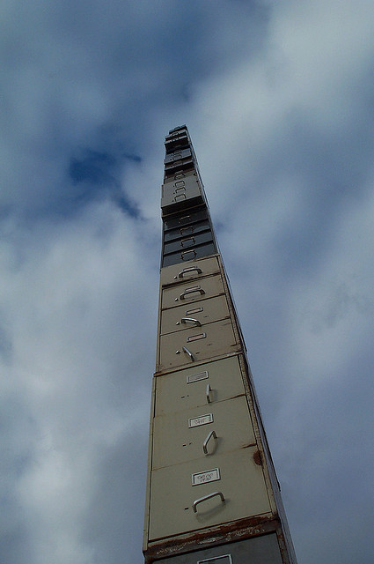
Project File Storage

Slide 6
ProjectWise Expressions
ProjectWise Nomenclature:
Datasource
Project/Folders
Document
Datasource = File Cabinet
Document = packet inside (file drawer)
Projects\Folders = File Drawers

Slide 7
Basic ProjectWise Functions
Logging in/Logging out

Slide 8
ProjectWise Log In
To Request ProjectWise usernames and passwords
Email name and workstation number to Julie Annino
Note: First check to see if PW is already installed
Start->All Programs->Bentley->ProjectWise V8i->ProjectWise Explorer
Digital Project Development Manual (DPDM) for ProjectWise
http://www.ct.gov/dot/lib/dot/documents/aec/digital_project_development.pdf

Slide 9
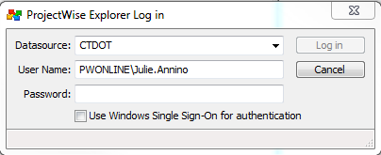
ProjectWise Log In
Easiest way to log in to ProjectWise is to cut and paste your username/password from either the email or a text file on your desktop
Usernames always begin
with “PWONLINE\”

Slide 10
Changing Your Password
Passwords can be changed; to change the passwords go to:
https://extranet.projectwiseonline.com/Shared%20Documents/Change%20Password.aspx
Passwords should be a minimum of seven (7) characters and contain three (3) out of four (4) of the following requirements:
Uppercase characters
Lowercase characters
Base 10 digits (0-9)
Non-alphanumeric characters ( such as !, $, # or %)
Passwords can be changed once every 24 hours
Passwords cannot contain three or more consecutive characters from the account name
New passwords cannot be any of the prior 24 passwords

Slide 11
Basic ProjectWise Functions
Logging in/Logging out
Navigating around the PW Interface

Slide 12
ProjectWise Interface
Projects
Documents
Properties

Slide 13
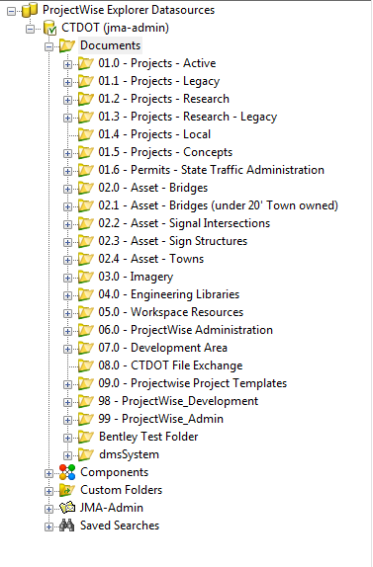
ProjectWise Interface
The ProjectWise datasource contains projects/folders along with their sub-folders and documents
CTDOT is the name of the datasource
CTDOT
Datasource

Slide 14
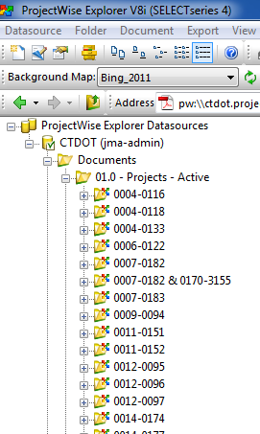
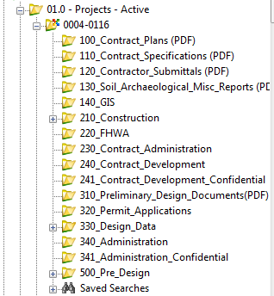
ProjectWise Interface
The “1.0 – Projects – Active” folder contains the active projects
Expand any folder by pressing the “+” next to it
Project
folders

Slide 15
Project Container

Slide 16
ProjectWise Interface
Icons next to the document listing indicates document access and document type

Slide 17
ProjectWise Interface - Document Access
Read/Write (Can create a document)
Read-only
Locked (can still open and read the document)
Checked out (can still open and read the document)
Final status of document (can still open and read)

Slide 18
ProjectWise Access - Types of Documents
Word Document
Estimate
Text document
.pdf document
Spreadsheet
.dgn design file
Zipped document

Slide 19
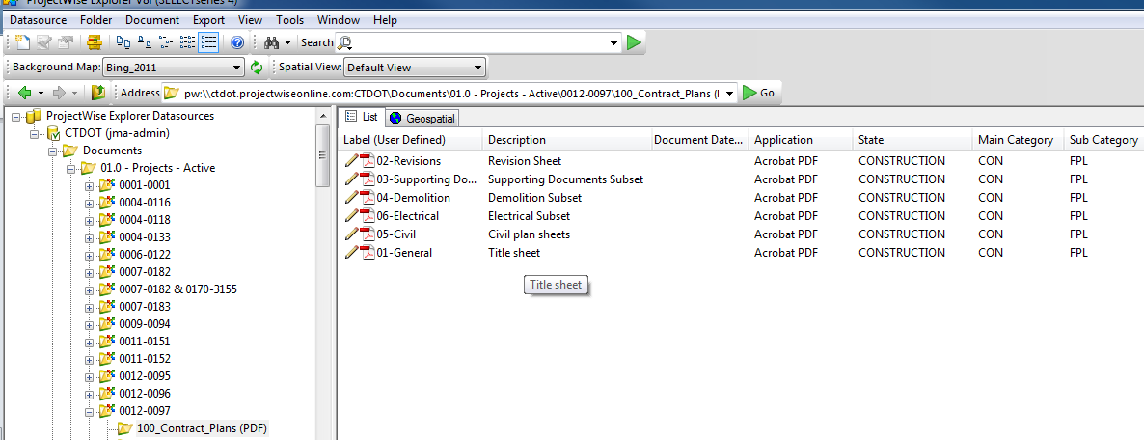
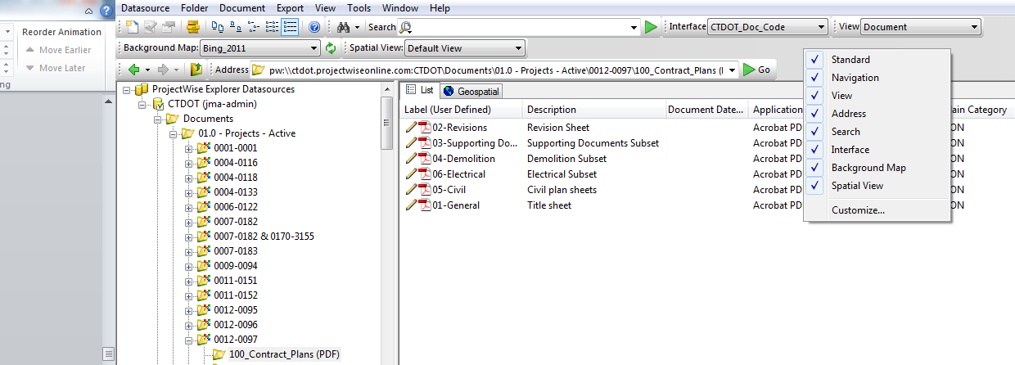
ProjectWise Interface
On the ProjectWise menu bar, make sure that the “Interface” and “View”
pull-down menus appear
If they do not appear, right click anywhere on the menu bar
Select View and Interface
Note: Views are already pre-set for each project; no need to change

Slide 20
ProjectWise Interface
On the ProjectWise menu bar, make sure that the “Interface” and “View”
pull-down menus appear
If they do not appear, right click anywhere on the menu bar
Select View and Interface
Note: Views are already pre-set for each project; no need to change

Slide 21
Basic ProjectWise Functions
Logging in/Logging out
Navigating around the PW Interface
Opening/checking out documents
Closing/checking in documents

Slide 22
Checking out Documents
Checking out documents opens the document
Locks the document and makes it read-only for other ProjectWise users
Checked-out
document

Slide 23
Checking In Documents
To check in a document
Select the document, right click and select Check In
Only the person that checked out the document can check it back in to ProjectWise
PW Admins can also check in the documents

Slide 24
Checking In Documents
If you checked out the document from ProjectWise, and have it open on your computer screen, and then close the document, you will be prompted by ProjectWise to check the document back in.

Slide 25
Checking In Documents
“Check-In” options
Check-In options:
Check In uploads the modified document
Update Server copy – Replaces the server copy but keeps the document checked out
Free – Removes a lock on a document; but changes are not made to the document since it was checked out

Slide 26
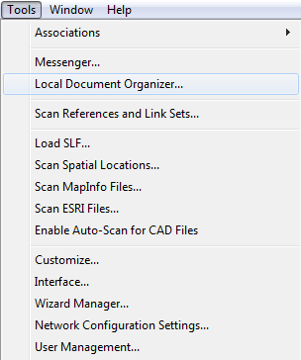
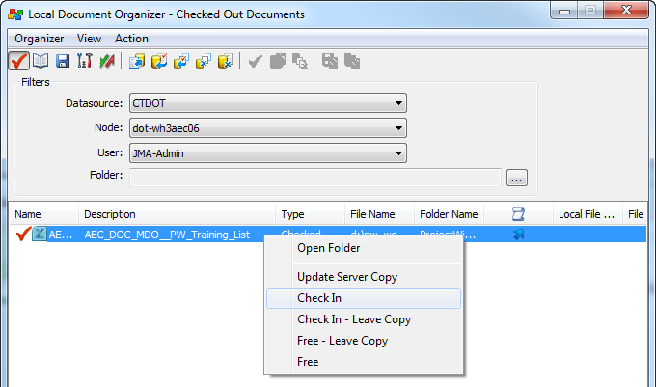
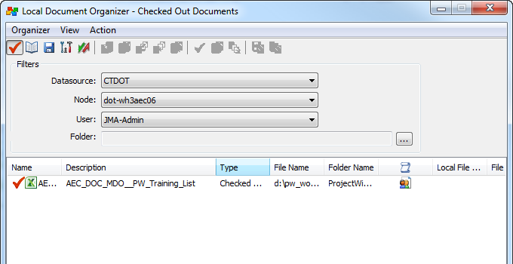
Checking In Documents
Documents can also be checked in by using the Local Document Organizer
Go to Tools->Local Document Organizer
Select the document
to be checked in by
right clicking on the
document. Then select
Check In.

Slide 27
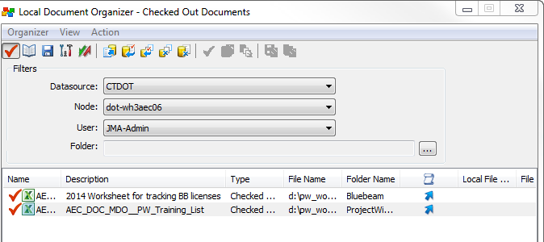
Checking In Documents
Note: If you have more than one file checked out, the local document organizer will appear (pop up) when you try to log out of ProjectWise.
The Local Document Organizer dialog box will list other documents that you have checked out
You can either check the documents back in or ignore the dialog box (by clicking on the “X” in the upper right
By clicking on the
“x” you close
the dialog box

Slide 28
Basic ProjectWise Functions
Logging in/Logging out
Navigating around the PW Interface
Opening/checking out documents
Closing/checking in documents
Exporting documents

Slide 29
Exporting Documents
Documents can be exported out of ProjectWise and saved to your computer
Select the document(s)
to export, right click, and
select export

Slide 30
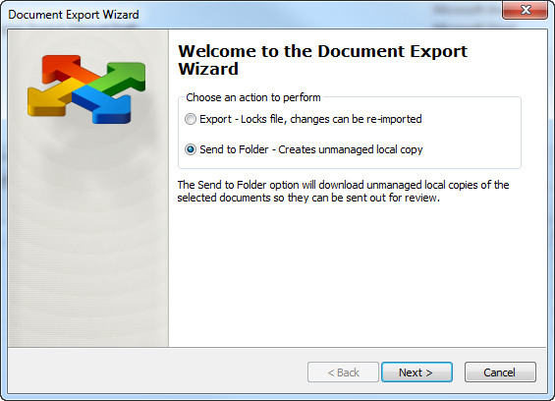
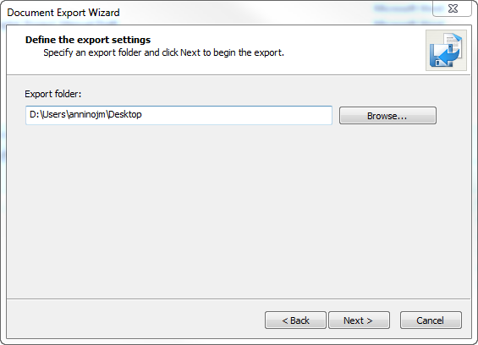
Exporting Documents
Browse to the folder
on your computer that you want to store the exported document
Select “Send to Folder”
Click
Click

Slide 31
ProjectWise Topics
Logging in PW
Navigating around the PW interface
Opening/Checking Out documents
Closing/Checking In documents
Exporting documents
Project Properties vs. Document Attributes

Slide 32
Project Properties
Project Properties provide information about a project
Allow searching and sorting
Categories of project properties:
General information - project number, project title, improvement type)
Location - town(s), route(s), mileage
Assets - signals, signs, bridges
Scheduling information - FDP, DCD, ADV, Construction Initiation, Contract Award, etc.
Cost information – Total project cost, revised contract value, etc.
Design information - percent complete, primary design, project manager, consultant engineer, project engineer
Construction information - percent compete, primary inspector, contractor

Slide 33
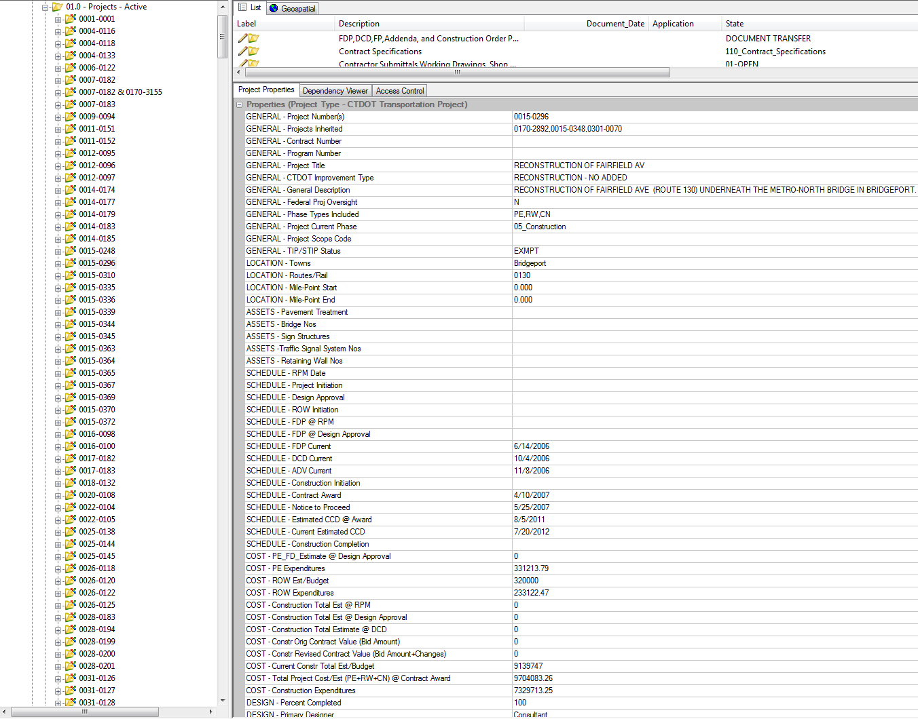
Project Properties
Highlight a project
Project properties for a
Transportation project

Slide 34
Document Attributes
Document attributes describe the document
Attributes are searchable and sortable
Label
Description
Application (Word, Excel, Power Point, etc.)
Main Category
Sub Category
Document Date
Discipline (Facilities, Traffic, Highways, etc.)

Slide 35
Document Attributes

Slide 36
Basic ProjectWise Functions
Logging in/Logging out
Navigating around the PW Interface
Opening/checking out documents
Closing/checking in documents
Exporting documents
Searching and Sorting

Slide 37
Type of Searches
Quick Searches
Advanced Searches
Search Form
Search Builder
Saved Searches
Global Searches
Created by ProjectWise Admins
Personal Searches
Created by users

Slide 38
Quick Search
Allows users to search for documents, folders and projects just by typing the text string in the search box
Select whether to search in the datasource or in current folder/subfolder
By default, quick searches first search in the currently selected folder/project and its subfolders
Options for searching: All Content, Full Text Search, Document and Folder properties

Slide 39
Quick Search
Type in what you want to search in the Search box.
Then click on the green arrow to perform
the search.
Then right click in the search area and select where you want to search.
Note: Wildcards, such as * or %, can be used when you do not know the exact string of
characters to search.

Slide 40
Type of Searches
Quick Searches
Advanced Searches
Search form
Search Builder

Slide 41
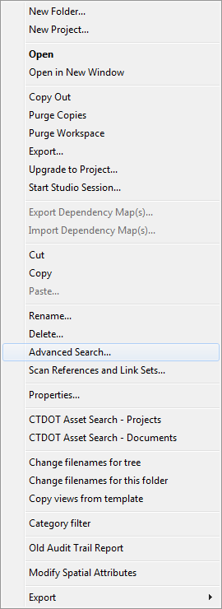
Advanced Search
To start the advanced search
Highlight the folder or project to start the search.
Then right click and select Advanced Search

Slide 42
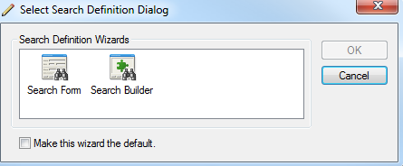
Search By Form
The search form allows users to search on
document properties, document attributes
and file properties.

Slide 43
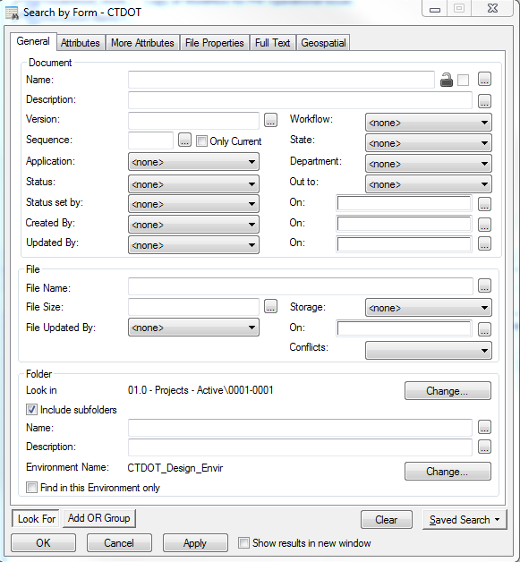
Search By Form
General – Document info, file info, folder info
Attributes – Information about the document
More Attributes – Additional information about the document
File Properties – Information about the file itself
Full Text – search for specific text
Geospatial – In development; location-based

Slide 44
Search By Form
General
Document information
File information
Folder information
Can add multiple criterion by using “Add OR Group”

Slide 45
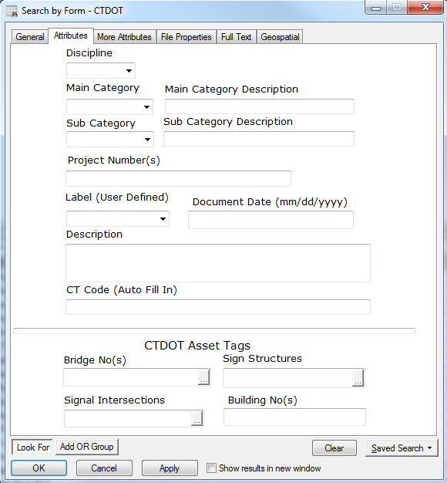
Search By Form
Attributes – Information about the document
Discipline
Main Category
Sub-Category
Project Number(s)
Label
Document date
Description
Asset Tags
Bridge No(s)
Sign Structures
Signal Intersections

Slide 46
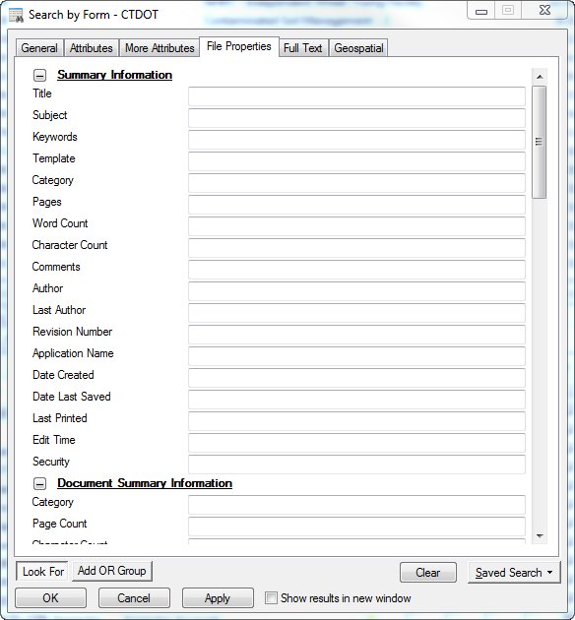
Search By Form
File Properties – Information about the File
Title
Subject
Keywords
Author
Date Created
Date last saved
Sub-Category
Project Number(s)
Label
Document date
Description
Asset Tags
Bridge No(s)
Sign Structures
Signal Intersections

Slide 47
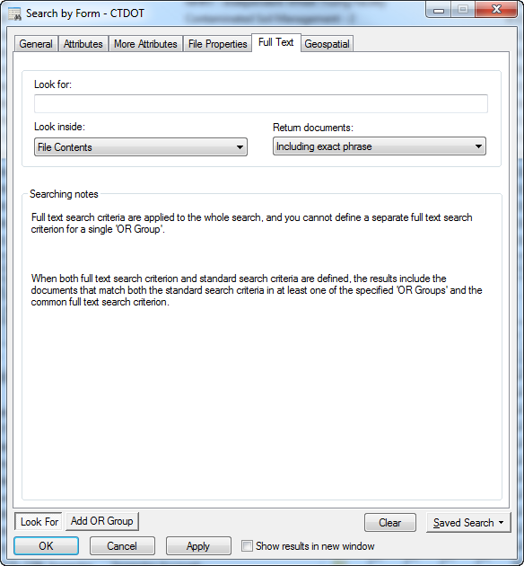
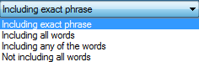
Search By Form
Full Text – Word(s) or phrase. Options:
Look Inside:
File contents
ProjectWise attributes
Return documents:
Exact phrase
Including all the words
Including any of the words
Not including any of the words

Slide 48
Advanced Search
Two types of advanced searches in ProjectWise:
Search by Form
Search Builder
Highlight the folder or project to start the search.
Then right click and select Advanced Search

Slide 49
Search Builder
The Search Builder has the same functionality as the Search Form, but with more flexibility on project information and project types.

Slide 50
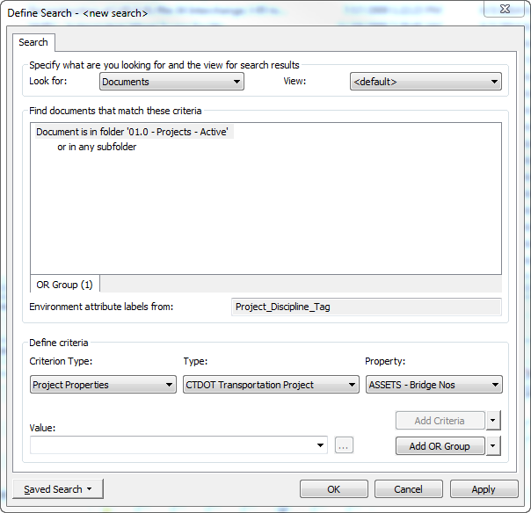
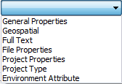
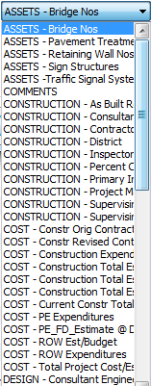
Search Builder
Look For: Documents or Projects/Folders
Criterion Type: Project Properties, General Properties, Geospatial, etc.
Type:
Transportation Project – Active & Legacy Projects
Bridge Inspection – Bridges (includes Rail and Transit bridges)
Intersection Number – Traffic Signals
OSTA projects
Research Projects
Under 20 Bridges
Sign Supports
Property (town, route number, project
manager, FDP date, etc.)

Slide 51
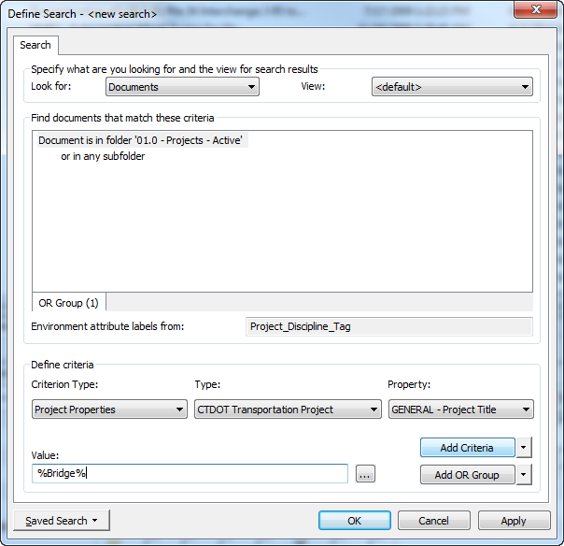
Search Builder
Type in a Value. (Note: You can use wild cards such as % and *.
Once you have selected the property and typed in a value to search, select Add Criteria.
You can add another set of criteria with the “Add OR Group” button, and repeat Steps 4 through 6.
Select Apply
OK

Slide 52
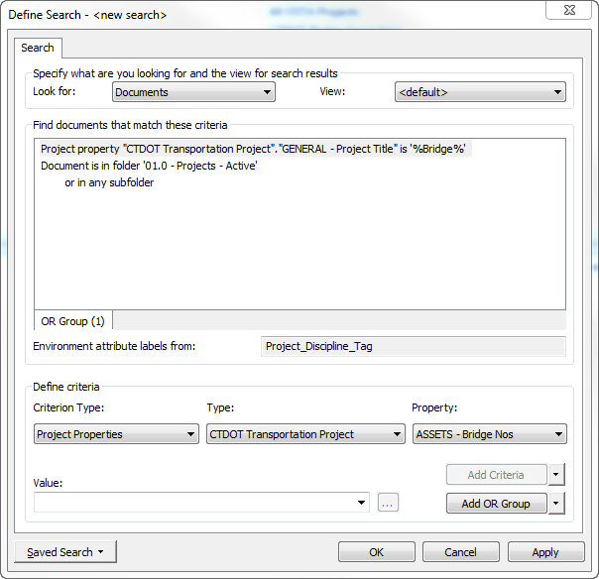
Search Builder
Notice that the search criteria appears
Either Add another set of criteria
Or select Apply to start the search

Slide 53
Search Builder – Notes
Types of Projects:
CTDOT Transportation Projects
Active and Legacy
CTDOT Bridge Inspection
Bridges (State-owned, Rail, Transit)
Under 20’ (Town Owned bridges)
CTDOT Intersection Number
Signals
CTDOT Research Projects
CTDOT – OSTA (State Traffic Commission)
CTDOT Sign Structure
Sign Supports

Slide 54
Search Builder – Notes
Types of information (Project Property):
Transportation Projects
General, Location, Assets, Schedule, Cost, Design, Construction
Bridge Inspection
Identification, Type of bridge (structure, design, material), Condition of the bridge, Evaluation
Intersection Number
Identification, Type of signal, Operation
Research Projects
General, Contact, and Date
OSTA (State Traffic Commission)
Various information ( OSTA Number, Development name, town, Certificate number
Sign Structure
Identification, Type of sign structure, Condition, Evaluation

Slide 55
Type of Searches
Quick Searches
Advanced Searches
Search Form
Search Builder
Saved Searches
Global Searches
Personal Searches

Slide 56
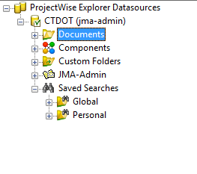
Saved Searches
Saved Searches
Global Searches
Created by ProjectWise Admins
Available to all ProjectWise users
Personal Searches
Created by users
Only available to user who created the search

Slide 57
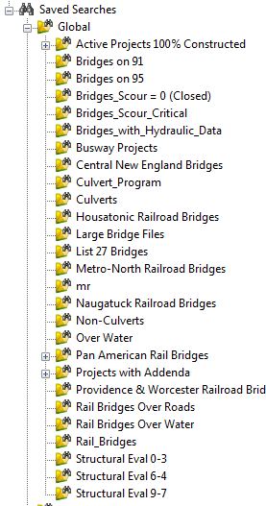
Saved Searches
Global Searches
Expand Global and the Global searches will appear

Slide 58
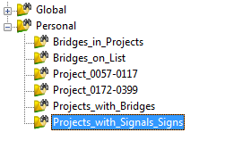
Saved Searches
Personal Search
Saved personal searches are created in the Search Form or Search Builder
Saved personal Searches appear by expanding Personal under Saved Searches

Slide 59
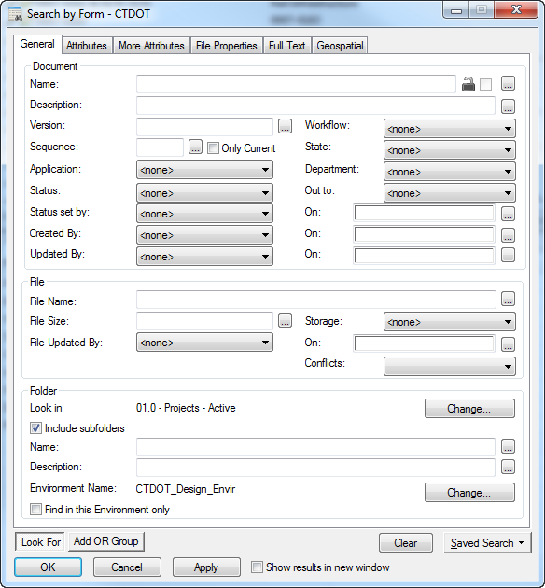
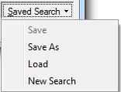
Saved Searches
Example shows the Search Form
Select Saved Search at the bottom right of the form
Select Save As

Slide 60
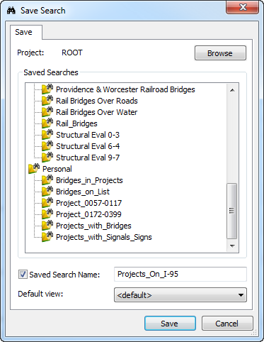
Saved Searches
Select Personal
Type in a name for the saved search
Click Save

Slide 61
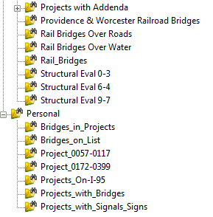
Saved Searches
The saved search should now appear
in your personal searches
Note: Documents folders and/or projects that match your search criteria, but to which you do not have access, will not appear in the search results list.

Slide 62
Basic ProjectWise Functions
Logging in/Logging out
Navigating around the PW Interface
Opening/checking out documents
Closing/checking in documents
Exporting documents
Searching and Sorting

Slide 63
Sorting
Sorting helps to organize similar documents together in the document list.
Documents can be sorted by clicking on the column header in the document list

Slide 64
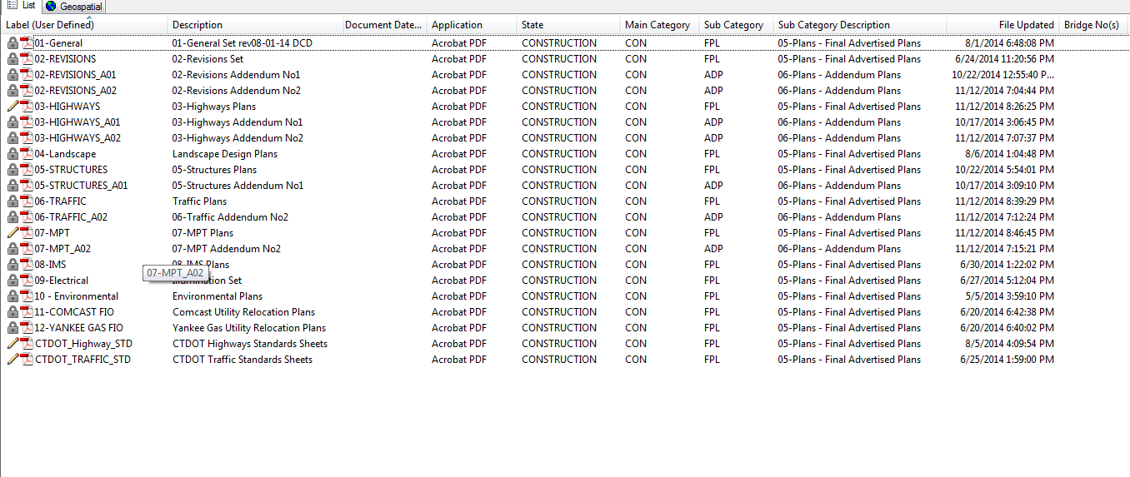
Sorting
Document list before sorting:
Click on a column heading

Slide 65
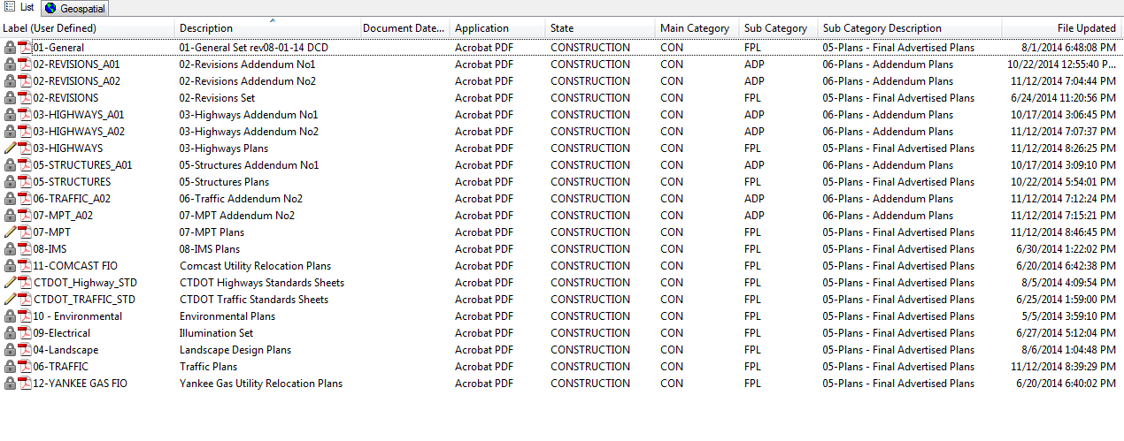
Sorting
Document list after sorting:

Slide 66
ProjectWise Topics
Logging in PW
Navigating around the PW interface
Opening/Checking Out documents
Closing/Checking In documents
Exporting documents
Project Properties vs. Document Attributes
Searching and Sorting
Creating email links to PW Documents

Slide 67
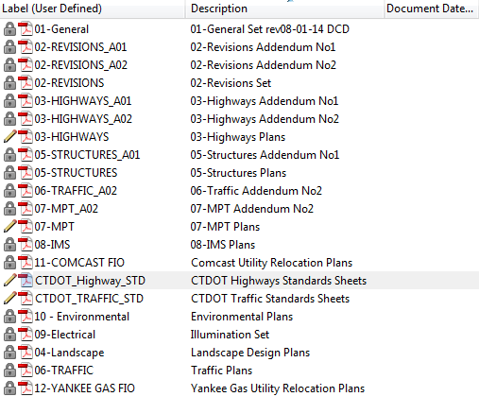
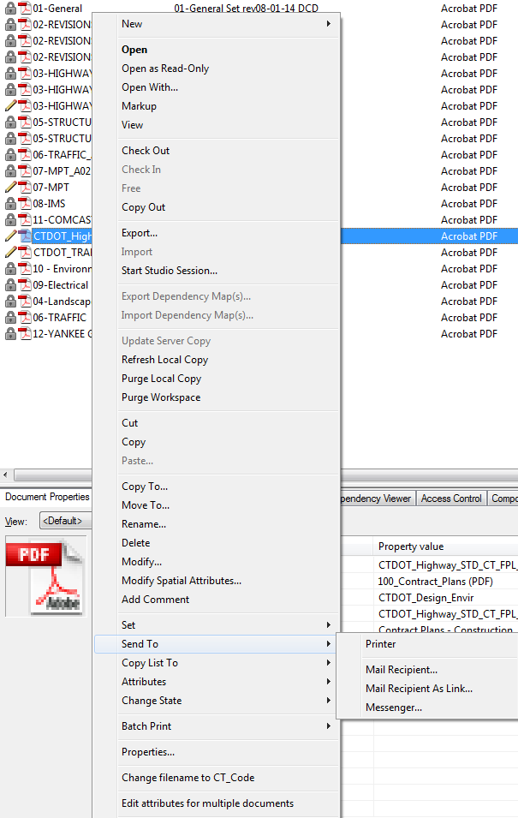
ProjectWise Email Links
Every document has a link associated with it
Can be forwarded to other ProjectWise users
Select the document.
Then select Mail Recipient As Link
Right click and select Send To.

Slide 68
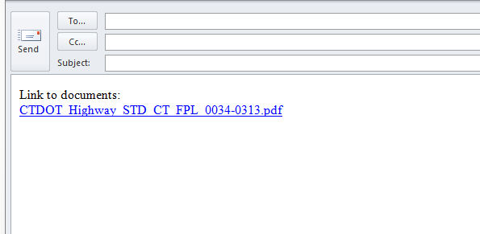
ProjectWise Email Links
Link then appears in an email, ready to be sent.

Slide 69
Other Basic Functions
Audit Trail
Project/Folder/Document Security

Slide 70
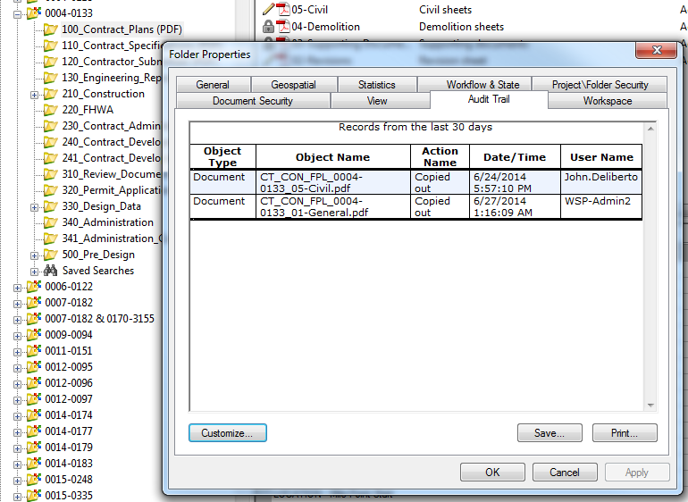
Audit Trail
Records document and folder activity
Tracks all actions when a document was created, edited or deleted
Audit information is reset after a certain time period

Slide 71
ProjectWise Security
Access to projects, folders and documents to given to group
Each Engineering discipline is a group
Each Consulting firm is a group
Each Support unit/agency is a group
FHA, FTA, FHWA, FRA, Metro North, etc.
Muncipalities
Utility Companies (UI, Eversource, etc.)
If a group does not have access to a project, they will not see the project listed in ProjectWise

Slide 72
Contact Information
Julie Annino (x2730)
Matt Calkins ( x2988)
Henok Abdissa (x2986)
Bruce Bourgoin (x2760)

Slide 73
Questions?

