Slide 1


INTRODUCTION to TEAM MODULE 5
CONNECTICUT STATE DEPARTMENT OF EDUCATION
The Connecticut Code of Professional Responsibility for Educators
Regulations of Connecticut State Agencies
Section 10-145d-400a

Slide 2

As public service employees, educators hold a special position of trust.

Slide 3
Educators exercise powers that have a significant impact on the lives of children and young people.

Slide 4
Consequently, there is a community
expectation that these powers will be properly and prudently used.

Slide 5
The Connecticut Code of Professional Responsibility for Educators is a set of principles which the education profession expects its members to honor and follow.

Slide 6
Professional conduct
Key words underpinning the code
integrity
committed
respect
trust
values
responsibility
fairness
confidentiality
high standards
professionalism
accountability
positive role models
propriety
responsiveness

Slide 7

Educators are expected to practice the profession according to the highest possible degree of ethical conduct and standards.

Slide 8

A code helps us to understand our responsibilities, prioritize our obligations, and find wise resolutions to the ethical dilemmas we face.

Slide 9
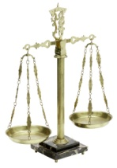


Ethical training has become an important part of the business and professional world.
Attorneys
Physicians
Accountants
Clergy
Therapists

Slide 10

According to Charlotte Danielson, teachers make over 3,000 decisions per day.

Slide 11

Are teachers prepared to always make the right decision?

Slide 12
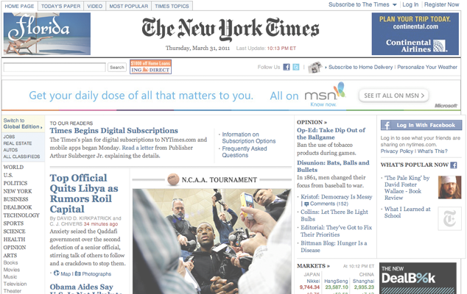
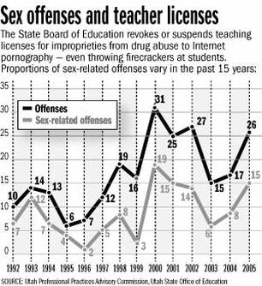
Unfortunately, educator misconduct occurs and is a serious concern for communities, schools, districts and states across the country.
Charges of teacher misconduct are on rise
Published: Saturday, April 22, 2006 12:00 a.m. MDT
Copyright 2006 Deseret Morning News
Teacher Web sites triggering questions
Some are posting personal data that students can access
Published: Saturday, June 10, 2006 12:00 a.m. MDT By Laura Hancock

Slide 13

Not only does it harm our students,
educator misconduct disgraces the community and denigrates the profession.

Slide 14
A code supports us in doing what is right.
It provides support for behaving ethically
especially
when there is pressure or temptation
to do what is easiest
or
what will make people like us.

Slide 15

Teaching is complex.
Teachers continually shape and reshape their actions to respond to the individual needs of their students.

Slide 16
Developing a positive relationship with students is essential to effective teaching.

Slide 17
When you develop positive relationships with your students, they are more likely to engage academically and achieve more.

Slide 18
Teachers who foster positive relationships with their students create classroom environments more conducive to learning and meet students’ developmental, emotional, and academic needs.

Slide 19
Marzano (2003) states that students will resist rules and procedures along with the consequent disciplinary actions if the foundation of a good relationship is lacking.

Slide 20

Students are more likely to be emotionally and intellectually invested in classes where they have positive relationships with their teachers.

Slide 21

How does a teacher develop positive relationships with students and uphold the
Code of Professional Responsibility for Educators?
Notes:
Schools are
responsible for providing students with a safe environment
in which to develop academically, emotionally and
behaviorally.
make
responsible decisions, establish
positive relationships and
effectively handle challenging
situations.
head off potential conflict

Slide 22

Students need to feel a sense of comfort and safety from physical and emotional abuse and from criticism in their classrooms.

Slide 23
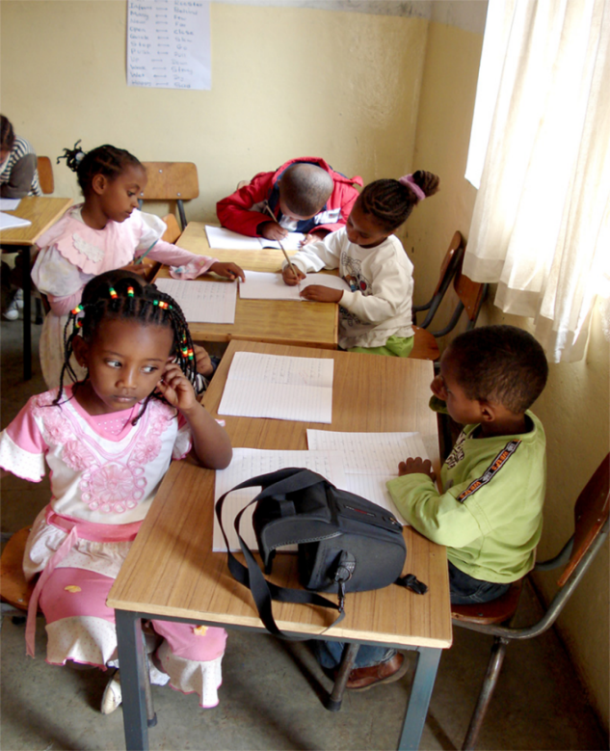
Schools are responsible for providing students with a safe environment
in which to develop academically, emotionally and behaviorally.

Slide 24

Educators develop positive relationships by
making responsible decisions,
effectively handling challenging situations and
heading off potential conflicts.

Slide 25

Students are very sensitive to a teacher’s attitude towards the school
and the class in general;
teachers must be certain that they are modeling positive behaviors for the class.

Slide 26

Learning about students’ cultural backgrounds
help teachers relate more effectively with their students.

Slide 27

Teachers are expected to use good judgment at all times.

Slide 28

The Code applies at all times.
This includes times when a teacher is not at school and not performing work duties.

Slide 29
Even though an individual’s intent may be purely innocent,
engaging in certain activities with students or in the presence of students
can subject a teacher to possible perceptions of impropriety.

Slide 30
The appearance of unethical behavior can be just as damaging to public confidence in the profession as unethical conduct itself.

Slide 31

What are some examples of behavior that may raise a reasonable suspicion?
Generally, meeting with a student alone, behind closed doors, regardless of gender.
Giving students gifts, rewards or incentives that are not school related.
Touching or having physical contact with students that is unwanted and/or inappropriate.

Slide 32

Communicating with students, by phone/cell phone, email, Internet, texting or in person at any time for purposes that are not specifically related to school.

Slide 33
Providing students with your personal home/cell phone number, personal Email address, home address or other personal contact information, except for specific school-related purposes.

Slide 34
Making statements or comments, either directly or in the presence of students, which are not age-appropriate, professional or which may be considered sexual in nature, harassing or demeaning.

Slide 35
Engaging in behaviors that are immoral, illegal, unethical, unprofessional or exploitive.
Transporting students in your personal vehicle without proper permission from administrators and parents/family.

Slide 36
Taking or accompanying students to any event that is not school related.
Meeting with or being in the company of students at non-school related events.

Slide 37

There are boundaries that cannot be crossed.

Slide 38

When allegations of inappropriate conduct or behavior are made, the District is obligated to investigate the allegations, and
if warranted, take appropriate administrative, legal and/or disciplinary action.

Slide 39

What are the consequences of teacher misconduct?
Sometimes a violation of the Code is solely an employment matter and most appropriately handled by the employer;
other times conduct may warrant more severe and significant action.

Slide 40
Consequences of Teacher Misconduct
What are the consequences of teacher misconduct?
Administration imposed discipline
Suspension of employment
Dismissal from employment
Criminal proceedings
Certification denial or revocation
Civil litigation- teachers can be sued as individuals

Slide 41
Benefits of Facilitated Conversations
Following this introduction to Module 5, you and your colleagues will participate in a facilitated conversation to examine several case scenarios in which you will have the opportunity to
share multiple perspectives,
learn from one another,
examine consequences of actions
examine strategies to assure more positive outcomes and
foster professional growth.

Slide 42

The focus of Module 5 is to raise a level of awareness about the Code of Professional Responsibility for Educators
and to discuss your professional obligations and the potential consequences of misconduct.

Slide 43
Cases pose questions that draw on the guiding principles or standards of the teaching profession.
Entering into discussions regarding real life ethical situations provides teachers with the opportunity to consider and to reflect on their own professional judgments and actions.

Slide 44

Be a Professional!
Deciding on the right course of action will often involve weighing competing priorities and responsibilities.

Slide 45
Be a Professional!
However, if a teacher is unsure of what to do
discuss the matter in confidence with an appropriate individual such as a supervisor
seek further advice from the school nurse, social worker, guidance counselor, etc. depending on the situation

Slide 46
Before proceeding, teachers should ask themselves these questions:
Are my actions within the spirit and letter of the law?
Are my actions consistent with the district’s goals, values and principles and the Code of Professional Responsibility for Educators?

Slide 47
Could I adequately defend my action to my supervisor, the parents/families and the community if the situation was made public?
Is this the right thing for me to do?

Slide 48
What will the outcome of my actions be for
    students?
    the school, the district and the public interest?
    parents?
    my colleagues?
    the teaching profession?
    others?
    me?

Slide 49

“A teacher affects eternity; he can never tell where his influence stops.” -Henry Brooks Adams

