Slide 1
Education Financial System (EFS)
Connecticut State Department of Education
Introductory Training
Notes:
Welcome to our introductory training for the Education Financial System (the EFS). The EFS is used annually by school districts to report financial information to the Connecticut State Department of Education (the CSDE). This session provides an overview of the system; more detailed information is available in the EFS User Guide and through the help screens found in the system.

Slide 2
EFS Training Agenda
System flowchart
Log In to the EFS
Review upload template
Prepare upload file
Allocation
Upload data
Data validation and errors
Process data
Expenditure detail and summary
Review EFS Schedules
Review EFS Reports
Review next steps to practice using EFS
EFS reporting tips
Notes:
In today’s training, we will introduce the system flowchart, explain how to log in to the system, go over the upload file template, and show how to prepare a file to upload your district’s expenditures. We will explain how to allocate certain expenditures within the system, and how to upload your expenditure file. We will discuss the data validation process, how to process the uploaded data file, and the expenditure detail and summary screens. We’ll show the EFS Schedules and Reports. Then finally we’ll review the next steps for you to practice using EFS and provide some reporting tips.

Slide 3
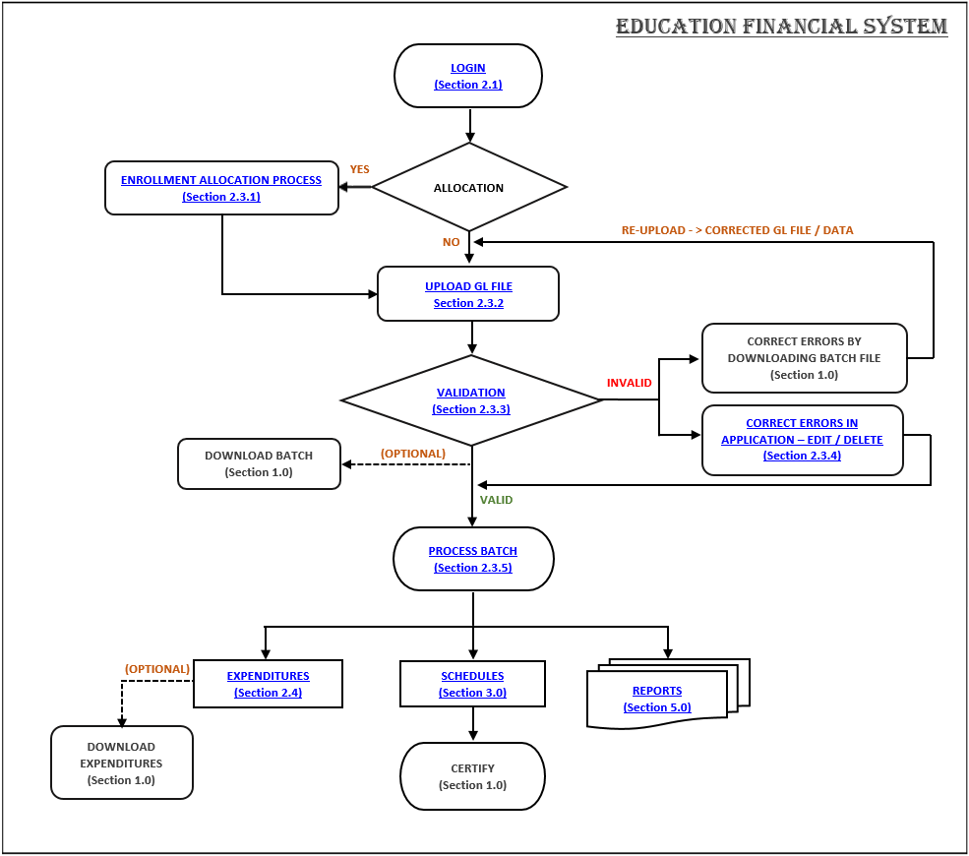
Notes:
The flowchart, as well as everything we will be highlighting today, is included in the EFS User Guide – we’ll provide the link for that at the end of this session. The basic process shown on the flowchart is to log-in, determine whether certain expenditures will need to be allocated to school locations, and upload an expenditure file from your general ledger. Then correct any errors found during the validation step, and process your batch. Finally, review the EFS schedules and reports, and certify the file. That is the general outline, now we’ll discuss the whole process in more detail.

Slide 4
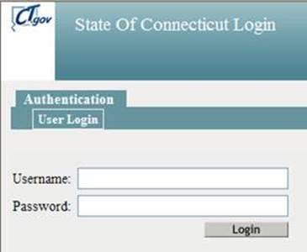
Login Slide 1
Using Internet Explorer or Google Chrome, go to the EFS data entry website. Use https://stg-csde.ct.gov for training and practice, or https://csde.ct.gov for actual data reporting. The system displays the State of Connecticut Login screen.
Notes:
You will need a user log-in and password; if you don’t have one, ask your districts’ security manager for the CSDE Directory Manager System to set you up with the “EFS Writer” role. Navigate to the EFS user website, and enter the log-in information. Note we have a website dedicated to training as well as the actual data reporting website, both addresses are provided on the slide.

Slide 5
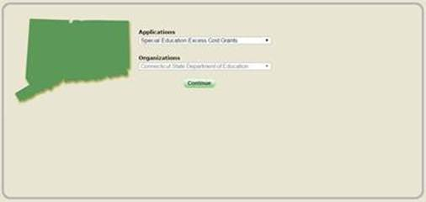
Login Slide 2
If you only have access to EFS, the system displays the EFS Home page.
If you have access to more than one application, the system displays the State Department of Education Home Page.
  Select Education Financial System from the Application drop-down menu and click Continue. The system displays the EFS Home page.
Notes:
If you have other state reporting roles assigned through the Directory Manager system, you will see a drop down menu, where you can select “EFS”, and click the Continue button. This will bring you to the EFS home page. If you have no reporting roles other than EFS, you will be pointed directly to the EFS home page when you log in.

Slide 6
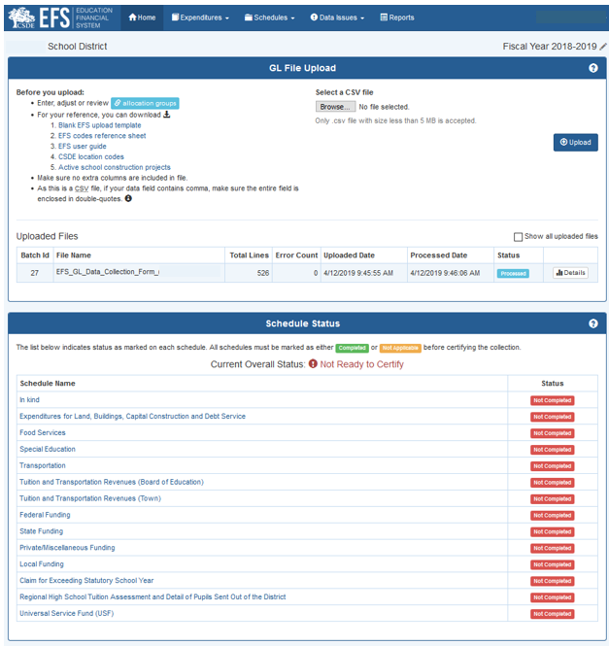
EFS Home Page
From the Home Page, you can:
Navigate to Allocation page.
Select and upload data file.
View status of uploaded files.
View details of uploaded files.
View status of schedules.
Notes:
From the EFS home page, you can do several things: navigate to the allocation page, select and upload an expenditure data file, view the status of uploaded files, view the details of uploaded files, and view the status, and navigate to, all schedules.

Slide 7
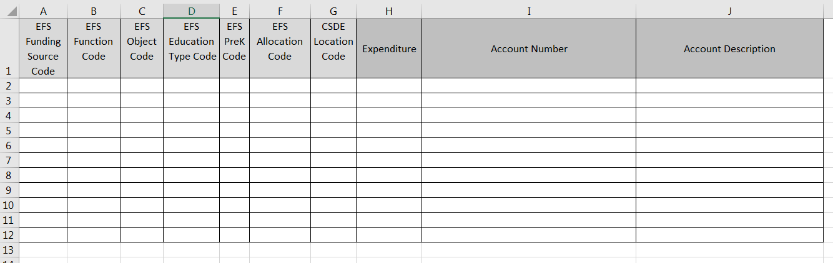
EFS Template
Notes:
The EFS template is an excel file that provides the layout that your expenditure upload file will need to have. Each of your expenditure records will be a row on this file. You will identify the attributes of each record using the appropriate EFS codes in columns A through G: the funding source, function, education type, an optional designation of Prek expenditures, an allocation code if needed, and location code (the particular school or your central office to which the expenditure applies). Columns H through J are from your general ledger; the expenditure amount, account number, and account name.

Slide 8
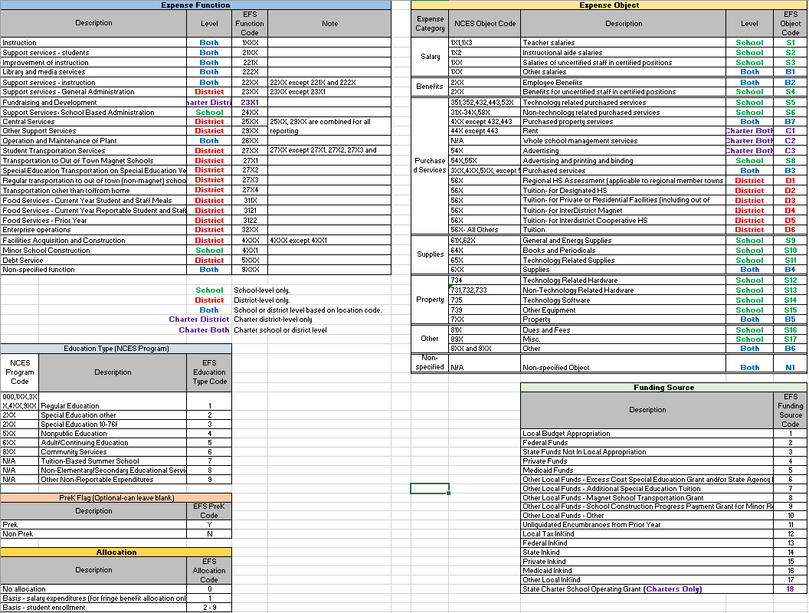
EFS Codes
Notes:
This is the table that defines the EFS codes. The funding source code identifies if the expenditure was funded by local, state, federal, or other funds. The function code identifies the activity for which the expenditure is used, for example instruction, administration, or transportation, and is based on the coding in the federal handbook “Financial Accounting for Local and State School Systems 2014”. The object code identifies the service or commodity obtained by the expenditure. The applicable codes from the federal handbook (the NCES Object Codes) are shown on the table for reference, but you will need to use the applicable EFS object code on your file. The education type codes are based on the program codes shown in the federal handbook (the NCES Program Codes), but again you will use the EFS education type code on your file. Reporting the PreK code is optional, we don’t currently need this for any reporting purposes. If you don’t identify expenditures as Prek or not you may leave this field blank on your file. And finally, the allocation codes are used to identify either employee benefit records to be allocated by function and school location, or other expenditure records that need to be allocated to school locations.

Slide 9
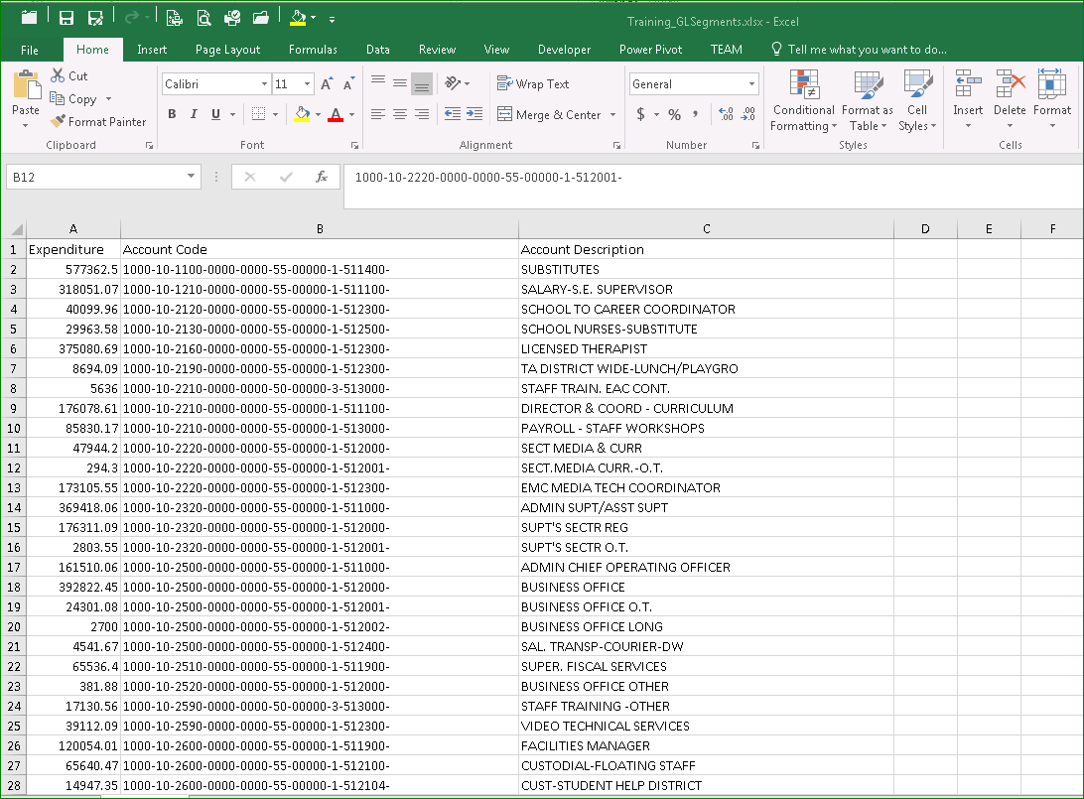
Upload File Prep – G/L Download
From your district’s accounting program, download general ledger expenditures. Need Account Code, Account Description, and Expenditure amount.
Notes:
To prepare your upload file, first you will need to download expenditure account totals from your district’s general ledger into an excel file. The fields we need are the expenditure amount, and your account code and description. For this demonstration we’re showing just a few records.

Slide 10
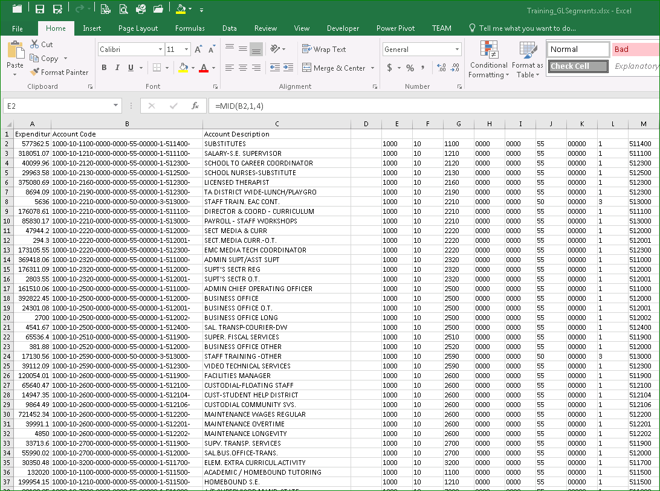
Upload File Prep – Segment Accounts (optional)
To aid in sorting to assign EFS codes, it may be helpful to segment Account Codes. One way to do this is by using the “MID” excel function, see Instructions Appendix A.
Notes:
It may be helpful for you to segment your account codes by function, object and other attributes built into your account numbers to aid in sorting the records so EFS codes can be assigned to a group of records. There are several ways to segment fields in excel; we show one method using the “MID” function in Appendix A of the EFS User Guide.
Copy and paste as values all records from your excel file on a copy of the EFS template starting in Column H. You will then need to assign the appropriate EFS codes to each expenditure record in Columns A through G. It is fine to use column K and greater to hold the segmented account information until you have completed assigning EFS codes.

Slide 11
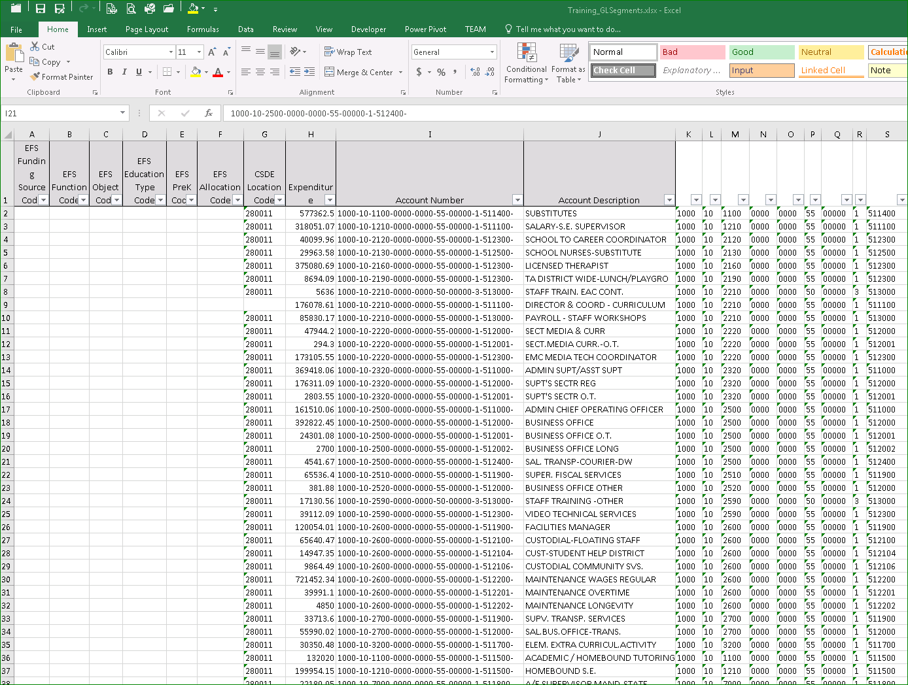
Upload File Prep – Assign EFS Codes
Copy and paste values from g/l download and any columns with account segments, onto a copy of the EFS template beginning in column H. Assign EFS codes in columns A-G. For example, code “02” in column L is my school code that corresponds to CSDE Location Code 280211.
Notes:
For example, if you sort your expenditures based on your location codes, you may be able to assign each appropriate EFS location code to all of the corresponding records at once.
This screen shows the file with all EFS codes assigned.
Also note that there are a number of combinations of EFS codes that are not valid. For example, you can’t report a teacher salary object using a transportation function. These are specified in the user guide.

Slide 12
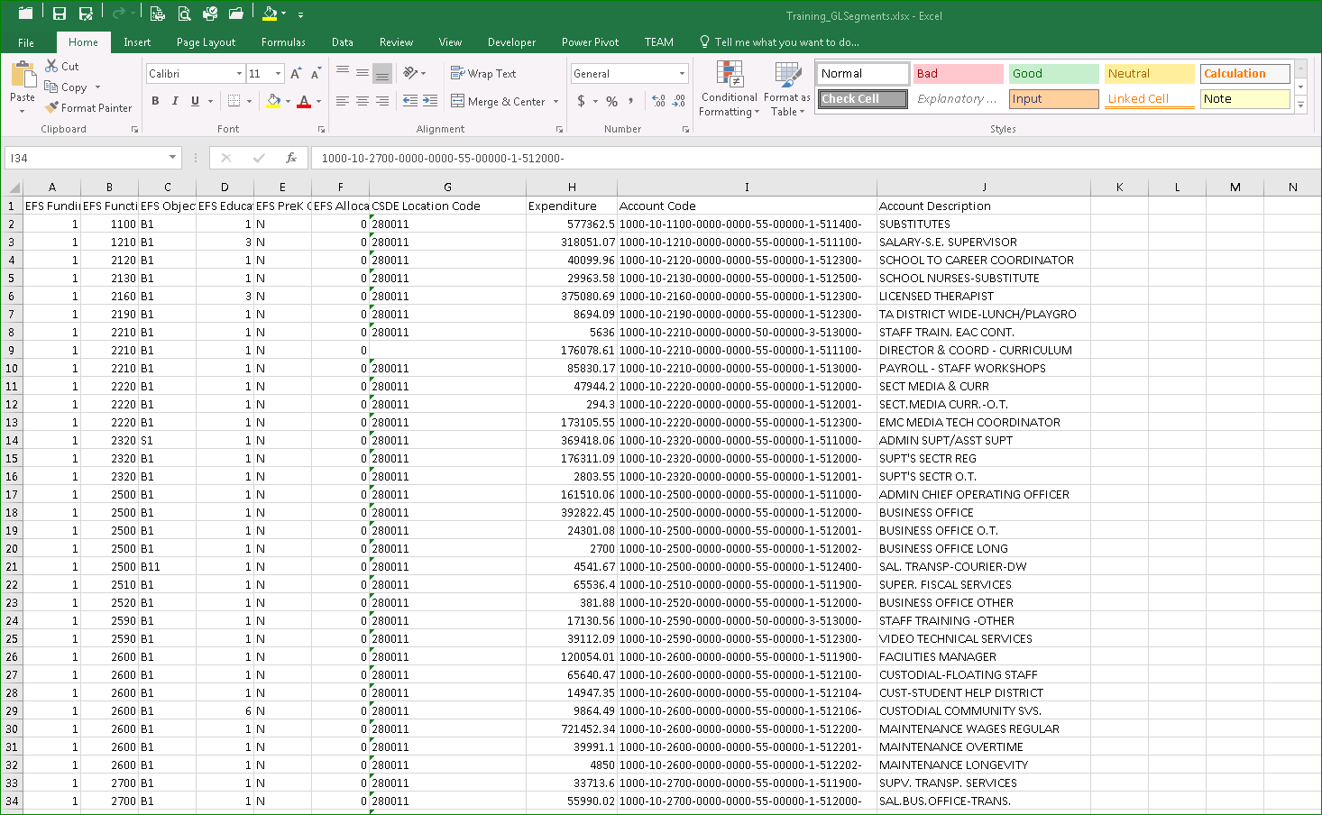
Upload File Prep – Delete columns after J
Notes:
Once EFS codes have been assigned to all records, delete all columns K and greater from the upload file (but you may first want to save a copy of the whole spreadsheet for your files).

Slide 13
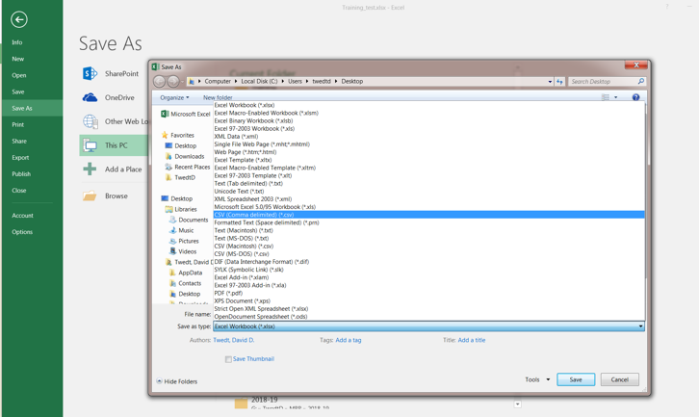
Upload File Prep – Save as .csv
Notes:
Then save the file on your computer as type Comma Delimited, .csv.

Slide 14
Allocation Slide 1
Allocation Code 1
Basis - salary expenditures (for fringe benefit allocation only)
This allocation applies only to employee fringe benefits, EFS Object Code “B2”. The expenditure amount for a record identified with EFS Allocation Code “1” will be allocated to all EFS expenditure segments based on salary expenditures.
Allocation Codes 2-9
Basis – school enrollment
This allocation allows minor school-level expenditures not identified to individual schools on the district’s accounting records to be allocated to schools based on student enrollment.
Notes:
EFS includes two ways to allocate expenditures. The first is for employee fringe benefits, which need to be assigned to the same function, education type, and location code as their corresponding salaries. You can either do this by assigning them specifically in your upload file, or you can use the allocation feature built into EFS to assign the benefits based on salary expenditures. To use the EFS allocation feature, you first need to create separate benefit expenditure records for each funding source and education type, then use EFS Object Code B2 and EFS Allocation Code 1 on each record.
The other allocation available in EFS is used to assign minor school-level expenditures not identified to individual schools on the district’s accounting records to schools based on student enrollment. This method requires you to define the allocation codes 2-9 used on your upload file to the schools to which they apply.

Slide 15
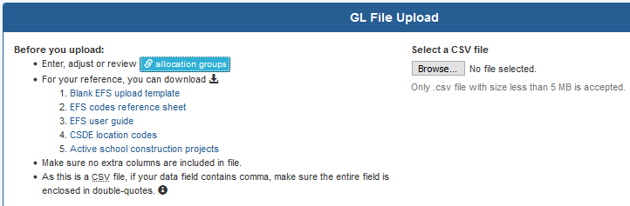
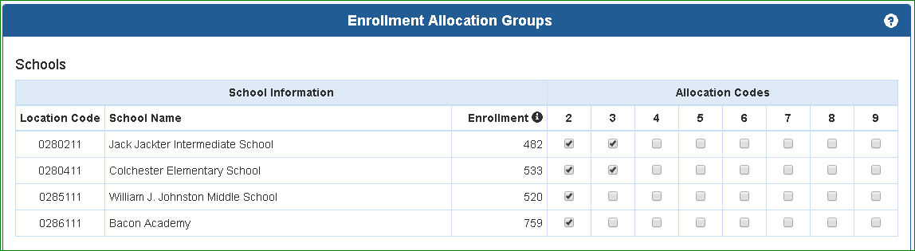
Allocation Slide 2
From Home screen, click “allocation groups”.
Check the boxes for the schools applicable to each allocation code used in the upload file.
Notes:
To do that, from the home screen select “allocation groups”. This opens the allocation table which lists all of the schools and programs operated by your district. Use the checkboxes to identify the allocation codes applicable to particular schools and programs. For example the screen shown will allocate any expenditure using EFS Allocation Code 2 to all four schools checked, and those using code 3 to just the two elementary schools.

Slide 16
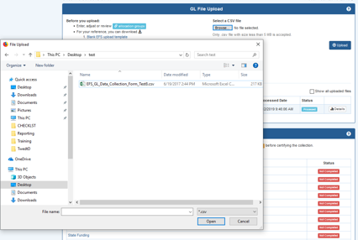
Upload Slide 1
From Home Screen, under “Select a CSV file” > click “Browse”
Locate where the .csv file was saved > select the file > click “Open”
Notes:
Once your upload file and allocation table are complete, you are ready to upload the file to the system. Navigate to the Home page, then select “Browse”. Find the upload .csv file stored on your computer, then click “Open”.

Slide 17
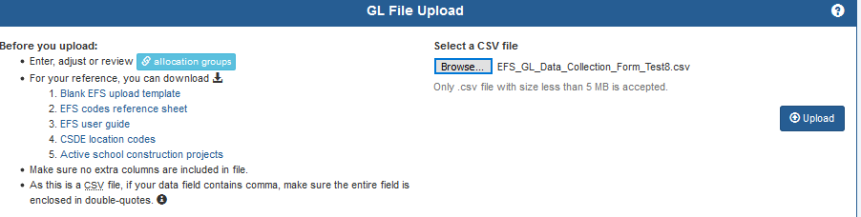
Upload Slide 2
Click “Upload” button
Notes:
Now your upload file name will appear next to the “Browse” button. Click on the “Upload” button.

Slide 18
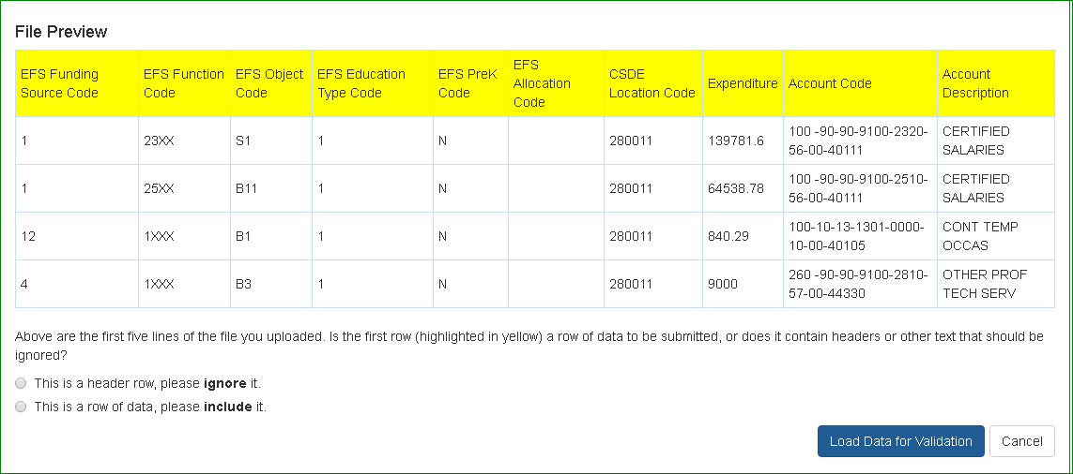
Upload Slide 3
If your csv file contains a header, select the first option to ignore first row.
If the csv file has no header, select second option, first row is a data row.
Click “Load data for validation”
Notes:
If your upload file contains a header row, which it probably does unless you deleted it, select the first option “This is not a row of data, please ignore it”, then click “Load Data for Validation”.

Slide 19
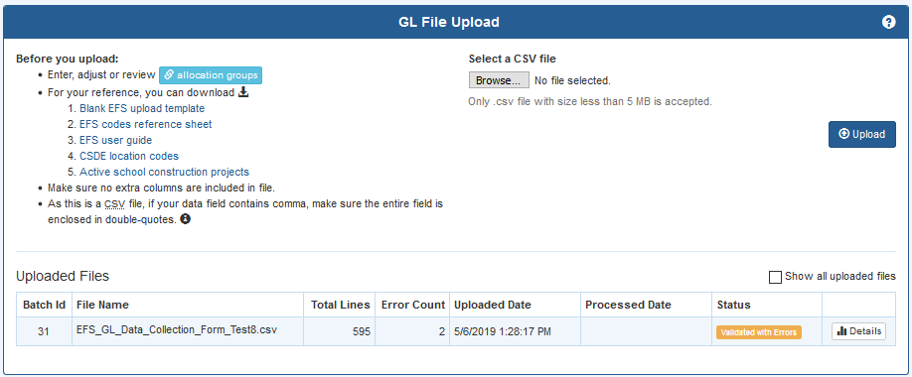
Upload Slide 4
Status is “Validated with Errors”. Click on “Details” button.
Notes:
Initial uploads may contain errors in EFS coding, or in the way that EFS codes were combined. If that is the case, the Status indicated in the file upload table will be “Validated with Errors”. To see the errors, click the “Details” button.

Slide 20
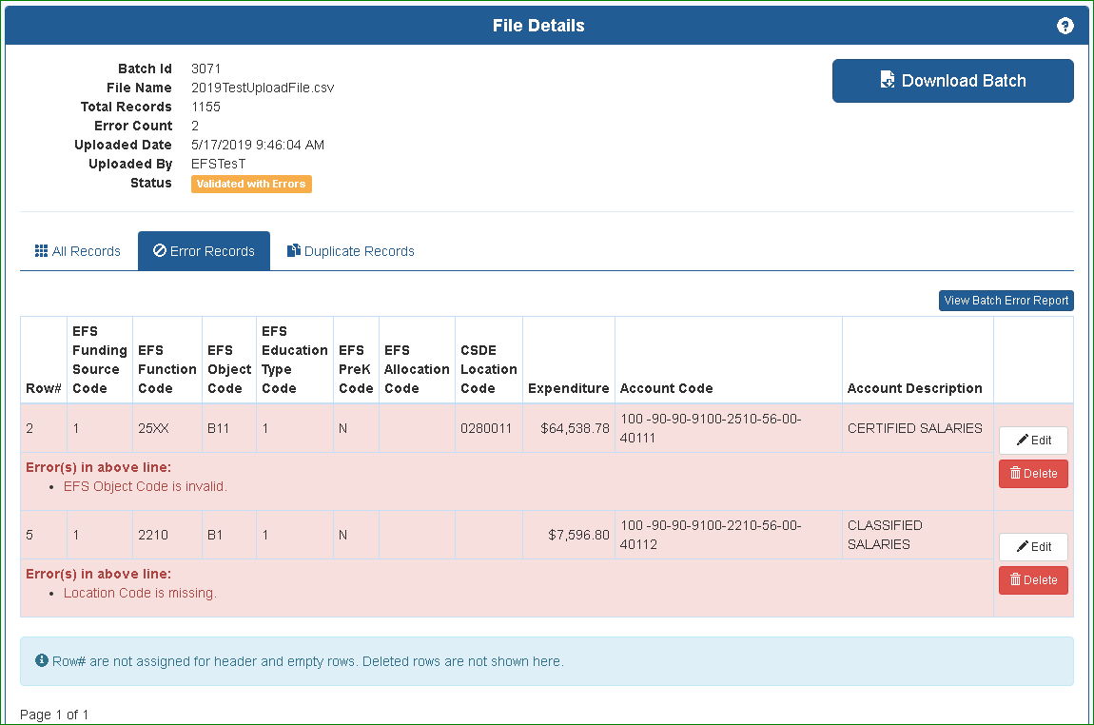
Data Validation and Errors - Slide 1
Click on “Error Records” tab. Two options at this point:
Review errors, fix upload file and re-upload, or
Click “Edit” button to fix each error record.
Notes:
In this case there are 2 coding errors, a missing EFS Location code and an invalid EFS Object Code. To fix the errors, you can either correct your upload file on your computer, then re-upload it into EFS. The other option is to edit the record within the EFS system. If you edit the record within the system, we recommend that you also update the upload file stored on your computer in case you later need to upload again, to avoid experiencing the same error.
When you click the “Edit” button,

Slide 21
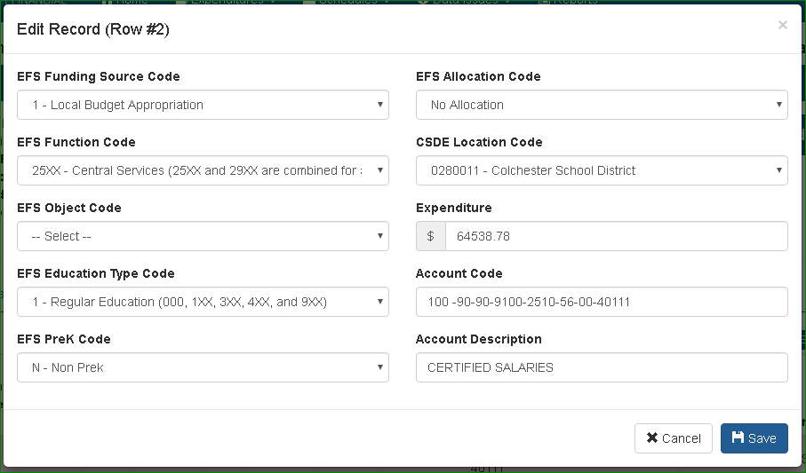
Data Validation and Errors - Slide 2
Error was missing location code. Clicked “Edit” button, edit window appears. Select CSDE Location Code from dropdown, then click “Save”.
Notes:
a pop-up window opens with drop-down menus for each EFS code. In this case, the error was a missing location code, so we just selected the school from the drop-down list, then clicked “Save” to save the change.
We fix the second error in the same way, by choosing the correct Object Code from the drop-down list.

Slide 22
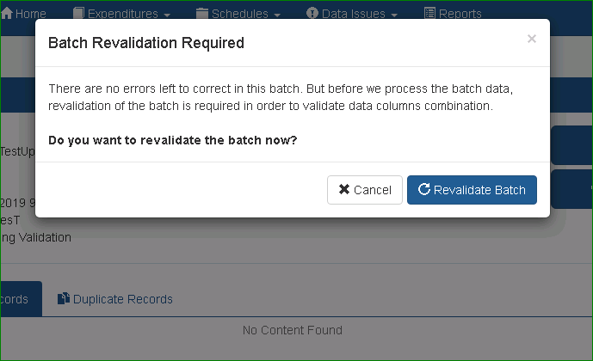
Data Validation and Errors - Slide 3
Once errors are cleared, click “Revalidate Batch”.
Notes:
Once the initial coding errors are cleared, click the “Revalidate Batch” button. This is a second validation process that checks the combination of EFS codes used.

Slide 23
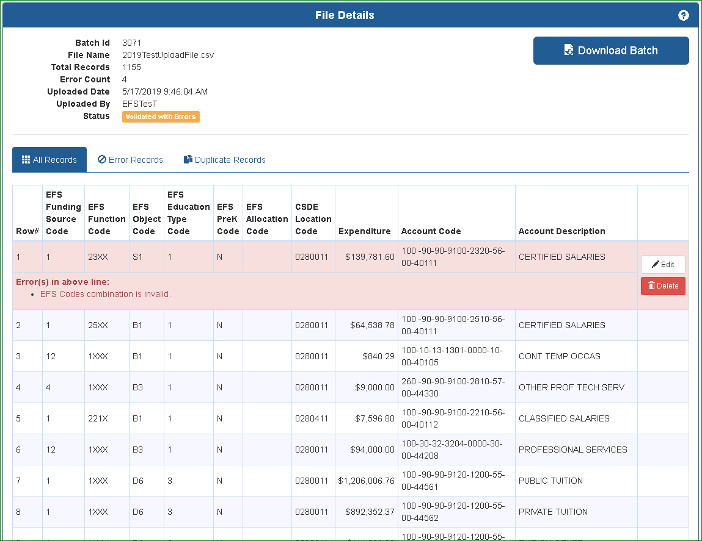
Data Validation and Errors - Slide 4
More Errors! This is a 2nd stage error check that ensures that the combinations of codes used meet requirements, for example Row 13 where object S1 for Teacher Salary was used with Function 2320 for Central Administration.
Notes:
In this case, there is an additional error due to invalid code combinations, using the teacher salary object code with the function for central administration, which is not valid. We can correct the error in the same manner as the previous errors that were fixed.

Slide 24
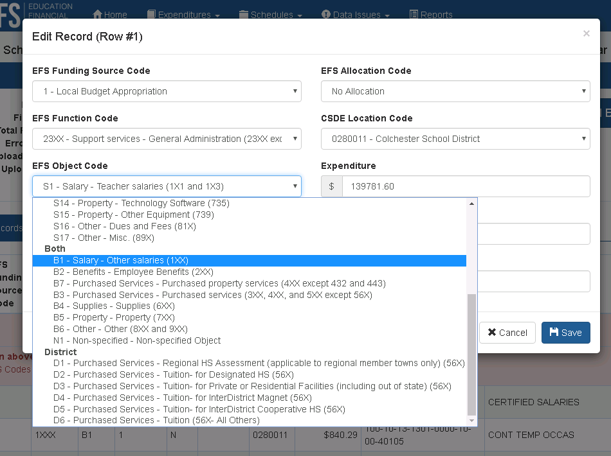
Data Validation and Errors - Slide 5
Use dropdown to revise Object Code to B1, then click “Save”.
Notes:
We click the “Edit” button, then correct the object code, and save.

Slide 25
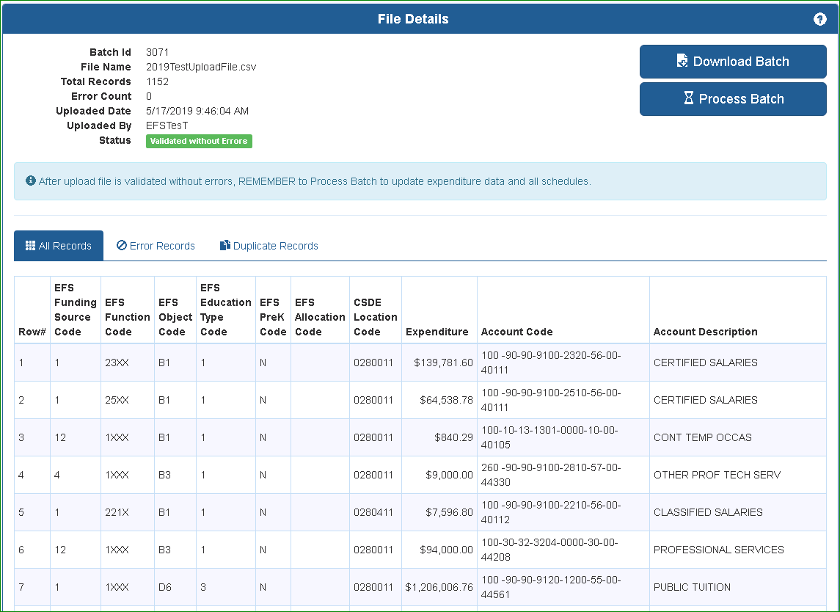
Process Data – Slide 1
Status is “Validated without Errors”. YOU ARE NOT DONE. Need to click “Process Batch” to perform the allocations and populate database and schedules.
This process will create additional records if allocation codes were included in the upload file.
Notes:
After the errors have all been corrected, the status changes to “Validated without Errors”. You MUST then click “Process Batch”, which performs the allocation calculations, combines records with identical coding, and loads your data into the EFS expenditure table.

Slide 26
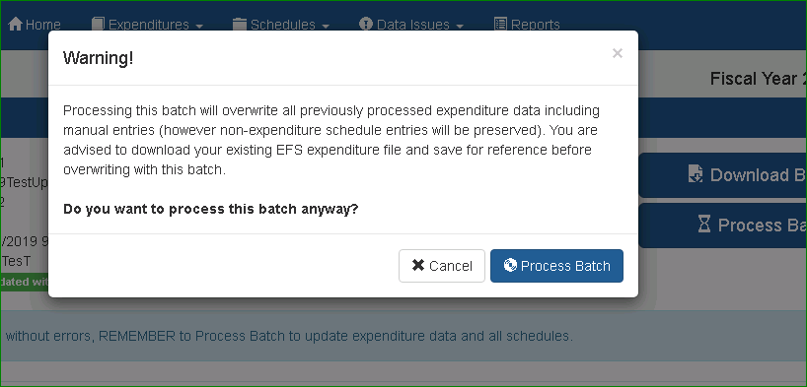
Process Data – Slide 2
Warning that processing the batch will overwrite existing expenditure data. You may want to download and save the prior batch from “Expenditure Detail” screen. Then click “Process Batch”.
Notes:
You’ll see a warning that when you process the batch, all previous expenditure data will be overwritten. If you had processed a batch previously, it would be wise to download the previously processed data from the Expenditure Detail screen and save on your computer. Then click the “Process Batch” button.

Slide 27
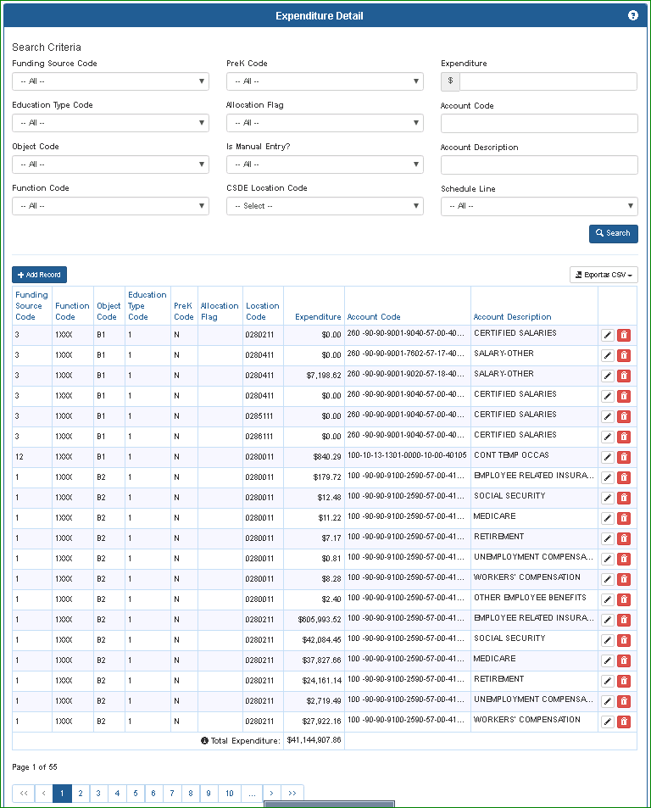
Expenditure Detail
Lists all processed expenditure records.
Can search by each EFS segment.
Use page navigation at bottom to view additional records.
Use buttons on the right side to edit or delete records.
Use “Export as csv” button to export all records or the filtered set. These are “after allocation” records so may contain more records
Notes:
The Expenditure Detail screen now opens, which lists all of your processed records loaded into the EFS expenditure table. If you used the allocation features in EFS, the expenditure table will include more records than were in your upload file, due to allocating out the costs. On this page you can filter and search by any of the EFS fields, and can download either the complete file or just the filtered records.

Slide 28
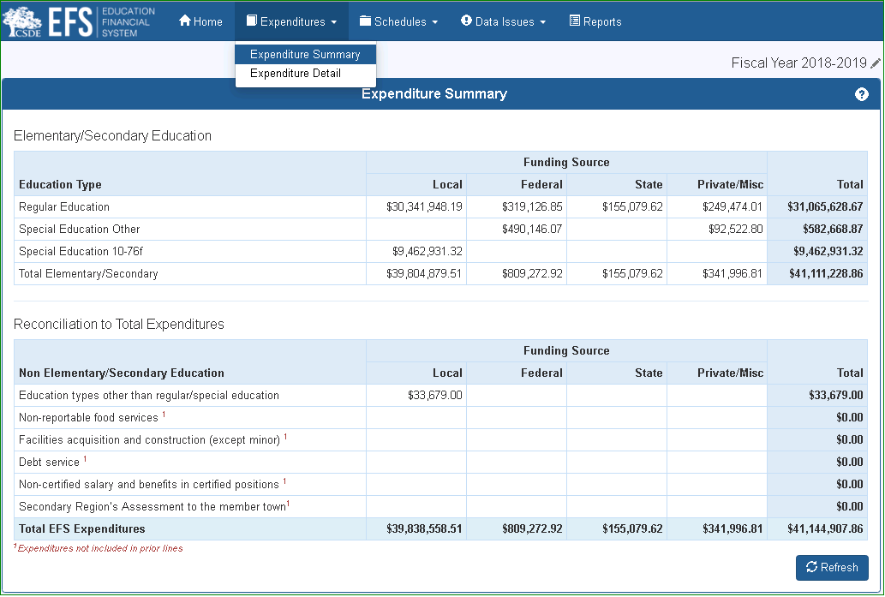
Expenditure Summary
Elementary/Secondary Education section includes all expenditures that in the past would be included on ED001 Schedule 12 – total would tie to Line 1213/1.
Reconciliation to Total Expenditures section adds back the expenditures not included in the upper section, to arrive at the total expenditures reported in the database.
The “Total EFS Expenditures” line is the same amount as the total shown on the Expenditure Detail page.
Use “Refresh” button to update this page for any changes to expenditures made while this page is open.
Notes:
There is also an Expenditure Summary screen, which shows the “Elementary/Secondary Expenditure” amounts that are included on the EFS schedules and reports, with a reconciliation to the total expenditure amount included in your expenditure file.

Slide 29
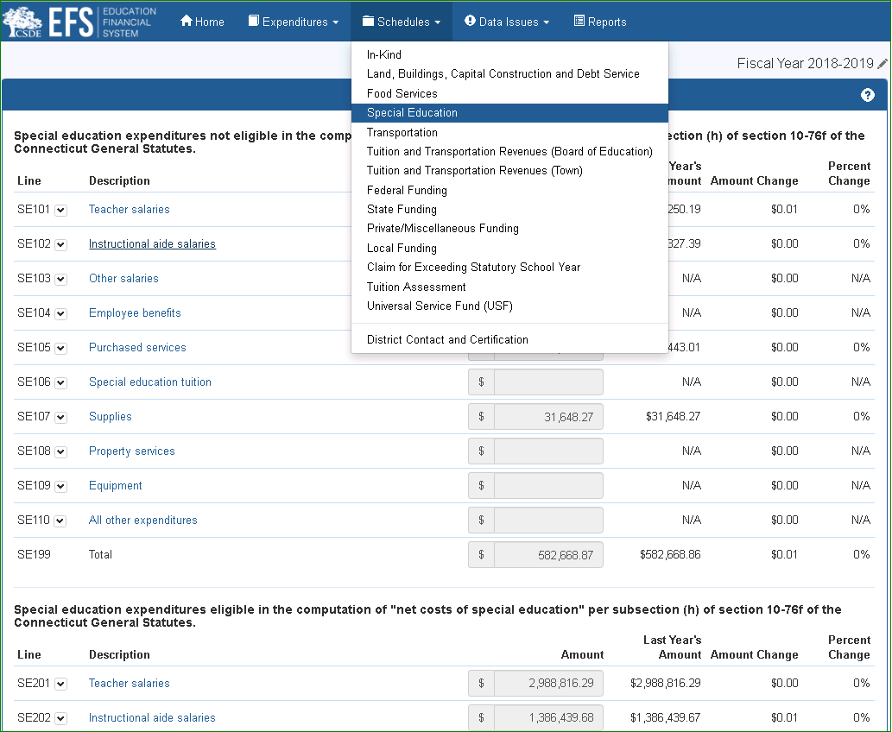
Schedule Example – Special Education – Slide 1
All amounts on this schedule are from EFS expenditure table. Any changes made here will change all affected schedules and reports.
Two sections, for Special Education eligible and not eligible as “net costs of Special Education” per Section 10-76f of the Connecticut General Statutes” equivalent to old ED001 Columns 1 and 2.
Notes:
EFS includes several schedules, which summarize your expenditure data in categories that are important for reporting or grant reasons. Each of the schedule lines includes data from the prior year, as well as the dollar and percentage differences, for your reference. Some of the schedules also have fields for amounts that you must enter manually. The list of schedules is shown under the “Schedules” header. We’ll introduce you to some of them now.
All amounts shown on the Special Education Schedule are from the EFS expenditure table. The amounts are divided into upper and lower sections determined by EFS Education Type 2 or 3 used on each expenditure record, which classify the expenditures as eligible or not eligible in the computation of "net costs of special education" per state statutes. The sections are equivalent to the former ED001 Schedule 4; the upper section to Column 1, and the lower section to Column 2.
On any EFS screen, you can click the question mark in the upper right corner to open the applicable section of the EFS User Guide; from the Special Education Schedule, the question mark will open

Slide 30
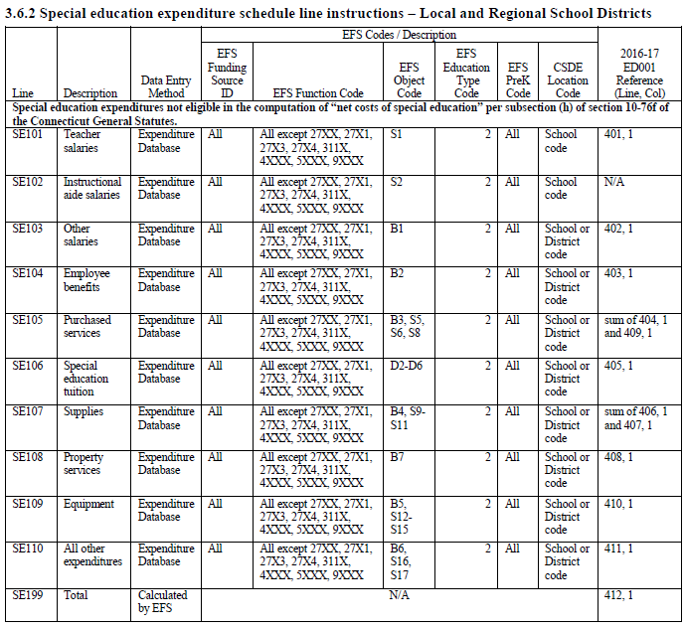
Schedule Example – Special Education – Slide 2
Schedule line definitions, including reference to prior ED001 lines, are provided in the User Guide, under “Documents/Forms” at:
http://portal.ct.gov/SDE-EFS.
Notes:
the table that defines the EFS expenditure codes that apply to each data field.

Slide 31
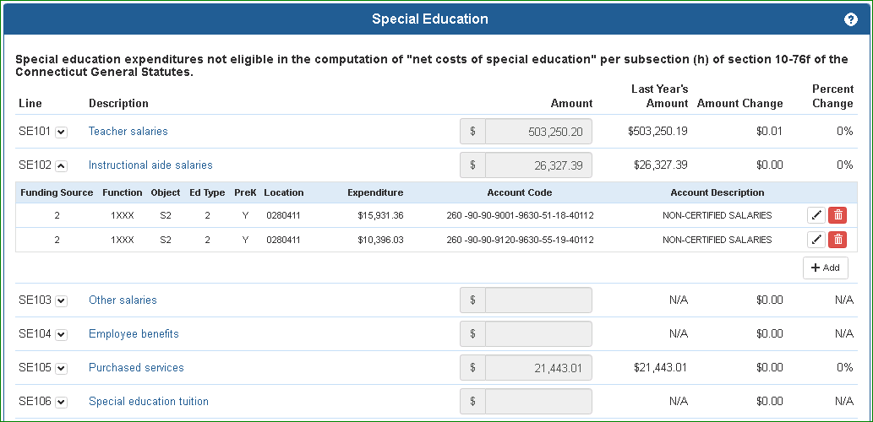
Schedule Example – Special Education – Slide 3
To view expenditure records for a line, click the down arrow next to the line number.
Edit or delete a record using the buttons on the right side.
Notes:
Clicking on any line or dropdown arrow will show the detail records making up that line. From this screen you can edit or delete any of the records.
If we click the ”Edit” button,

Slide 32
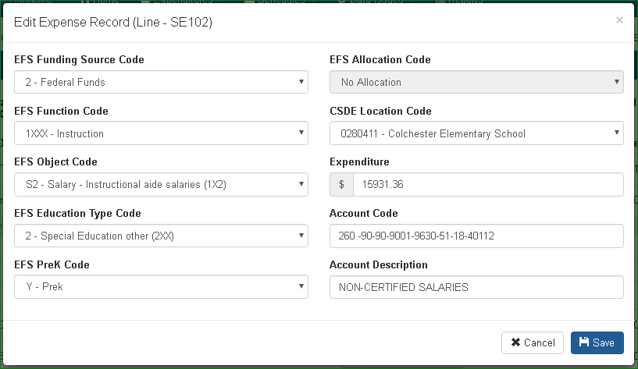
Schedule Example – Special Education – Slide 4
Edit record by choosing from dropdown or retyping expenditure amount or local account code or description. Click “Save” when done.
Dropdowns for EFS codes include only the codes that apply to the line being edited. Changes to other EFS codes may be made on the Expenditure Detail screen.
Notes:
a pop-up window opens where we can change the amount or certain EFS codes. Note that when editing from a schedule line, the only EFS codes available are those that apply to that line. So for example in this case we could not change the Education Type Code to anything other than 2, since that is the only code that applies to this line. To make that type of change, you could navigate to the Expenditure Detail screen, find the record there, then make any changes necessary.

Slide 33
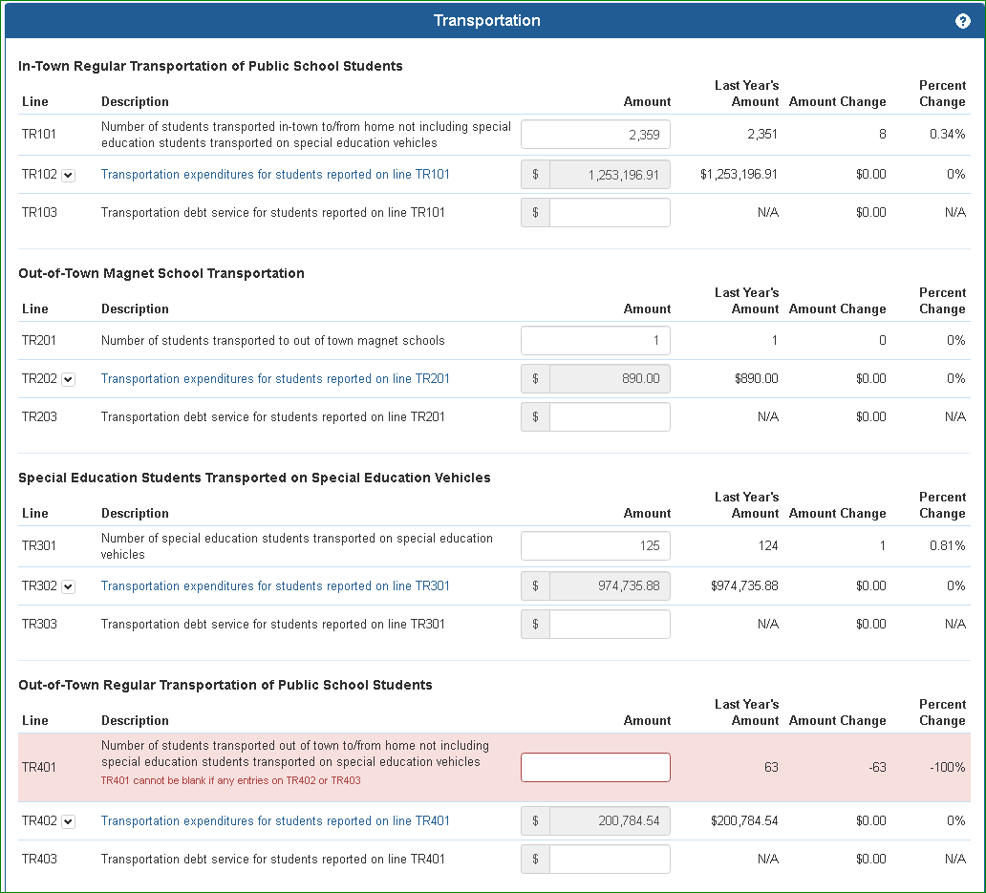
Schedule Example – Transportation – Slide 1
Expenditure amounts on this schedule are from EFS expenditure table. Any changes made to those lines will change all affected schedules and reports.
Numbers of students, and debt service amounts, are manual entries made on the page. These amounts do not affect the EFS expenditure table.
Note that the numbers of students must be entered in any section that shows expenditures, and vice-versa.
Notes:
As an example of a schedule that includes both expenditure fields filled from the EFS expenditure table, as well as manual entry fields, we’ll review the Transportation Schedule. The expenditure fields operate in exactly the same way as on the Special Education schedule.

Slide 34
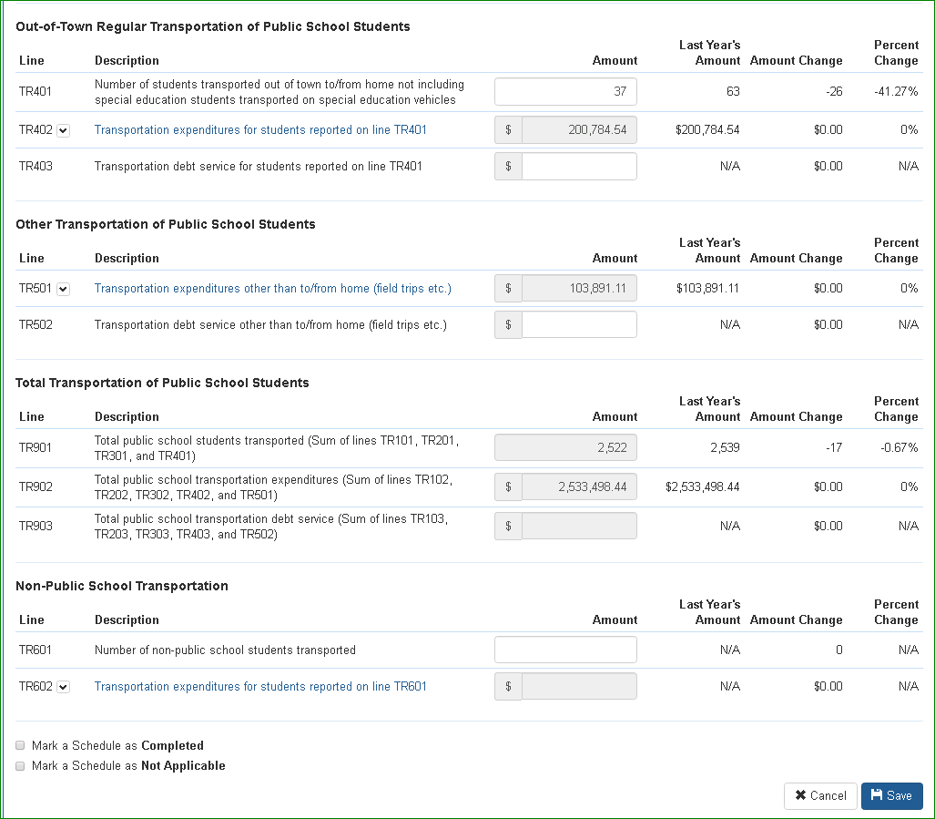
Schedule Example – Transportation – Slide 2
Manually entered “37” in Line TR401. Tab or click outside of that field to retain manual entry on screen.
When finished making manual entries, Click “Save” button.
Notes:
For the manual entry fields, you must enter the data items then click the “Save” button. In this case, we need to enter the number of students transported for each expenditure shown.

Slide 35
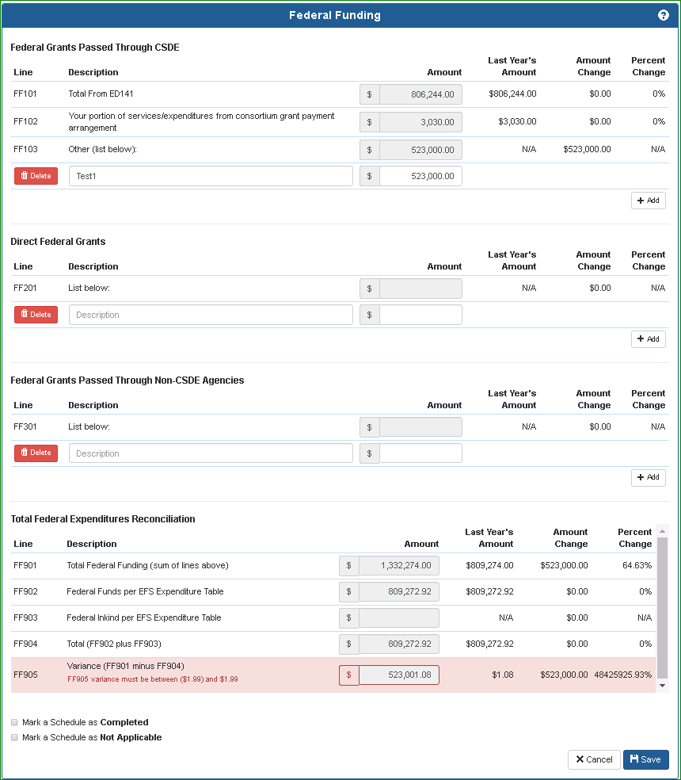
Schedule Example – Federal Funding – Slide 1
Lines FF101-FF301 are grant details, similar to entries on Form ED001 Schedule 8.
Lines FF101 and FF102 are filled from the Prepayment Grants System – Form ED141. So ED141s need to be complete before finishing this schedule (same also for State and Private/Miscellaneous Funding Schedules).
Total federal expenditures listed on this schedule need to match the total of federal funds for elementary and secondary education in EFS expenditure database. In other words, you need to include federal expenditures in your upload file or by manual entry, coded with proper EFS Codes. Variance in Line FF905 needs to be zero +/- $1.99 before certifying.
Notes:
There are separate schedules for the different sources of funding used for your expenditures. An example is the Federal Funding schedule, which includes all of your federal grant expenditures. The upper section of the schedule, lines FF101-FF301, lists the details of federal grants expended; the lower section reconciles those expenditures to the total federal fund expenditures you reported in the EFS expenditure table using EFS Funding Source Codes 2 and 13. In the upper section, lines FF101 and FF102 are imported directly from the Prepayment Grants (ED141) System; if ED141s have been updated a refresh button will appear next to the expenditure; click it to update the EFS number. Enter the details of any other federal grants expended in the appropriate lines FF201 and FF301; be sure to click “Save” when you are done.

Slide 36
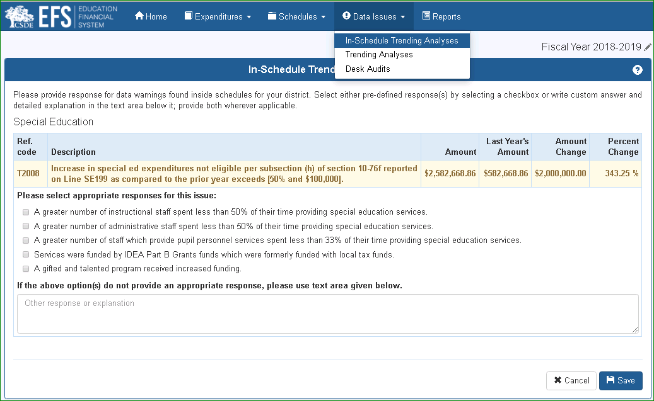
Data Issues
Select a data issue type from the drop-down menu, then reply by selecting one or more of the potential answers provided, and/or entering text in the “Other” box.
In-Schedule Trending Analyses are available as soon as an expenditure file is processed.
You generate Trending Analyses by clicking on the “Perform Analyses” button once an expenditure file is processed.
Desk Audits are prepared by CSDE staff based on review of EFS data. These become available when the EFS is re-opened for all districts for review of data issues and audit.
Notes:
Three types of data checks are included under the “Data Issues” Header. Districts must answer all of these by selecting the applicable answers provided, and/or entering text in the Other box. Be sure to click “Save” after answering each page. The data check types are: In-Schedule Trending Analyses, which the system automatically generates when you process a file or revise expenditures; Trending Analyses, which run when you click the “Perform Analyses” button; and “Desk Audits”, which aren’t available until CSDE has reviewed your data after your initial September 1 submission and we re-open the system for revisions, typically by late October.

Slide 37
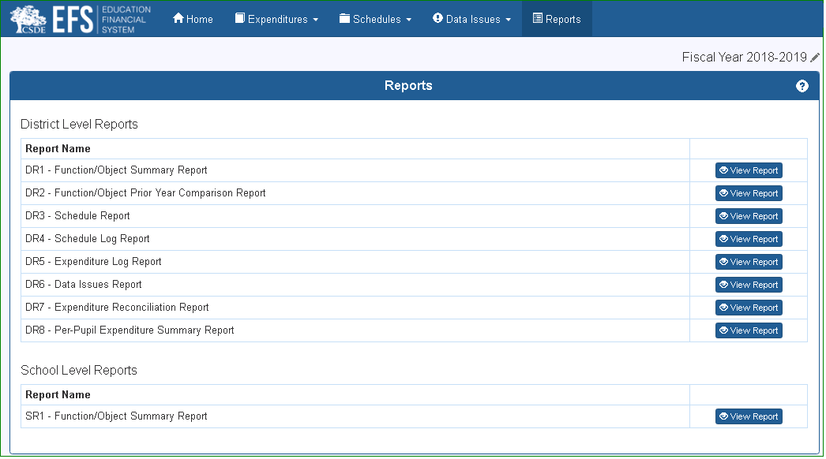
Reports – Slide 1
Choose desired report
Notes:
There are several reports available under the “Reports” header. Most show data at the district level, reports DR1-DR8. Report SR1 is also available, which shows expenditures by function and object for each school.

Slide 38
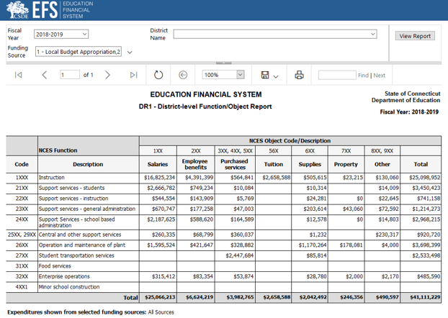
Reports – Slide 2
D1 - District-Level Function/Object Summary Report similar to ED001 Schedule 12.
Select Fiscal Year (defaults to current)
Select Funding Source (defaults to All)
Defaults to your district – can select any for Reports D1, D2, D3, S1.
Click “View Report” to run
Click on any amount to see detail.
Notes:
An example is the DR1 Function/Object Summary Report, which is equivalent to Schedule 12 on the old Form ED001 or ED001R, and similar to Schedule 2 on the old Form ED001C. You can run this report for any fiscal year with EFS data, any school district, and can filter by funding source if desired. If you click on any amount another window will open listing the detail records that make up that amount.

Slide 39
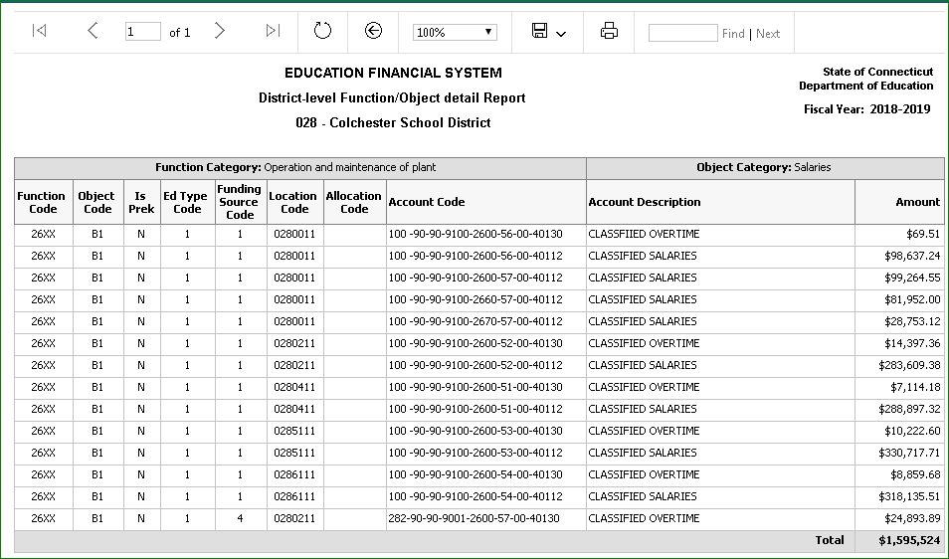
Reports – Slide 3
Click on back arrow to return to summary report.
Notes:
Click the back arrow to go back to the main report.
Now that we’ve shown how to enter and review EFS data, we’ll go over some next steps for you to take, and provide a few tips for using EFS.

Slide 40
EFS Next Steps for Users
Review the User Guide and other EFS materials under “Documents/Forms” at: http://portal.ct.gov/SDE-EFS
Try creating a test file from your general ledger and uploading to the staging server at https://stg-csde.ct.gov website.
Become familiar with EFS schedules and reports.
Plan on submitting expenditures using EFS by September 1 following the June 30 close of each fiscal year.
Please send any issues or questions to our mailbox at SDE.efs@ct.gov.
Notes:
We recommend that new users review the EFS guidance available on our website, which include the EFS User Guide and some frequently asked questions. Then try working with the system with a practice file in our staging test server, and review the EFS schedules and reports. Your actual data submission is due on Sept 1 each year. Send us questions anytime to our mailbox.

Slide 41
EFS Tips – File Uploads
We recommend doing at least one test upload with a portion of your g/l template to see if what types of errors you receive, if any, before uploading your entire file. Note that subsequent uploads will overwrite prior processed expenditure data.
After your file is uploaded with status “Validated without errors” you need to “Process Batch”. Only the processed data appears on the “Expenditures” tab, schedules, or reports.
Although EFS does accept records with expenditures of zero, we recommend deleting these from your file before uploading to minimize the number of records in the database.
Notes:
And finally we have a few reporting tips to highlight. For initial uploads you may want to send just a portion of your file to see what types of errors you receive; this may guide you preparing your entire file. Any file you upload will overwrite all existing expenditure data. Don’t forget to click the “Process batch” button after all of your errors are cleared. Also, we recommend that you delete any records with zero expenditures from your file before uploading to make the system run a little more efficiently.

Slide 42
EFS Tips – Function Codes
The EFS Function Codes include “X” as a wild card; you may use any digit in these cases.
The EFS function codes are similar to the NCES function codes, but there are some differences, for example NCES function code 3100 for Food Services needs a little more detail for EFS. In general 3110 is the code to use for most food service expenditures. Only the portion funded by the local budget to cover an operating deficit should use functions 3121 or 3122.
Some districts use function codes in their general ledger beyond those defined by NCES (for which 5000 is the highest). Many districts use 2100 on their books for Special Ed – that’s not currently an NCES code. For Special Ed you need to use the appropriate function code along with EFS Education Type 2 or 3.
Notes:
Many of the function codes include an X character as a wild card. You can use any number or letter in place of the X in your upload file, however it will be converted to an X in the processed file. The function codes are modeled on the standard federal codes published by the National Center for Education Statistics, but in some cases we need more detail in EFS. For example, for food service expenditures we need to separate the portion funded by local funds to cover an operating deficit, from the portion funded by grants and fees, so we have created separate codes. Also note that some districts use function codes in their general ledgers that aren’t consistent with the NCES codes. For example, some districts use function 2100 for Special Education expenses, however that is not a current NCES code. For EFS, Special Ed expenditures are identified using the Education Type Code 2 or 3.

Slide 43
EFS Tips – School vs. District-Level Expenditures
For the most part, the level is driven by the defined level of the function.
If function is district-level, use the location code for your central office (XXX0011 for local districts, XXX0012 for regions, XXX0014 for RESCs, XXX0013 for charter schools).
If function is school-level, use a school location code, or if it needs to be allocated to schools use the central office code along with an allocation code.
Expenditures for staff assigned to one school may not be allocated; must be identified to the proper school using the school location code.
If function level is “both”, school or district level is determined by object level.
Notes:
We have defined certain expenditures as “School-level”, which will be reported by school, and “District-level”, which are not. The level is usually determined by the defined level of the function; there are more specifics listed in the User Guide. District-level expenditures should use your district central office organization code, listed on the slide. School-level expenditures must be reported either with a school location code, or if allocation is needed, the central office code along with an allocation code. Staff assigned to one location should always be reported using the code for that location, and not allocated.

Slide 44
Education Financial System (EFS)
Connecticut State Department of Education
Introductory Training
Notes:
We hope this presentation gave you a helpful introduction to the EFS. The EFS User Guide contains more detailed instructions regarding the topics we covered. Thank you for your attention and please don’t hesitate to contact us if you have questions.

