Slide 1
Fractals
Self-similar
Repeating pattern
Result: image appears complex, but really made of repeating simple images at different scales
Examples follow.

Slide 2
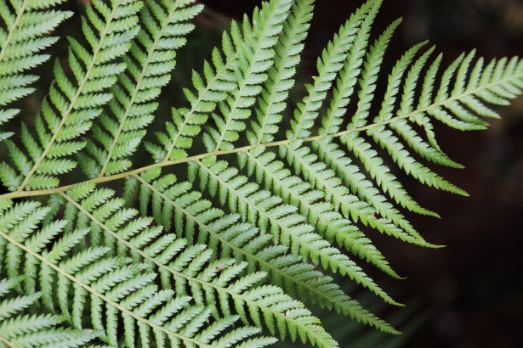
Fern
(by Deanna Roberts)

Slide 3
Fern Leaf
(by Deanna Roberts)

Slide 4
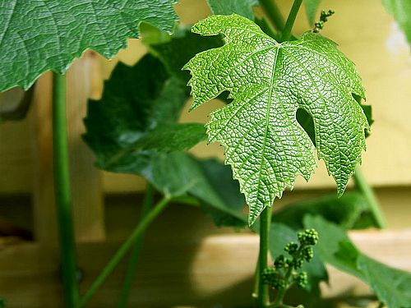
Leaf

Slide 5
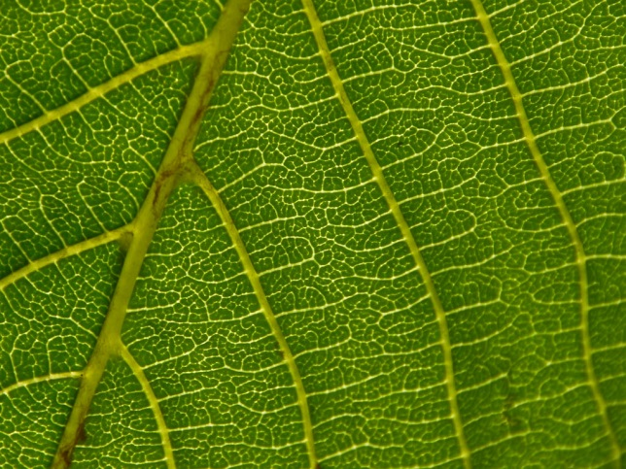
Leaf Veins

Slide 6
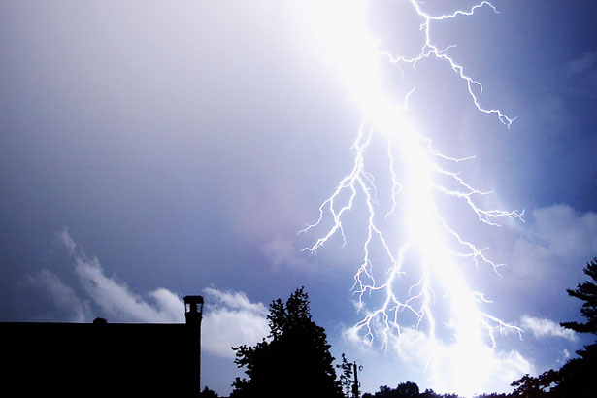
Lightning
(by Mark Coldren)

Slide 7
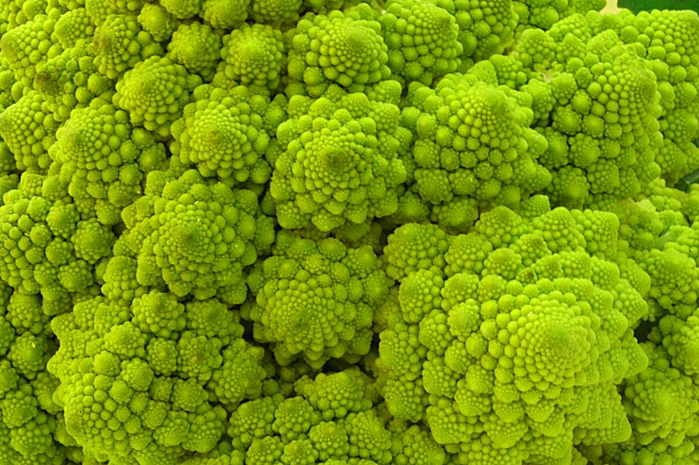
Fractal Food

Slide 8
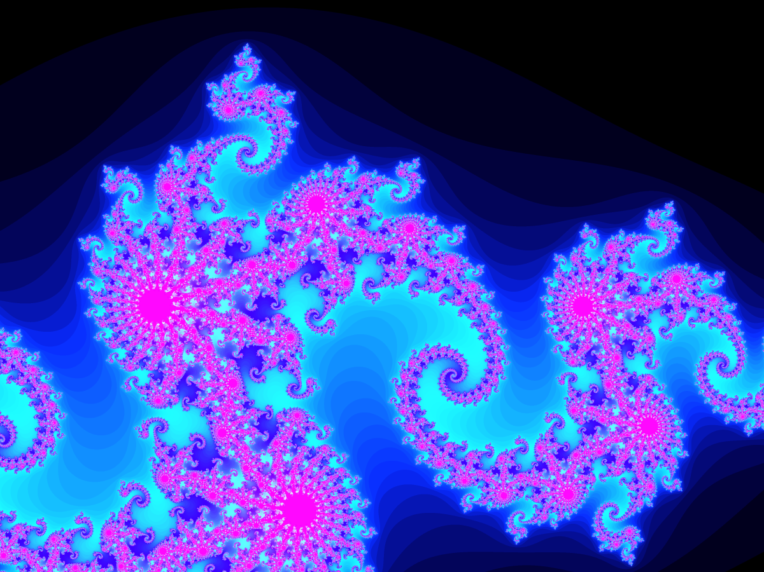
Julia Set

Slide 9
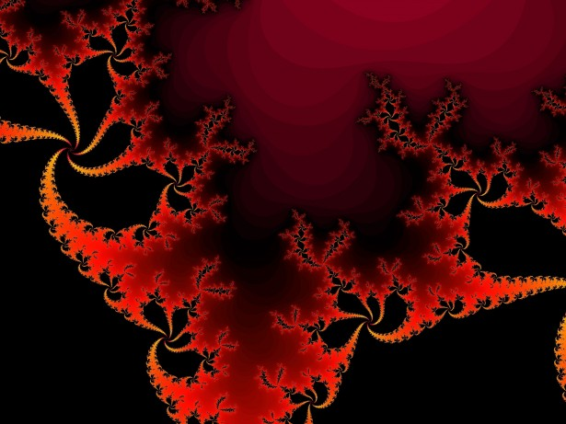
Fractal Art
(red fractal background by Irina Pechkareva)

