Slide 1


CONNECTICUT STATE DEPARTMENT OF EDUCATION
Linking Curriculum, Instruction and Assessment in Mathematics
March 10, 2016

Slide 2
Learning Targets
By the end of this presentation, I will know:
the structure of the Smarter Balanced Assessment
what the Smarter Balanced Assessment measures
how the Smarter Balanced Assessment links to curriculum and instruction
Notes:
Learning targets frame a lesson from the student point of view. A learning target helps students grasp the lesson's purpose--why it is crucial to learn this chunk of information, on this day, and in this way.
With this in mind, the three learning targets stated on this slide inform participants of the learning goals based on the scope of this presentation.

Slide 3

The Smarter Balanced Assessment
What is it?

Slide 4
Two Components of the Assessment
Smarter Balanced Assessment
Computer Adaptive Test
(CAT)
Performance Task
(PT)
Notes:
There are two components of the Smarter Balanced assessment. The Computer Adaptive section and the Performance Task.

Slide 5
A Look Into the CAT
Allows students to have more engaging test questions from the real world
More efficient for students than a typical paper-and-pencil test
Allows students flexibility and accessibility
Gives access to helpful tools and resources
Contains 27 to 34 items
Notes:
Since the Smarter Balanced Assessment is taken on a computer, the CAT part… Speak to the slide.

Slide 6
A Look Into the PT
Requires students to answer a set of complex questions centered on a common topic or problem
Measures capacities such as depth of understanding, research and writing skills, and/or complex analysis with relevant evidence
Designed to provide students with an opportunity to demonstrate their ability to apply their knowledge and higher-order thinking skills to explore and analyze a complex, real-world scenario
Contains 4 to 6 items
Notes:
The performance task for math enables students to demonstrate application of mathematics in a situation requiring high level thinking. The classroom task is no longer administered and although the PT has been removed for ELA, it remains for math.

Slide 7
A Look At Item Types
Type of Item | Description of Response
Multiple Choice, single correct response | Four-option multiple choice
Multiple Choice, multiple correct responses | Multiple-option multiple choice
Matching Tables (with a variation True/False or Yes/No) | Table format, click entry
Short text | Keyboard alphanumeric entry
Drag-and-Drop | Drag-and-Drop single or multiple elements
Hot Spot | Select text
Table Fill in | Table format, click entry
Graphing | Plot points and or draw lines
Equation/numeric | Enter equation or numeric response
Sample Items By Task Type
Notes:
One of the biggest changes in the Smarter Balanced Assessment is the item types. Previously students had multiple choice, grid-in and constructed response. As a result of technology there are many more types of items that students may experience. It is a good idea to be aware of these item types and expose your students to them. One resource that you can use is a compilation of sample items by task type created by Oregon’s Department of Education from released Smarter Balanced items. Click on the link to explore.

Slide 8
The Smarter Balanced Assessment
What does it measure?
Notes:
To effectively prepare students for the assessment, it is important to understand what is being measured.

Slide 9
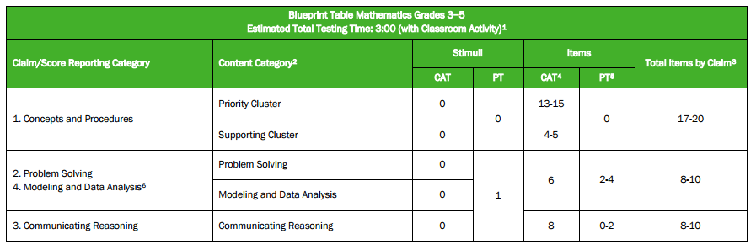
Understanding the Blueprint
Notes:
The blueprints for grades 3-5 and grades 6-8 provide an overview of what is assessed. We will now take a few minutes to dig deeper into these blueprints

Slide 10
What is a Claim?
A Claim is a summary statement about the knowledge and skills students are expected to demonstrate on the assessment related to a particular aspect of the CT Core Standards for mathematics.
Claim #1 – Concepts and Procedures
Claim #2 – Problem Solving
Claim #3 – Communicating Reasoning
Claim #4 – Modeling and Data Analysis
Notes:
So, what is a claim? A Claim is a summary statement about the knowledge and skill student are expected to demonstrate on the assessment related to a particular aspect of the CT Core Standards for mathematics.
The four Mathematics Claims for grades 3-8 and 11 are:
Claim 1 – Concepts and Procedures. Claim 1 items measure the extent to which students can explain and apply mathematical concepts and interpret and carry out mathematical procedures with precision and fluency.
Claim 2 – Problem Solving. Claim 2 items measure the extent to which students can solve a range of complex well-posed problems in pure and applied mathematics, making productive use of knowledge and problem solving strategies.
Claim 3 – Communicating Reasoning. Claim 3 items measure the extent to which students can clearly and precisely construct viable arguments to support their own reasoning and to critique the reasoning of others.
Claim 4 – Modeling and Data Analysis. Claim 4 items measure the extent to which students can analyze complex, real-world scenarios and can construct and use mathematical models to interpret and solve problems.
Claims 2 and 4 are reported as one score.
Additional information about the Claims is available in the Smarter Balanced Mathematics Content Specifications available on the Smarter Balanced Web site.

Slide 11
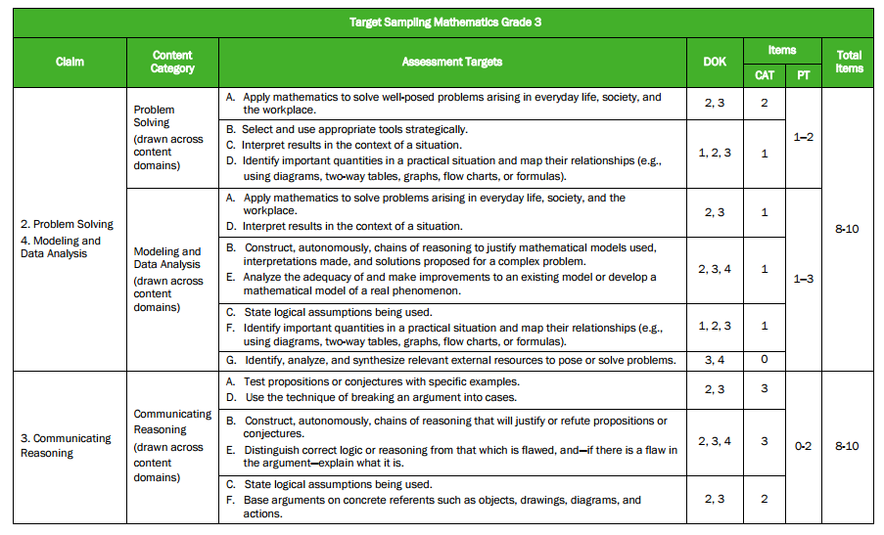
Going Deeper Into the Blueprint
Notes:
For each grade level, the blueprints are expanded to show specific assessment targets related to each claim.

Slide 12
What is a Target?
Each Claim is accompanied by a set of assessment targets that provide more detail about the range of content and Depth of Knowledge levels being assessed.
For Claim 1, the assessment targets are drawn from the grade-level cluster headings from the CT Core Standards for mathematics.
For Claims 2, 3, and 4 the assessment targets are drawn from the CT Core Standards for Mathematical Practice. The assessment targets for Claims 2, 3, and 4 are the same across all tested grades.
Notes:
Assessment targets for each claim provide more detail about the range of content and Depth of Knowledge levels being assessed.
For Claim 1, the assessment targets are drawn from the grade-level cluster headings from the CT Core Standards for mathematics.
For Claims 2, 3, and 4, the assessment targets are drawn from the CT Core Standards for Mathematical Practice. The assessment targets for Claims 2, 3, and 4 are the same across all tested grades.

Slide 13
Understanding the Targets
Claim 1 targets change based upon the grade level being assessed
  Grade 4 Cluster Heading Number & Operations - Fractions: Extend understanding of fraction equivalence and ordering.
  Grade 4 Claim 1 Target F: Extend understanding of fraction equivalence and ordering
  Grade 8 Cluster Heading Geometry: Understand and apply the Pythagorean Theorem.
  Grade 8 Claim 1 Target H: Understand and apply the Pythagorean Theorem.
Notes:
For Claim 1, the assessment targets are drawn from the grade-level cluster headings from the CT Core Standards for mathematics. This example shows the targets as they related to the domains in grade 4. As you can see, the targets for claim 1 change based upon the grade level being assessed because the cluster heading change. Claims 2, 3 and 4 targets draw from the language of the practice standards. In some cases the target is directly pulled from the practice standard in others it is similar. Hand out the practice standards and the targets and have them spend time looking for the connections.

Slide 14
Understanding the Targets
Claim 2, 3 and 4 targets do not change based upon the grade level being assessed
Target Language
Claim 3 Target D
  Use the technique of breaking an argument into cases.
Claim 4 Target E
  Analyze the adequacy of and make improvements to an existing model or develop a mathematical model of a real phenomenon.
Math Practice Language
Math Practice 3
  They are able to analyze situations by breaking them into cases and recognize and use counterexamples.
Math Practice 4
  They routinely interpret their mathematical results in the context of the situation and reflect on whether the results make sense, possibly improving the model if it has not served its purpose.
Notes:
For Claim 1, the assessment targets are drawn from the grade-level cluster headings from the CT Core Standards for mathematics. This example shows the targets as they related to the domains in grade 4. As you can see, the targets for claim 1 change based upon the grade level being assessed because the cluster heading change. Claims 2, 3 and 4 targets draw from the language of the practice standards. In some cases the target is directly pulled from the practice standard in others it is similar. Hand out the practice standards and the targets and have them spend time looking for the connections.

Slide 15
The Smarter Balanced Assessment
How can I use it to drive curriculum and instruction?
Notes:
One of the biggest questions that teachers and administrators revolves around assessment. I would like to provide you with some updates on the assessment landscape in CT and explain the beliefs surrounding assessment from the Academic Office.

Slide 16
Progressions of Topics
Understanding the progressions of the standards from grade to grade
  Grade 6 Ratio and Proportions
  Target A: Understand ratio concepts and use ratio reasoning to solve problems.
  Grade 7 Ratio and Proportions
  Target A: Analyze proportional relationships and use them to solve real-world and mathematical problems
Resource to support the blueprints
Notes:
The blueprints can help you understand the progressions from grade level to grade level. In claim 1 the progressions can be seen by the target language within the same domain. The results from the assessments when looked at from a grade level perspective can also help in identifying strengths and weaknesses within the curriculum. Oregon put together an expandable blueprint that takes information from various smarter balanced documents. This information is all in one location so that the blueprints can help inform your instruction. It includes a description of the target as well as the evidence of what will be required of the student for that target. Look at the resource.

Slide 17
Depth-of-Knowledge and Instruction
The CT Core Standards require high-level of cognitive demand
  Students are expected to apply content knowledge and skills to new situations and sustained tasks.
The DOK is identified for each target
Notes:
The Common Core State Standards require high-level cognitive demand, such as asking students to demonstrate deeper conceptual understanding through the application of content knowledge and skills to new situations and sustained tasks. The blueprint for the Smarter Balanced Assessment System, therefore, requires that questions cover a range of cognitive levels.
Interpreting and assigning depth-of-knowledge levels to assessment items is an essential requirement of alignment analysis. Four levels of Depth of Knowledge are used for the Smarter Balanced items.

Slide 18
Webb’s Depth-of-Knowledge Levels
DOK Level | Description | Tasks
1 | Recall and Reproduction | Facts, simple procedures; little transformation of knowledge; right or wrong
2 | Basic Application of Skills and Concepts | Transform knowledge before responding, e.g. compare, explain
3 | Strategic Thinking | Use knowledge and extended thinking to solve complex problems with more than one possible solution
4 | Extended Thinking | Sustained strategic thinking over a period of time; real audiences; collaboration
Notes:
Webb’s Depth of Knowledge consists of 4 levels.
DOK-1 – Recall & Reproduction - Recall of a fact, term, principle, concept, or perform a routine procedure
DOK-2 - Basic Application of Skills/Concepts - Use of information, conceptual knowledge, select appropriate procedures for a task, two or more steps with decision points along the way, routine problems, organize/display data, interpret/use simple graphs
DOK-3 - Strategic Thinking - Requires reasoning, developing a plan or sequence of steps to approach problem; requires some decision making and justification; abstract, complex, or non-routine; often more than one possible answer
DOK-4 - Extended Thinking - An investigation or application to real world; requires time to research, problem solve, and process multiple conditions of the problem or task; non-routine manipulations, across disciplines/content areas/multiple sources
I am providing you with a deeper description of the DOK levels as they relate to math specifically.

Slide 19
DOK is about complexity – not difficulty!
The intended student learning outcome determines the DOK level. What mental processing must occur?
While verbs may appear to point to a DOK level, it is what comes after the verb that is the best indicator of the rigor/DOK level.
  Describe the properties of a parallelogram.
  Describe how ratios and rates are alike and different.
  Describe the most significant component of a linear graph.
Source: Karin Hess, Ed.D. National Center for Assessment
Notes:
As an example to illustrate this point, let’s look at the verb describe. Notice that we are using the same verb, but what comes after the verb determines the level of complexity. Being more complex is not the same as being harder.

Slide 20
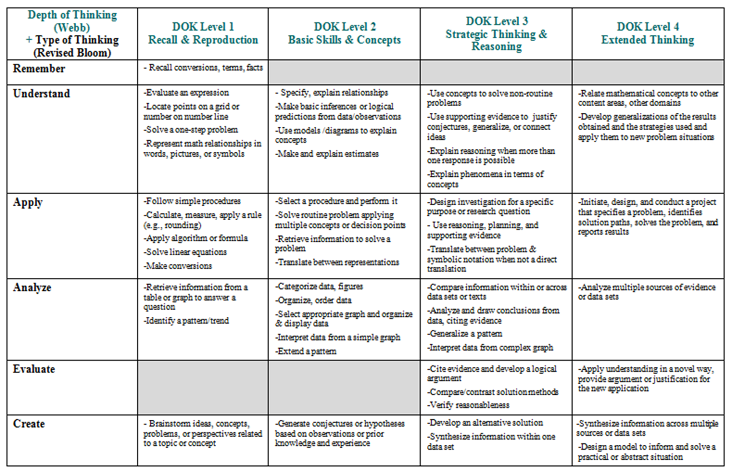
Putting It Into Practice
Cognitive Rigor Matrix for Math
Notes:
The Cognitive Rigor Matrix integrates two widely accepted measures to describe cognitive rigor
Revised Bloom’s Taxonomy
Webb’s DOK Levels
This chart provides Bloom’s and Webb’s explanations of expectations for each level for mathematics and examples of what those expectations might look like. Handout DOK Levels for Assessment tasks and ask participants to decide where the tasks would fall on the cognitive rigor matrix.

Slide 21
Identifying the DOK Level
Grade 8: In which set are the numbers equivalent?
a. 1/3, 3/27, 33%
b. 0.090, 90%, 0.90
c. 88%, 88/100, 22/25
d. 0.66%, 2/3, 66.7%
Notes:
Incorporating all levels of DOK in classroom instruction and assessment will help students be bettered prepared for the cognitive demands of the Smarter Balanced Assessment. Take a look at the three multiple choice items on the slide and determine what you think the DOK level is. (allow time)
Go over the results which are:
First example is level 2 because there are a number of different concepts and procedures that can be used for this problem rather than one obvious, simple one. Not only must they identify different representations, they must also manipulate and compare.
The second example is a level 1 because students only need to be able to recognize even numbers.
Finally in the last example, we see an example of level 3. This item requires generalizations, reasoning and hypothesis testing.
Even though these are all multiple choice, the complexity of the problem and the level of cognitive demand that is needed in order to solve the problem is varied.

Slide 22
Identifying the DOK Level
Bill lives on the side of the street with even-numbered addresses. Which addresses below would be found on Bill’s side of the street?
a. 1020, 1022, 1024
b. 2021,2023,2025
c. 3168, 3169, 3170
d. 4167, 4168, 4170

Slide 23
Identifying the DOK Level
Which of the following is NOT true for any value of x?
a. x < x² < x³
b. x³ < x < x²
c. x < x³ < x²
d. x² < x < x³
e. x³ < x² < x

Slide 24
Identifying the DOK Level
DOK Level 1
DOK Level 3
From any vertex of a 4-sided polygon, 1 diagonal can be drawn.
From any vertex of a 4-sided polygon, 1 diagonal can be drawn.
From any vertex of a 4-sided polygon, 1 diagonal can be drawn.
From any vertex of a 4-sided polygon, 1 diagonal can be drawn.
How many diagonals can be drawn form any vertex of a 20-sided polygon
Think carefully about the following question. Write a complete answer. You may uses drawings, words, and numbers to explain your answer. Be sure to show all of your work.
Laura wanted to enter the number 8375 into her calculator. By mistake, she entered the number 8275. Without clearing the calculator, how could she correct her mistake?
Without clearing her calculator, how could she correct her mistake another way?
Notes:
The same idea holds true for open ended questions. An open ended question does not necessarily mean that it will be at a higher DOK level. To demonstrate this point look at the questions on this slide.
Although both of these are open ended item, the first example is a level 1 because the pattern is very routine. It is easily recognizable and requires not processing. The second open ended question has more then one possible answer and multiple approaches to the problem. The student needs to make strategic decisions about how to proceed, which is more complex then simply applying a set of procedures or skills.

Slide 25
What DOK Means For Classroom Assessment
Formative Levels 1 & 2 - varied, on-going, on the spot
Summative Levels 2 & 3 – standardized, end of unit
Performance-Based Levels 3 & 4 – complex, CCSS aligned, inquiry-based projects
Notes:
Incorporating all levels of DOK in classroom instruction and assessment will help students be bettered prepared for the cognitive demands of the Smarter Balanced Assessment. Some guidance on how to do this is seen on this slide.

Slide 26
Keep in Mind...
DOK is a tool to promote student achievement
DOK is a scale of cognitive demand
DOK level is determined by the item/standard, not the students’ ability
DOK is determined by the context, not the specific verb being used
DOK 1 + DOK 1 does not equal DOK 2
Notes:
Speak to the slide.

Slide 27
The Smarter Balanced Assessment
How does it connect with the Interim Assessments?

Slide 28
Two Types of Interim Assessments
Smarter Balanced Interim Assessments
Interim Comprehensive Assessment
(ICA)
Interim Assessment Blocks
(IAB)
Notes:
There are two types of interim assessments, the Interim Comprehensive Assessments (ICA) and the Interim Assessment Blocks (IAB)

Slide 29
Interim Comprehensive Assessments (ICA)
Use the same blueprints as the summative assessments and assess the same standards
Include the same item types and formats, including performance tasks, as the summative assessments
CAUTION: Take the same amount of time as the summative assessment
Notes:
The Interim Comprehensive Assessments or ICAs were developed using the same blueprints as the summative assessments. The blueprints give additional information such as number of items and DOK levels that may be useful as we will discuss later.
The ICAs are fixed form tests, which means that every student will see the exact same items. Our former assessments (CMT/CAPT were fixed form tests. As more items are added to the interim assessment bank, the tests will be adaptive, similar to the summative assessments.
The ICAs include the same item types and performance tasks as the summative assessment.
Each grade level ICA will take the same amount of time as the summative assessment, therefore, consideration of the amount of instructional time needed to administer the ICAs should be considered, prior to test administration.

Slide 30
Interim Assessment Blocks (IAB)
Focus on smaller sets of targets and therefore are more flexible to better support instruction
Include the same item types and formats, including performance tasks, as the summative assessments
Notes:
The Interim Assessment Blocks focus on assessing a finer grain level of instruction. They were developed to be used as part of a unit of study.
The IABs are currently available as fixed form tests, but may be made adaptive depending on the content being assessed and the availability of items in the interim item bank.
Like the ICAs, they include the same types of items and performance tasks as the summative assessment.

Slide 31
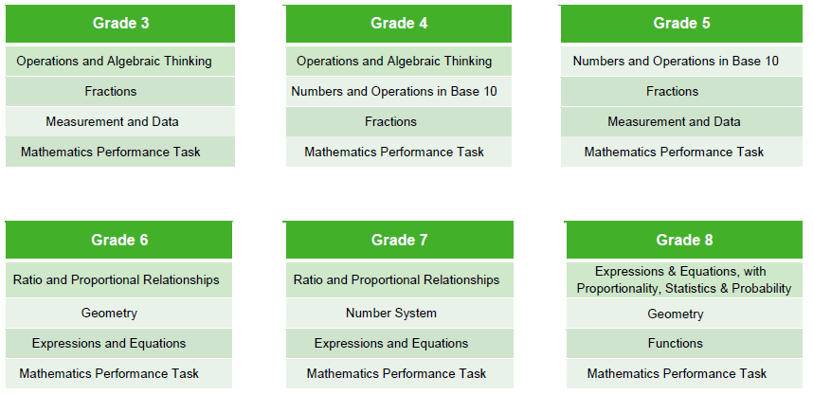
Interim Assessment Blocks
Currently Available
Notes:
These are the IABs that are currently available. There are 3 “non-PT” blocks and one PT block available for each grade level.
For Grade 3, the non-PT blocks are Operations and Algebraic Thinking, Fractions, and Measurement and Data. You will note that some block titles repeat grades, such as fractions. However, the items in those blocks are different and based upon the grade level content standards. This speaks to the progressions inherent in the CT Core Standards.
The non-PT blocks are completely machine scored. Hand scoring is required for some of the items in the PT blocks. These PTs are currently the same as the PTs available for the ICAs. Additional PTs will be made available as the interim item bank is augmented.
Hand scoring of the interim assessments is a local responsibility.
Educators will use the same scoring rules as the summative assessment.
Training is essential to provide optimal levels of reliability and validity when interpreting test results.
Hand scoring training materials will be available in the Teacher Hand Scoring System (THSS) and in the Test Information Distribution Engine (TIDE) for download.

Slide 32
Curriculum and Instruction
Each target has an identified DOK level associated with it
The targets for claim 1 are at DOK Level 1 or 2
The blueprints of the interims shows the progression of these DOK levels by domain
Fractions | Fractions | Fractions
Grade 3 | Grade 4 | Grade 5
12 Claim 1 0 Claim 2/4 1 Claim 3 | 13 Claim 1 1 Claim 2/4 2 Claim 3 | 11 Claim 1 2 Claim 2/4 2 Claim 3
Notes:
The targets DOK level can help teachers identify appropriate tasks to use within their class in order to meet the needs of their student. Take a look at the blueprints for grades 3, 4 and 5 fractions block. Notice that in Grade 3 there is only 1 question that may be at a higher DOK level than level 2, but by the time a student is in Grade 5 there are 4 questions that may be a level 3 or higher.

Slide 33
Educators should have clarity regarding the purpose of the assessment and the uses of the assessment data before committing to the use of the assessments.
Use of Interims
Possible purposes
    Curriculum
    Instruction
    Student learning
    Item type familiarity
    Professional development
Grade flexibility
Tests from any grade can be used, depending on purpose.
Notes:
As can be seen the assessments are tied directly to the standards for math content and the standards for math practice. Therefore, assessment, curriculum and instruction need to work together. To this end the interims have a variety of possible uses. Educators will also need to be trained on the use of the hand scoring materials prior to giving the PT that requires hand scoring.

Slide 34
Questions
Jennifer Michalek
Math Education Consultant
Jennifer.Michalek@ct.gov
860-713-6557
Notes:
Should you have any further questions, please feel free to contact us.

Slide 35
THANK YOU!
Notes:
One of the biggest questions that teachers and administrators revolves around assessment. I would like to provide you with some updates on the assessment landscape in CT and explain the beliefs surrounding assessment from the Academic Office.

