Slide 1


Connecticut Core Standards for Mathematics
Systems of Professional Learning
Module 5 Grades 6–12:
Focus on Sustaining Change

Slide 2

Sustaining Change
Section 5
Page 38
Notes:
Section 5: Sustaining Change
Section 5 Time: 30 minutes
Section 5 Training Objectives:
To receive feedback on coaching plans.
To wrap up Modules 1‒5.
Section 5 Outline:
(25 minutes) Participants will complete a gallery walk in which they will visit four different spots around the room. At each spot, they will discuss with others each of the four areas covered by Modules 1‒4:
Understanding the Standards
Content Knowledge
Instructional Practices
Designing CCS-Math Learning
For each topic, participants will discuss any remaining questions/needs, and provide suggestions or strategies for meeting the needs, etc. Then, they will add either a question, need, or strategy to the chart paper for the corresponding topic.
(5 minutes) After everyone has addressed all four topics, participants will come together as a large group to discuss their needs and strategies for each. The facilitator will wrap up this section by providing additional resources for building coaching skills and answer any remaining questions.
Section 5 Supporting Documents
Additional Ideas for Support
Section 5 Materials
Chart paper
Markers
Sticky Notes

Slide 3
Sharing Ideas
With your group, visit each of the following areas to address the topic presented there:
  Understanding the Standards
  Content Knowledge
  Instructional Practices
  Designing CCS-Math Learning
For each topic, discuss any remaining questions/needs, provide suggestions of strategies for meeting the needs, etc.
Then, add either a question, need, or strategy to the chart paper for the corresponding topic.
Page 38
Notes:
Sharing Ideas
Place participants in grade level alike or course alike groups and explain that with their group they will visit and rotate through each of the following areas:
Understanding the Standards
Content Knowledge
Instructional Practices
Designing CCS-Math Learning
At each piece of chart paper, groups should discuss any remaining needs that they have found in that area and should add a question and a need to the chart paper. Then, if they have an answer/idea/strategy to address a question posted by another group, they should add that answer/idea/strategy to the chart paper as well. Allow approximately 15-20 minutes for participants to visit each piece of chart paper.
Then, bring everyone back together and review what is on each piece of chart paper as a result of their work and provide strategies and/or ideas for any remaining needs that have not been addressed.

Slide 4
Final Wrap -Up
Important Points to Remember:
  Successful implementations of the CCS-Math require a shift in the way that teaching and learning is carried out at all grade levels.
  Teachers should come together in a learning environment in order to collaborate and share ideas so that the implementation becomes a true school-wide effort.
  Support for implementing the CCS-Math can come in many forms. Try to find the method(s) of support that meets the needs of all teachers.
Notes:
Final Wrap-Up
Wrap-up Modules 1-5 by providing the important points to remember on the slide. Ask if there are any remaining questions and then close out the session by transitioning to the closing activities.

Slide 5
Systems of Professional Learning Project Updates and Reminders
Principal Webinars
Professional Development for Educators of Students with Unique Learning Characteristics
In-District Coaching

Slide 6
Principal Webinars
CSDE Principal Webinar Series
with hosts Dianna Roberge Wentzell, Chief Academic Officer
& Ellen E. Cohn, Division Director, Academic Office
Mark Your Calendar!
Webinars will be held the last Wednesday of every month from 1-2 PM.
(except December)
Notes:
CSDE is hosting a series of webinars for principals this year. These are interactive sessions where principals can gain information about the Systems of Professional Learning project, ask questions, and share experiences. To register and for more information about the series, please visit ctcorestandards.org. Use the screenshot on the next slide to show participants where to look for more information.

Slide 7
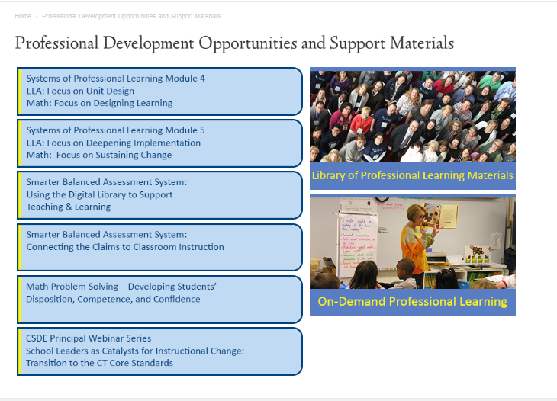
Principal Webinars
Notes:
More information about the sessions and registration information can be found under “Professional Development Opportunities” on the CT Core Standards website.

Slide 8
Professional Development for Educators of Students with Unique Learning Characteristics
Three professional learning modules for school teams.
Each team will include five members:
  Principal or designated building leader,
  Special Education teacher,
  ELL teacher, and
  Two general education teachers.
Mark Your Calendar!
Sessions begin October 30!
Notes:
In partnership with the Connecticut State Department of Education, Public Consulting Group (PCG) will present a professional development series for educators working with students with unique learning characteristics. The goal of this professional development series is to enable local educators to implement CCS-aligned curriculum, instructional practices, and assessments to meet the needs of a wide variety of learners.
Participants will attend as teams to empower educators to align efforts resulting in an inclusive environment, and increase their capability to foster change in their school systems.
Registration is open through the PCG “RegisterMe” website and accessible on the ctcorestandards.org website under the Professional Development link.
In the first module to be offered October through December, the full team from each school, including educators who work with English language learners (ELL) and students with disabilities (SwD), will explore the importance of a culture of academic optimism underpinned by the belief that through high expectations, trust in students and parents, and teacher efficacy that all students can learn. The morning will provide participants an overview of the power of a growth mindset in both students and teachers and discuss implications of adopting a culture of academic optimism in their schools and the collaboration required to achieve that goal. In the afternoon, teams will form a common understanding of Universal Design for Learning (UDL), which provides the foundation and springboard for two subsequent modules that expand participants’ ability to support all learners through using a UDL approach to planning and teaching.

Slide 9
In-District Coaching
This work is being scheduled now by the RESCs. Please contact your local RESC with any questions regarding the Systems of Professional Learning coaching services.
ACES Leslie Abbatiello labbatiello@aces.org | CREC Ellen Retelle eretelle@crec.org | Education Connection Jonathan Costa costa@educationconnection.org
CES Esther Bobowick bobowice@ces.k12.ct.us | EASTCONN Scott Nierendorf SNierendorf@eastconn.org | LEARN Lynmarie Thompson lthompson@learn.k12.ct.us
Notes:
The CSDE has announced that 66 LEAs have received an allocation of in-district coaching services to support implementation of the Connecticut Core Standards for the 2014-2015 school year. For information about your district’s allocation, check with your district administration and your local RESC.

