Slide 1


Connecticut Core Standards for English Language Arts & Literacy
Systems of Professional Learning
Module 5 Grades 6–12:
Focus on Deepening Implementation

Slide 2

Closing Activities
Post-Assessment
Session Evaluation
Page 35
Notes:
10 minutes

Slide 3

Post-Assessment
Where Are You
Now?
Assessing Your
Learning
Notes:
The Post-Assessment will be the same as the Pre-Assessment they took at the beginning of the session. This assessment is to gauge their learning based on the activities of the morning. They will find the Post-Assessment in the Participant Guide (3-4 minutes).
Ask for further thoughts, questions.

Slide 4
Session Evaluation
Thank you for attending today’s session. Your feedback is very important to us! Please fill out a short survey about today’s session.
The survey is located here http://surveys.pcgus.com/s3/CT-ELA-Module-5-6-12.
Notes:
Remind participants to complete the online Session Evaluation. The survey is located here http://surveys.pcgus.com/s3/CT-ELA-Module-5-6-12. Ask for further thoughts, questions.

Slide 5
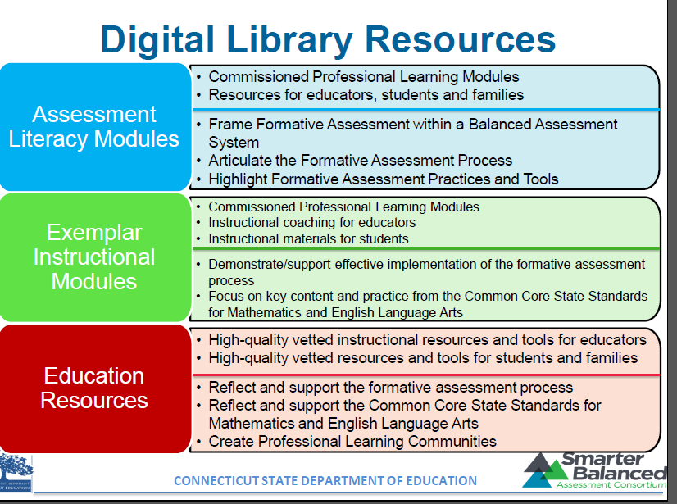
Resource for CT Educators

Slide 6





Other Key Resources
ctcorestandards.org
engageny.org
achievethecore.org
americaachieves.org

Slide 7
Thank you!

