Slide 1


Meeting the Challenge:
CT Core Standards Success for English Learners and Students with Disabilities
A Professional Learning Series for School Teams Dedicated to the Success of ALL Students
Module 1a:
Developing a Culture of Academic Optimism

Slide 2
Morning Session Agenda
Developing a Culture of Academic Optimism
  Pre-Assessment Interactive Poll
  What it Takes for Student Success
  Academic Optimism
  Growth vs. Fixed Mindset
  Action Planning
  Session Evaluation
Lunch Break
Notes:
Review the agenda noting there will be a break for lunch as well as a short morning and afternoon break. You may want to add the importance of coming back from breaks on time to ensure enough time to complete all the work of the day. The afternoon session will have a different focus: Universal Design for Learning.

Slide 3
You are Here! Introductory Activity
Introductory Activity
Part 1:
What it takes for Student Success
Part 2:
Academic Optimism
Part 4:
Building a Plan for Academic Optimism
Part 3:
Growth vs. Fixed Mindset
Notes:
Point out to participants that this module is composed of 4 parts and the introduction. At each transition of sections, they will be reminded where we are in the module. (Slides 4 and 5 will take about 20 minutes.)

Slide 4

Pre-Assessment Interactive Poll
Using your cell phone, answer the poll questions on the next slide regarding Academic Optimism and Growth Mindset. As participants begin to answer, the results will show on the screen.
Notes:
This slide will prepare the teams for the first poll. Give the participants a few minutes to select their answers. It will be more difficult the first time the participants complete the survey. As they begin putting in their answers, the graph will begin to fill in. At the end of the survey, discuss the poll results and ask if they were surprised by the results. This should be interactive and interesting for teams to share out with everyone. No names or team names will be shown in the poll results.

Slide 5

Sharing Out the Results
Statement 1: I believe all students can be successful with the new standards, based on our current programs and supports. (Y-N)
Statement 2: I have the tools at my school or district to ensure all students are successful. (Y-N)
Statement 3: I believe that with training and support my colleagues can gain the ‘Academic Optimism’ to work collaboratively and improve all students’ achievement levels, no matter their individual needs are. (Y-N)
Statement 4: When it comes to planning and implementing the new CCS for all my students, I consider my skill level to be ___________. (a. basic; b. intermediate;
c. advanced; or d. expert)
Page 4
Notes:
This will take about 10 minutes.

Slide 6
You are Here!
Part 1: What it Takes for Student Success
Introductory Activity
Part 1:
What it Takes for Student Success
Part 2:
Academic Optimism
Part 4:
Building a Plan for Academic Optimism
Part 3:
Growth vs. Fixed Mindset
Notes:
(Part 1; Slides 7 and 8 will take about 20 minutes.)

Slide 7
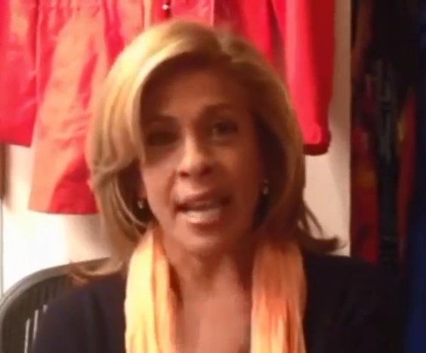
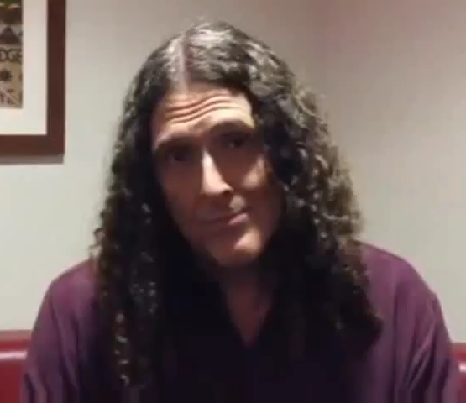

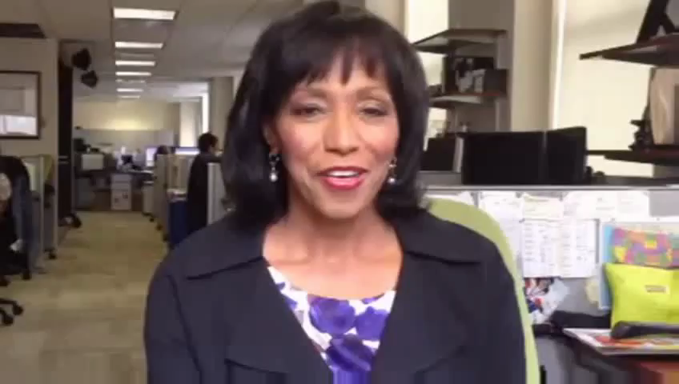
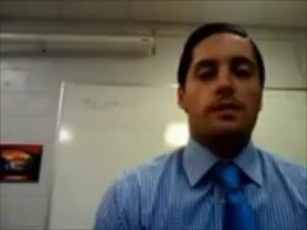
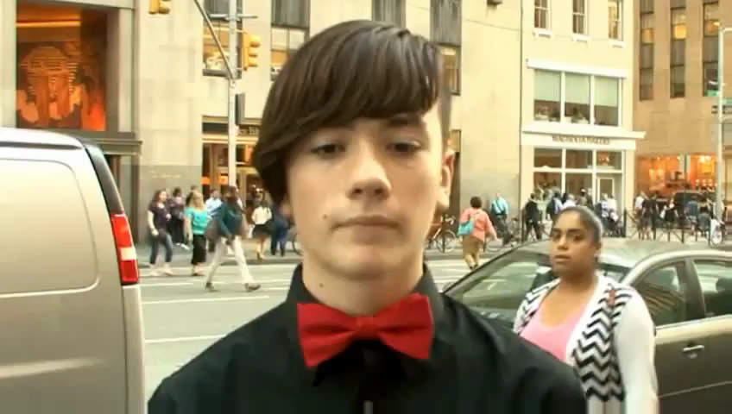
What Does it Take for Student Success?
I believe it takes…
Hoda Kotb
Weird Al Yankovic
Rehema Ellis
Kip Pygman
John Sammon
Notes:
Before showing the video vignettes, discuss that there are many opinions throughout the country as to what is needed for students’ success. Most likely, there are varying opinions within one school. Share with participants that on this slide, celebrities, news personalities, a student, and an educator discuss what they believe it takes for student success. After playing all five clips (all less than 30 seconds), ask the participants to turn and talk with someone at their table about the different ideas and the similarities. This will lead into the first activity.

Slide 8

Activity 1: For Student Success, We Believe it Takes…
Identifying Student Success Factors
In school teams, brainstorm what it takes for students to be successful at your school. Group the ideas into categories that incorporate similar themes. You may use sticky notes to make this easier. Using the themes from your brainstorming session, on chart paper, develop a school statement of what it takes to be successful. Your statement should begin with At (your school name), for students’ success it takes…
Page 6
Notes:
The first activity begins to get participants thinking about what it takes for students to be successful in their school. If there is time, ask a few school teams to volunteer what they created. Allow 15 minutes for this activity.
Discussion Prompt:
When you finish developing your statement, discuss whether other staff members at your school would agree with your statement. Why or why not?

Slide 9
You are Here!
Part 2: Academic Optimism
Introductory Activity
Part 1:
What it takes for Student Success
Part 2:
Academic Optimism
Part 4:
Building a Plan for Academic Optimism
Part 3:
Growth vs. Fixed Mindset
Notes:
(Part 2, Slides 10-18 will take about 20 minutes.)

Slide 10

How Do We Create the Academic Optimism for Success of ALL Students?
Expectations in public education have changed; we are now focused on successfully educating ALL children.
How can we create a culture of Academic Optimism in our schools to make this happen?
Notes:
In this section of this module, the school teams will be focused on recognizing and creating conditions for Academic Optimism. Share with participants that educational expectations have changed under the new CT Core Standards with the goal being that all students need to be career and college ready before leaving high school. However, if teachers or school leaders do not believe their students can reach those academic goals, then students will not have opportunities for success. As school teams, they must find ways to support a high level of optimism in their school.

Slide 11
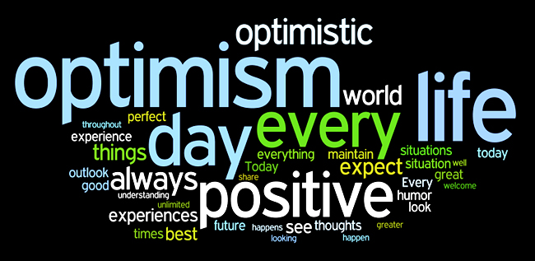
Academic Optimism
Essential Question:
What does Academic Optimism look like and how do we support it within our schools?
Notes:
Read the Essential Question. Ask the participants to discuss with someone at their table what they believe Academic Optimism looks like in school. Also have them discuss what faculty members could do to support that concept. Ask volunteers to share what they believe Academic Optimism would like in a school setting. This is a lead in to a new body of research that many participants will not be familiar with.

Slide 12





Academic Optimism
A
school with high
Academic Optimism believes that faculty can make a difference, students can learn, and academic performance can be achieved.
Hoy et al., 2006
Notes:
Read aloud (or ask a participant to read) the definition of Academic Optimism. Let participants know that research on Academic Optimism, by Wayne Hoy of Ohio State University School of Educational Policy and Leadership, will play an important role in the success of all students as they transition to the new CT Core Standards. Dr. Hoy has been researching this construct for 40 years and has provided a compilation of the research to PCG for this project.
The next few slides will provide an overview of the three constructs of Academic Optimism. Once the participants receive the overview, they will be watching its implementation in action at an elementary school.

Slide 13
What Characterizes Academic Optimism?
Academic Emphasis
Academic Optimism
Collective Efficacy
Faculty Trust in Parents and Students
Hoy et al., 2006
Notes:
Academic Emphasis: Academic achievement is important
Faculty Trust: Students and parents can be trusted to cooperate with teachers
Collective Efficacy: A school-wide confidence that students will succeed academically
Note that the three areas are connected. They are all of equal importance.
Three important dimensions collectively produce a potent academic environment that positively influences school achievement. Share with the participants that they are going to learn more about each of these and subsequently watch a video that depicts an elementary school environment that demonstrates all three areas.

Slide 14
Academic Emphasis
Academic emphasis is the extent to which a school or district is driven by a belief system that includes high expectations for students to achieve
High, but achievable goals are set for students
The learning environment is orderly and serious about academic expectations
Students are motivated to work hard and they respect academic achievement and want to meet their goals
Academic Emphasis
Hoy et al., 2006
Notes:
Read the slide which provides an overview of academic emphasis. Your goal over the next few slides is to build a shared understanding as to what each element looks like in a school. After each slide, ask for comments or discussion from the participants either as a whole group or at their table.

Slide 15
Collective Efficacy
The collective efficacy of the faculty is the teachers’ belief that they can affect student learning. There is a “We can do it” attitude amongst staff
Individuals and groups are unlikely to initiate or change practice without a positive sense of self efficacy
The research shows that schools where the faculty collectively had a strong sense of efficacy flourished, and schools that had serious doubts declined or showed little academic progress
Collective Efficacy of the Faculty
Hoy et al., 2006
Notes:
Read the slide which provides an overview of collective efficacy. Continue to build a shared understanding as to what the element looks like in a school. After the slide, ask for comments or discussion from the participants either as a whole group or at their table.

Slide 16
Faculty Trust in Parents, Students, and
Each Other
Faculty, administrators, and parents/families cooperate and collaborate on improving student learning
Trust is a concept with at least five facets; benevolence, reliability, competence, honesty, and openness
Learning is typically a cooperative process and distrust makes cooperation virtually impossible
Learning necessitates risk-taking, therefore distrustful people are less likely to take learning risks
Faculty
Trust in Parents, Students, and Each Other
Hoy et al., 2006
Notes:
Read the slide which provides an overview of trust. Continue to build a shared understanding as to what the element looks like in a school. After the slide, ask for comments or discussion from the participants either as a whole group or at their table. They will be moving into watching the video.

Slide 17

Activity 2a: Do You Believe ALL Students Can Be Successful?
Watch the video and use the Note Catcher on page 9 in your Participant Guide to highlight how staff create an environment of high expectations and Academic Optimism that connects with students and parents. After the video, discuss each area of Academic Optimism and where it was found within the school, citing evidence.
César Chávez Elementary School: What makes a great school?
Pages
8-9
Notes:
Before playing the video, ask the participants to locate their video note taking sheet in the Participant Guide on page 9. They will be using the Note Catcher to jot down notes regarding how all three areas of academic optimism can be seen within the school. The video is 7:38. The participants will reference the notes while discussing the three areas in table groups after the video. Between the video and the discussion, participants will be given 20 minutes for this part of the activity.
This is the video web address: https://www.youtube.com/watch?v=qruX_1vyJhA

Slide 18
Activity 2b: Identifying the Tenets of Academic Optimism Within Your School
Developing an Understanding of Academic Optimism
Using the activity sheet, Creating a School Culture of Academic Optimism, found on page 10 of your Participant Guide, identify the components of Academic Optimism that are already present in your school and what areas are not as strong (if present at all). Determine which areas should be prioritized for improvement within your school that will support achievement for all students. Be prepared to share out with the large group.
Page 10
Notes:
This activity brings the construct of Academic Optimism back to their own school. Ask the team to discuss the video and using the Activity Sheet, determine areas that are present and what areas are lacking. They will have 25 minutes to complete this activity.

Slide 19

Let’s Take A Break…
…Be back in 10 minutes
Notes:
The break should be 10 minutes. Remind the participants to try to be timely in their return. When participants return, we will look at Growth and Fixed Mindsets.

Slide 20
You are Here!
Part 3: Growth vs. Fixed Mindset
Introductory Activity
Part 1:
What it takes for Student Success
Part 2:
Academic Optimism
Part 4:
Building a Plan for Academic Optimism
Part 3:
Growth vs. Fixed Mindset
Notes:
(Part 3; Slides 22-32, will take about 50 minutes.)

Slide 21
What is Mindset?
Mindset
Related to belief about ability
Creates belief system defining who you are
Fixed Mindset: Ability cannot change
Growth Mindset: Ability can change and grow
Dweck, 2006
Notes:
This slide is based off of Dr. Carol Dweck’s work in Mindset. The participants will be reading more details about Growth vs Fixed Mindset in the next activity.

Slide 22
Activity 3: ABC…Plus One Protocol
Growth Mindset Development in Students
Read the short article Creating a Growth Mindset in Your Students on page 16 of your Participant Guide. Divide into groups of 4. Following the ABC…Plus One protocol, share with your group your agreements, big ideas, connection, and most important application to your work in your schools. Be prepared to share with the large group.
Pages
14-15
Notes:
Using the ABC…Plus One protocol, participants read the article on Growth vs. Fixed Mindset. Participants use this protocol to identify areas that they agree with and can connect to their school. The important component of this protocol is that we want the teams to think where they can apply some of the content within their school. Allow 20 minutes for this activity.
Activity 3: ABC…Plus One Protocol
DESCRIPTION
ABC…Plus One is a reading strategy protocol for small groups to explore ideas, areas of agreement, and connections. Each participant selects and records responses to specific prompts on the Note Catcher on page 15 of the Participant Guide.
Directions
Review the ABC…Plus One process in your group. Provide each team member with a letter from
A to D.
Starting on page 16, read the article Creating a Growth Mindset in Your Students and in the appropriate box record:
One thing with which you Agree
One Big Idea
One Connection to your current work
Round 1: Each member shares their Agree box without elaborating about why they chose that item. When all Agree boxes have been read, Person A offers a summarizing paraphrase of what has been said. He or she then leads a short discussion among the group about what influenced members to write what they wrote.
Round 2: Each member repeats the process with the Big Idea box. Person B leads the discussion.
Round 3: Each member repeats the process with the Connection box. Person C leads the discussion.
Round 4: Each person locates the 4th box on the Note Catcher and writes how this information might be used or applied. Members repeat the process. Person D leads the discussion.
Small groups share insights with the larger group.
Discussion Prompt:
How can this protocol help to clarify the main ideas of the reading while transferring the understanding to your school setting?

Slide 23
Motivational Framework Supporting Mindsets
Goals
Effort
Responses
Strategies
Notes:
This framework provides a juxtaposition of growth vs. fixed mindset in the following four areas. The next few slides will clearly demonstrate the opposing points of view of each area of the motivational framework.

Slide 24
Goals: Things We Aim For
People with Fixed Mindset:
  Create performance goals
  Believe a person’s potential can be measured
  Aim to receive validation from others
  Attribute success or intelligence to the grade or score received…low marks or scores mean they are not smart or not successful
  BOTH SUCCESS AND FAILURE CAUSE ANXIETY…
Do you see this in your students? How about the adults?
Dweck, 2006
Notes:
After reviewing the slide ask the participants to Turn and Talk with someone at their table regarding the statement “Both success and failure cause anxiety.” Do they see that in their students? Do they see that in adults?

Slide 25
Goals: Learning
People with Growth Mindset:
  Create learning goals rather than performance goals
  Aim for mastery and competence
  Consider scores or marks as a measure of progress toward goal, not a measure of a person’s potential
  Provide an example of where you have seen this in your school with your students or colleagues?
Notes:
Learning goals have shown an increase in performance and enjoyment and a decrease in negative emotions. Ask the participants if they have experienced that as well. Have them share experiences with others at their table.

Slide 26
Effort: Requirement for Success?
Fixed Mindset
View effort as a reflection of low intelligence or lack of skill
Hard work means “I don’t get it or I am not smart enough”
Growth Mindset
Effort as a necessary part of success
Effort = Success
Effort = Lack of ability
Try harder when faced with setback
Dweck, 2006
Notes:
After reviewing the slide, ask participants to see how effort and success not only can be attributed to students, but also to adults. As the schools and districts incorporate more of the CT Core Standards and instructional shifts, some staff members will see the extra effort needed as a reflection on their teaching ability rather than that there will be extra effort needed to be successful. We see this same thinking in students as well. However, with the new standards, some students who have normally been easily successful in school will need to understand that the extra effort is not a reflection on their intellect or abilities, but rather on the changes in the curriculum and in the expectations.

Slide 27
Responses: How We React to Events
Mastery - Growth Mindset
Helpless - Fixed Mindset
Does not pay attention to learning information
Appears depressed or has a loss of self-esteem
Says things such as “I am stupid”
Seems to under represent success, over represent failure
Pays attention to learning information
Tries out new ways of doing things
Focuses on learning rather than how they feel
Uses self motivating statements such as “the harder it gets, the harder I try”
Dweck, 2006
Notes:
Discuss slide. Discuss that it is not uncommon to hear students who are struggling saying negative statements such as they are stupid or the assignments are stupid or even the teacher is stupid. Those negative emotional statements contribute to a lack of self-esteem and perpetuate a lack of perseverance. The statements should be turned around into something positive, which focuses on how much effort students are showing to complete the work.

Slide 28
Strategies: How to Reach Success?
Fixed Mindset
Continuously uses the wrong strategy when trying to solve problems, but doesn’t change the approach
Growth Mindset
Looks for options, new ways to solve problems
Disengages from problem; gives up
Thinks outside of the box because they believe they can
Dweck, 2006
Notes:
It is important to have a plan in place to turn a fixed mindset into a growth mindset for both students and adults. When a student or adult keep using the wrong or unsuccessful strategy to solve a problem, it is necessary to help them find new ways to solve a problem. This will prevent them from giving up or disengaging from successful completion of the problem. By supporting new ways of thinking, you are building a culture of academic optimism in classrooms and throughout the school.

Slide 29
Reactive and Proactive Behaviors
Reactive - Fixed Mindset
Proactive - Growth Mindset
I’ll be happy when I have…
If only I had parents or a principal who wasn’t…
If I just had respect from…
Dweck, 2006
I can be a better role model for…
I can be more organized and more informed about…
I can be more understanding…
I can seek out support when…
Notes:
Here are some typical statements you may hear from students and adults with a fixed and growth mindset. After reading the slide, ask participants if they see some of these behaviors in both students and adults. Have the teams discuss when they have seen this in their school and what is the antecedent for the reactive behaviors.

Slide 30
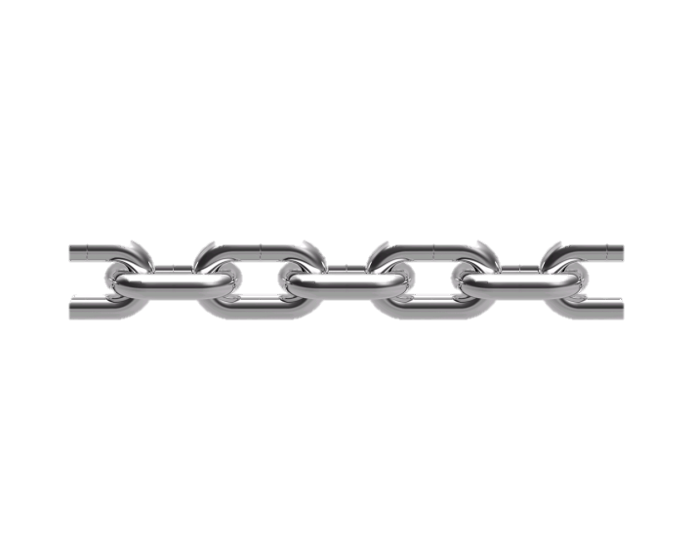
What’s the Link?
ACADEMIC OPTIMISM
GROWTH MINDSET
Notes:
This is an introductory slide to building a connection between Academic Optimism and a Growth Mindset. The two concepts should not be thought of as separate entities, but rather as strongly linked. Students and staff will need both the Academic Optimism and the belief in a growth mindset to change the culture of the school through their beliefs and deliberate actions.

Slide 31
Activity 4: What’s the Link?
Connecting the “Big Ideas” of Academic Optimism & Growth Mindset
In school teams, draw a Venn Diagram on chart paper. Label the first circle, Academic Optimism and the second Growth Mindset. Using sticky notes of the same color, individually brainstorm key points and big ideas regarding Academic Optimism that you have learned or discussed in the session and place in the diagram. Repeat the process using different color sticky notes for Growth Mindset. As a team, examine both sections of the Venn Diagram. Move sticky notes that have a natural connection into the overlapping circles in the middle of the diagram that you would like your school to focus on throughout the year. Discuss ways of shifting school culture through the link between Academic Optimism and Growth Mindset that supports all students becoming successful.
Page 20
Notes:
The goal of this activity is to find connections between Academic Optimism and Growth Mindset. Participants will be using a Venn Diagram to find natural connections between both constructs which will be a jump start to making their plan in the next activity. Allow 20 minutes for this activity.
DESCRIPTION
Participants will make a connection between Academic Optimism and a Growth Mindset that can be supported or implemented within their school.
Directions
In school teams, draw a Venn Diagram on chart paper. Label the first circle, Academic Optimism and the second Growth Mindset.
Using sticky notes of the same color, individually brainstorm key points and big ideas regarding Academic Optimism that you have learned or discussed in the session and place in the diagram.
Repeat the process using a different color sticky note for Growth Mindset.
As a team, examine both sections of the Venn Diagram. Move sticky notes that have a natural connection into the overlapping circles in the middle of the diagram that could be supported or implemented within your school.
Discuss ways of shifting the school culture through the link between Academic Optimism and Growth Mindset that supports all students becoming successful.
Discussion Prompt:
What will be the most challenging task as you begin to shift the culture and mindset of teachers, parents, and students to one of Academic Optimism?

Slide 32
You are Here!
Part 4: Building a Plan for School-wide Academic Optimism
Introductory Activity
Part 1:
What it takes for Student Success
Part 2:
Academic Optimism
Part 4:
Building a Plan for Academic Optimism
Part 3:
Growth vs. Fixed Mindset
Notes:
(Part 4; Slides 33-34, will take about 30 minutes.)

Slide 33
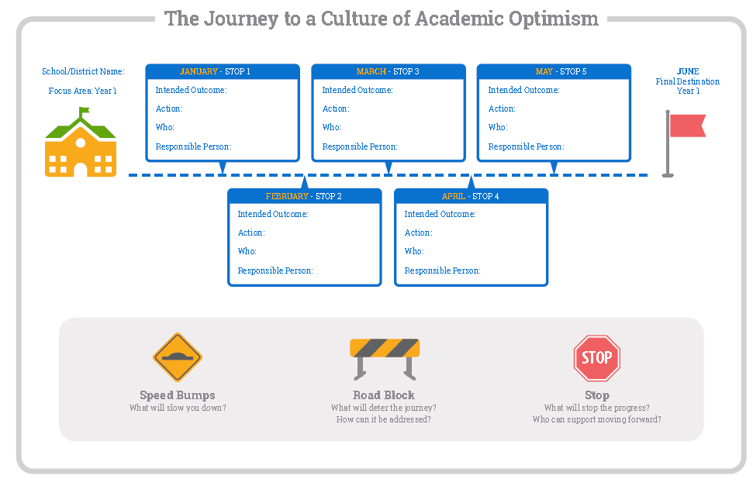
Mapping Out A Plan
Notes:
Developing an action plan that is well articulated is important as you begin to change your school culture to Academic Optimism and incorporating the tenets of Growth Mindset. It has an unexpected value of protecting goals from distractions and other competing initiatives. Planning for road blocks and speed bumps that may stop progress along the way is also important in order to be prepared and be proactive about addressing the barriers rather than being reactive, which may not be a well thought out approach. Discuss the journey map and how the participants should think about filling it out, which will be the last activity of the morning. They will be given a template to fill out, but having a graphic depiction of their “journey” can be posted within their school as a reminder of their plan.

Slide 34
Activity 5: Developing An Action Plan for Academic Optimism
Developing An Action Plan
Using the Action Planning Template in your Participant Guide, begin to plan what actions will be taken to support a culture of Academic Optimism. Consider incorporating the components of Academic Optimism and Growth Mindset as you design your plan. During the process, plan for obstacles (speed bumps) and detours that may occur during the implementation stage. After completing the Action Planning Template, on the Journey Map, fill in the “journey” that you would like the school to take throughout the remainder of the school year to achieve the goal of a Culture of Academic Optimism which will lead to increased academic achievement for ALL students.
Pages
22-24
Notes:
Review the activity for the school teams in building a culture of Academic Optimism. They will begin outlining their plan. Allow 25 minutes for this activity.
Directions
Using the Action Planning Template on page 23 of the Participant Guide, begin to plan what actions will be taken to support a culture of Academic Optimism. Consider incorporating the components of Academic Optimism and Growth Mindset as you design your plan.
During the process, plan for obstacles (speed bumps) and detours that may occur during the implementation stage.
After completing the Action Planning Template, on chart paper, draw out the “journey” that you would like the school to take throughout the remainder of the school year to achieve the goal of Developing a Culture of Academic Optimism which will lead to increased academic achievement for ALL students.
Discussion Prompts:
When writing your action plan, what additional data may you need before you can solidify your plans?
What tools or supports may be needed for all stakeholders as they begin their journey to a Culture of Academic Optimism?

Slide 35

Bon Appétit
Notes:
As the morning session comes to a close, tell the participants that the work they began in the morning will connect to the afternoon’s session of Universal Design for Learning. Encourage teams to think about ways they can apply the concepts in their schools.
They have 60 minutes for lunch. Remind them to be back on time as we will begin promptly.

Slide 36
Session Evaluation
Thank you for attending Module 1a’s session, Developing a Culture of Academic Optimism.
Your feedback is very important to us! Please fill out a short survey about this morning’s session.
The survey is located here: http://surveys.pcgus.com/s3/CT-Module-1a
Notes:
Remind participants to complete the online Session Evaluation. The survey is located here: http://surveys.pcgus.com/s3/CT-Module-1b. Ask for further thoughts, questions.

Slide 37
Meeting the Challenge:
CT Core Standards Success for English Learners and Students with Disabilities
A Professional Learning Opportunity for School Teams Dedicated to the Success of ALL Students
Module 1b:
Universal Design for Learning
Notes:
This module supports participants as they form a common understanding of Universal Design for Learning, which provides the foundation and springboard for two subsequent modules that expand participants’ ability to support all learners through using UDL as an instructional design element and approach to planning and teaching.

Slide 38
Essential Questions
How can I support the widest range of diversity represented in my students so they all can be successful?
How can I facilitate learning and success of all my students in a manner that I know is research-based?
How can I plan and integrate instructional practices based on Universal Design for Learning (UDL)?
How can I continue to learn about UDL and meaningfully collaborate with colleagues to work smarter, not harder?
Notes:
These are the big questions that are the underpinning for today’s UDL session. Today and at each subsequent PD, we’ll delve into addressing these questions.
However, today we want to start at the beginning. So let’s look at what we will be addressing today.

Slide 39
Afternoon Session Agenda
Universal Design for Learning (UDL)
  Introductory Activities: Pre-Assessment Interactive Poll
  The Foundation for UDL
  UDL in Practice
  UDL for Unit & Lesson Planning
  Reflection, Next Steps, and Session Evaluation
Notes:
Presenter shares the points on the slide.

Slide 40
You are Here! Introductory Activities
Introductory Activities
Part 1:
The Foundation for UDL
Part 2:
UDL in Practice
Part 3:
UDL for Unit & Lesson Planning
Part 4:
Reflection, Next Steps, & Session Evaluation
Notes:
Point out to participants that this module is composed of 4 parts and an introduction.
In the introduction, we’ll look at some interesting information about SwD and ELs. We’ll also do a check to see what we already know.
From there, in Part 1, we will look at the foundation for UDL, its definition, and how the UDL principles each support the total construct of UDL.
In Part 2, we will examine UDL in practice—how do we move from the conceptual framework to real classroom application. In other words, what does it look like and how do each of the UDL principles support and inform our classroom practices?
In Part 3, we’ll look at how we can infuse UDL into our lesson planning to strengthen our plans to reach our learners.
Finally, in Part 4, we’ll reflect on what we learned and think through what UDL means for us individually and as teams and how we develop next steps for starting to incorporate UDL into our daily practices and routines.
At each transition to the next part of the presentation, participants will be reminded where we are in the module.

Slide 41
Just the Facts
Over _______ % of students with disabilities spend at least 80% of the day in general education.*
Over ______ % of public school students are English learners.*
* The Condition of Education (2014). National Center for Education Statistics.
Notes:
Before we begin, let’s learn more about the two groups that we are addressing in this module. Directions: Have participants turn to a partner and discuss and come up with responses. Call on audience members for each blank. Give correct answers on next slide.

Slide 42
Just the Facts
Over 62% of students with disabilities spend at least 80 percent of the day in general education.*
Over 9% of public school students are English learners.*
* The Condition of Education (2014). National Center for Education Statistics.
Notes:
In times past, barriers to student learning were attributed to perceived student or family shortcomings. For example, comments such as “Nathan has a learning disability and he can’t learn grade level curriculum,” “Miguel comes from a home where the parents can’t speak English,” and “Tess is unmotivated and doesn’t care to learn” are examples of how problems of learning were situated in variables external to the instructional and classroom variables. Student capacity to learn was seen as diminished due to these and other perceived barriers.
Clearly students with disabilities and ELs are 2 groups that we serve who are in typical settings and must be considered as we think about effective teaching that help students meet the CCS.

Slide 43

Pre-Assessment ‒ Poll Everywhere
Statement 1: I understand the term “Universal Design.” (Y-N)
Statement 2: I understand the term “Universal Design for Learning.” (Y-N)
Statement 3: I believe that all students can meet the Connecticut Core Standards (CCS). (Y-N)
Statement 4: I know how to design instruction to support all students to meet the CCS. (Y-N)
Statement 5: When it comes to planning and implementing curriculum using UDL, I consider my skill level to be _________. a) basic; b) intermediate; c) advanced; or d) expert
Page 4
Notes:
We are now going to learn a little bit more about us as a group gathered here today. We have 5 polling statements on which we’d like you to rate yourself.
You will see a number to text depending on how you want to answer the questions. Choose the response (and number) and text in your response. Once you do, we’ll see the group’s collective status in regard to each statement and we’ll start off with an understanding of the larger group’s standing.

Slide 44
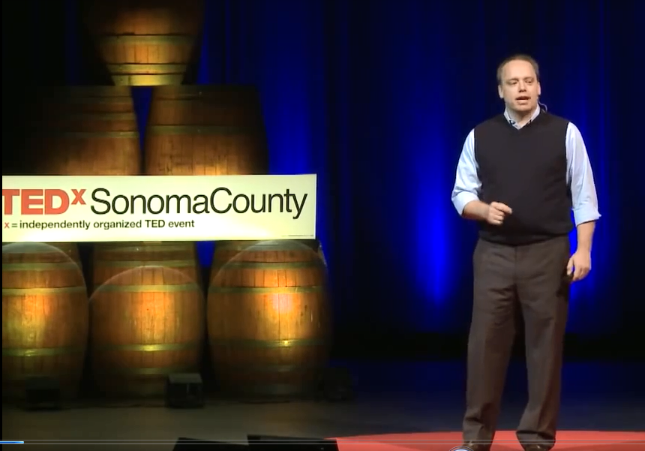
Activity 1: Myth of Average
How might a "one size fits all" classroom present challenges to learning like a "one size fits all” cockpit presents challenges to flying?
Pages 5-6
Notes:
SHOW VIDEO FROM BEGINNING TO ONLY TO 5.55 (“I think we all know we have some problem.”) Participants will view the video clip The Myth of Average taking notes on their Note Catcher as they view. Afterwards, participants will stand and locate someone they do not know and share their reflections related to the question on the PPT using some of the terms addressed in the video: jagged learning profile, ban the average, design to the edges, cockpit of our economy. Participants will also share their big take away from viewing the video. Participants will discuss their responses at their table groups. Afterwards, participants will text responses when prompted to create a word cloud of their take-aways for practice. The video can be found here: http://tedxtalks.ted.com/video/The-Myth-of-Average-Todd-Rose-a

Slide 45
Using the ideas in the video clip, can you make connections to designing curriculum and instruction to support a wider range of learners?
Notes:
Participants will text responses when prompted to reply to this prompt creating a “Word Cloud.” Choose a few participants to respond to the large group as well.

Slide 46
You are Here!
Part 1: The Foundation for UDL
Introductory Activities
Part 1:
The Foundation for UDL
Part 2:
UDL in Practice
Part 3:
UDL for Unit & Lesson Planning
Part 4:
Reflection, Next Steps, & Session Evaluation
Notes:
In Part 1 we will look at the foundation for UDL, its definition, and how the UDL principles each support the total construct of UDL.
Make sure each table has chart paper and large bold colored markers.

Slide 47
Activity 2: Defining Universal Design
Universal Design
On the next slide you will see 7 examples of “Universal Design” (UD) and each represents a principle of UD. As a table team, (no internet search!), discuss each of the pictures from the standpoint of how users are supported. Then come to a consensus about the common thread that makes these all examples of “Universal Design” (5 mins). On your chart paper, record the common thread that each principle supports for Universal Design. Be ready to share.
Page 8
Notes:
Let’s first examine Universal Design. Why? Universal Design for Learning is a construct borrowed from UD, from the field of architecture. It’s a design principle that has been around for decades. Understanding UD can help one understand UDL, although they have distinct and specific applications in both fields.
Introduce the activity on the slide. Answer any questions. Provide 15 minutes for this activity.

Slide 48
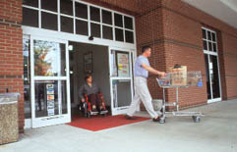
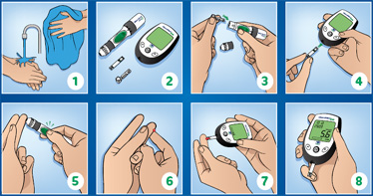
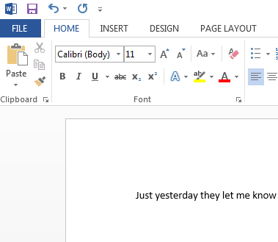

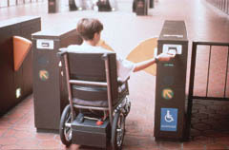


Notes:
Call on a few groups to share the common thread of UD. You will hear different response. You can also share that the idea of UD is to design spaces and products that integrate and include all users rather than separate and distinguish between different segments of the human population, such as disabled or older users. All the pictures on the screen represent one of the principles of Universal Design that make it usable by persons to the greatest extent possible, without needing adaptation or specialized design. BE SURE TO SHARE THESE IDEAS WITH PARTICIPANTS BEFORE MOVING ON. Activity sharing 5-10 minutes.
Some of your participants will want to know more about each principle and what it addresses. The answers are below.
Top left Equitable use - The design is useful to people with diverse abilities.
Middle, left Flexibility in Use - The design accommodates a wide variety of individual preferences and abilities.
Bottom, left Perceptible Information - The design communicates necessary information effectively to the user, regardless of conditions or the user’s sensory abilities.
Center, middle Tolerance for Error - The design minimizes the hazards and adverse consequences of accidental or unintended actions.
Top, right Simple and Intuitive Use - Regardless of the design, it is easy to understand, regardless of the user’s experience, knowledge, language skills, or education level.
Middle, right Size and Space for Approach and Use - Appropriate size and space is provided for approach, reach, manipulation, and use regardless of user’s body size, posture, or mobility.
Bottom, right Low Physical Effort - The design can be used efficiently and comfortably and with a minimum of fatigue.

Slide 49
Activity 3a: Defining Universal Design for Learning
Viewing a Video
View a brief video clip, UDL at a Glance, and take notes so you can capture the key ideas. These will be used in building your definition of UDL in Activity 3b. After viewing, individually create your keys. Next, you will join 2 other non-table participants and share your keys. Be prepared to return to your table group and share the most important keys.
Page 9
Notes:
Participants will view a brief video (less than 5 minutes long), UDL at a Glance. The video will address the 3 principles of universal design; multiple means of engagement, multiple means of representation, and multiple means of action and expression.
Step 1: Before showing the video, tell participants that the goal is for them to capture keys from the video clip in any manner that works for them‒written and/or spoken language, a drawing or illustration or a visual mapping. Urge them to consider their chosen method. Encourage them to take notes throughout the video clip so they can create their keys.
Step 2: Show the video. Provide 5 minutes after the video for participants to do their assignment mentioned in Step 1.
Step 3: Afterwards, tell participants that they are to get up and form triads with other non-table participants and share their keys. They can add on to their keys, exchange out one idea for another, etc. Their goal is to consider the keys that they want to consider for their table definition. Provide them 10 minutes to share and discuss. (If triads finish early, they can move on to combine and share with another triad.)
Step 4: Participants return to their tables and share their most important keys. (5 minutes) Total-25 minutes

Slide 50

Exploring UDL
UDL at a Glance. Cast (2010). Retrieved from http://www.cast.org/library/video/udl_at_a_glance/index.html
Notes:
UDL at a Glance. Cast (2010). Retrieved from http://www.cast.org/library/video/udl_at_a_glance/index.html

Slide 51
Activity 3b: Defining Universal Design for Learning (continued)
Universal Design for Learning
Directions: Based on what you’ve learned about Universal Design for Learning, your table group will discuss, come to a consensus, and develop a working definition for “Universal Design for Learning” on chart paper. (15 minutes)
Page 11
Notes:
Participants are to use chart paper! 15 minutes for this activity.

Slide 52
UNIVERSAL DESIGN FOR LEARNING means a scientifically valid framework for guiding educational practice that:
provides flexibility in the ways information is presented, in the ways students respond or demonstrate knowledge and skills, and in the ways students are engaged; and
reduces barriers in instruction, provides appropriate accommodations, supports, and challenges, and maintains high achievement expectations for all students, including students with disabilities and students who are limited English proficient.
Higher Education Opportunity Act 2008 (HEOA)
Notes:
Show this definition of UDL included in the Higher Education Opportunity Act of 2008. Tell participants to silently read the introduction and 2 parts of the definition.
Tell table teams that they are to review their definition of Universal Design for Learning and discuss how theirs compares with the “expert” definitions on the slide. Tell them to revise/adjust their definition on their chart paper if/as they feel is needed to capture all essential elements but in their own terms. Provide teams 10-15 minutes for this.
Tell them to be prepared to share with the larger group. Participants display their chart paper with the definition on the wall (15 minutes).

Slide 53
Activity 3c: Defining Universal Design for Learning (continued)
Compare your Definitions
Directions: Review your definition of Universal Design for Learning and discuss how yours compares with the “expert” definitions on the next slide. Revise/adjust your definition on your chart paper to include all essential elements but in your own terms. Be prepared to share. Display your chart paper with the definition on the wall (15 minutes).
Page 11
Notes:
15 minutes. From here, dismiss participants for the break. Encourage participants to take a “gallery walk” sometime during the break to look at UDL definitions on the walls from the different table groups. Ask them to provide feedback on each table group’s definition by using “post-it notes” with feedback about their definition. (e.g., Great job!, Consider…)

Slide 54
Let’s Take A Break…
…Be back in 10 minutes
Notes:
The break should be 10 minutes. Remind participants to try to be timely in their return. Remind them that when they return, we will start looking at UDL in practice.

Slide 55
You are Here!
Part 2: UDL in Practice
Introductory Activities
Part 1:
The Foundation for UDL
Part 2:
UDL in Practice
Part 3:
UDL for Unit & Lesson Planning
Part 4:
Reflection, Next Steps, & Session Evaluation
Notes:
In Part 2, we will examine UDL in practice—how do we move from the conceptual framework to real classroom application. In other words, what does it look like and how do each of the UDL principles support and inform our classroom practices?

Slide 56
UDL Reduces Barriers to Learning
Learning Goals
Instructional Materials
Instructional Methods
Assessments
Notes:
UDL does not change our instructional focus--the learning goals and the skills and habits that we want students to acquire. These learning goals are reached through careful instructional design and considerations around instructional methods, materials, and formative assessment and progress monitoring.

Slide 57
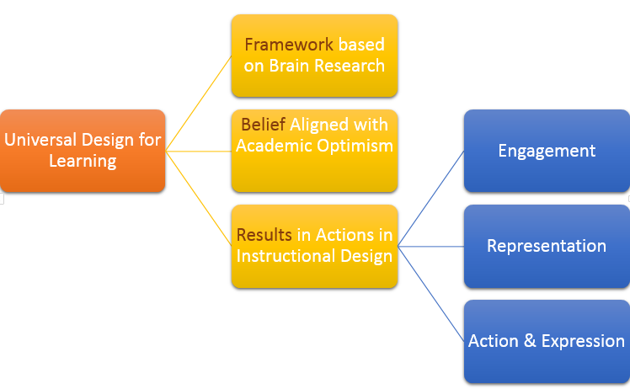

Universal Design for Learning
Notes:
To summarize the big ideas about Universal Design for Learning:
It is a conceptual framework based on cognitive neuroscience.
It aligns with academic optimism
It results in PLANNING and INSTRUCTIONAL ACTIONS that provide flexibility and responsiveness to meet the learning diversity among all learners.
UDL Principles are organized around the networks of the brain and how they function:
Engagement is based on the affective networks - the affective network or the “why” of learning-how learners get engaged and stay motivated. How they are challenged, excited, or interested. These are affective dimensions. The adage, “If you can’t hook them, you can’t cook them” applies to the power of engagement in order for students to learn. We cannot underestimate the power and the NEED for engagement. Nothing is remembered if there is not an emotional connection-good or bad.
Representation is based on the recognition networks - is the “what” of learning. How we gather information and categorize what we see, hear, and read. Identifying letters, words, or an author's style are examples of recognition tasks. This is a pattern recognition process.
Action & Expression is based on the strategic networks - is the “how” of learning. These networks deal with the planning and performing tasks, how we organize and express our ideas. Writing an essay or solving a problem are strategic tasks.

Slide 58

UDL in…
Notes:
Let’s walk through an application in reading of how one Universal design for Learning principle, Representation, can work.

Slide 59
Let’s Consider ‒ Representation
UDL and Reading
Students with a reading disability related to decoding
Students who decode below grade-level expectations and/or struggle with typical grade-level materials
Emergent readers who would benefit from accessing text above their current decoding level
Students learning English as another language
Students who would benefit from hearing written text read back during the editing process of a writing assignment
Students with a visual processing difficulty
Students with vision loss
Notes:
Reading is a process of constructing meaning from written text. Decoding is a sub skill of this process. Students who have difficulties decoding text must overcome barriers related to reading and understanding printed materials in order to be able to access content and information. While students experiencing difficulty require both explicit reading instruction and practice, they may also benefit from the use of technology as a support to help reduce the barriers of print while they are improving their skills. To maximize student success, technologies must be combined and aligned with effective instruction.

Slide 60
Benefits
Reduce fatigue and/or frustration and increase reading assignment completion
Help student pay attention and remember more through the use of highlighted and spoken text
Increase independent access to interesting and age-appropriate content and opportunities to engage with text
Other benefits?
Notes:
Text-to-speech can:
decode text with an accuracy and fluency that students who struggle with text cannot attain on their own
enable students to work more independently with grade-level materials
increase independent access to interesting and age-appropriate content and opportunities to engage with text
support comprehension by freeing students to focus on the meaning of the text
support comprehension by enabling students to reread blocks of text, instructions, or questions as many times as needed to ensure comprehension
provide opportunity for repeated reading of text to help students develop decoding, vocabulary, and grammatical skills
allow students to participate in discussions and activities related to content read
reduce fatigue and/or frustration, and increase students’ ability to complete reading assignments
help students pay attention and remember more through the use of highlighted and spoken text
assist students in proofreading written work by hearing content read back out loud

Slide 61
Representation
Flexible means to achieve the outcome or goal
Learner
Potential Barrier: Printed Text
Learning Outcome
UDL Options: Screen Readers, Text-to-Speech, Digital Talking Books, Masterful Read
Notes:
Let’s think about this application as a visual representation of the problem. (Presenter, as you click each time, a part of the visual display will appear.)
The learner has a significant reading problem, reading a few levels below the text selection.
The learning goal/outcome remains the same. You want them to be able to identify conflicting information in the text. This is not to suggest that the student should be able to improve his/her decoding/reading skills and that should be addressed.
What you need is a flexible means for the student to achieve the goal; a different way for the material to be represented.
Possible UDL Options include screen readers, text-to-speech readers, digital talking books, and a masterful read by teacher, student, or through an audio file.

Slide 62
Representation
Flexible means to achieve the outcome or goal
Learner
Learning Outcome
UDL Options: Screen Readers, Text-to-Speech, Digital Talking Books, Masterful Read
Notes:
What happens when you provide a UDL option for an alternate representation? The potential barrier is removed and the student has access to meet the learning outcome.

Slide 63

UDL Principles Jigsaw

Slide 64
Activity 4: UDL Principles Jigsaw
UDL Principles Jigsaw (10 minutes)
Number off at your table: 1, 2, 3 (1-Engagement; 2-Representation; 3-Action and Expression). Position yourself next to your table mates with the same number. With your table mates, read and discuss the corresponding UDL principle from the article Universal Design for Learning: Assistance for Teachers in Today’s Inclusive Classrooms (Representation pp. 13‒16; Action & Expression pp. 16‒17, and Engagement p. 17) to: Be able to explain the principle Gather examples of the principle in practice Use the puzzle form on the page 13 of the Participant Guide to record examples of the principle in practice. Be prepared to share with your table mates. As your colleagues share, you may wish to continue recording examples of each principle in practice.
Pages 13-14
Page
Notes:
(10 minutes)

Slide 65
Activity 5: UDL Principles, Guidelines, and Checkpoints
UDL Principles, Guidelines, and Checkpoints
First, review and discuss the guideline for the UDL Principle that you and your table mates read in the article, Universal Design for Learning: Assistance for Teachers in Today’s Inclusive Classrooms. What does each guideline mean? (5 minutes) Next, return to the article and then match specific recommendations in the article to each guideline for the principle that you read. Place one example from the article on a Post-It and place it next to the guideline to which it relates. Be prepared to share examples as they relate to specific guidelines or checkpoint for each principle. (5 minutes)
Page 15
Notes:
Provide a brief explanation of what are the principles, the guidelines, and checkpoints in the chart.

Slide 66
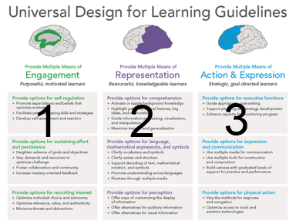
Activity 5: UDL Guidelines (continued)
UDL Guidelines, CAST (2014). Retrieved from http://castprofessionallearning.org/wp-content/uploads/2014/05/UDL-Guidelines-2014.pdf
Notes:
(5 minutes) Give participants time to review and discuss each guideline associated with the UDL principle that they read about in the article.
(5 minutes) Afterward, each table group member will return to the article and then match specific recommendations in the article to each guideline for the principle that they read. Participants place one example on each small Post-It note and position it on the guideline to which it relates. Afterwards, participants share examples with their table mates as they relate them to specific guidelines for each principle.

Slide 67
Activity 6: UDL in Practice
UDL in Practice
Watch a classroom demonstration where principles of UDL were incorporated in the planning process. As you watch the video, keep a look out for practices that reflect your team’s UDL Principle and Guidelines. Record them on the blank UDL Guidelines template in your Participant Guide. After viewing the video clip, take a few minutes to work with your team to discuss what you recorded and why. Be prepared to share.
Page 17
Notes:
As participants view the video, they should keep a look out for practices that reflect their team’s UDL Principle and Guidelines. Participants record them on the blank UDL Guidelines template in the Participant Guide.

Slide 68
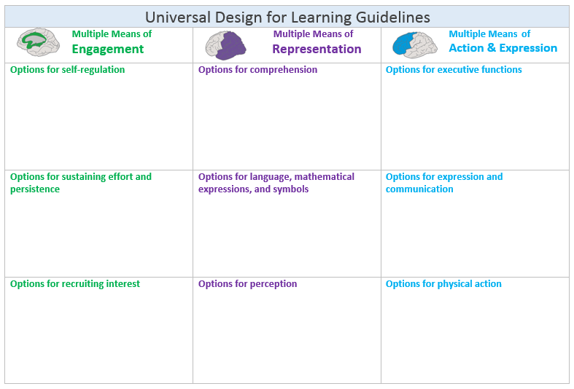
Activity 6: UDL in Practice (continued)
Page 17
Notes:
Blank UDL Guidelines template in the Participant Guide to record practices that reflect the team’s UDL Principle and Guidelines.

Slide 69
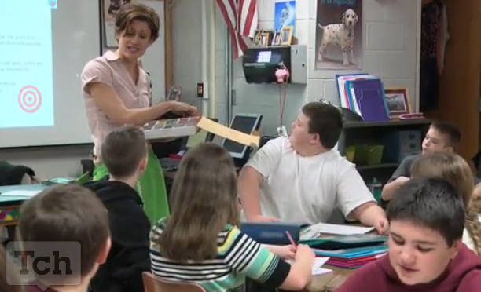
Video: UDL in Practice
The Teaching Channel: Exploring Imagery through Beowulf https://www.teachingchannel.org/videos/descriptive-details-sensory-language
Notes:
After viewing the video, participants take a few minutes to work with their team to discuss what they recorded and why (The Teaching Channel: Exploring Imagery through Beowulf https://www.teachingchannel.org/videos/descriptive-details-sensory-language).

Slide 70
You are Here!
Part 3: UDL for Unit & Lesson Planning
Introductory Activities
Part 1:
The Foundation for UDL
Part 2:
UDL in Practice
Part 3:
UDL for Unit & Lesson Planning
Part 4:
Reflection, Next Steps, & Session Evaluation
Notes:
In Part 3, we’ll look at how we can infuse UDL into our lesson planning to strengthen our plans to reach our learners.

Slide 71

UDL Habits of Design Step 1
Unit Overview, Lessons, and Performance Tasks
Are outcomes separated from the means to meet the outcomes?
Do outcomes support higher-order skills and encourage a deeper connection with the content?
Are there ways I can promote learners’ ability to monitor their own learning (e.g., goal setting, self-assessment, and reflection)?
Notes:
The power of using UDL comes through a careful planning process that considers how UDL can enhance new or existing units and lessons. Furthermore, when collaboration becomes part of the planning process, teacher teams can more effectively plan for potential barriers and provide curriculum supports that help diverse learners access rigorous curriculum. Participants will listen to a brief overview of the UDL Habits of Design (5 mins.).
Step 1-Unit Overview, Lessons, and Performance Tasks
Outcomes separated from Means-Refer back to the example of separating out understanding complex text from decoding.
Outcomes that support higher-order skills and encourage deep connection-All students can engage with more rigorous thinking about content. This is the nature of curiosity‒to think deeply about the how, why. Learning for SwD does not mean that content/concepts must not challenge them or that they must be learning less rigorous and engaging content. Scaffold but stretch students’ limits. We want to PRESUME COMPETENCE!
Promote learners’ ability to monitor their own learning-Having more control and responsibility for monitoring one’s own learning and progress can be very motivating, especially to students who typically feel that there are limits to their progress. Goal setting, self-assessment, reflection all lead to better student skills and independence!

Slide 72
UDL Habits of Design Step 2
Curriculum Supports
The goal is to adapt a lesson or unit in ways that will help all learners access rigorous content. Some key questions to ask are:
Where can I add flexible ways for my students to engage with and stay motivated by the lesson? How can I engage them to become more independent learners?
Where might my students benefit from different methods of representing the lesson?
Where might my students benefit from different ways of interaction with and expressing what they learn?
Notes:
Curriculum Supports
Where can I add flexible ways for my students to engage with and stay motivated by the lesson? How can I engage them to become more independent learners? This should be engaging for you to find what engages them. There are ways to make learning engaging, even when there seems to be no way. Case in Point-Try showing weird Al Yankovic’s vevo video or “word crimes” prior to a lesson on grammar. Or take an everyday object and ask students to take an object (like a pen or a book) and compare it to whatever the concept or content is that the class is studying. How are A and B alike? How are they different? Sounds crazy but it works! Why? You are engaging learners to make sense of something new with something they already know. Is it a stretch? Challenging? Perhaps, but it will engage to help a learners access rigorous content.
Where might my students benefit from different methods of representing the lesson? Consider Katie Novak, the teacher in the video who enticed her students to use descriptive language through her Chez Novak Cafe!
Where might my students benefit from different ways of interaction with and expressing what they learn? Think about how the students interacted with and expressed what they learned in the Chez Novak Café video.
Flexibility is the key!

Slide 73
UDL Habits of Design Step 3
Potential Learning Barriers Present in the Instructional Methods and Materials
Have I identified potential barriers to learning (e.g., physical, social, cultural, or ability-level) that may be present in the instructional methods (e.g., lecture, group discussion) and materials (e.g., text, handouts) given what I know about my students’ learning characteristics?
Notes:
Have I identified potential barriers to learning (e.g., physical, social, cultural, or ability-level) that may be present in the instructional methods (e.g., lecture, group discussion) and materials (e.g., text, handouts) given what I know about my students’ learning characteristics?
As you design instruction and consider ways to make the curriculum more flexible through engagement, representation, and action and expression, you make it accessible for more learners. The next step in the UDL Habits of Design Process is to consider other specific potential barriers to learning and the materials, given what you know about your learners.
Student A has been in this country for less than a year and does not have the same cultural background experiences as his peers. What potential barriers might this pose to learning when background knowledge may be important?
Student B has a significant language processing disorder and consequently is reluctant to engage in class discussions. What potential barriers might this pose to learning in student lead discussion?
Student C has a history of shutting down when faced with what she perceives as difficult or an overwhelming amount work, e.g., a multi-step process, such as writing an essay. What potential barriers might this pose to learning?

Slide 74
UDL Habits of Design Step 4
Consultation
Have I considered that some learners with significant learning challenges require consultation, support, and planning with specialists? Presume learner competence and maintain a growth mindset about these learners.
Notes:
Have I considered that some learners with significant learning challenges require consultation, support, and planning with specialists? Presume learner competence and maintain a growth mindset about these learners.
Schools are communities of practices where we support one another to reach all students. Consequently, we need to consult with our colleagues with specialized expertise, perhaps an instructional coach, a special educator, a teacher of ELs with knowledge of the student and strategies to support student learning.
Above, everything, we must presume that all students can learn and based on that presumption, we must seek ways to reach them all. We can learn, our students can learn!

Slide 75
Activity 7: Instructional Design ‒ UDL-izing Your Planning Process
Instructional Design ‒ UDL-izing Your Planning Process
In groups of 3 at your tables, consider: How can the UDL Guidelines and their checkpoints help you in the planning process? What do you think is most helpful? Why? (5 minutes) How do you think the UDL Habits of Design can help you to UDL-ize your lessons? Which step do you think will help you the most as you start off? Be ready to share. (5 minutes)
Pages
20-21
Notes:
Review the steps in Activity 7 and guide participants through the process. 10 minutes total.

Slide 76
You are Here!
Part 4: Reflection, Next Steps, and Session Evaluation
Introductory Activities
Part 1:
The Foundation for UDL
Part 2:
UDL in Practice
Part 3:
UDL for Unit & Lesson Planning
Part 4:
Reflection, Next Steps, & Session Evaluation
Notes:
In Part 4, we’ll reflect on what we learned and think through what UDL means for us individually and as teams and how we develop next steps for starting to incorporate UDL into our daily practices and routines.

Slide 77
Activity 8: Reflection and Next Steps
UDL Brief
Develop a UDL Brief in your own language that reflects your collective understanding of UDL and its salient features and characteristics that you can take back and share with their colleagues.
Pages 23-25
Notes:
For Reflections and Next Steps, participants who came as teams must be seated with each other.

Slide 78
Writing a Brief about UDL
Key Message
  Objective? (Create awareness, knowledge of UDL, and “UDL-izing instructional design with UDL Habits of Mind”?)
  Audience? (Teachers, administrators, students, parents?)
  Attitudes/beliefs? (What is the status quo?)
  Proposed behavior and call to action? (What do you want them to do, to happen, to change?)
  Why? (How will it benefit your audience? What’s in it for me? Our students?)
Notes:
Briefly go over the possibilities for their UDL Briefs. 15minutes

Slide 79
Activity 8: Reflection and Next Steps
Tweak the Environment
Build UDL-izing habits
1.
1.
3.
2.
3.
2.
Page 24
Notes:
Teams will develop next steps to “shape the path” for their use of UDL in lesson design at their school. They will discuss and develop: a) at least one doable action they will take to “tweak their environment” to support UDL lesson design and b) “build at least one habit” that is easy enough and not taxing (such as using the Habits of Design Tool).

Slide 80
Session Evaluation
Thank you for attending Module 1b’s session, Universal Design for Learning.
Your feedback is very important to us! Please fill out a short survey about this afternoon’s session.
The survey is located here: http://surveys.pcgus.com/s3/CT-Module-1b
Notes:
Remind participants to complete the online Session Evaluation. The survey is located here: http://surveys.pcgus.com/s3/CT-Module-1b. Ask for further thoughts, questions.

Slide 81
Thank you!

