Slide 1


Connecticut Core Standards for Mathematics
Systems of Professional Learning
Module 3 Grades K–5:
Focus on Teaching and Learning

Slide 2

Sharing Implementation Experiences
Section 1
Page
7
Notes:
Section 1: Sharing Implementation Experiences
Section 1 Time: 30 Minutes
Section 1 Training Objectives:
To review the key ideas developed in the Standards for Mathematical Content in Module 2.
To share, discuss, and address experiences with, and common challenges of, supporting teachers in implementing the Standards for Mathematical Practice and Standards for Mathematical Content.
Section 1 Outline:
The facilitator will begin by reviewing the key ideas developed on the Standards for Mathematical Content in Module 2.
In groups, participants will share experiences and describe any “aha moments” from their continued implementation of the Standards for Mathematical Practice (SMP) and with assisting teachers with strategies for teaching the Standards for Mathematical Content. Participants will look for themes or choose one or two important successes, challenges, and/or insights to share with the larger group. These will be recorded on chart paper so that common themes and additional strategies can be discussed as a large group. Participants can record new ideas on the handout Moving Forward with the Content Standards.
The facilitator will wrap up Section 1 by explaining that to build upon their knowledge and experience with the CCS-Math thus far, participants will begin to connect instructional strategies discussed in Modules 1 and 2 to a more focused teaching and learning framework derived from considerations within Universal Design for Learning, and begin to discuss connections between teaching, learning, and formative assessments.
Supporting Documents
Moving Forward with the Content Standards
Materials
Chart paper
Markers

Slide 3

Module 2 Review
In Module 2 you:
  Examined the implications of the language of the content standards for teaching and learning.
  Analyzed the progression of topics in the content standards both within and across grade levels.
  Identified and modified CCS-aligned tasks that combine both the content and practice standards.
  Explored strategies for supporting teachers as they make changes to their classroom practices.
Notes:
Review the four objectives of Module 2 with participants. As you quickly go through slides 7–18 you will support each bullet one-by-one with key slides from the Module 2 PowerPoint. Begin here with the first bulleted objective.
Examined the implications of the language of the content standards for teaching and learning. Remind participants that they discussed the differences of and connections between conceptual understanding, procedural skill and fluency, and application of mathematics. Use slides 8–10 to support this objective.

Slide 4
Conceptual Understanding
“Conceptual understanding refers to an integrated and functional grasp of mathematical ideas.”
Adding it Up: Helping Children Learn Mathematics (2001)
Notes:
Conceptual Understanding
Review the quote on the slide, as well as the quote provided to participants in their Module 2 Participant Guide.
“Students demonstrate conceptual understanding in mathematics when they provide evidence that they can recognize, label, and generate examples of concepts; use and interrelate models, diagrams, manipulatives, and varied representations of concepts; identify and apply principles; know and apply facts and definitions; compare, contrast, and integrate related concepts and principles; recognize, interpret, and apply the signs, symbols, and terms used to represent concepts. Conceptual understanding reflects a student’s ability to reason in settings involving the careful application of concept of definitions, relations, or representations of either.” (Balka, Hull, & Harbin Miles, n.d.)

Slide 5
Procedural Skill and Fluency
“Procedural skill and fluency is demonstrated when students can perform calculations with speed and accuracy.”
Achieve the Core
“Fluency promotes automaticity, a critical capacity that allows students to reserve their cognitive resources for higher-level thinking.”
EngageNY
Notes:
Procedural Skill and Fluency
Review the quotes on the slide.

Slide 6
Application of Mathematics
The Standards call for students to use math flexibly for applications.
Teachers provide opportunities for students to apply math in authentic contexts.
Teachers in content areas outside of math, particularly science, ensure that students are using math to make meaning of and access content.
Frieda & Parker (2012)
Achieve the Core (2012)
Notes:
Application of Mathematics
Go through points on the slide. Ask participants how they have had students apply mathematics. Get two or three examples. Ask participants why this is important.
Application of mathematics is important because without this step or expectation students are learning math as a set of rules, procedures, etc. that have no real meaning in the world outside of the classroom. Students need to learn how math works and how it is used. Note here that when the conversation of application of mathematics typically comes up the phrase “real-world problems” is usually somewhere in the conversation. As teachers think about the types of problems that students will solve in order to apply their mathematical understanding, have them think about problems that would be “real world” to their students. This means that the problems should be contextually relevant and easily understood by the students at their particular grade level. Also note that, just as we saw with the fluency standard, not all standards focus on application. But, when the standard does point to solving problems through an application of mathematics, we really want to see how students can flexibly use what they know and understand. Finally, ask participants to briefly discuss how they can engage students in authentic problem-solving scenarios.
Before moving to the next slide that has examples of contextually relevant problems, focus participants on the third bullet on the slide and ask for one or two volunteers to give examples of how the CCS-Math standards can be supported and connected to the standards from other content areas in order for students to see and apply mathematics outside of their typical math lesson time.

Slide 7
Module 2 Review
In Module 2 you:
  Examined the implications of the language of the content standards for teaching and learning.
  Analyzed the progression of topics in the content standards both within and across grade levels.
  Identified and modified CCS-aligned tasks that combine both the content and practice standards.
  Explored strategies for supporting teachers as they make changes to their classroom practices.
Notes:
Review the second bulleted objective: Analyzed the progression of topics in the content standards both within and across grade levels. Remind participants that they completed the card sorting activity in order to see the vertical and horizontal connections between and within standards and domains. Use slides 13 and 14 to refocus participants on the overall distribution and progressions of the content standards.

Slide 8
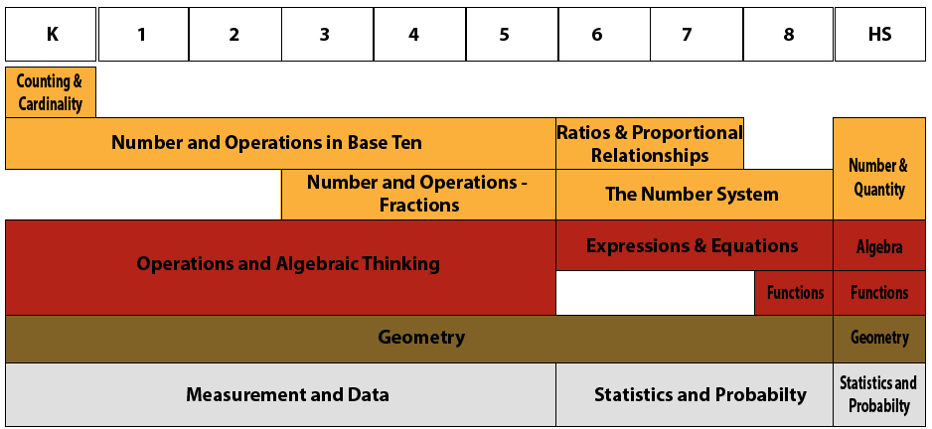
Domain Distribution
Source: http://www.definingthecore.com
Notes:
Domain Distribution
Remind participants that in K–5 there are four domains that span all of the grade levels: Number and Operations in Base Ten, Operations and Algebraic Thinking, Geometry, and Measurement and Data.
Kindergarten has a unique domain of Counting and Cardinality which includes standards that are foundational to both Number and Operations in Base Ten and Operations and Algebraic Thinking.
When students are developmentally ready and have a solid foundation in Number and Operations in Base Ten, Number and Operations – Fractions is layered on beginning in third grade.
Transition to the next slide by reminding participants that the domains were determined based on a very specific and coherent roadmap for learning called a progression.

Slide 9
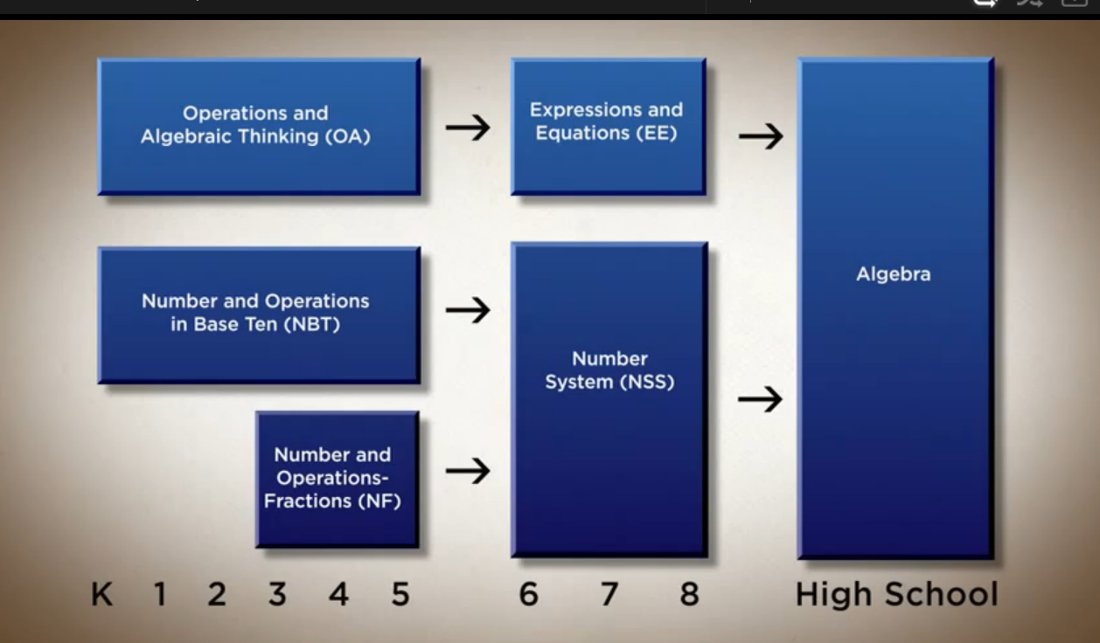
Domain Progression
For more Information: http://commoncoretools.me/category/progressions/
Notes:
Domain Progression
Remind participants that the domains were written so concepts build on each other grade after grade so that, in this particular progression, there is a clear pathway to high school Algebra. The video at the end of this section is an explanation of the progressions from CCSS-Math Co-Author Bill McCallum.
More information about specific domain progressions can be found at the Common Core Tools Website: http://commoncoretools.me/category/progressions/. Have participants make a note of this resource.

Slide 10
Module 2 Review
In Module 2 you:
  Examined the implications of the language of the content standards for teaching and learning.
  Analyzed the progression of topics in the content standards both within and across grade levels.
  Identified and modified CCS-aligned tasks that combine both the content and practice standards.
  Explored strategies for supporting teachers as they make changes to their classroom practices.
Notes:
Review the third bulleted objective: Identified and modified CCS-aligned tasks that combine both the content and practice standards. Use slides 15 and 16 to refocus participants on the big question that was examined - How can I help teachers incorporate cognitively rigorous mathematics tasks that will benefit ALL students?

Slide 11
Strategies for Differentiating Cognitively Rigorous Tasks
Scaffolding
Open Questions
Parallel Tasks
C-R-A
Notes:
Strategies for Differentiating Cognitively Rigorous Tasks
In Module 2, participants discussed the four strategies listed on the slide. Remind participants that one of the key things to keep in mind when differentiating mathematics tasks is that teachers will want to be sure to make modifications or offer choices in tasks that allow students the needed point for entry into the mathematics, but at the same time keeping the level of rigor high. Often mathematics is differentiated by providing “easier” tasks to students who may not yet be ready for the main task. These “easier” tasks sometimes lower the level of rigor to the point that the students’ engaged in that task are never given the opportunity to engage in deeper reasoning about the mathematics. Whenever possible, teachers should maintain the level of rigor, but make modifications in such a way that a solution is still within the students’ reach.

Slide 12

Resources for Finding Tasks
Illustrative Mathematics
http://www.illustrativemathematics.org/
Achieve the Core
http://achievethecore.org/
Smarter Balanced
http://smarterbalanced.org/
Mathematics Assessment Project
http://map.mathshell.org/materials/index.php
Notes:
Resources for Finding Tasks
Remind participants of some of the resources available for finding cognitively rigorous tasks. Ask participants which they have used and which they have recommended to teachers. Be sure to chart any additional recommendations so that participants can add them to their own list.

Slide 13
Module 2 Review
In Module 2 you:
  Examined the implications of the language of the content standards for teaching and learning.
  Analyzed the progression of topics in the content standards both within and across grade levels.
  Identified and modified CCS-aligned tasks that combine both the content and practice standards.
  Explored strategies for supporting teachers as they make changes to their classroom practices.
Notes:
Wrap up the review by focusing on the fourth bulleted objective: Explored strategies for supporting teachers as they make changes to their classroom practice. Use slide 18 to briefly discuss the strategies presented at the end of Module 2.

Slide 14
A New Spin on Old Strategies
Group 1: Journals
Group 2: Mathematical Language
Group 3: Fluency
Group 4: Group Work & Decision Making
How can this strategy/resource support the CCS-Math content and practice standards?
Generate at least one new idea for the use of the strategy/resource with students.
Notes:
A New Spin on Old Strategies
As you remind participants of the strategies that were reviewed at the end of Module 2, ask participants if they have had the opportunity to discuss these with teachers, and if so, which were discussed and how the strategies were received. Transition this short discussion into a discussion of participants overall CCS-Math implementation that begins on the next slide.

Slide 15

Sharing Implementing Experiences
CSS-Math Practice Standards
Positive Highlights
Sharing Implementation Experiences
Each participant will discuss with their table group one Positive Highlight, one Challenge, and one Lesson Learned from their personal implementation of the Content Standards thus far.
Each table group will then determine two Positive Highlights, one common Challenge, and one common Lesson Learned that they will present to the larger group.
Participants will record notes and “New Ideas” generated from the discussion.
Challenges
Lessons Learned
Pages
7–8
Guide Pages 8-9
Notes:
Now that you have quickly reviewed the key points from Module 2, ask participants to now reflect on the work that they have done back at their school, in their role as a Core Standards Coach, with helping teachers learn more about and implement the CCS-Math. Have each participant discuss with their table group one positive highlight, one challenge, and one lesson learned from their personal implementation of the Conent Standards thus far. Each table group will then determine two positive highlights, one common challenge, and one common lesson learned that they will present to the larger group. They can record notes from their discussion on page 7 in the Participant Guide.
As table groups present, record the participants’ responses on the chart paper titled Positive Highlights, Challenges, and Lessons Learned. After all groups have presented, summarize what has been charted and then ask the large group if anyone has a solution to any of the common challenges. Encourage participants to record “New Ideas” on page 8 in the Participant Guide.
Wrap up the activity by explaining that the challenges will be revisited periodically throughout the day.
Transition to the next activity by explaining that participants will now begin to focus more deeply on the classroom practices that support teaching and learning with the CCS-Math.
Note: If teachers have not had the time between the previous module and this module to begin their implementation, have them instead focus on things that they have seen and heard back at their school, including positive highlights of where their school is, challenges that they now recognize they may be facing, and any lesson learned in terms of the outcomes of the first module and where they think they need to go next with the implementation.

Slide 16
Building a Teaching and Learning Framework through UDL
Section 2
Page
10
Notes:
Section 2: Building a Teaching and Learning Framework through UDL
Section 2 Time: 60 minutes
Section 2 Training Objectives:
To articulate a common understanding of Universal Design for Learning (UDL).
To identify the importance of incorporating UDL practices into lessons.
To align UDL practices to the instructional practices and learning implications of the CCS-Math.
Section 2 Outline:
Participants will begin by generating a list of the instructional strategies discussed in Modules 1 and 2. These include: the use of multiple representations, providing multiple pathways into the learning through task modification, engaging students in group work, providing opportunities for mathematical discourse, and the use of effective questioning. As a large group, participants will discuss the student benefits of the use of each strategy. (10 minutes)
Then, the facilitator transitions to adding to this list of strategies by explaining that they will examine additional strategies, but will do so through the lens of applying the principles of Universal Design for Learning. The facilitator will explain what UDL is and engage participants in the importance of providing flexibility and reducing barriers in instruction. The facilitator will then go over each of the three principles: Provide Multiple Means of Representation, Provide Multiple Means of Action and Expression, and Provide Multiple Means of Engagement. (10 minutes)
Participants will then work in groups to complete a graphic organizer around one of the nine UDL Guidelines. Using information given on the assigned guideline, participants will complete the graphic organizer by defining the guideline, identifying examples of specific strategies that can be used to fulfill the guideline, making a connection to their work with the CCS-Math, identifying student benefits, and creating at least one example of how this guideline might be met at a particular grade level. (20 minutes)
This activity concludes with groups presenting the information included in their graphic organizer. (20 minutes)
Note: Information will be presented in such a way as to not lead participants to think that they must include all nine guidelines in every lesson every day and that by connecting the UDL principles and guidelines to work that has been completed already around CCS-Math instructional practices, many participants are already applying or promoting UDL in their classroom and schools.
Supporting Documents
What is Universal Design for Learning
Universal Design for Learning Guidelines
Universal Design for Learning Guidelines Worksheet
Materials
Chart paper
Markers

Slide 17

Focus on Instruction
What instructional strategies were
discussed in Module 1 and Module 2?
How does the use of these strategies benefit student learning?
Notes:
Focus on Instruction
Begin by asking participants to think about the instructional strategies that were discussed in Modules 1 and 2. Depending on the group discussions that took place in each module these may vary, but those explicitly addressed include:
Module 1:
Effective questioning
Multiple representations
Student discourse
Module 2:
The use of cognitively rigorous tasks
Task modification
Parallel tasks
Open questions
Scaffolding
C-R-A continuum
Journals
Strategies for developing fluency
Group work and decision making
Use of graphic organizer for developing mathematical language
As participants name these strategies, chart their responses so that as this section continues, this list can be referenced. After the list is generated, briefly discuss, as a large group, how students benefit from the use of these strategies. For example, the use of parallel tasks, open questions, scaffolding, and the C-R-A continuum allow for multiple entry points into a cognitively rigorous task. The use of math journals and providing opportunities for students to engage in mathematical discourse allow students’ thinking to become visible assisting the teacher in learning what the student understands, helps to uncover student misconceptions, etc.
Transition from this discussion by explaining to participants that they are now going to expand on this list of strategies by examining the principles of Universal Design for Learning, or UDL as it is commonly referred to, but first they will take a few minutes to understand what UDL is and how it supports teaching and learning of the CCS-Math.

Slide 18

What is UDL?
Universal Design for Learning is a scientifically valid framework for guiding educational practices.
CAST (2011)
Notes:
What is UDL?
Begin the discussion of UDL by explaining to participants that Universal Design for Learning is a framework, developed by CAST, that includes a set of three principles that were developed with the goal of providing all individuals equal opportunities to learn. Mention that in Module 2, we discussed differentiating the mathematics tasks in order to provide multiple entry points into the mathematics. Here we will build off of that idea because UDL and differentiation are closely linked. The main difference to highlight at this point is that differentiation typically looks at a specific subset of a lesson, the task for example, and asks teachers to modify that aspect in order to meet the needs of all students. UDL, on the other hand, looks at modifying the whole learning process, not just one aspect.
Note: This understanding will continue to unfold throughout this module, and will become even more clear in Module 4, during which participants are involved in learning design.

Slide 19
What is UDL?
Universal Design for Learning principles include guidance on providing flexibility in:
  The way information is presented
  The ways students respond or demonstrate knowledge and skills
  The ways students are engaged
AND…..
CAST (2011)
Notes:
What is UDL?
Remind participants that in Module 2 they discussed the importance of providing multiple entry points into cognitively rigorous tasks so that all students had the opportunity to learn mathematics as a deeper level. UDL takes this a step further by providing guidance in the principles that focuses on providing students with flexibility in the way information is presented, in the way students respond or demonstrate knowledge and skills, and in the ways students are engaged within a lesson.

Slide 20
What is UDL?
Universal Design for Learning principles also include guidance on:
  Reducing barriers in instruction
  Providing appropriate accommodations, supports, and challenges
  Expectations for all students including students with disabilities and students who are limited English proficient
CAST (2011)
Notes:
What is UDL?
Through the UDL principles guidance is also provided that helps teachers to reduce barriers to instruction, provide appropriate accommodations, supports, and challenges, and to maintain high expectations for all students, including students with disabilities and students who are limited English proficient.

Slide 21

Principle 1: Provide Multiple Means of Representation
Providing options for:
  Perception
  Language, mathematical expressions, and symbols
  Comprehension
Recognition Networks
Resourceful, knowledgeable learners
CAST (2011)
Notes:
Principle 1: Provide Multiple Means of Representation
Begin the discussion of each of the three UDL principles by having participants turn to the Universal Design for Learning Guidelines chart on page 11 in their Participant Guide. Go over Principle 1. Explain that providing multiple means of representation focuses on recognition tasks that include how students gather facts and categorize what they see, hear, and read. To help students with these types of tasks, teachers can present content in different ways. Pause and have participants examine the Principle 1 column of the chart. Provided within the column is an overview of guidelines and checkpoints that teachers can follow when addressing Principle 1. Ask participants to look back at the list of instructional strategies created at the beginning of this section and to think about how those strategies can be applied to Principle 1. Ask for volunteers to provide examples. Examples that can be brought up if participants do not:
Guideline 1: Provide options for perception
The use of multiple representations
The use of the C-R-A continuum
Guideline 2: Provide options for language, mathematical expressions, and symbols
The use of graphic organizers to clarify understanding of mathematical language and symbols
Guideline 3: Provide options for comprehension
The use of the C-R-A continuum
As examples are shared, ask participants how each strategy provides individuals equal opportunities to learn using multiple representations.
Also point out that as teachers implement strategies connected to the UDL checkpoints under Guideline 3, they will also be implementing strategies that will assist in helping students develop the mathematical habits of mind laid out in the Standards for Mathematical Practice. (Note: Participants will examine these strategies in more depth in the second part of this section.)

Slide 22

Principle 2: Provide Multiple Means of Action and Expression
Providing options for:
  Physical action
  Expression and communication
  Executive functions
Strategic Networks
Strategic, goal-oriented learners
CAST (2011)
Notes:
Principle 2: Provide Multiple Means of Action and Expression
Go over Principle 2. Explain that providing multiple means of action and expression focuses on planning and performing tasks that include how students organize and express ideas. To help students with these types of tasks, teachers can differentiate the ways that students can express what they know. Point out that planning and performing tasks activate the strategic network of the brain and that solving mathematics problems are, in themselves, strategic tasks.
Pause and have participants examine the Principle 2 column of the chart. Provided within the column is an overview of guidelines and checkpoints that teachers can follow when addressing Principle 2. Ask participants to look back at the list of instructional strategies created at the beginning of this section and to think about how those strategies can be applied to Principle 2, also ask them to think about the connection between the guidelines and principles and the Standards for Mathematical Practice. Ask for volunteers to provide examples. Again, as examples are shared, ask participants how each strategy provides individuals equal opportunities to learn using multiple means of action and expression. Examples that can be brought up if participants do not:
Guideline 4: Provide options for physical action and Guideline 5: Provide options for expression and communication
The use of multiple representations
The use of the C-R-A continuum
The use of journals
The use of groups
Providing opportunities to engage students in mathematical discourse (highlight the opportunity for students to develop solution strategies and to share those strategies with others)
Connected to SMP 4: Model with mathematics and SMP 5: Use appropriate tools strategically
Guideline 6: Provide options for executive functions
While specific strategies have not been discussed that would support this guideline, participants will examine these strategies in more depth in the second part of this section.

Slide 23

Principle 3: Provide Multiple Means of Engagement
Providing options for:
  Recruiting interest
  Sustaining effort and persistence
  Self-regulation
Affective Networks
Purposeful, motivated learners
CAST (2011)
Notes:
Principle 3: Provide Multiple Means of Engagement
Go over Principle 3. Explain that providing multiple means of engagement focuses on how learners get engaged, stay motivated; and include how students are challenged, excited, or interested by learning. Each of these are affective dimensions and work to provide the “why” of learning. The teachers’ role here is to design learning that stimulates students’ interest and motivation for learning.
Pause and have participants examine the Principle 3 column of the chart. Provided within the column is an overview of guidelines and checkpoints that teachers can follow when addressing Principle 3. Ask participants to think about the discussions had in Modules 1 and 2 and connections that can be made to the guidelines and checkpoints of Principle 3. Ask for volunteers to provide examples. Again, as examples are shared, ask participants how each strategy provides individuals equal opportunities to learn using multiple means of engagement.
Examples of connections that can be brought up if participants do not:
Discussions on SMP1: Make sense of problems and persevere in solving them.
Discussions on the type of tasks and the context provided within the task.
Discussions on group work, decision making, and engaging students in mathematical discourse.
Discussions on the classroom environment that promotes perseverance.

Slide 24
Helping Teachers Understanding UDL
Access in-depth information about the UDL Principles here: http://www.udlcenter.org/aboutudl/udlguidelines
With your group explore your assigned UDL Guideline and determine the following:
  How you would explain this guideline to teachers?
  Create 2–3 examples of beginning strategies that teachers can incorporate into their lessons to address this guideline.
Notes:
Helping Teacher Understand UDL
Explain to participants that they will now work in groups to examine one of the nine UDL guidelines in more depth and think about how they will bring this initial understanding of UDL back to their teachers. Assign each group of participants one of the nine UDL guidelines. In their groups they will access the UDL Principles at the website provided and determine how they would explain that particular guideline to their teachers. Also, they will create 2–3 examples of beginning strategies that teachers can incorporate into their lessons to address their assigned guideline. As participants work to create their examples explain that they will want to make connections, wherever possible to the work and information that they have already brought back to teachers so that teachers are able to see the connections between UDL and their implementation of the CCS-Math Standards. Have participants place their work on chart paper as it will be used to present their guideline to the larger group. Allow participants 20 minutes to work.
After participants have completed their work, each group will present their information allowing for all participants to hear information and ideas around each of the nine guidelines. Space has been provided on page 12 in the Participant Guide for participants to take notes during the presentation. Allow 20 minutes for the presentations as each group should need no more than 2 or 3 minutes present. Hang each piece of chart paper around the room so that while participants are on break they can further examine the information provided on each guideline.
Note: If, when you get to this activity, issues arise with internet connections, have participants center their discussion and work around the Universal Design for Learning Guideline Chart provided in their Participant Guide and provide the link to the UDL center as a resource that can be used with their teachers back at their school. Also, it is suggested that each facilitators access the complete set of UDL Principles and Guidelines here: http://www.udlcenter.org/aboutudl/udlguidelines/downloads in order to provide support for participants as they compete this activity.

Slide 25
Key Points for Getting Started with UDL
UDL can support teachers implementation of the CCS-Math Standards.
The strategies that have been discussed for implementing the CCS-Math Standards overlap with the strategies that can be used to meet the UDL Guidelines and Checkpoints.
Think about, plan for, and implement the UDL strategies strategically.
Begin with those that will have the greatest impact on YOUR students.
Notes:
Key Points for Getting Started with UDL
Wrap up Section 2 by explaining to participants that as they help teachers begin to implement UDL strategies as a framework for teaching and learning the CCS-Math standards, they will want to communicate four key points:
UDL can support teachers implementation of the CCS-Math Standards. They will want participants to see UDL as a way to teach the CCS-Math Standards to all students, not as something separate that needs to be implemented.
The strategies that have been discussed for implementing the CCS-Math Standards parallel the strategies that can be used to meet the UDL Guidelines and Checkpoints. They will want to bring out, just as was done during the discussion of each of the UDL Principles, the connections to work that has already been covered on implementing the CCS-Math Standards as this will help to clarify that the relationship between UDL and the CCS-Math implementation.
Think about, plan for, and implement the UDL strategies strategically. This idea is important in that teachers may feel overwhelmed at the idea that there are nine guidelines with thirty-one checkpoints. The goal is not for the checkpoints to become a list of “things” that a teacher does, but that they should be used to provide the flexibility and options as described in order to meet the needs of their students and every lesson will not call for every checkpoint to be addressed.
Begin with those that will have the greatest impact on YOUR students. As they work with teachers on incorporating UDL strategies, participants will want to help teachers examine their lessons, learning targets, and the needs of their students to determine which checkpoints will be used as a guide for planning their mathematics instruction. Learning targets are important here because, participants will need to make sure that teachers understand that the strategies they choose to implement may differ depending on the learning target. They will also want to keep in mind teachers readiness levels and help them choose the checkpoints and associated strategies that will have the greatest impact on their students’ learning and those that teachers can easily manage. These beginning strategies can be used as a foundation for further strategy introduction later on as teachers get more comfortable with UDL and the CCS-Math standards themselves.
Transition into the break by explaining to participants that after the break they will begin to look at and plan for instruction that incorporates UDL strategies during a mathematics lesson.

Slide 26

Let’s Take A Break…
…Be back in 10 minutes

Slide 27
Teaching and Learning with the UDL Principles
Section 3
Page
16
Notes:
Section 3: Teaching and Learning with the UDL Principles
Section 3 Time: 90 minutes
Section 3 Training Objectives:
To provide participants with an opportunity to observe a mathematics lesson in order to identify UDL Principles in use.
To provide participants with an opportunity to examine a mathematics lesson outline in order to identify UDL Principles in use.
To provide participants with an opportunity to practice planning a lesson outline in order to incorporate UDL strategies using specific planning questions as a guide.
Section 3 Outline:
Section 3 begins with participants viewing the Teaching Channel video Multiplying Whole Numbers and Fractions with an understanding that even though the lesson is seen being carried out within a 4th grade gifted classroom, the focus is on the UDL strategies being used that are applicable to all grade levels. While they watch, participants will make notes of the strategies they observe on the Video Observation page in their Participant Guide. After the video, participants will discuss the strategies observed, the benefit for students, and any additional opportunities to apply additional strategies. (15 minutes)
Participants will then examine a lesson outline of a 5th grade lesson design around a task that addresses standards 5.NF.1, 5.NF.2, and SMPs 1, 3, and 6. To examine the outline, the facilitator will go over each of the activities and questions planned for the set-up of the task. A discussion will then take place around how each of the UDL Principles and their corresponding Guidelines were addressed in the outline. This discussion takes place in order to model the type of thinking needed when planning a lesson and to provide additional ideas for addressing the guidelines within a lesson. The task used in the lesson is Stuffed with Pizza and the UDL strategies were adapted for this task from NYC Department of Education found here: http://schools.nyc.gov/academics/commoncoreLibrary/tasksUnitsStudentWork/default.htm (15 minutes)
The final activity of this section involves participants having the opportunity to practice planning a lesson outline that includes the application of UDL strategies within a specific grade level. Participants are asked to work in groups to first select the standard(s) they wish to address. After making their selection, participants go online to illustrativemathematics.org and select a task that aligns with their standard(s). Groups then use specific questions for planning UDL lessons (adapted from NYC Department of Education and found here: http://schools.nyc.gov/Academics/CommonCoreLibrary/ProfessionalLearning/UDL/default.htm to determine where, when, and which strategies they would use within the lesson. Note: Participants are given a choice in standards and tasks in order to model a flexible strategy and to also provide guided experience with selecting tasks that align to standards. (40 minutes)
The activity will conclude with volunteers sharing what their group has planned. (20 minutes)
Supporting Documents:
Video Observation worksheet
5th Grade Lesson Outline
Questions to Guide Your Thinking worksheet
Materials
Chart paper
Markers
Video
Multiplying Whole Numbers and Fractions found here: https://www.teachingchannel.org/videos/multiplying-fractions-by-whole-numbers-lesson

Slide 28
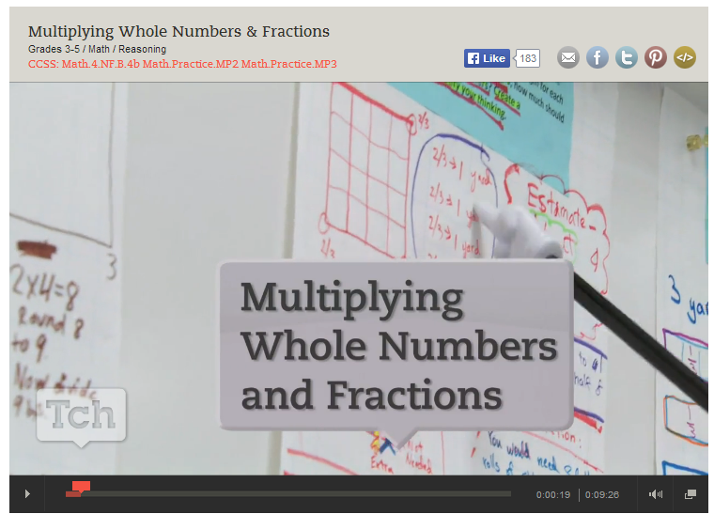
Observing a Lesson
Page
16
https://www.teachingchannel.org/videos/multiplying-fractions-by-whole-numbers-lesson
Notes:
Observing a Lesson
Begin the discussion of incorporating UDL Principles into classroom lessons by having participants first watch the Teaching Channel video Multiplying Whole Numbers and Fractions. Explain to participants that while this lesson is being carried out within a 4th grade gifted classroom, the focus is on the UDL strategies being used that are applicable at all grade levels. While participants watch, have them take notes on each of the three UDL Principles using the Video Observation page in their Participant Guide. After the video has been watch, debrief the strategies that participants highlighted in their notes and discuss any additional strategies or opportunities to apply strategies that participants would suggest to this teacher. Examples of strategies to point out if they are not highlighted by participants include:
Principle 1: Provide Multiple Means of Representation
Guideline 1: Used ribbon and other props and drawings to explain the situation
Guideline 2: Prompted students to attend to precision
Guideline 3: Connected the current task to previous work, student presentations of work provided multiple representations of solutions
Principle 2: Provide Multiple Means of Action and Expression
Guideline 4: Used student created charts as tools, allowed students to sit and work in various areas for group work
Guideline 5: Provided card activity
Guideline 6: Students created their own solution strategy
Principle 3: Provide Multiple Means of Engagement
Guideline 7: Created a coaching environment in which students discussed, asked questions of each other, and assisted each other in understanding thinking
Guideline 8: Students worked in groups, students critiqued the reasoning of the solutions on the cards
Guideline 9: Provided prompting with guidance for journal entry
Transition to the next activity by explaining to participants that they will now go through an example of a lesson and examine the thinking behind a teacher’s planning.

Slide 29
A 5th Grade Lesson
5.NF.1 Add and subtract fractions with unlike denominators (including mixed numbers) by replacing given fractions with equivalent fractions in such a way as to produce an equivalent sum or difference of fractions with like denominators.
5.NF.2 Solve word problems involving addition and subtraction of fractions referring to the same whole, including cases of unlike denominators, e.g., by using visual fraction models or equations to represent the problem. Use benchmark fractions and number sense of fractions to estimate mentally and assess the reasonableness of answers.
Notes:
A 5th Grade Lesson
To help participants gain a better understanding of what the UDL strategies look like when implemented in a CCS-Math- aligned lesson, have participants put themselves in the role of a 5th grade teacher as they consider each part of a lesson that will now be described. Explain that as a 5th grade teacher they want to plan a lesson around standards 5.NF.1 and 5.NF.2. They will also incorporate SMP 1: Make sense of problems and persevere in solving them, SMP 3: Construct viable arguments and critique the reasoning of others, and SMP 6: Attend to precision.
Go through the lesson outline by using both the slides and pages 17–20 in the Participant Guide.

Slide 30
A 5th Grade Lesson
Tito and Luis are stuffed with pizza! Tito ate one-fourth of a cheese pizza. Tito ate three-eighths of a pepperoni pizza. Tito ate one-half of a mushroom. Luis ate five-eighths of a cheese pizza. Luis ate the other half of the mushroom pizza. All the pizzas were the same size. Tito says that he ate more pizza than Luis because Luis did not eat any pepperoni pizza. Luis says they each ate the same amount of pizza. Who is correct? Show all of your mathematical thinking.
Notes:
A 5th Grade Lesson
Go over the task that is being used to as the main lesson task to address the identified standards.

Slide 31
A 5th Grade Lesson
Provide students with different versions of the task as needed
Read the task
Clarify language
Clarify mathematics
Clarify facts
Check for understanding of problem situation
Activate prior knowledge and address possible misconceptions
Activate problem solving
Clarify expectations
Provide a process
Provide graphic organizer and checklist
Notes:
A 5th Grade Lesson
Explain that before students began to work the task the following steps were taken. Go through each step using the information in the Participant Guide. After going through each step, discuss as a large group how each of the nine UDL guidelines were addressed.
Guideline 1: Problem was read and different versions of the problem were provided (version 1: original problem/no change, version 2: underling used to separate who was eating which pizza, version 3: text was broken up so that students would work with each piece of information separately).
Guideline 2: Language was clarified.
Guideline 3: Activated prior knowledge and problem solving.
Guideline 4: Discussed tools and strategies that may be used.
Guideline 5: Students allowed to solve their own way.
Guideline 6: Graphic organizer and checklist provided.
Guideline 7: Partial solutions were allowed to be discussed.
Guideline 8: Students allowed to work in groups.
Guideline 9: Process provided with time limits along with checklist for self-assessment.
Before moving on, ask participants if there is anything that they might add or change to further address the guidelines? Also, have participants think about and discuss whether or not addressing the guidelines in the manner they were addressed decreased the level of rigor of the problem. If participants say that the level of rigor was decreased, ask how an alternative action might maintain the level of rigor. If participants say that the level of rigor was not decreased, ask in what ways addressing the guidelines in the manner they were addressed provided all students with equal access to the learning.
Finally, wrap up this part of Section 3 by asking participants if it was necessary to address all nine Guidelines. The answer here is that it really depends on the students. Some teachers may find that there students do not need all nine Guidelines addressed as the implementation of any UDL strategy for any of the Guidelines is based on the needs of the students.
Transition to the next part of Section 3 by explaining that participants will now have the opportunity to create a similar lesson outline around standards and a task that they will choose.

Slide 32
Outlining a Lesson
Step 1: With your group, determine what standard(s) you want to address in your lesson.
Step 2: Find a task that you will use as the main lesson task from those provided on Illustrative Mathematics. http://www.illustrativemathematics.org/
Step 3: Use the planning questions provided to outline your lesson.
Step 4: Present your lesson outline.
Notes:
Outlining a Lesson
In this activity participants will work in grade level groups so that there is at least one group per grade level, K–5. Participants can either self-select into a group or be assigned a specific grade level group. Explain that with their group they will be outlining a lesson similar to the lesson outline that was just discussed. As groups work, they will first determine what standard(s) they want to address in their lesson. Remind participants to include both Content and Practice Standards. Then, participants will go online and find a task that they will use as the main lesson task. Participants can choose a task from those provided on Illustrative Mathematics. http://www.illustrativemathematics.org/ After identifying their task, participants will answer the planning questions provided on page 21 in the Participants Guide. These questions will help participants think through how they will address the UDL Principles and, as answers are generated, will develop the lesson outline. Allow participants 40 minutes to work. Note: While groups are planning, hang three pieces of chart paper with one labeled “Provide Multiple Means of Representation,” one labeled “Provide Multiple Means of Action and Expression,” and one labeled “Multiple Means of Engagement.” These three pieces of chart paper will be used to capture strategies discussed during group presentations of their outlines.
Once the lesson outlines are completed, each group will have the opportunity to present their outline. While groups present each part of their outline, chart their suggested strategies for each Principle so that participants have a master list for each from which to pull additional ideas when they complete the work in Section 4. Allow 20 minutes for presentations as each group should only need 3–4 minutes to discuss their outline.
Wrap up Section 3 and transition to Section 4 by explaining to participants that after lunch they will use their work generated in Sections 2 and 3 to begin making plans for how they will introduce teachers to Universal Design for Learning. As the discussion begins to come to a close remind participants that, as they work with teachers, it is important to understand that every Guideline may not be addressed in every lesson. It is beneficial to think through each guideline to determine if addressing that Guideline will benefit students, as this is the ultimate goal. We do not want teachers to look at the UDL guidelines as a check point, but to be very purposeful in those that they address within any given lesson. This is similar to the way that we think about the Standards for Mathematical Practice. Each practice is extremely important, however not every lesson will explicitly address every Practice Standard.
Dismiss participants for lunch.

Slide 33

Bon Appétit
Notes:
Remind participants of the need to be timely. Allow 45 minutes. State time to return.

Slide 34
Supporting Teachers with UDL
Section 4
Page
25
Notes:
Section 4: Supporting Teachers with UDL
Total Time on Section 4: 30 minutes
Section 4 Training Objectives:
For participants to begin to set goals for their implementation back at their school.
For participants to begin planning next steps around the key ideas of Module 3.
For participants to deepen their peer coaching network.
Section 4 Outline:
Participants are guided through setting one to two goals for an initial introduction of UDL to teachers at their school. For example, a goal might be to have teachers focus on the use of multiple representations. (5 minutes)
After setting their goals, teachers will work within their group to back-map the key learning ideas and the steps that need to happen in order to get teachers to the point that the goal is met. (20 minutes)
Participants will wrap up the activity by reflecting on and anticipating teacher needs and questions around UDL.
(5 minutes)
Supporting Documents
Goal Setting and Next Steps
Additional Resources and Reflect
Materials
Chart paper
Markers

Slide 35
Setting Goals and Creating Next Steps
Identify a Key Idea about UDL.
Set 1 or 2 implementation goals that support the Key Idea.
Determine the steps to take in order to help teachers meet the goal(s).
Notes:
Setting Goals and Creating Next Steps
Explain to participants that they will now use their work from Sections 2 and 3 to set goals and create next steps for bringing UDL back to their teachers. Further explain that even if they find themselves at a point in the school year when introducing UDL may not take place immediately, they can still plan for steps they want to take as they begin the 2014–15 school year. Participants will work in groups to identify a key idea about UDL that they want to start their introduction. Participants can reference their work at the end of Section 2. Participants will with set one or two implementation goals that support the key idea and then determine steps they will take in order to help teachers meet the goal(s). Go through the next three slides to provide participants with an example of this process.

Slide 36
Setting Goals and Creating Next Steps
Identify a Key Idea about UDL.
  Key Idea: UDL focuses on providing a variety of options that allow all students to be successful.
Notes:
Setting Goals and Creating Next Steps
Go over the example of a Key Idea selection.

Slide 37
Setting Goals and Creating Next Steps
Set 1 or 2 implementation goals that support the Key Idea.
Implementation Goal 1: Teachers will have students work in groups in order to foster collaboration and community (P3, G8, C8.3).
Notes:
Setting Goals and Creating Next Steps
Go over the example of a goal that supports the identified Key Idea. Explain that this goal addresses UDL Principle 3, Guideline 8, and Checkpoint 8.3.

Slide 38
Setting Goals and Creating Next Steps
Determine the steps to take in order to help teachers meet the goal(s).
  Help teachers to create a peer coaching environment that allows students to discuss individual solution strategies in order to get assistance and feedback.
  Help teachers to understanding how to group students for maximum impact.
  Help teachers develop guidelines that students can use during group work.
Notes:
Setting Goals and Creating Next Steps
Go over the example of steps to take to meet the set goal. Explain that this is not a comprehensive list, but an example of the types of steps and order in which they will be carrier out that can help teachers to meet the goal.

Slide 39
Setting Goals and Creating Next Steps
Identify a Key Idea about UDL.
Set 1 or 2 implementation goals that support the Key Idea.
Determine the steps to take in order to help teachers meet the goal(s).
Page
25
Notes:
Setting Goals and Creating Next Steps
Allow participants 20 minutes to work in their groups. Participants should use the chart on page 25 in the Participant Guide to guide their planning. When time is called allow volunteers to share their plans.

Slide 40
Additional Resources
Center for Applied Special Technology
  http://www.cast.org
National Center on Universal Design for Learning
  http://www.udlcenter.org/
The Universal Design for Learning Implementation and Research Network http://udl-irn.org/
NYC Tasks, Units, & Student Work
  http://schools.nyc.gov/academics/commoncoreLibrary/tasksUnitsStudentWork/default.htm
Page
27
Notes:
Additional Resources
Go over the additional resources on the slides, explaining that each of these provides additional information and examples for implementing UDL at the classroom level. These resources have been provided on page 27 in the Participant Guide.

Slide 41
Reflect
What questions and/or concerns do you anticipate coming from the teachers you work with?
What are teachers doing now that you want to build off of as you introduce UDL?
Page
27
Notes:
Reflect
Wrap up Section 4 by having participants answer the reflection questions on page 27 in the Participant Guide.

Slide 42
Assessing Learning Progress
Section 5
Page
29
Notes:
Section 5: Assessing Learning Progress
Section 5 Time: 75 minutes
Section 5 Training Objectives:
To help participants understand the differences in assessment of learning and assessments for learning.
For participants to experience assessments for learning from a student perspective.
For participants to have a shared understanding of the four attributes of the formative assessment process.
For participants to work together to describe various ways to elicit evidence of student learning.
Section 5 Outline:
Participants will begin Section 5 by working through a mini-lesson around the Two Interpretations of Division task from Illustrative Mathematics. Just as with the Two Machines, One Job problem in Module 1, while participants work, the facilitator will model the formative assessment practices that will be discussed later in the section. After the lesson is complete, the facilitator will have participants identify the UDL strategies that can be used with students around this task and then transition the discussion to the process of formative assessment by asking how the learning that is taking place through the lesson can be assessed.
The facilitator will then provide information on assessments of learning and assessments for learning and explain that they will focus on assessments for learning (the formative assessment process) at this time. The facilitator will review the four attributes of formative assessment: clarifying intended learning, eliciting evidence, interpreting evidence, and acting on evidence.
Participants will then, as a large group, identify the formative assessment practices used by the facilitator in the Two Interpretations of Division mini-lesson as well as by the teacher in the Multiplying Whole Numbers and Fractions video.
Participants will wrap-up the activity by working together to complete a graphic organizer on ways to elicit evidence of student understanding (attribute 2).
Supporting Documents
Two Interpretations of Division
Identifying UDL Strategies
Describing Assessment Goals
Assessment ‘of’ and Assessment ‘for’ Learning Template
Four Attributes of Formative Assessment
Reflecting on Formative Assessment
Materials
Chart paper
Markers

Slide 43
Two Interpretations of Division
Maria cuts 12 feet of ribbon into three equal pieces so she can share it with her two sisters. How long is each piece?
Maria has 12 feet of ribbon and wants to wrap some gifts. Each gift needs 3 feet of ribbon. How many gifts can she wrap using the ribbon?
Page
29
Notes:
Have participants read the Two Interpretations of Division task on page 29 in their Participant Guide and work on this alone for 6–7 minutes. Explain that this is a Grade 3 task from Illustrative Mathematics (http://www.illustrativemathematics.org/illustrations/344) aligned to 3.OA.3.1. Provide participants with the following framework on chart paper: Work alone for 5 minutes. Work with your group for 5 minutes. Discuss as a large group for 5 minutes.

Slide 44

What UDL strategies did you observe as you worked on this task?
Notes:
Have participants turn to page 30 in their Participant Guide. Then, have the participants identify the UDL strategies that may be used if students worked on the task and then transition the discussion to assessment practices by asking how the learning that is taking place through the lesson can be assessed. Examples of UDL strategies that can be discussed are: The use of actual ribbon, clarification of language, providing tools such as fraction strips and number lines, having students write their learning goal in their own words, providing the problem solving process, allowing all students to create their own solution strategy, working in groups, reading the problem aloud, as so forth.

Slide 45

What are your goals for assessment?
Notes:
On flip-chart paper, record responses to the question on the slide. Use these responses to transition to the next two slides that highlight the difference between assessment OF learning (summative) and assessment FOR learning (formative).

Slide 46
Assessments OF Learning:
Assessments designed to provide information regarding the level of student, school, or program success at an end point in time.
“Summative”
Notes:
The phrase “Assessments OF learning” refers to evaluating progress at an end point in time as this slide indicates. Assessment OF learning’s purpose is summative, intended to provide an evaluative judgment, make inferences, or assign a grade for purposes of local, state, or federal accountability. Summative assessments usually signal a student’s relative position amongst other students (an indication as to why they are sometimes referred to as “high stakes” assessments).
Add to references: Council of Chief State School Officers. 2012. Distinguishing Formative Assessment From Other Educational Assessment Labels. Retrieved at http://www.ccsso.org/Documents/FASTLabels.pdf

Slide 47
Assessments OF Learning:
In other words:
Assessments that happen after learning is supposed to have occurred to determine if it did.
Stiggins, et al. (2007)
“Summative”
Notes:
NOTE: Stiggins coined the phrase “assessments OF learning” and “assessments FOR learning”.
Reference: Classroom Assessment for Student Learning: Doing it Right – Using it Well. Stiggins, R. J.; Arter, J. A.; Chappuis, J.; Chappuis, S. Pearson Education, Inc. 2007 Upper Saddle River, NJ

Slide 48
Assessments FOR Learning:
“Formative assessment is a process used by teachers and students during instruction that provides feedback to adjust ongoing teaching and learning to improve students’ achievements of intended instructional outcomes.”
CCSSO (2012)
“Formative”
“Summative”
Notes:
Use this slide to highlight the differences between the two types of assessment. “On these occasions, the grading function is laid aside … this is about getting better” (Stiggins et al, 2007), providing an indication of why these assessments are sometimes referred to as “low stakes.” It’s important to note that summative assessments aren’t bad or wrong, they have a different purpose and have their place.

Slide 49
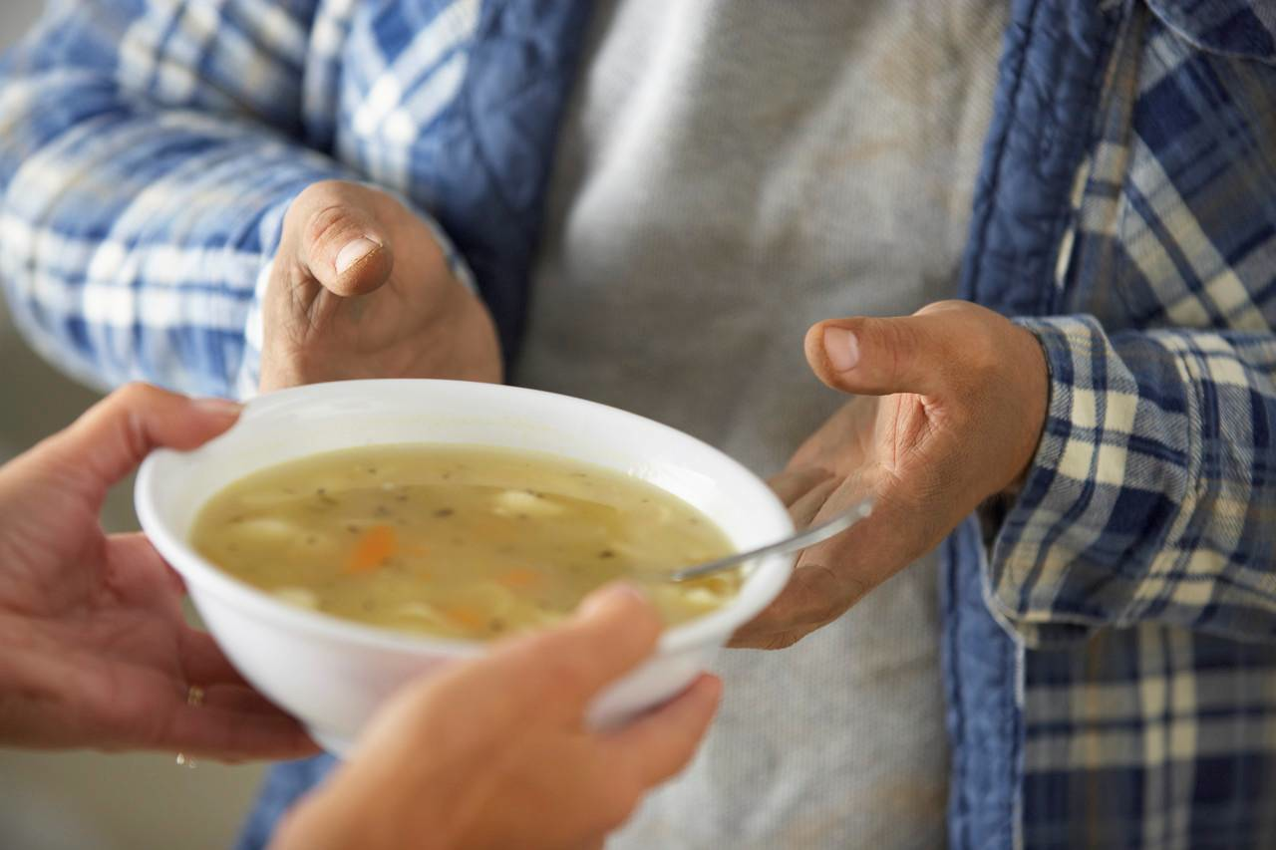
Summative vs. Formative:
When the cook tastes the soup that is formative; when the guest tastes the soup that is summative.
R. Stake
Notes:
After summing up the difference between the two types of assessments with this quote from Robert Stake, go back to the flip chart and the goals of assessment that were generated and ask participants to categorize each goal as being the result of “summative” or “formative” assessment practices. Transition to the next slides by asking why the formative assessment process is so important. Quickly move through the next few slides that provide a rationale from research for a focus on assessment FOR learning.
Quoted in Scriven, Michael. “Beyond Formative and Summative Evaluation.” In M.W. McLaughlin and ED.C. Phillips, eds., Evaluation and Education: A Quarter Century. Chicago: University of Chicago Press, 1991: p. 169. Reported in Patton, Michael Quinn, Utilization-Focused Evaluation: The New Century Text. Edition 3. Thousand Oaks, CA: Sage, 1997: p. 69.

Slide 50
Assessment FOR Learning:
Research
“Few interventions have the same level of impact as assessment for learning. The most intriguing result is that while all students show achievement gains, the largest gains accrue to the lowest achievers.”
Stiggins, et al. (2007, p. 37)
Notes:
This quote speaks for itself as to the impact of formative assessment.

Slide 51
Assessment FOR Learning:
Research
“…formative assessment does improve student learning. The gains in achievement appear to be quite considerable, …, among the largest ever reported for educational interventions.”
Black & Wiliam, Assessment in Education (1998, p. 61)
Notes:
In 1998, Paul Black and Dylan Wiliam summarized the findings from more than 250 studies on formative assessment in an article in Assessment in Education.
Reference: Assessment and Classroom Learning. Paul Black, Dylan Wiliam Assessment in Education: Principles, Policy & Practice. Vol. 5, Iss. 1, 1998.

Slide 52
Assessment FOR Learning:
Research
“The effect of assessment for learning on student achievement is some four or five times greater than the effect of reduced class size.”
Ehrenberg, Brewer, Gamoran & Willms (2001)
Notes:
This slide provides more evidence regarding the benefits of the formative assessment process. Transition to the next slides by telling participants that this research should motivate educators to want to effectively use formative assessment practices in the classroom.

Slide 53
Assessment FOR Learning:
Research
“The FAST SCASS regards formative assessment practices as essential tools for teachers in supporting students to meet the rigorous demands of the Common Core State Standards, which emphasize higher levels of thinking for all students.”
CCSSO (2012)
Notes:
Indicate that “FAST SCASS” is the State Collaborative put together by the CCSSO to clarify the meaning and uses of assessments. [Acronym stands for: Formative Assessment for Students and Teachers (FAST) State Collaborative on Assessment and Student Standards (SCASS)]. There are also SCASSes for ELA, mathematics, ELL, special populations, science and large scale assessment. CSDE consultants are members of these collaboratives.
Transition to the next slides by telling participants that this research should motivate educators to want to effectively use formative assessment practices.

Slide 54
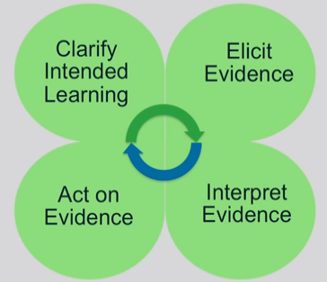
Formative Assessment: Four Attributes
Page
32
Notes:
These next slides give an overview of the four attributes of formative assessment given in the recently developed SBAC Digital Library of formative assessment practices and professional learning resources for educators. Explain that many participants will also be receiving training at the RESCs on this Digital Library in the next couple of months.
Participants should turn to page 32 in their Participant Guide as the attributes are clarified using the next slides. As these four attributes are described, participants should note in the margins how these attributes were modeled by the facilitator in the Two Interpretations of Division task and/or by the teacher in the Multiplying Whole Numbers and Fractions video.
The attributes are qualities or characteristics that would be present in the process of formative assessment.

Slide 55
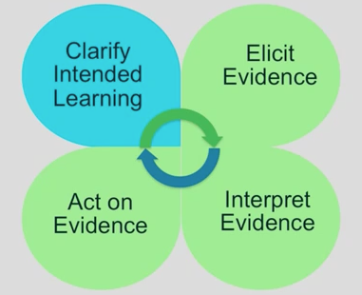
Formative Assessment: Four Attributes
Learning targets: Focus on what students will learn, not what they will do.
Success Criteria: Observable and measurable behaviors to be reached.
Notes:
Purpose of clarifying intended learning is to help students and teachers understand the expectations and goals for their work together. (This slide is animated, click to get information regarding this attribute.)
Learning targets should be communicated in student-friendly language (like we did with our “I can” statements for the SMP in Module 1).
Success criteria extend from the learning targets. Sharing success criteria may include discussing rubrics and modeling what an exemplar might look like. Use examples of strong and weak work.

Slide 56
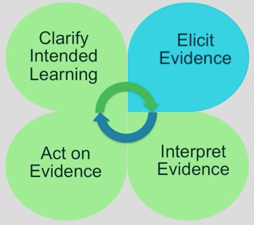
Formative Assessment: Four Attributes
Evidence of learning can be elicited in a variety of ways.
Can be planned for or done spontaneously.
Informal assessment activities can be conducted by the teacher, by peers, or may involve self-reflection by the student.
Notes:
The next attribute is “Elicit Evidence.” As the teacher implements formative assessment practices, evidence of learning is elicited. We will come back to this and talk more about ways to elicit evidence later in this section.

Slide 57
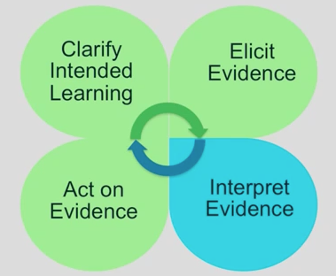
Formative Assessment: Four Attributes
Gaps or misunderstandings in student’s prior knowledge may be discovered.
Instructional plans may need to be adjusted.
Interpreting evidence is not just the job of the teacher.
Notes:
Once evidence is elicited, it must be interpreted to determine where students are in relation to the learning target and success criteria.
Students and peer groups can engage in their own learning by having opportunities to interpret their own evidence.

Slide 58
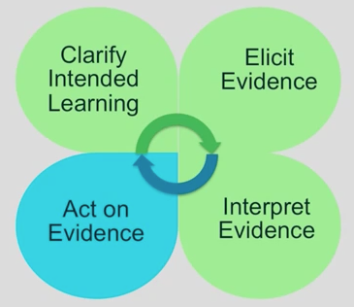
Formative Assessment: Four Attributes
Teachers provide timely, descriptive feedback that is actionable.
Students can also receive feedback through self-assessment or peer-assessment.
Instructional plans may need to be adjusted.
Notes:
Students and teachers act on the interpretation of the evidence. Instructional plans may include mini-tutorials, group work, etc. Provide feedback that is task-involving rather than ego-involving. Best feedback helps students see where they are in relation to the learning target, and then provides hints or suggestions to act on. It puts “the ball back in the student’s court.” Teachers need to set aside the time for students to reflect on and act on the feedback.
The cycle continues as shown by the arrows in the center.
Add to references: Wiliam, D. (2011). Embedded Formative Assessment. Solution Tree Press. Bloomington, IN.

Slide 59
Reflect on Task/Video:
Notes:
Ask participants to reflect on the Two Interpretations of Division task that they did earlier and the tasks/questioning used in the video: Were targets and success criteria made clear? Was the facilitator/teacher effective in eliciting evidence of student learning? After evidence was interpreted, was actionable feedback given? Give participants a minute to jot down some notes in response to this question in their Participant Guide on page 33.
Debrief as a group addressing each of the questions above. (5 minutes)

Slide 60
Eliciting Evidence
At your table groups, create a web of ideas for eliciting evidence of learning on poster paper.
Eliciting Evidence
Notes:
Have participants work together to create a web of ideas showing ways to elicit evidence in their classrooms. Either have participants do a gallery walk when they are done or have each group share out a couple of ideas they had included on their poster.
Ideas that may be shared: Questioning, observations, anecdotal comments of individual or group work, mini-white boards, traffic lights/thumbs up-down, think-pair-share, writing prompts, short quizzes, journals/logs, exit cards, student self-assessment, peer assessment, all-student response systems, diagnostic interviews, etc.

Slide 61

An assessment functions formatively
to the extent that evidence about student achievement is elicited, interpreted, and used by teachers, learners, or their peers
to make decisions about the next steps in instruction that are likely to be better, or better founded, than the decisions they would have made in absence of that evidence.
Dylan Wiliam (2011, p. 43)
Notes:
This quote by Wiliam (2011) sums up Section 5. Transition now to section 6 where we will look more closely at some formative assessment practices.

Slide 62
Let’s Take A Break…
…Be back in 10 minutes

Slide 63
Students’ Role in the Formative Assessment Process
Section 6
Page
35
Notes:
Section 6: Students’ Role in the Formative Assessment Process
Section 6 Time: 45 minutes
Section 6 Training Objectives:
To provide participants with an opportunity to reflect on the role of students in the formative assessment process.
To provide participants with additional opportunities to plan collaboratively around bringing formative assessment practices back to teachers at their school.
Section 6 Outline:
Participants will examine two strategies that Wiliam (2011) suggests are key to effective formative assessment: activating students as learning resources for one another and activating students as owners of their own learning.
Participants will examine brief descriptions of nine practical techniques for the first strategy, activating students as resources for one another. After reading these techniques individually, participants will discuss in groups the pros/cons of the techniques and which they feel they would like to bring back to their teachers.
For the 2nd strategy, activating students as owners of their own learning, participants will share techniques they have used to have students reflect on their own learning.
Supporting Documents
Activating Students as Instructional Resources for One Another: Practical Techniques
Technique Sharing
Materials
Chart paper
Markers

Slide 64
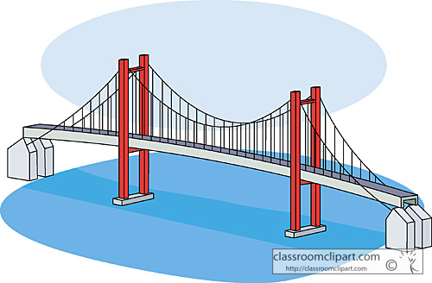
Assessment as a Bridge
“… what students learn as a result of our instruction is unpredictable.”
“Assessment is, indeed, the bridge between teaching and learning.”
  Wiliam (2011)
Notes:
Use this slide to connect teaching and learning (the focus of this module) to assessment.
Transition to the focus of this section by saying that the four attributes of formative assessment that we’ve looked at have made clear that formative assessment is a deliberate process used by teachers AND students. In this section we will look closer at the role of students in effective formative assessment and how the their role in formative assessment links to the CCS-Math which requires higher levels of thinking for all students.

Slide 65
Key Strategies Focusing on Students’ Role in the Formative Assessment Process:
Activating students as learning resources for one another
Activating students as owners of their own learning
Wiliam (2011)
Notes:
We will look at two key strategies that focus on the extent to which students are owners of their own learning (Wiliam, 2011). The next slides describe these two strategies and will give participants an opportunity to think about ways to engage students in the formative assessment process. Mention the connection between these strategies and Connecticut’s “Common Core of Teaching” (http://www.sde.ct.gov/sde/cwp/view.asp?a=2618&q=320862) in which student ownership of learning is clearly an expectation and has ties to teacher evaluation.

Slide 66
Activating students as learning resources for one another
The learning environment must provide for group goals—students are working as a group, not merely working in a group.
There is individual accountability— there are no “passengers” within the group.
Notes:
Point out to participants that research has shown that this first strategy produces some of the largest gains seen in any educational interventions, provided conditions above are met. (Slavin, Hurley, and Chamberlain (2003) as referenced in Wiliam, 2007).

Slide 67
Activating students as learning resources for one another
Read the “Practical Techniques” for accomplishing this on page 35 in your Participant Guide.
Discuss with your group, the pros/cons of the various techniques. Which would you most like to see your teachers implement back in your school/district and why?
Notes:
Have participants turn in their Participant’s Guide to page 35 and read the “Practical Techniques” for activating students as learning resources for one another. Give them 10 minutes to discuss, in their groups, the pros/cons of the various techniques and share which strategies they would like to bring back to their teachers and why. Space has been provided on page 36 in the Participant Guide for note taking. Note that as long as peer assessment is focused on improvement and not on evaluation, it can be especially powerful—students can be more direct with one another than teachers dare to be. Peer assessment is also beneficial to the individual giving the feedback.

Slide 68

Activating students as owners of their own learning
Students take an active part in monitoring and regulating their learning.
To maximize learning, the focus needs to be on personal growth rather than on a comparison with others.
Wiliam (2007)
Techniques: Traffic lights,
Learning portfolios
Notes:
The last strategy, activating students as learning resources for one another, can be viewed as a stepping-stone to the strategy given here. Many of the techniques described for the last strategy can be adapted for self-assessment. Two additional practical techniques for having students reflect on their own learning are named on the slide:
Traffic lights: Students flash green, yellow, or red cards to indicate their level of understanding of a concept.
Learning portfolio: Keep a record of growth when better work is done, it is added to the portfolio rather than replacing earlier work to allow students to review their learning journeys. Focusing on improvement, the student is more likely to see ability as incremental rather than fixed.
Ask participants if they have other techniques that they have used in order to have students take ownership of their own learning. Take 5–10 minutes to allow participants to share and discuss these techniques. Ask participants to add any techniques that they want to bring back to their school/district to the Technique Sharing worksheet on page 36.

Slide 69
Moving Forward with the CCS-Math Implementation
Section 7
Page
38
Notes:
Section 7: Moving Forward with the CCS-Math Implementation
Section 7 Time: 20 minutes
Section 7 Training Objectives:
To provide participants with the opportunity to work collaboratively to identify common coach and teacher needs around implementing and supporting the implementation of the CCS-Math.
Section 7 Outline:
In this short, but focused section, participants will work collaboratively to discuss and identify coach and teacher needs around implementing and supporting the implementation of the CCS-Math. Groups will work to answer implementation and support questions on the Needs Identification worksheet and will identify three common needs for each stakeholder.
This section will wrap-up with each group writing their common needs on a sticky note and placing it on a piece of chart paper labeled Teacher Needs and Coach Needs. Time permitting, the facilitator will go over the needs posted and elicit feedback from the larger group.
Supporting Documents
Needs Identification worksheet
Section 7 Materials
Chart paper
Markers
Sticky notes

Slide 70
Needs identification
Read the instructions on top of the Needs Identification worksheet on page 38.
Record on “stickies” up to three common needs for each stakeholder and place these on the appropriate chart paper.
Notes:
Tell participants that they will now work collaboratively to discuss and identify coach and teacher needs around implementing and supporting the implementation of the CCS-Math. Have them turn to page 38 in their Participant Guide and follow along as you provide the instructions.
Have each group write their common needs on a sticky note and place it on the piece of chart paper labeled Teacher Needs or Coach Needs. Time permitting, go over the needs posted and elicit feedback from the larger group.

Slide 71

Closing Activities
Page
40
Notes:
Participants will discuss Next Steps, complete a Post-Assessment and an online Session Evaluation.
Closing Activities
Closing Activities Time: 10 minutes
Supporting Documents:
Post-Assessment
Session Evaluation (online)
Section 8 at a Glance:
1. Review the Module 3 Outcomes.
2. Have participants complete the Post-Assessment.
3. Have participants complete the online Session Evaluation located here: http://surveys.pcgus.com/s3/CT-Math-Module-3-K-5

Slide 72
Focus on Standards for Mathematical Content Outcomes
By the end of this session you will have:
  Strengthened your working relationship with peer Core Standards Coaches.
  Deepened your understanding of the Practice and Content standards specified in the CCS-Math.
  Articulate a common understanding of UDL.
  Identified the importance of incorporating UDL practices into lessons.
  Described the alignment of instructional practices and learning expectations of the CCS-Math.
Notes:
Review the outcomes for the day.

Slide 73
Focus on Standards for Mathematical Content Outcomes (cont'd)
By the end of this session you will have:
  Planned for implementing UDL strategies within classroom lessons.
  Measured progress towards learning targets using the formative assessment process.
  Explored strategies for supporting teachers as they make changes to their classroom practices.
  Made plans for next steps in your CCS-Math implementation.

Slide 74

Post Assessment and Session Evaluation
Where Are You Now?
Assessing Your Learning.
Please complete an online Session Evaluation. Your feedback is very important to us!
http://surveys.pcgus.com/s3/CT-Math-Module-3-K-5
Notes:
This Post-Assessment is the same as the Pre-Assessment they took in the beginning of the session. This assessment is to gauge their learning based on the activities of the full day session. Remind the participants to fill out their online Session Evaluation forms as well.

Slide 75
Thanks and see you next time!

