Slide 1


Connecticut Core Standards for Mathematics
Systems of Professional Learning
Module 3 Grades 6–12:
Focus on Teaching and Learning

Slide 2

Students’ Role in the Formative Assessment Process
Section 6
Page
35
Notes:
Section 6: Students Role in the Formative Assessment Process
Section 6 Time: 45 minutes
Section Training Objectives:
To provide participants with an opportunity to reflect on the role of students in the formative assessment process.
To provide participants with additional opportunities to plan collaboratively around bringing formative assessment practices back to teachers at their school.
Section 6 Outline:
Participants will examine two strategies that Wiliam (2011) suggests are key to effective formative assessment: activating students as learning resources for one another and activating students as owners of their own learning.
Participants will examine brief descriptions of nine practical techniques for the first strategy, activating students as resources for one another. After reading these techniques individually, participants will discuss in groups the pros/cons of the techniques and which they feel they would like to bring back to their teachers.
For the 2nd strategy, activating students as owners of their own learning, participants will share techniques they have used to have students reflect on their own learning.
Section 6 Supporting Documents
Activating Students as Instructional Resources for One Another: Practical Techniques
Technique Sharing
Section 6 Materials
Chart paper, Markers

Slide 3
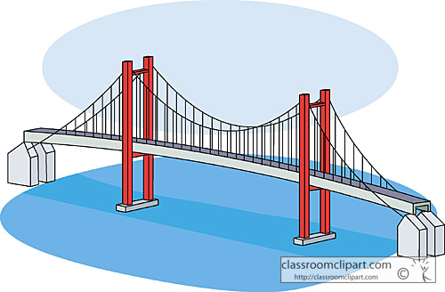
Assessment as a Bridge
“… what students learn as a result of our instruction is unpredictable.”
“Assessment is, indeed, the bridge between teaching and learning.”
  Wiliam (2011)
Notes:
Use this slide to connect teaching and learning (the focus of this module) to assessment.
Transition to the focus of this section by saying that the four attributes of formative assessment that we’ve looked at have made clear that formative assessment is a deliberate process used by teachers AND students. In this section we will look closer at the role of students in effective formative assessment and how the their role in formative assessment links to the CCS-Math which requires higher levels of thinking for all students.

Slide 4
Key Strategies Focusing on Students’ Role in the Formative Assessment Process:
Activating students as learning resources for one another
Activating students as owners of their own learning
Wiliam (2011)
Notes:
We will look at two key strategies that focus on the extent to which students are owners of their own learning (Wiliam, 2011). The next slides describe these two strategies and will give participants an opportunity to think about ways to engage students in the formative assessment process. Mention the connection between these strategies and Connecticut’s “Common Core of Teaching” (http://www.sde.ct.gov/sde/cwp/view.asp?a=2618&q=320862) in which student ownership of learning is clearly an expectation and has ties to teacher evaluation.

Slide 5
Activating students as learning resources for one another
The learning environment must provide for group goals—students are working as a group, not merely working in a group.
There is individual accountability—there are no “passengers” within the group.
Notes:
Point out to participants that research has shown that this first strategy produces some of the largest gains seen in any educational interventions, provided conditions above are met. (Slavin, Hurley, and Chamberlain (2003) as referenced in Wiliam, 2007).

Slide 6
Activating students as learning resources for one another
Read the “Practical Techniques” for accomplishing this on page 35 in your Participant Guide.
Discuss with your group, the pros/cons of the various techniques. Which would you most like to see your teachers implement back in your school/district and why?
Notes:
Have participants turn in their Participant’s Guide to page 35 and read the “Practical Techniques” for activating students as learning resources for one another. Give them 10 minutes to discuss, in their groups, the pros/cons of the various techniques and share which strategies they would like to bring back to their teachers and why. Space had been provided on page 36 in the Participant Guide for note taking. Note that as long as peer assessment is focused on improvement and not on evaluation, it can be especially powerful—students can be more direct with one another than teachers dare to be. Peer assessment is also beneficial to the individual giving the feedback.

Slide 7

Activating students as owners of their own learning
Students take an active part in monitoring and regulating their learning.
To maximize learning, the focus needs to be on personal growth rather than on a comparison with others.
Wiliam (2007)
Techniques: Traffic lights,
Learning portfolios
Notes:
The last strategy, activating students as learning resources for one another, can be viewed as a stepping-stone to the strategy given here. Many of the techniques described for the last strategy can be adapted for self-assessment. Two additional practical techniques for having students reflect on their own learning are named on the slide:
Traffic lights: Students flash green, yellow, or red cards to indicate their level of understanding of a concept.
Learning portfolio: Keep a record of growth when better work is done, it is added to the portfolio rather than replacing earlier work to allow students to review their learning journeys. Focusing on improvement, the student is more likely to see ability as incremental rather than fixed.
Ask participants if they have other techniques that they have used in order to have students take ownership of their own learning. Take 5–10 minutes to allow participants to share and discuss these techniques. Ask participants to add any techniques that they want to bring back to their school/district to the Technique Sharing worksheet on page 36.

