Slide 1
Connecticut Core Standards for Mathematics
Systems of Professional Learning
Module 3 Grades 6–12:
Focus on Teaching and Learning

Slide 2
Assessing Learning Progress
Section 5
Page
29
Notes:
Section 5: Assessing Learning Progress
Section 5 Time: 75 minutes
Section 5 Training Objectives:
To help participants understand the differences in assessment of learning and assessments for learning.
For participants to experience assessments for learning from a student perspective.
For participants to have a shared understanding of the four attributes of the formative assessment process.
For participants to work together to describe various ways to elicit evidence of student learning.
Section 5 Outline:
Participants will begin Section 5 by working through a mini-lesson around the Track Practice task from Illustrative Mathematics. Just as with the Kite problem in Module 1, while participants work, the facilitator will model both UDL and formative assessment practices that will be discussed later in the section. After the lesson is complete, the facilitator will have participants identify the UDL strategies used and then transition the discussion to the process of formative assessment by asking how the learning that is taking place through the lesson can be assessed.
The facilitator will then provide information on assessments of learning and assessments for learning and explain that they will focus on assessments for learning (the formative assessment process) at this time. The facilitator will review the four attributes of formative assessment: clarifying intended learning, eliciting evidence, interpreting evidence, and acting on evidence.
Participants will then, as a large group, identify the formative assessment practices used by the facilitator in the Track Practice mini-lesson as well as by the teacher in the Conjecturing About Functions video.
Participants will wrap-up the activity by working together to complete a graphic organizer on ways to elicit evidence of student understanding (attribute 2).
Section 5 Supporting Documents
7.RP Track Practice
Identifying UDL Strategies worksheet
Assessment of and Assessment for Learning worksheet
Attributes of Formative Assessment worksheet
Reflecting on Formative Assessment worksheet
Section 5 Materials
Chart paper
Markers

Slide 3
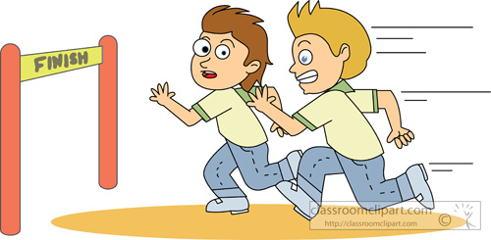
Track Practice (7.RP)
Read the Track Practice task on page 29 of the Participant Guide.
Page
29
Notes:
Track Practice Task:
Have participants read the Track Practice task on page 27 in their Participant Guide and work on this alone for 6 –7 minutes. Explain that this is a Grade 7 task from Illustrative Mathematics (http://www.illustrativemathematics.org/illustrations/82) aligned to 7.RP.A and 7.RP.A.1. Just as with the Kite problem in Module 1, while participants work, the facilitator will model both UDL and formative assessment practices that will be discussed later in this section. When 6 -7 minutes are up, give participants about 5 minutes to discuss their strategies for solving the problem in their groups.

Slide 4
What UDL strategies did you observe as you worked on this task?
Notes:
Have participants turn to the next page in their Participant guide. In group discussions, have the participants identify the UDL strategies that were used while participants worked on the task and then transition the discussion to assessment practices by asking how the learning that is taking place through the lesson can be assessed.

Slide 5
What are your goals for assessment?
Notes:
On chart paper, record responses to the question on the slide generated from the large group. Use these responses to transition to the next two slides that highlight the difference between assessment OF learning (summative) and assessment FOR learning (formative).

Slide 6
Assessments OF Learning:
Assessments designed to provide information regarding the level of student, school, or program success at an end point in time.
“Summative”
Notes:
The phrase “Assessments OF learning” refers to evaluating progress at an end point in time as this slide indicates. Assessment OF learning’s purpose is summative, intended to provide an evaluative judgment, make inferences, or assign a grade for purposes of local, state, or federal accountability. Summative assessments usually signal a student’s relative position amongst other students (an indication as to why they are sometimes referred to as “high stakes” assessments).
Add to references: Council of Chief State School Officers. 2012. Distinguishing Formative Assessment From Other Educational Assessment Labels. Retrieved at http://www.ccsso.org/Documents/FASTLabels.pdf

Slide 7
Assessments OF Learning:
In other words:
Assessments that happen after learning is supposed to have occurred to determine if it did.
Stiggins, et al. (2007)
“Summative”
Notes:
NOTE: Stiggins coined the phrase “assessments OF learning” and “assessments FOR learning”.
Reference: Classroom Assessment for Student Learning: Doing it Right – Using it Well. Stiggins, R. J.; Arter, J. A.; Chappuis, J.; Chappuis, S. Pearson Education, Inc. 2007 Upper Saddle River, NJ

Slide 8
Assessments FOR Learning:
“Formative assessment is a process used by teachers and students during instruction that provides feedback to adjust ongoing teaching and learning to improve students’ achievements of intended instructional outcomes.”
CCSSO (2012)
“Formative”
“Summative”
Notes:
Use this slide to highlight the differences between the two types of assessment. “On these occasions, the grading function is laid aside … this is about getting better” (Stiggins et al, 2007), providing an indication of why these assessments are sometimes referred to as “low stakes.” It’s important to note that summative assessments aren’t bad or wrong, they have a different purpose and have their place.

Slide 9
Summative vs. Formative:
When the cook tastes the soup that is formative; when the guest tastes the soup that is summative.
R. Stake
Notes:
After summing up the difference between the two types of assessments with this quote from Robert Stake, go back to the flip chart and the goals of assessment that were generated and ask participants to categorize each goal as being the result of “summative” or “formative” assessment practices. Transition to the next slides by asking why the formative assessment process is so important. Quickly move through the next few slides that provide a rationale from research for a focus on assessment FOR learning.
Quoted in Scriven, Michael. “Beyond Formative and Summative Evaluation.” In M.W. McLaughlin and ED.C. Phillips, eds., Evaluation and Education: A Quarter Century. Chicago: University of Chicago Press, 1991: p. 169. Reported in Patton, Michael Quinn, Utilization-Focused Evaluation: The New Century Text. Edition 3. Thousand Oaks, CA: Sage, 1997: p. 69.

Slide 10
Assessment FOR Learning: Research
“Few interventions have the same level of impact as assessment for learning. The most intriguing result is that while all students show achievement gains, the largest gains accrue to the lowest achievers.”
Stiggins, et al. (2007, p. 37)
Notes:
This quote speaks for itself as to the impact of formative assessment.

Slide 11
Assessment FOR Learning: Research
“…formative assessment does improve student learning. The gains in achievement appear to be quite considerable, …, among the largest ever reported for educational interventions.”
Black & Wiliam, Assessment in Education (1998, p. 61)
Notes:
In 1998, Paul Black and Dylan Wiliam summarized the findings from more than 250 studies on formative assessment in an article in Assessment in Education.
Reference: Assessment and Classroom Learning. Paul Black, Dylan Wiliam Assessment in Education: Principles, Policy & Practice. Vol. 5, Iss. 1, 1998.

Slide 12
Assessment FOR Learning: Research
“The effect of assessment for learning on student achievement is some four or five times greater than the effect of reduced class size.”
Ehrenberg, Brewer, Gamoran & Willms (2001)
Notes:
This slide provides more evidence regarding the benefits of the formative assessment process. Transition to the next slides by telling participants that this research should motivate educators to want to effectively use formative assessment practices in the classroom.

Slide 13
Assessment FOR Learning: Research
“The FAST SCASS regards formative assessment practices as essential tools for teachers in supporting students to meet the rigorous demands of the Common Core State Standards, which emphasize higher levels of thinking for all students.”
CCSSO (2012)
Notes:
Indicate that “FAST SCASS” is the State Collaborative put together by the CCSSO to clarify the meaning and uses of assessments. [Acronym stands for: Formative Assessment for Students and Teachers (FAST) State Collaborative on Assessment and Student Standards (SCASS)]. There are also SCASSes for ELA, mathematics, ELL, special populations, science and large scale assessment. CSDE consultants are members of these collaboratives.
Transition to the next slides by telling participants that this research should motivate educators to want to effectively use formative assessment practices.

Slide 14
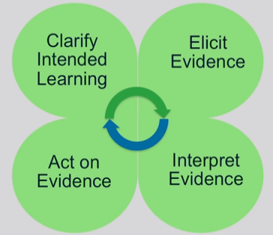
Formative Assessment: Four Attributes
Page
32
Notes:
These next slides give an overview of the four attributes of formative assessment given in the recently developed SBAC Digital Library of formative assessment practices and professional learning resources for educators. Explain that many participants will also be receiving training at the RESCs on this Digital Library in the next couple of months.
Participants should turn to page 32 in their Participant Guide as the attributes are clarified using the next slides. As these four attributes are described, participants should note in the margins how these attributes were modeled by the facilitator in the Track Practice task and/or by the teacher in the Conjecturing about Functions video.
The attributes are qualities or characteristics that would be present in the process of formative assessment.

Slide 15
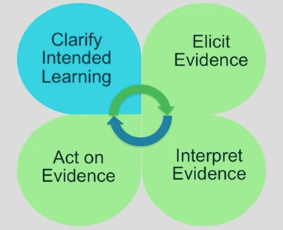
Formative Assessment: Four Attributes
Learning targets: Focus on what students will learn, not what they will do.
Success Criteria: Observable and measurable behaviors to be reached.
Notes:
Purpose of clarifying intended learning is to help students and teachers understand the expectations and goals for their work together. (This slide is animated, click to get information regarding this attribute.)
Learning targets should be communicated in student-friendly language (like we did with our “I can” statements for the SMP in Module 1).
Success criteria extend from the learning targets. Sharing success criteria may include discussing rubrics and modeling what an exemplar might look like. Use examples of strong and weak work.

Slide 16
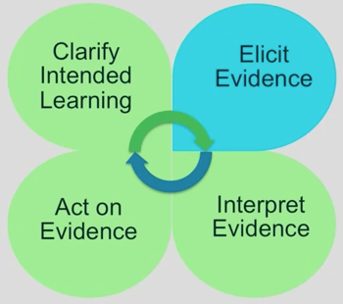
Formative Assessment: Four Attributes
Evidence of learning can be elicited in a variety of ways.
Can be planned for or done spontaneously.
Informal assessment activities can be conducted by the teacher, by peers, or may involve self-reflection by the student.
Notes:
The next attribute is “Elicit Evidence.” As the teacher implements formative assessment practices, evidence of learning is elicited. We will come back to this and talk more about ways to elicit evidence later in this section.

Slide 17
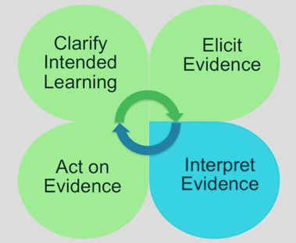
Formative Assessment: Four Attributes
Gaps or misunderstandings in student’s prior knowledge may be discovered.
Instructional plans may need to be adjusted.
Interpreting evidence is not just the job of the teacher.
Notes:
Once evidence is elicited, it must be interpreted to determine where students are in relation to the learning target and success criteria.
Students and peer groups can engage in their own learning by having opportunities to interpret their own evidence.

Slide 18
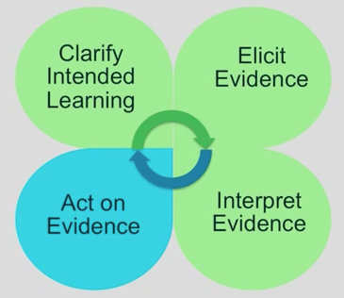
Formative Assessment: Four Attributes
Teachers provide timely, descriptive feedback that is actionable.
Students can also receive feedback through self-assessment or peer-assessment.
Instructional plans may need to be adjusted.
Notes:
Students and teachers act on the interpretation of the evidence. Instructional plans may include mini-tutorials, group work, etc. Provide feedback that is task-involving rather than ego-involving. Best feedback helps students see where they are in relation to the learning target, and then provides hints or suggestions to act on. It puts “the ball back in the student’s court.” Teachers need to set aside the time for students to reflect on and act on the feedback.
The cycle continues as shown by the arrows in the center.
Add to references: Wiliam, D. (2011). Embedded Formative Assessment. Solution Tree Press. Bloomington, IN.

Slide 19
Reflect on Task/Video:
Notes:
Ask participants to reflect on the Track Practice task that they did earlier and the tasks/questioning used in the video – Were targets and success criteria made clear? Was the facilitator/teacher effective in eliciting evidence of student learning? After evidence was interpreted, was actionable feedback given? Give participants a minute to jot down some notes in response to this question in their Participant Guide on page 33.
Debrief as a group addressing each of the questions above. (5 minutes)

Slide 20
Eliciting Evidence
At your table groups, create a web of ideas for eliciting evidence of learning on poster paper.
Eliciting Evidence
Notes:
Have participants work together to make a poster showing a web of ideas of ways to elicit evidence in their classrooms. Either have participants do a gallery walk when they are done or have each group share out a couple of ideas they had included on their poster.
Ideas that may be shared: Questioning, observations, anecdotal comments of individual or group work, mini-white boards, traffic lights/thumbs up-down, think-pair-share, writing prompts, short quizzes, journals/logs, exit cards, student self-assessment, peer assessment, all-student response systems, diagnostic interviews, etc.

Slide 21
“An assessment functions formatively to the extent that evidence about student achievement is elicited, interpreted, and used by teachers, learners, or their peers to make decisions about the next steps in instruction that are likely to be better, or better founded, than the decisions they would have made in absence of that evidence.”
Dylan Wiliam (2011, p. 43)
Notes:
This quote by Wiliam (2011) sums up Section 5. Transition now to section 6 where we will look more closely at some formative assessment practices.

