Slide 1


Connecticut Core Standards for English Language Arts & Literacy
Systems of Professional Learning
Module 3 Grades K–5:
Supporting All Students in Writing and Research

Slide 2

Closing Activities
Post-Assessment
Session Evaluation
Page 62
Notes:
Adjusting for time, you may want to ask groups to share some of their ideas from Activity 10.

Slide 3

Post-Assessment
Where Are You
Now?
Assessing Your
Learning.
Notes:
The Post-Assessment will be the same as the Pre-Assessment they took in the beginning of the session
Ask for further thoughts, questions.

Slide 4
Session Evaluation
Thank you for attending today’s session. Your feedback is very important to us! Please fill out a short survey about today’s session.
The survey is located here: http://surveys.pcgus.com/s3/CT-ELA-Module-3-K-5
Notes:
Remind participants to complete the online Session Evaluation.
Ask for further thoughts, questions.

Slide 5

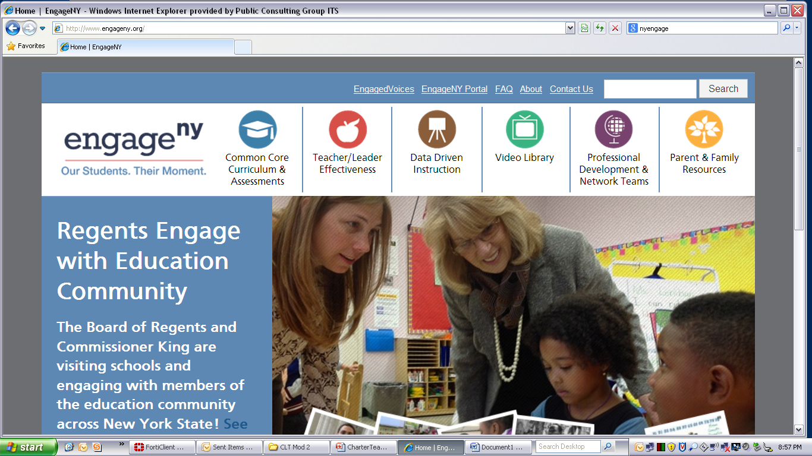



Some Key Resources
ctcorestandards.org
engageny.org
achievethecore.org
americaachieves.org

