Slide 1


Connecticut Core Standards for English Language Arts & Literacy
Systems of Professional Learning
Module 3 Grades K–5:
Supporting All Students in Writing and Research

Slide 2
Today’s Session
CCS Writing and Research
Successes and Challenges
Close Look at the Writing Standards
Research in CCS ELA & Literacy
Writing Grounded in Evidence
from Text
Supporting Students in Writing
Routine and Daily Writing
Notes:
One group of writing standards is focused on research skills. However the CCS are explicit in pointing out that research is integrated throughout the standards.

Slide 3

Part 4
Research in CCS-ELA & Literacy
Page 25
Notes:
Part 4 is allotted 60 minutes.
In this section, we’ll look at the standards related to research and technology, and think about what that means for elementary students and teachers, especially at the earliest grades. One of the best ways to do this is to look at units that have been developed by teachers and writers who have worked closely with the authors of the CC.

Slide 4
CCS-ELA & Literacy Writing Standards for Research
CCS.W.7 Conduct short as well as more sustained research projects based on focused questions, demonstrating understanding of the subject under investigation.
CCS.W.8 Gather relevant information from multiple print and digital sources, assess the credibility and accuracy of each source, and integrate the information while avoiding plagiarism.
CCS.W.9 Draw evidence from literary or informational texts to support analysis, reflection, and research. (Starts in Grade 4)
Notes:
The purpose of this slide is to show the writing standards that focus on research skills.

Slide 5
How does Research Grow?
K-1
Shared research
Writing projects
With support from adults, recall experiences or gather information from provided sources
Grade 2
Recall experiences or gather information from provided sources
Grade 3
Conduct short research projects that build knowledge
Gather relevant information from print and digital sources
Grade 4
…short research projects that build knowledge through investigation of different aspects of a topic
Take notes…Sort evidence
Draw evidence from literary or informational texts to support analysis, reflection and research
Grade 5
…short research projects that use several sources
Print and digital sources
Summarize or paraphrase information
Notes:
Increased independence, more complex tasks, more complex sources, multiple sources. In grade 4, addition W.9, which links Grade 4 reading standards with writing standards.

Slide 6

Activity 6: Research in CCS-aligned Units
Activity 6: Research in CCS-Aligned Units
Your team will develop expertise on one research unit. Together, review your unit to see how it is organized. If it is long or complex, you may want to divide it. Read and use the “Developing Research” Organizer for notes. Be sure to notice and note how research skills are taught and what is missing in the unit! Create a poster with words and symbols to represent the way research skills are taught and developed in your unit. Prepare to “host” representatives from other teams at your poster on a gallery walk.
Page 25
Notes:
The review of the units and the hosted gallery walk are allotted 45 minutes. Allow 20 minutes to review the units, another 10 to create the poster, and 15 for the hosted gallery walk. It will be tight. Emphasize the importance of dividing up large units.
Facilitator: If you’d like, you can creatively use the cards that participants were dealt this morning to form research teams. Or if you’d like, you can just number off; for example a group of 30 can number be formed into 6 teams (2 teams for each unit). No team should be larger than 6 members.

Slide 7
Activity 6: Research in CCS-aligned Units
Activity 6: Links for Research Units
Grade 1: Informational Text, Research, and Inquiry Circles: Animals and Habitats Grade 2: Informational Text: Reading for Inquiry and Writing a Report Grade 4: Reading and Writing Informational Texts: Negro League Baseball http://www.doe.mass.edu/candi/model/files.html
Notes:
Facilitator: You do not have to do anything with this slide; it is for the convenience of participants who are following along with the PPT. There will be hard copies of each of the modules for the participants to choose. Since all three modules are located on the same web site there is only one web address for them to retrieve a copy of all three units.

Slide 8
Activity 6: Research in CCS-aligned Units
Activity 6: Hosted Gallery Walk
Join a group with representatives from each of the research teams. Each group starts at a different poster. Whoever in your group was a participant in making that poster will be the “host.” The host will explain the research process in his or her unit, including anything unique or noteworthy. At a given signal, each group moves to the next poster and the host changes.
Notes:
Re-group participants so that each new group has one member from each former team. There should be a representative from each unit in each group. So, if there were six teams working on the three units (2 teams per unit) they should make six new groups with representatives from the six research teams. These groups should be formed standing up, not seated. Although some participants reviewed the same unit, they will create different charts. They should be hung together in order to see the different areas that each team focused on as well as the “missed opportunities” for building research skills within the unit.
Tell groups what the signal will be (e.g. rhythmic clap, lights flicking, stopwatch on your cell phone, or on the computer). It can be an audible or visible signal. Depending on the number of groups, allow approximately 2 minutes at a poster, then move participants to the next poster. With movement, this activity should take about 15 minutes.
Hosted Gallery Walk adapted from Expeditionary Learning’s Protocols and Resources on EngageNY: http://www.engageny.org/sites/default/files/resource/attachments/appendix_protocols_and_resources.pdf
The hosted gallery walk involves small-group collaboration to create a product, yet makes individuals responsible for the learning and the teaching.

Slide 9
Research in CCS-aligned Units
To what extent did you see grade level research standards reflected in the units/modules you reviewed?
What types of instruction in the units will help students grow in their research skills?
How does instruction in research skills differ from (or mirror) other writing instruction?
Notes:
This slide provides closure to the Gallery Walk. Encourage volunteers to offer responses, based on their review of units and the Gallery Walk.

Slide 10
Writing and Research build Content Knowledge
“It is especially important that writing is included as an integral part of content instruction in the disciplines… When students write informative papers about the content they are learning, it forces them to make decisions about
  What information is most important
  What consequences were positive, negative, or both
  How findings should be organized and presented”
Graham (2013)
Notes:
This slide reminds coaches of the importance of research for building knowledge in the disciplines. It is especially important that writing is included as an integral part of content instruction in disciplines like science, social studies, and mathematics. This slide reminds coaches of the importance of research for building knowledge in the disciplines.
Full quote: “ It is especially important that writing is included as an integral part of content instruction in disciplines like science, social studies, and mathematics. For example, when students write informative papers about the content they are learning in social studies (the consequences of the westward movement in American history as illustrated through the Oregon Trail, for instance), it forces them to makes decisions about (1) what information is most important; (2) what consequences were positive, negative, or both; and (3) how their findings should be organized and presented. Such analyses and interpretation forces students to wrestle with the content, especially if they have to defend the choices they made (e.g., why were the consequences they presented important).”
Graham, S. (2013). Writing Standards. In Morrow, L.M., Wixson, K.K., & Shanahan, T. (Eds.), Teaching with the common core standards. (p. 102).

Slide 11
Where is Technology in the Writing Standards?
CCS.W.6 Use technology, including the Internet, to produce and publish writing and to interact and collaborate with others.
CCS.W.7 Conduct short as well as more sustained research projects based on focused questions, demonstrating understanding of the subject under investigation.
CCS.W.8 Gather relevant information from multiple print and digital sources, assess the credibility and accuracy of each source, and integrate the information while avoiding plagiarism.
Notes:
Technology is integrated throughout the standards. It is specifically embedded in the research standards. This could be considered a shift from former standards, which frequently isolated technology as an end in itself.

Slide 12
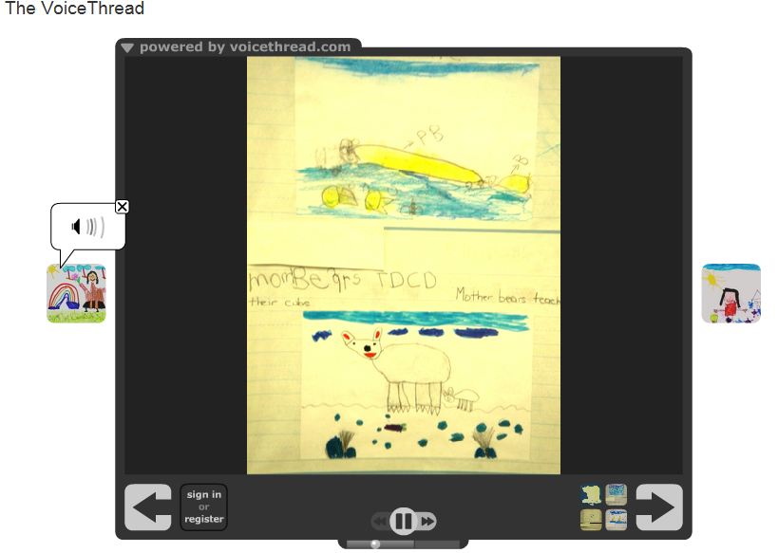
Digital Storytelling
https://voicethread.com/share/4215555/
Notes:
The next slides illustrate several technology applications that support the CCS.
This project illustrates the Kindergarten research standards as well as the use of technology. This VoiceThread, All About Polar Bears, Kindergarten ESL by Monica Schnee, won a PBS Teacher Innovator Award. The authors of the "book" are kindergartners who were learning English as a second language. Some of the children barely spoke English, as you can see by the short sentences, and some were advanced students. They had just started to learn how to read and write. This work is a great example of how children learn a second language, how they learn literacy, how they learn oral fluency and practice their oral skills and most importantly, how their parents were able to see and hear how their children are learning English.
The teacher: We spent a lot of time reading books, looking at websites, particularly National Geographic and Nature on PBS. We collected facts, a word that children learned in nonfiction. Then, each student chose a fact, wrote it and had to illustrate it like a true nonfiction illustrator. Therefore, the drawings had to be in "real colors". After we finished our "traditional hard copy" book. We read it to all the kindergartners, including their American peers. Then we practiced our lines and made it into a VoiceThread.

Slide 13
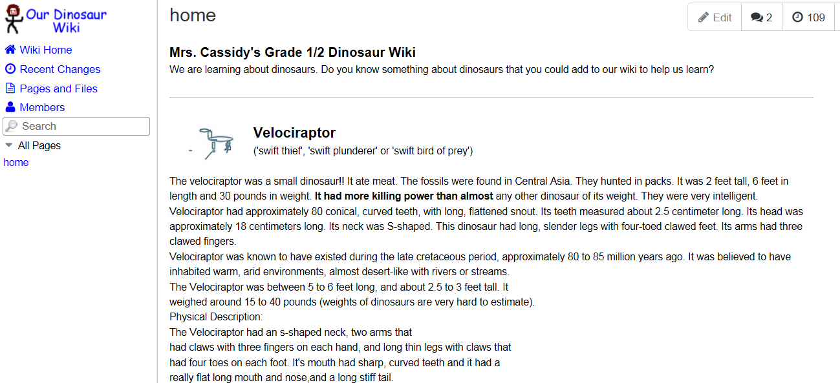
Shared Writing
http://room2-wiki6.wikispaces.com/
Notes:
http://www.wikispaces.com/content/classroom/about
Project-Based Learning
Project-Based Learning is a dynamic approach to teaching in which students explore real-world problems and challenges. With this type of active and engaged learning, students are inspired to obtain a deeper knowledge of the subjects they're studying.
Wikispaces Classroom provides a simple structure that allows you to create projects, define teams, assign students and manage them all through successful completion of their projects. Starting from pre-built templates, or a blank slate, students can work in private groups until their work is due. At the end of the project you can share the results with the rest of the class or even parents and other participants. In the project illustrated, the teacher asks students to contribute to the wiki.

Slide 14
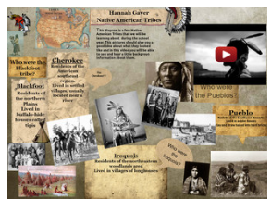
Interactive Posters
http://hgaver.edu.glogster.com/native-american-tribes/?=glogpedia-source
Notes:
A Glog is an interactive visual platform in which users create a “poster or web page” containing multimedia elements including: text, audio, video, images, graphics, drawings, and data.
The teacher creates projects with templates and instructional guidelines, assigns them to the students, provides feedback throughout the assignment, and assesses their finished work.
Once projects are complete, the teacher can share students’ work in a variety of educational settings. Glogs can be embedded in a blog, wiki, or web page or shared with others using Glogster.

Slide 15
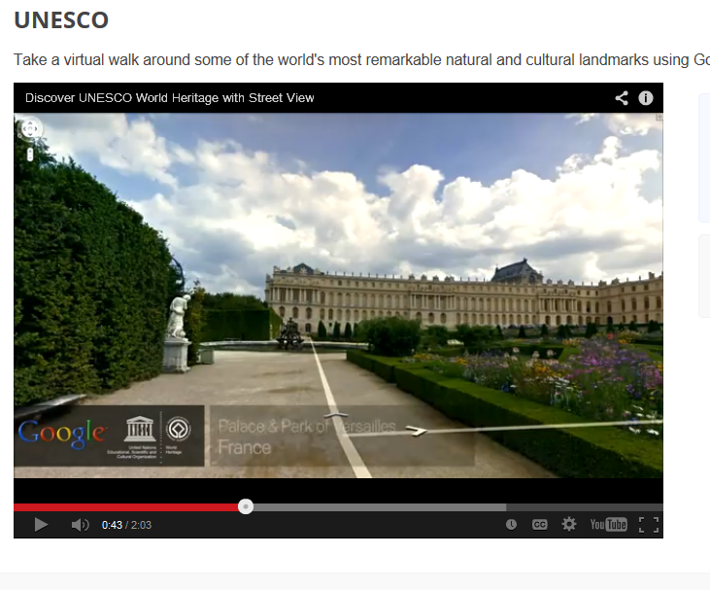
Virtual Field Trips
http://www.google.com/earth/explore/showcase/unesco.html
Notes:
With Google Earth, teachers can create customized field trips for shared research. This is great for primary classes.

Slide 16
Digital Literacy Skills Students Need
Refined search skills
Ability to evaluate the veracity of sources
Ability to synthesize information from multiple sources
Practice in sending clear, unambiguous messages in online environments
Skills for navigating social media and collaborative environments
Adapted from http://www.newliteracies.uconn.edu/events.html
Notes:
The New Literacies Research Lab at the University of Connecticut is the most widely recognized center in the world for conducting research on the new reading comprehension and learning skills required by the Internet and other emerging information and communication technologies. Their work develops research-based evidence to prepare students for their literacy and learning future. They are currently developing an online assessment to determine students digital literacy skills. They have determined areas in which students struggle with digital literacy. The list on this slide is derived from their research.

