Slide 1


Connecticut Core Standards for English Language Arts & Literacy
Systems of Professional Learning
Module 3 Grades 6–12:
Supporting all Students in Writing and Research

Slide 2

After Learning How to Write Claims, Students Write an Argument, Supporting that Claim
At your table discuss:
What are the qualities of effective argument writing?
Consider what students must know and be able to do to write effective arguments.
Notes:
Once a claim has been made and the evidence has been gathered, the next step is to teach students how to provide this information in a structured, cohesive, and compelling essay. Have participants discuss the qualities of an effective written argument and the skills students need.

Slide 3
What are the Qualities of Effective Argument Writing?
An effective claim with a clear introduction of idea(s)
Collection of strong textual evidence
Well-constructed grouping and connecting ideas with mature transitions
Effective explanations of the evidence that supports the claim
Counterclaims appropriately addressed
Use of correct English conventions
Strong and meaningful conclusion
Use a variety of words eloquently
Notes:
These are just some of the qualities needed for effective argument writing. Have participants compare this list to what they considered in their discussions.

Slide 4
The 4 Cs of Evidence-based Writing
Claim it: Violence on television affects children in negative ways.
Cite it: According to Palmer, children under the age of 10 who watch more than 15 hours a week of television were more likely to play pretend games where others were killed or harmed.
Clarify it: In reviewing the research, the overwhelming number of studies suggest that violence on television does have a negative effect on children.
Counterclaim it: On the other hand, the Television Association of America, in a 2004 study, found that watching television had no effect on young children. In their study…
Notes:
The 4Cs (counterclaim may be optional in younger grades) is one way for teacher’s to gain evidence of learning. It is a simply formula to use initially as students unwrap the pieces of making claims and creating arguments. This can be used as an initial introduction to this process or as a ”ticket out the door” activity wherein teachers can assess if students are able to produce a rudimentary beginning of argumentative writing. This can be used for explanation as well as argument. The difference is, in explanation, we start with the premise that the claim is true, not arguable, and that we are just going to explain it. Teachers could use the terminology Explain/Cite/Clarify.
Note: The information in these next 2 pieces are fictional so no citing from sources for its content was necessary.

Slide 5
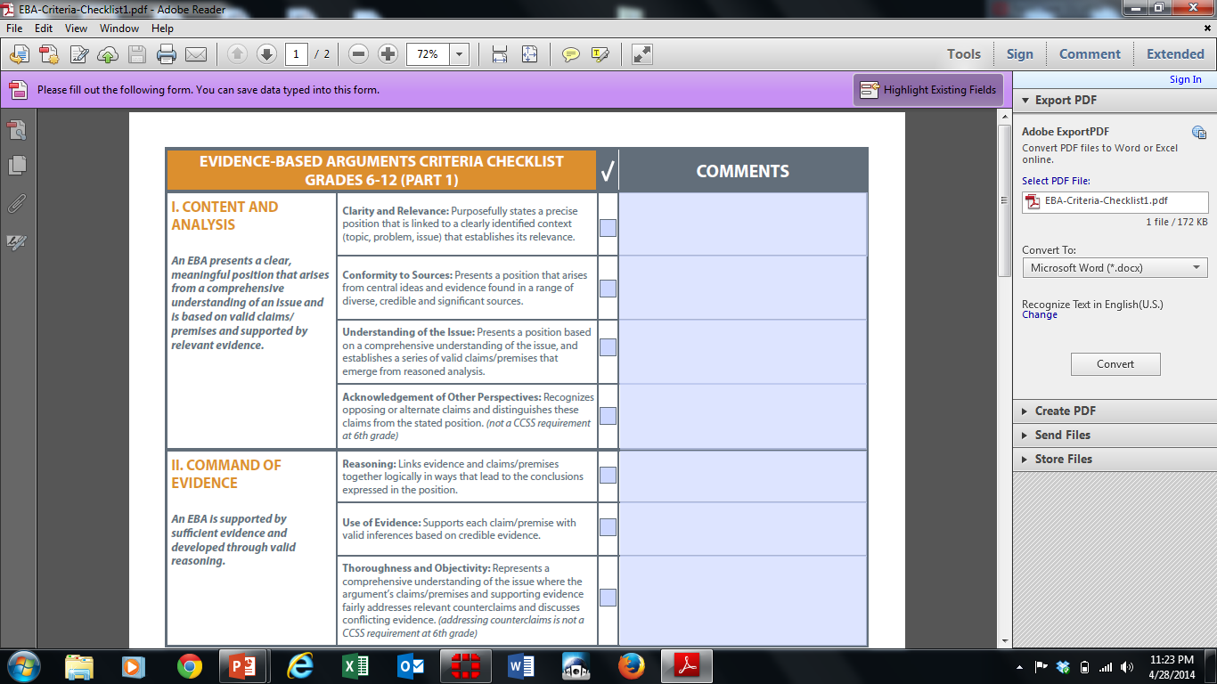
ODELL EVIDENCE-BASED ARGUMENTS CRITERIA CHECKLIST GRADES 6-12
Notes:
Have participant’s open to the Odell Education’s Evidence-based Argument Criteria Checklist in the Appendix of their Participant Guide.
Have participants review each section with a partner. Partners discuss how this tool can help support argument writing.

Slide 6
Persuasion vs. Argument: Both have the goal of persuading people to believe something is true or change their beliefs
Persuasion
Use of Persuasive Strategies
Ethos (author credibility)
Pathos (emotional appeals)
Argument
Use of Logic
Logos (logical appeals)
Reason
Claims
Proof
Audience self-interest
Notes:
This is an important distinction for students to understand. Students will conduct both types of writing and there is a fine but important distinction between logical argument and persuasive writing, even though persuasion is the goal of each. The distinction lies in the appeal each makes: Persuasion may rely on persuasive techniques such as appealing to self interest or emotion. Argument, on the other hand, always relies on a logical case that persuades by convincing the reader of the merits of the claims and proofs.
For instance, when asked to write a short paper “persuading a parent” to do something, we have all seen instances when one or more students will resort to flattery, bargaining, even pleading–which may in fact be very persuasive at home, but certainly does not represent progress toward‒or understanding of‒the ability to write a reasoned, logical argument that is required to be college and career ready.

Slide 7


Activity 5b: Finding Evidence to Support an Argument
Activity 5b: Finding Evidence to Support an Argument – Viewing a Video
View the Video Developing Evidence-based Arguments: http://commoncore.americaachieves.org/module/1 Consider the following: How were students supported in developing their arguments? How were students supported in finding evidence for their arguments? What role does discussion play in crafting arguments and gathering evidence?
Page 33

