Slide 1


Connecticut Core Standards for English Language Arts & Literacy
Systems of Professional Learning
Module 2 Grades K–5:
Supporting all Students in Close Reading, Academic Language, and Text-based Discussion
Notes:
(Slides 1-7, including the Pre-Assessment, will take about 20 minutes total.)

Slide 2
Today’s Session
Common Core ELA & Literacy
Successes and Challenges
Design of CCS-aligned Units
Classroom Discussion
Close Reading, Text-dependent Questions, and Academic Language
Universal Design for Learning

Slide 3
Part 4
Connecting Close Reading and
Text-based Discussion
Notes:
(60 minutes total for Part 4) This backward design portion is meant only as general information and guidance so that participants will understand where a close reading lesson might fit into an overall unit. Module 4 will go more deeply into unit design.
Facilitator, preview Part 2 for participants:
This activity is meant to introduce components of a core standards-aligned unit in Modules 2 and 3. exemplary unit and lesson design–the big picture–before we look closely at various
We will review design principles.
We will examine several exemplar units for elements of those design principles and key elements.
These are units that have been vetted and approved on your Ctcorestandards website.

Slide 4
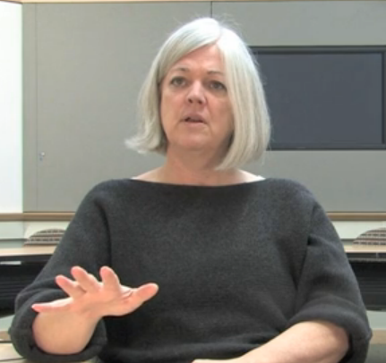
Text-based Discussion
Classroom discourse in which a teacher or classmate asks "how do you know…" or "aren't you ignoring…" would support careful and critical attention to precisely what a text says, what the author intends, and what evidence is offered.
http://ccdd.serpmedia.org/index.php
Notes:
Read the quote and show the video as a prelude to the article handout.
In this brief video, Catherine O’Connor, professor at Boston University and researcher, discusses a project in which she is involved through SERP. SERP is an organization that provides a structure for research and research based programs carried out in field sites – schools and school districts, who work in partnership with SERP. In this video, Catherine O’Connor explains the importance of text-based discussion while explaining a new project, CCDD, “Catalyzing Comprehension through Discussion and Debate.”
http://ccdd.serpmedia.org/index.php
Segment: 2:40 – 5:45

Slide 5


Activity 5:
Reading about Classroom Discussion
Activity 5: Using the 4 A’s Protocol
Choose a facilitator and a timekeeper. Read the excerpt silently, from the bottom of page 6 through the first column of page 8. Make notes in your Participant Guide. (8 minutes) Conduct a discussion, using the 4 A’s protocol. (8 minutes) Discuss: “What does this mean for our work with teachers and students?” (4 minutes) Share out with the whole group. (5 minutes)
Page 23
Notes:
Description of the Activity:
Participants read and annotate a handout excerpt from an IRA policy brief, “Close Reading and Far-Reaching Classroom Discussion: Fostering a Vital Connection” (Snow & O’Connor, 2013 retrieved from: http://www.reading.org/Libraries/lrp/ira-lrp-policy-brief--close-reading--13sept2013.pdf). In groups of 4, they use the 4 A’s Protocol, to discuss the article, and prepare to answer the question, What implications does this excerpt have for our work with teachers and students?
Gray, Judith. "Four 'A's Text Protocol." National School Reform Faculty. 2005. Harmony Education Center. http://www.nsrfharmony.org/protocol/doc/4_a_text.pdf
1. Point out the location of the activity in their Participant Guide. This summary (below) is in the Participant Guide. Explain that they are going to read an excerpt from a longer article and discuss it. You will summarize the parts of the article they are not reading.
2. Read this summary: The authors, Snow and O’Connor examine close reading and consider the advantages, as well as the limitations of close reading. They suggest ways in which close reading might be usefully supplemented by other classroom practices, to ensure that it supports comprehension and to avoid problems from an excessive focus on close reading, such as student frustration, a decline in motivation to read, and reduction in opportunities to learn content.
3. Review the directions and point out the location of the protocol grid in their Participant Guide. The sections of the article participants will read address the relationship between classroom discussion and close reading. They read, beginning at the bottom of page 6 through the first column on page 8: “Narrow Close Reading Undermines Valuable Classroom Discussion,” and, “Productive Close Reading.”
Choose a timekeeper and facilitator.
Read the excerpt silently, making notes in the table for each of the 4 A’s and highlighting sentences, phrases, or words in the text as evidence. (8 minutes)
• What Assumptions does the author of the text hold?
• What do you Agree with in the text?
• What do you want to Argue with in the text?
• What part of the text do you want to Aspire to or Act upon?
In a round, have each person identify one assumption in the text, citing the text as evidence. (1 minute per person, 4 minutes total)
In the second round, each participant may choose any one of the remaining 3 A’s to share. (1 minute per person, 4 minutes total) Please note, this is a variation on the original 4 A’s which continues in rounds for each of the remaining A’s.
End the session with an open discussion framed around the questions: What does this mean for our work with teachers and students? (4 minutes)
One person from each table will share briefly about his/her table’s discussion. (5 minutes total)

