Slide 1


Connecticut Core Standards for Mathematics
Systems of Professional Learning
Module 1 Grades K–5:
Focus on Practice Standards
Notes:
(Slides 1-5, including the Pre-Assessment, will take about 10 minutes total.)

Slide 2

Closing Activities: Post-Assessment–CCS-Math and Session Evaluation

Slide 3


Post Assessment and Session Evaluation
Where Are You Now?
Assessing Your Learning.
Page 51
Notes:
This Post-Assessment will be the same as the Pre-Assessment they took in the beginning of the session. This assessment is to gauge their learning based on the activities of the full day session. Remind the participants to fill out their Session Evaluation survey online.

Slide 4

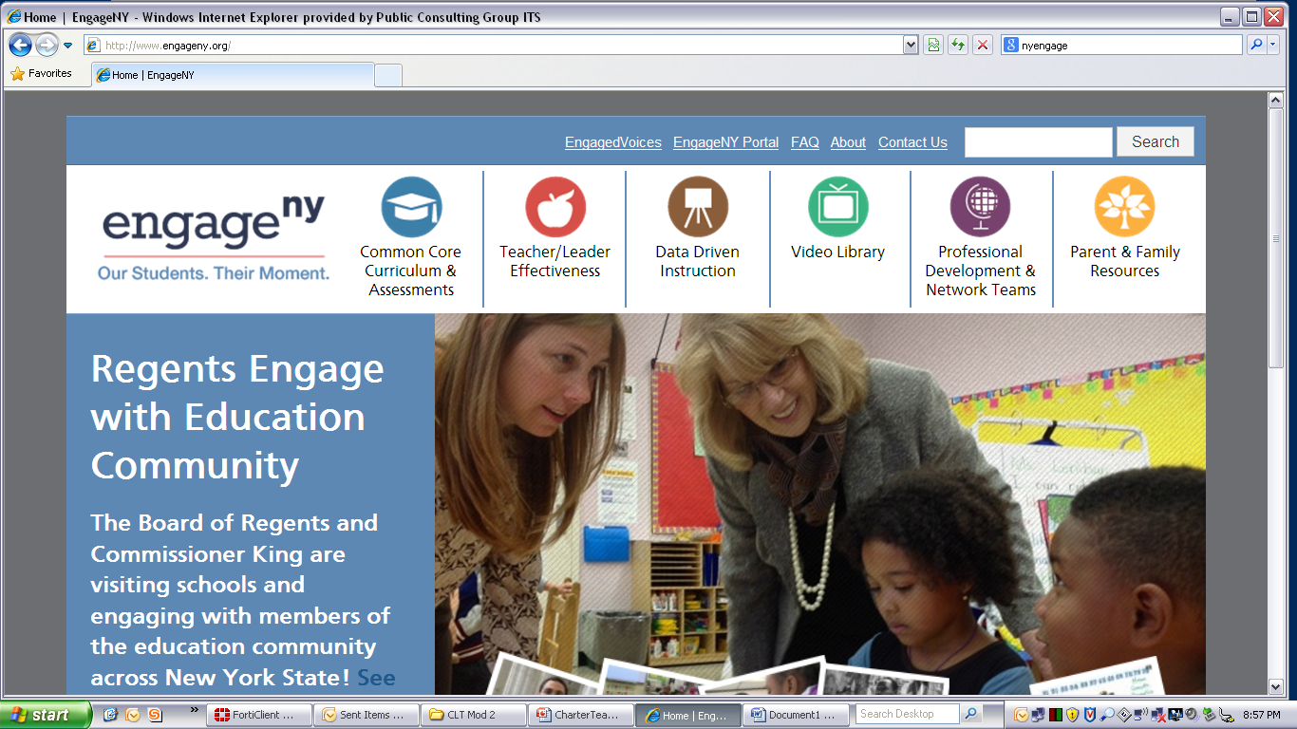



Some Key Resources
ctcorestandards.org
engageny.org
achievethecore.org
americaachieves.org

