Slide 1


Connecticut Core Standards for Mathematics
Systems of Professional Learning
Module 1 Grades 6–12:
Focus on Practice Standards
Notes:
(Slides 1-5, including the pre-assessment, will take about 10 minutes total.)

Slide 2


Understanding the Standards for Mathematical Practice: Developing Mathematical Expertise
Section 3
Page 15
Notes:
Section 3: Understanding the Standards for Mathematical Practice: Developing Mathematical Expertise
Section 3 Training Objectives:
To introduce all eight of the Standards for Mathematical Practice and adapting the language of the practices to make each grade level appropriate without reducing rigor.
Section 3 Outline:
Section 3 begins with participants solving problems that are each aligned to one of the Standards for Mathematical Practice.
The facilitator then provides information on each of the eight practices, including information about the standard, what the standard means, instructional supports for helping students to develop the practice, and sample “I Can” statements. Throughout the presentation participants will answer questions and work in groups to determine which of the problems was an example of the practice, and to create grade level “I Can” statements for each of the practices based on their new understanding of each practice.
The section wraps up with teachers discussing how they would pair the practices based on their attributes and then being shown Bill McCallum’s Mathematical Practices Grouping Chart.
Supporting Documents
Problem Set: Practice Standards Alignment
Understanding the Mathematical Practices
Materials
Chart paper, markers, two sets of signs for each of the 8 Practice Standards
Key Implementation Notes:
In this activity participants will work sample problems that will help them to understand what each of the Standards for Mathematical Practice look like in a classroom situation. Participants will work the problems without knowing the Practice Standard they are most aligned with and the alignment is revealed later during the presentation.
Begin the activity by asking participants to form eight GRADE LEVEL table groups. Once grade level groups have been formed, ask participants to turn to the Problem Set in their Participant Guide on pages 15-16. Number the groups. Coaches should work the problem that coincides with their group number. Participants should work the problem individually and hold off on the group discussion until directed to do so during the presentation of each of the Practice Standards.
While participants are working the problems, hang eight pieces of chart paper around the room. Each piece of chart paper should be labeled with one of the practices. After participants finish working the problems in the Problem Set tell them to move around the room and rate their personal understanding of each of the practices. They should use a rating scale of 1–5 with 1 having little or no understanding and 5 having a deep understanding of the practice. This exercise will allow you to gauge participants’ understanding of the practices and help you to determine the pace of the practices presentation.
During the interactive presentation on all eight of the practices, participants will need their copy of the Standards for Mathematical Practice. Suggest that participants use the Understanding the Mathematical Practices on pages 17-24 to make notes and answer questions in each of the designated areas.
Note: You should spend approximately 5-7 minutes per practice for the first four practices, and then 20-25 minutes on the small group discussions of the last four practices and 5-10 minutes debriefing the small group discussions.

Slide 3

SMP1: Make sense of problems and persevere in solving them
What does it mean to make sense of a problem?
What does it mean to persevere in solving a problem?
Notes:
SMP1: Have participants think for a moment about the questions on the slides. Ask for one or two volunteers to share their answer to the questions.
Responses that you want to listen for include points such as:
Making sense of a problem means that students are able to break the problem into usable parts and determine how each part will be used to answer the question.
Making sense of a problem means that students are able to use the information in the problem to determine the final questions to be answered.
Persevering in solving a problem means that students ‘stick with it’ and do not give up when they find themselves challenged.
Persevering in solving a problem means that students are able to ask questions about the problem that will help them clarify points of the problem and make the final problem question make sense rather than wait for someone to tell them how to solve the problem.
These two questions are answered in more depth over the next four slides.

Slide 4
SMP1: Make sense of problems and persevere in solving them
Mathematically proficient students:
Understand the meaning of the problem
Look for ways to start working on the problem
Analyze the information
Design a plan
Monitor and evaluate their progress
Change course as necessary
Check their answers to problems
Know if their answer makes sense
Notes:
SMP1: Review the checklist of attributes on the slide. As you get to the end of the list, ask for participants who had a problem that required them to do a number of these things as they came up with a solution. Allow groups a minute to discuss with their group to determine if their problem was the one most closely aligned to this practice.
Note: Participants may say that all of the problems had some element of this practice, however the problem on the next slide was chosen because it exemplified this practice more than any of the others.

Slide 5

SMP1: Make sense of problems and persevere in solving them
Farmer Lebowski has some chickens and some cows in her yard. Together, the animals have a total of 90 heads and 286 legs. How many chickens and how many cows are in the yard? Find a way to solve this problem that does not involve the use of an algebraic equation.
Notes:
SMP1: Explain that this problem was chosen as the most closely aligned to this practice. Ask for a volunteer from the group who worked this task to discuss this alignment. Key points to make:
There is no simple algorithm that will solve the problem directly. Students have to find a way to think about the problem and develop a strategy. It may require several false starts.
Students may be uncomfortable thinking about a problem that is not routine. They will have to work through that in order to successfully answer the question in the problem.

Slide 6
SMP1: Make sense of problems and persevere in solving them
Instructional Supports:
Don’t be afraid to challenge students!
Ask clarifying questions such as:
  What is the problem asking?
  How could you start the problem?
  What tools might be helpful?
  How can you check this?
  Does your answer make sense?
  How could you make this easier?
Notes:
SMP1: Review the instructional supports on the slide. Note for participants that the first support or idea, “don’t be afraid to challenge students!” will be seen throughout the practices. Ask participants what they think it means to challenge students. During the discussion, focus their thinking on challenging students by requiring students to really think about the mathematics. The Common Core is not about learning how to get an answer, as we heard Phil Daro discuss. The Common Core is about learning to solve problems. Solving problems is much more rigorous than getting answers. Students need to be challenged to gain conceptual understanding of the mathematics being taught and must reach a point of being able to recognize, on their own without prompting, when to apply the mathematics that they have learned to solve problems in new situations. This will be challenging and possibly uncomfortable for many students, however, students will need to be challenged in order to develop their mathematical expertise.

Slide 7
SMP1: Make sense of problems and persevere in solving them
Instructional Supports:
Create ‘I Can’ statements for your students so they know what is expected.
Example 1
I can tell you what the problem is asking me to do.
Example 2
I can keep working on a problem even when I encounter difficulties.
Notes:
SMP1: Review the ‘I Can” statements on the slide. Ask participants if they would add any statements here that would better fit students at their grade level. As volunteers provide their statements, make sure that they align with the practice so that students are receiving the correct information.

Slide 8
SMP2: Reason abstractly and quantitatively
What does it mean to reason
Abstractly?
Quantitatively?
Notes:
SMP2: Review the questions on the slide. Allow participants to think for a moment and then ask for volunteers to share their answers.
As you listen to participants’ answers, listen for things such as:
Reasoning abstractly means to reason within a context or within a situation, form theories, understand problems on a complex level through analysis and evaluation, and to know when and how to apply knowledge when solving problems.
Reasoning quantitatively means to apply their mathematical skills to solve a problem. Students understand the values that they are working with and are able to relate those to the problem itself.
These questions will be answered in more depth over the next four slides.

Slide 9
SMP2: Reason abstractly and quantitatively
Mathematically proficient students:
Make sense of quantities and relationships
Represent a problem symbolically
Considers the units involved
Understand and use properties
of operations
Decontextualize
Contextualize
Notes:
SMP2: Review the points on the slide. At the end of the list, know that some participants may not understand what it means for students to able to decontextualize and contextualize. To decontextualize means to be able to pull the values out of the problem situation and do the work with them that needs to be done. For example, in the problem, Olivia has 4 apples and Sophia has 6 apples. If they both give their apples to Anna, how many apples will Anna have? When decontextualizing, students are able to represent the problem as 4+6=10. And then to contextualize , they are able to put the final values back in to the problem situation. If students were given the number sentence 4+6=10 and are able to create a problem situation that makes the number sentence, this would be considered contextualizing as well.
Before moving to the next slide ask participants to look at the problems they solved and determine whose problem would be aligned with this practice.

Slide 10
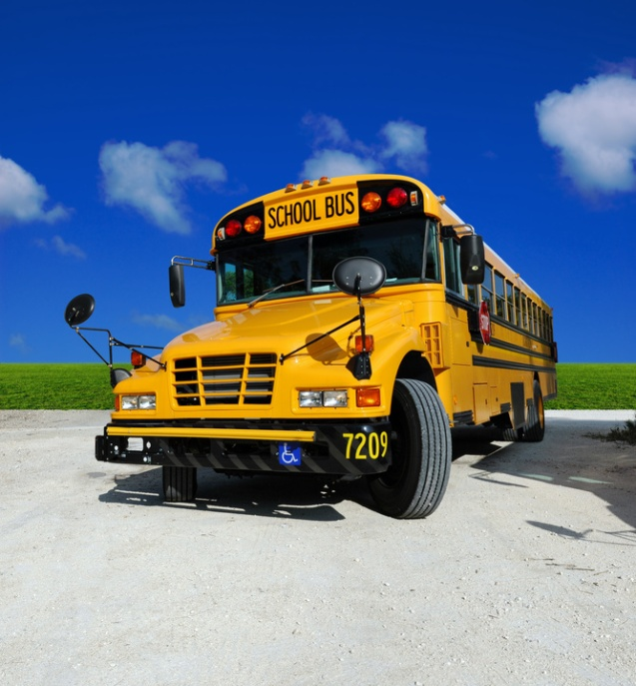
SMP2: Reason abstractly and quantitatively
Eighth graders are going on a field trip. There are 167 students going. How many buses are needed for the trip if each bus can hold 48 students?
Notes:
SMP2: Reveal that the ‘field trip’ problem was chosen for this practice because, not only do students need to apply practice 2 when working the problem, but they must also think about their answer within the context of the problem itself. While 167 divided by 48 gives us an answer of 3.47 or 3 with a remainder of 23, a student cannot use their calculated answer to solve the problem because the problem is not asking them to solve 167 divided by 48. The problem is asking them to determine how many buses are needed. Division is one tool that can be used to determine this. Others are estimating, rounding, etc. The final answer is four buses are needed.

Slide 11
SMP2: Reason abstractly and quantitatively
Instructional Supports:
Don’t be afraid to challenge students!
Ask clarifying questions such as:
  What does the number___ represent in the problem?
  How can you represent the problem with symbols and numbers?
  Does your answer fit what the problem is asking?
Notes:
SMP2: Review the instructional supports on the slide.

Slide 12
SMP2: Reason abstractly and quantitatively
Instructional Supports:
Create ‘I Can’ statements for your students so they know what is expected.
Example 1
Example 2
I can represent the problem with math symbols and numbers.
I can explain how my answer fits the problem.
Notes:
SMP2: Review the ‘I can” statements on the slide. Ask participants if they would add any statements here that would better fit the students at their grade level. As volunteers provide their statements, make sure they align with the practice so that students are receiving the correct information.

Slide 13
SMP3: Construct viable arguments and critique the reasoning of others
“(Students) make conjectures and build a logical progression of statements to explore the truth of their conjectures.”
“Students at all grades can listen or read the arguments of others, decide whether they make sense, and ask useful questions to clarify or improve the arguments.” CCSS-Math
Notes:
SMP3: Have participants read the two quotes on the slide. Ask them to tell you some thoughts or key words that jump out at them. Chart their responses so that there is a visual to discuss. Some things to watch and listen for are: construct arguments, arguments of others, decide, ask useful questions, and improve arguments. As participants look at the completed list of their responses on chart paper, have them think about what is not said. After a 30 second wait time, explain that this practice is not just about students explaining their work. It is about students telling why what they did worked, or didn’t work. Remember, it’s important for students to know and understand where something went wrong. Not knowing why something did or did not work can lead to misconceptions. Critiquing the reasoning of others does not mean to simply tell if another student got the answer right or wrong. It means that a student has to understand a peer’s approach and be able to tell why the mathematics behind that approach worked or did not work.
Use the next four slides to support these two quotes.

Slide 14

SMP3: Construct viable arguments and critique the reasoning of others
Two more points…
Mathematically proficient students:
  Use definitions and previously established results in constructing arguments.
  Make conjectures and attempts to prove or disprove through examples and counterexamples.
Continuous
Notes:
SMP3: Review the points on the slide and further emphasize to participants that this practice is continuous. Constructing viable arguments and critiquing the reasoning of others is something that should be done in small and large group discussions, in a student’s own work, etc. This should happen all the time. Before moving on, have participants determine which of the problems align most closely with this practice.

Slide 15
SMP3: Construct viable arguments and critique the reasoning of others
In 2009, the maintenance budget for a school was $30,000 of a total budget of $500,000. In 2010, the figure was $31,200 of a total budget of $520,000. Inflation between 2009 and 2010 was 8 per cent.
From parents: The maintenance budget has increased.
From the maintenance manager: The maintenance budget has decreased.
From the Principal: There has been no change in spending patterns at the school.
Is it possible that all comments are valid? Why or why not? Where do you stand?
Notes:
SMP3: Explain that this problem was chosen because students have to justify their answer using mathematics. In a classroom situation, this would be a good opportunity to have students compare answers and strategies. If students reach different answers, ask students to examine each other’s approach and to determine whose answer is right and why. Ask participants if anyone currently does this in their classroom and if so, have them describe the strategies they use. Allow other participants to ask questions. The next two slides provide additional instructional supports for practice 3.

Slide 16
SMP3: Construct viable arguments and critique the reasoning of others
Instructional Supports:
Don’t be afraid to challenge students!
Create tasks that directly involve argumentation and critique.
Ask questions such as:
  How can you prove that your answer is correct?
  What examples could prove or disprove your argument?
  How is your answer different from _____’s answer?
  What questions do you have for_____?
Notes:
SMP3: Review the instructional supports on the slide.

Slide 17
SMP3: Construct viable arguments and critique the reasoning of others
Instructional Supports:
Create ‘I Can’ statements for your students so they know what is expected.
Example 1
Example 2
Example 3
I can use mathematical language to explain my thinking.
I can prove my answer is right.
I can ask questions about others’ work.
Notes:
SMP3: Review the ‘I Can’ statements on the slide and ask participants if they would add anything to the list. Allow volunteers to share their ideas and then move to the next practice.

Slide 18
SMP4: Model with mathematics
What does it mean to model with mathematics?
Notes:
SMP4: Ask participants to think about the question on the slide and explain that practice 4 is one that tends to be interpreted rather narrowly. Modeling with mathematics is not just about building a concrete model or drawing a picture. It is more about doing those things to model mathematical situations and using those to develop an equation that makes sense for the problem. There is more on this over the next four slides. Before moving on, ask participants which of the problems in the Problem Set best aligns to the practice of modeling with mathematics.

Slide 19
SMP4: Model with mathematics
Mathematically proficient students:
Apply reasoning to create a plan or analyze a real world problem
Apply formulas/equations
Make assumptions and approximations to make a problem simpler
Check to see if an answer makes sense and changes a model when necessary
Use all kinds of models, physical images, and drawings, graphs, tables, equations, etc.
Notes:
SMP4: Review the points on the slide.

Slide 20

SMP4: Model with mathematics
On its menu, a restaurant has 3 different appetizers, 4 different entrées, and 2 different desserts. How many distinct meals of 1 appetizer, 1 entrée, and 1 dessert could you make from this menu? Show how you know.
Notes:
SMP4. Explain that, in this problem, students will generally have to come up with some type of model that will help them to solve the problem.

Slide 21
SMP4: Model with mathematics
Instructional Supports:
Don’t be afraid to challenge students!
Do not interpret the standard too narrowly
Provide a problem and explicitly ask students to write the equation or number sentence called for in the situation
Provide a model and ask students to create a situation that matches
Apply a C-R-A sequence when helping students to progress their thinking
Notes:
SMP4: Review the instructional supports on the slide. When you get to the last point, ask participants if they have heard of a C-R-A approach? If some have, ask them to explain this approach to the others. If no one has, explain that it is a continuum that they should use with students as they work through problems. Start with the concrete (C) such as using counters or cubes, move to the representational (R) such as pictures and drawings (things you have to create on paper that you cannot hold in your hand and physically manipulate), and then to the abstract (A) using mathematical symbols. As students work through problems they can go back and forth along this continuum. For example, if a student is having trouble at the abstract stage, they can go back a stage until they are successful and then move forward again.

Slide 22
SMP4: Model with mathematics
Instructional Supports:
Create ‘I Can’ statements for your students so they know what is expected.
Example 1
Example 2
I can record my thinking in many ways.
I can use mathematical notation as a tool to solve problems.
Notes:
SMP4: Review the ‘I Can’ statements on the slide. Ask participants if they would add anything to the list that would make these statements more grade-level specific. After volunteers have shared, move to the next practice.

Slide 23
Two Sentence Summary
With your grade level team, create a two sentence summary of what the practice will look like in YOUR classroom.
Write your summary on the designated chart paper.
Notes:
Two Sentence Summaries: Around the room, hang pieces of chart paper that are labeled with the first four practices. There will need to be three pieces of chart paper per practice. Label the first sheet “Grades 6 & 7,” the second sheet “Grades 8 & 9,” and the third sheet “Grades 10-12.” Allow participants 10 minutes to complete this portion of the activity and then move on to the last four practices.

Slide 24

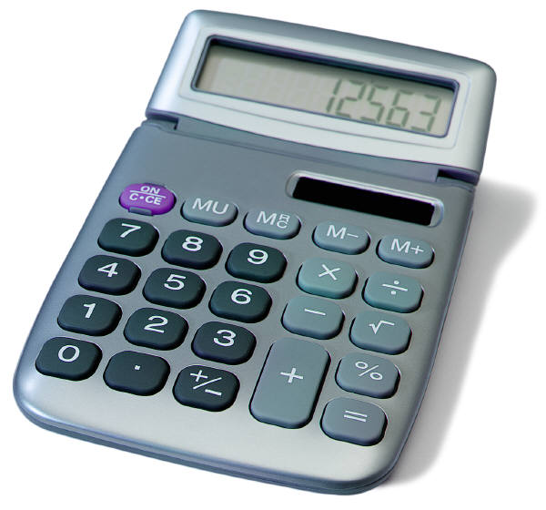
SMP5: Use appropriate tools strategically
What tools do students have available?
Notes:
SMP5: Have participants brainstorm a list of the tools that students have available to them—in and out of the classroom—and to then share responses. If not brought up by participants, add tools such as calculators, computers, physical models, sketches, tables and charts, graph paper, geoboards, number lines, word walls, lists of problem solving strategies, their own previous work, etc. These may be things that we do not normally think of as “tools” but all can be used strategically when solving problems.

Slide 25
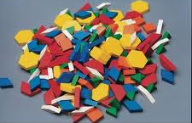
SMP5: Use appropriate tools strategically
Mathematically proficient students:
Identify relevant math resources and uses them to pose or solve problems
Make sound decisions about the use of specific tools
Use technological tools to explore and deepen understanding of concepts
Notes:
SMP5: Review the points on the slide and ask participants to determine which problem from the Problem Set most closely aligns with this practice.

Slide 26
SMP5: Use appropriate tools strategically
Find all the ways you can to divide a square in half.
Notes:
SMP5: Now that participants have had practice looking at four other problems and determining the alignment to the practices, have them talk for a moment at their tables and determine why this problem was chosen to represent the practice of using appropriate tools strategically. As participants talk, points that you will want to listen for (and to bring up, if participants do not) are: students may need simple 'low tech' tools like paper squares to fold and/or draw on or, if available a computer program that will let them do the same. But they will probably need some type of tool in order to solve the problem.

Slide 27
SMP5: Use appropriate tools strategically
Instructional Supports:
Don’t be afraid to challenge students!
Have students brainstorm tools that they might use to solve the problem during the problem introduction.
Use students prior knowledge about how they used tools to solve other problems.
Make a variety of math tools available.
Have participants evaluate their choice of tool after they have solved to problem.
Notes:
SMP5: Review the instructional supports on the slide.

Slide 28
SMP5: Use appropriate tools strategically
Instructional Supports:
Create ‘I Can’ statements for your students so they know what is expected.
Example 1
I can appropriately use a variety of mathematical tools.
I can explain how and why a particular tool was useful to solve a problem.
Example 2
Notes:
SMP5: Review the ‘I Can’ statements on the slide and ask participants if they want to add anything to make these grade-level specific. Ask for volunteers to share their thoughts and then move to the next practice.

Slide 29
SMP6: Attend to precision
Two things we know to be true
The study of mathematics entails the use of academic language and the more it is used, the better the communication.
Getting a correct answer is still important.
Notes:
SMP6: Review the two points on the slide. Explain that, while we have to focus much of our attention on how students think and reason within mathematics, we do still want them to be precise as well.

Slide 30

SMP6: Attend to precision
Mathematically proficient students:
Communicate precisely using clear definitions
State the meaning of symbols, calculate accurately and efficiently
Provide carefully formulated explanations
Label accurately when measuring and graphing
Notes:
SMP6: Review the points on the slide.

Slide 31
SMP6: Attend to precision
Explain why all squares are rectangles but not all rectangles are squares.
Notes:
SMP6: Have participants work for three minutes in their small group to determine what types of mathematical language students would need to use when answering this question from the Problem Set.

Slide 32
SMP6: Attend to precision
Instructional Supports:
Don’t be afraid to challenge students!
Be vigilant. Precision should become habit.
Model. Students will speak the language that you speak.
Ask questions such as:
  What does the term/symbol ____ mean?
  How could you explain ____ using mathematical language?
  What labels will you need to use?
  Have you labeled everything correctly?
Notes:
SMP6: Review the instructional supports on the slide.

Slide 33
SMP6: Attend to precision
Instructional Supports:
Create ‘I Can’ statements for your students so they know what is expected.
Example 1
Example 2
I can work carefully and check my work.
I can use mathematical terminology to describe my work.
Example 3
I can use math vocabulary and symbols, appropriately, correctly, and precisely.
Notes:
SMP6: Review the ‘I Can’ statements on the slide and ask participants if they would add any to the slide to make them more grade-level specific. After volunteers give their statements, move to the next practice.

Slide 34
SMP7: Look for and make use of structure
What is meant by structure?
Notes:
SMP7: Ask participants to think about the question on the slide and, in their table groups, try to come up with an answer to describe structure in mathematics. If participants struggle with this, let them know that its ok. Practice 7 and 8 are two of the most difficult practices for teachers to visualize. This is due in part to the language used within the practice, which doesn’t always align to the language that would be used.

Slide 35
SMP7: Look for and make use of structure
Mathematically proficient students:
Look for patterns or structure
Recognize the significance in concepts and models and can apply strategies for solving related problems
Look for the big picture or overview
5 x 7 + 3 x 7
= (5+3) x 7
= 8 x 7
Notes:
SMP7: Review the points on the slide. Use the example to further describe the idea of using structure. Students use structure when they understand that 8 x 7 is the same as 5 x 7 plus 3 x 7.

Slide 36
SMP7: Look for and make use of structure
How is multiplying 32x41 like multiplying (x+1) (X+3)?
Notes:
SMP7: Have participants look at their solution to this problem and determine what structure they used to solve this problem. They should notice that 32 is (30+2) and 41 is (40+1), so 32 x 41 is the same as (30+2)(40+1). The steps in the standard algorithm for multiplying 32 x 41 are the same steps as the “FOIL” method for multiplying (x + 1) (x + 3).

Slide 37
SMP7: Look for and make use of structure
Instructional Supports
Don’t be afraid to challenge students!
Take your time here. It will come.
Ask questions such as:
  Why does this happen?
  How is ___ related to ___?
  What do you know about ___ that can help you figure this out?
  What patterns do you see?
Notes:
SMP7: Review the instructional supports on the slide.

Slide 38
SMP7: Look for and make use of structure
Instructional Supports:
Create ‘I Can’ statements for your students so they know what is expected.
Example
I can use what I already know about numbers to solve new problems.
Notes:
SMP7: Review the ‘I Can’ statement on the slide. Ask participants to come up with at least one other statement that can be used at their grade level. After volunteers have shared their statement, move on to the final practice.

Slide 39
SMP8: Look for and express regularity in repeated reasoning
What does repeated reasoning look like?
Notes:
SMP8. To introduce this final practice, have participants think about examples they have seen of students using repeated reasoning in their classroom. An example might be determining a function based on the pattern seen in a table, chart, or graph. The next four slides will be used to support this practice.

Slide 40
SMP8: Look for and express regularity in repeated reasoning
Mathematically proficient students:
Notice repeated calculations and looks for general methods and shortcuts
Continually evaluate the reasonableness of their results
while attending to details and makes generalizations based on findings
Solve problems arising in everyday life
___ | X | ___ | = | ___
8 | X | 10 | = | 80
9 | X | 10 | = | 90
10 | X | 10 | = | 100
11 | X | 10 | = | 110
12 | X | 10 | = | ?
Notes:
SMP8: Review the points on the slide. Ask participants how students can use repeated reasoning to find the missing value in the chart.

Slide 41
SMP8: Look for and express regularity in repeated reasoning
Using the input and output below, identify the rule.
input | output
-1 | 1
0 | 3
1 | 5
2 | 7
3 | 9
Notes:
SMP8: Now challenge participants to look at this problem in the Problem Set. Ask for those that worked this problem to share their solution.

Slide 42
SMP8: Look for and express regularity in repeated reasoning
Instructional Supports:
Don’t be afraid to challenge students!
Take your time here. It will come.
Ask questions such as:
  What generalizations can you make?
  Can you find a short cut to make the problem easier?
  How could this problem help you solve another problem?
Notes:
SMP8: Review the instructional supports on the slide.

Slide 43
SMP8: Look for and express regularity in repeated reasoning
Instructional Supports:
Create ‘I Can’ statements for your students so they know what is expected.
Example 1
Example 2
I can discover and use shortcuts.
I can generalize and articulate a pattern as a mathematical rule or function.
Notes:
SMP8: Review the ‘I Can’ statements on the slide. Ask participants one last time to modify these to make them grade-level specific. Once volunteers have shared, move to the next slide.

Slide 44
Two Sentence Summary
With your grade level team, create a two sentence summary of what the practice will look like in YOUR classroom.
Write your summary on the designated chart paper.
Notes:
Two Sentence Summaries: Around the room, hang pieces of chart paper that are labeled with the final four practices. There will need to be three pieces of chart paper per practice. Label the first sheet “Grades 6 & 7,” the second sheet “Grades 8 & 9,” and the third sheet “Grades 10-12.” Allow participants 10 minutes to complete this portion of the activity.
Once participants have completed their summaries, have them revisit the chart on which they gave their initial rating of understanding and ask them to change the rating based on the last hours’ worth of work. Discuss with participants changes in their thinking, what they better understand now, and what they want to do once back in their classroom.

Slide 45

Pause and Reflect
Look back at all of the eight practices.
Is there anything that you want to add to your notes?
Do you have additional questions right now?
Notes:
Pause and Reflect: Allow participants two or three minutes to look back over their notes on the practices and make any needed additions. Before moving to the next slide, ask participants how they might group the standards based on the relationships they see and that we have discussed thus far. The next slide will show an example of how the practices have been grouped by some of the writers of the CCSS-Math.

Slide 46
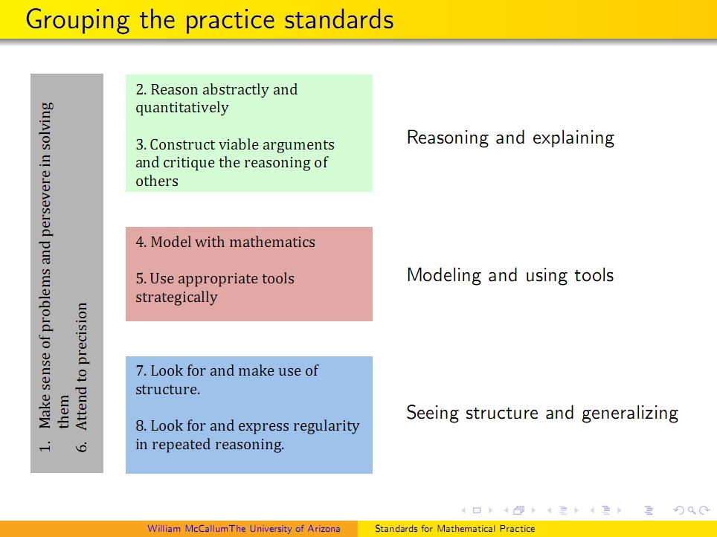
Finding Relationships
Notes:
Finding Relationships: Explain to participants that Bill McCallum, one of the writers of the CCSS-Math, put together this chart to show how the Practices can be grouped or organized based on their relationships. Ask participants if they would have grouped them differently and why. If participants are unsure of this grouping have them look for evidence in the standards themselves that support the organization found here. Further explain that Practice 1: “Make sense of problems and persevere in solving them” and Practice 6: “Attend to precision” are considered the overarching habits of mind of mathematical thinkers. This does not mean that these two practices are somehow more important. It means that these two practices are related to each of the other six practices. If needed, go back and look at the sample problems that were completed for each of the eight practices and have participants find evidence of Practice 1 and Practice 6 in each. When participants are ready to move on, let them know that because of the relationship that Practices 1 and 6 have to the other six practices, we are going to look more in-depth at each of those practices.

