Slide 1


Connecticut Core Standards for English Language Arts & Literacy
Systems of Professional Learning
Module 1 Grades K–5:
Focus on Instructional Shifts
Activity 5
Notes:
(Slides 1-5 , including the pre-assessment, will take about 10 minutes total.)

Slide 2


Activity 5
Bringing it All Together – Using the EQuIP Rubric to Assess Alignment
Page 31

Slide 3
Structure of the EQuIP Rubric
Use the EQuIP Rubric to examine alignment of units and lessons to CCS-ELA & Literacy:
Alignment to the depth of CCS-ELA & Literacy
Key shifts in the CCS-ELA & Literacy
Instructional supports
Assessment
Activity 5
Notes:
Participants will become familiar with the EQuIP Rubric to determine if a lesson is aligned to the CCS-ELA & Literacy. Read the information below and allow participants 10 minutes to review the rubric and become familiar with its components.
Educators Evaluating Quality Instructional Products (EQuIP) is a collaborative of states working to increase the supply of quality instructional materials that align with the CCSS for use in elementary, middle, and high schools. This rubric was developed by Massachusetts, Rhode Island, and New York as the Tri-State Rubric, with the assistance of Achieve. The rubric is now available for use by all states.
The rubric helps educators examine the following dimensions:
Alignment to the rigor of CCCS-ELA & Literacy: For example, are the standards identified and addressed? Is the purpose of instruction clear? Are appropriately complex texts used?
Key areas of focus: 1) content-rich text; 2) reading closely; 3) purposeful writing; 4) academic language
Instructional supports: engagement; variety of opportunities to engage with challenging text; scaffolding for all learners
Assessment: observable evidence that students are working towards proficiency on specified standards; use of aligned rubrics to assess writing
Note that we will mostly focus on 1 and 2 today.

Slide 4

Activity 5: Use the EQuIP Rubric to
Assess Alignment
Using the EQuIP Rubric
In table groups of K–1, 2–3, and 4–5 educators, coaches will reflect on an entire lesson for evidence of alignment using the EQuIP Rubric. Look for: Alignment to the depth of the CCS-ELA & Literacy Key shifts in the CCS Instructional supports Assessments Video: “Graphic Nonfiction: Harriet Tubman” (Sims)
http://commoncore.americaachieves.org/module/2
Activity 5
Notes:
(40 minutes) Participants will be provided with a copy of the lesson plan for the lesson they will see conducted in the video. They view the video, and use the lesson plan to make decisions about the alignment of the lesson. They will not be able to observe all of the elements of the EQuIP rubric in this lesson.
This activity culminates with volunteers offering observations or asking questions of the entire group.

Slide 5
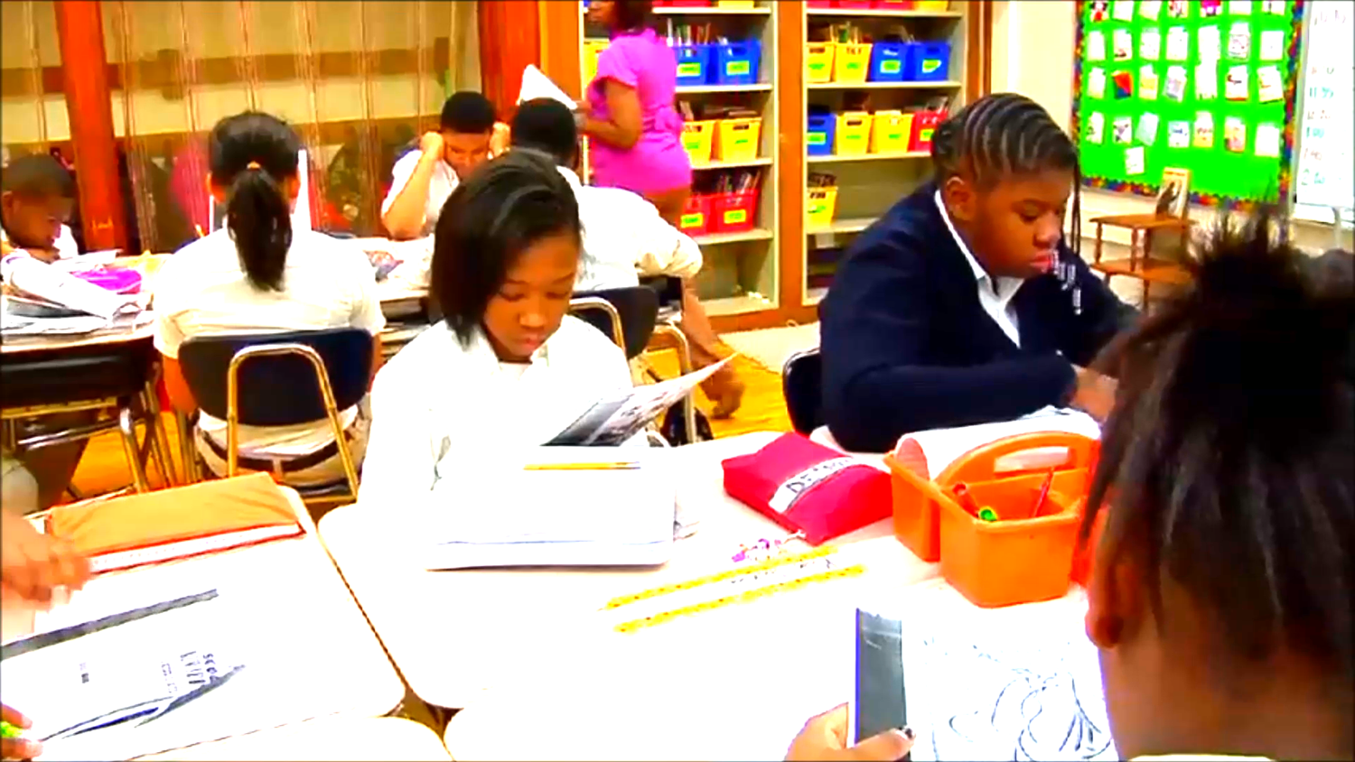
Activity 5

