Slide 1
Connecticut Core Standards for English Language Arts & Literacy
Systems of Professional Learning
Module 1 Grades K–5:
Focus on Instructional Shifts
Activity 4
Notes:
(Slides 1-5 , including the pre-assessment, will take about 10 minutes total.)

Slide 2
Activity 4
Complex Text and Its Academic Language
Page 24

Slide 3
#3 Shift in Academic Language and Complexity
Staircase of Complexity
Academic Language
Regular Practice with Complex Text and its Academic Language
Activity 4
Notes:
(Slides related to Shift 3 will take about 50 minutes total. Allow 10 minutes for introductory slides, 46 – 53.)
When this shift is shown as two shifts, the concept of “Staircase of complexity” is used to describe using increasingly complex texts and increasingly complex texts. Staircase of complexity is about rigor – more complex tasks with more complex texts. Experts agree that academic language is a key factor in text complexity.

Slide 4
Regular Practice with Complex Text and its Academic Language – Why?
Gap between complexity of college and high school texts is huge
Standards include a staircase of increasing text complexity from elementary through high school
Standards focus on building general academic vocabulary so critical to comprehension
0
Activity 4
Notes:
We now turn to Shift 3: Academic Language. Just as evidence appears throughout the CCS-ELA & Literacy, so does complexity.
Academic vocabulary and language including text structure and syntax are primary sources of text complexity.
It is important that students develop deep understanding of vocabulary and language structure if they are to become proficient readers and writers.
Hence, the third shift in instruction is to devote much more instructional time to vocabulary acquisition and language structure, primarily in the context of reading grade appropriate text.

Slide 5
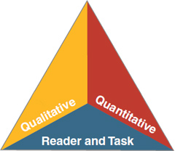
Text Complexity
Quantitative dimensions of text complexity include analysis of word frequency and sentence length
Qualitative factors include levels of meaning, structure, language conventionality, clarity, and knowledge demands
Reader and Task considerations include students' motivation, knowledge, and background interests
Common Core State Standards Initiative (2010)
Activity 4
Notes:
There is a tendency to focus on quantitative measures of text complexity; however there are numerous examples of texts that are seemingly simple in structure but complex in nuance and meaning. Students’ background knowledge can greatly influence the complexity of text for that particular student.
Note: We will go more deeply into the implications of text complexity in Module 2.

Slide 6
Changing Quantitative Complexity to Meet CCR
*COMMON CORE STATE STANDARDS FOR ENGLISH, LANGUAGE ARTS, APPENDIX A (ADDITIONAL INFORMATION), NGA AND CCCSO, 2012
Grade Band | Current Lexile Band | “Stretch” Lexile Band*
K–1 | N/A | N/A
2–3 | 450L–725L | 420L–820L
4–5 | 645L–845L | 740L–1010L
6–8 | 860L–1010L | 925L–1185L
9-10 | 960L–1115L | 1050L–1335L
11–CCR | 1070L–1220L | 1185L–1385L
Common Core State Standards For English, Language Arts, Appendix A (Additional Information), Nga and Cccso, 2012
Activity 4
Notes:
From CCS Appendix A:
Research indicates that the demands that college, careers, and
citizenship place on readers have either held steady or increased over roughly the last fifty years. Furthermore, students in college are expected to read complex texts with substantially greater independence (i.e., much less scaffolding) than are students in typical K–12 programs.
Despite steady or growing reading demands from various sources, K–12
reading texts have actually trended downward in difficulty in the last half century.
Lexile is one quantitative measure. The stretch Lexile band was intended to close the complexity gap between high school texts and college texts.

Slide 7
Text Complexity
Let every nation know, whether it wishes us well or ill, that we shall pay any price, bear any burden, meet any hardship, support any friend, oppose any foe to assure the survival and the success of liberty.
We want every country in the world, whether it is our friend or our enemy, to know that we will do whatever is necessary to make sure that freedom survives in the United States and around the world.
Activity 4
Notes:
This slide provides a sample of complex and simple text based on the same social studies passage. The top side of the slide represents John F. Kennedy’s actual words. On the bottom of the slide, the vocabulary and sentence structure have been simplified. Again, ask for a few observations about the texts from participants. Allow 2-3 minutes for discussion.
Increased text complexity means:
K–2 need exposure to complex read alouds
More rigorous conversations
More time and multiple reads on complex texts
Provide scaffolding; i.e., reading/thinking aloud, digital media to build background knowledge, routines for re-organizing text and collaborative activities such as reciprocal teaching
Teach annotation techniques
Use leveled texts carefully to build independence; do not supplant opportunities for engagement with grade level complex text.

Slide 8
Academic Language
“Words are not just words. They are the nexus–the interface between communication and thought. When we read, it is through words that we build, refine, and modify our knowledge. What makes vocabulary valuable and important is not the words themselves so much as the understandings.”
Adams, 2009, p.180
Activity 4
Notes:
This introduces the next topic. Ask someone to read the slide. Invite participants to discuss. What does Adams mean when she says, “Words are not just words.”?

Slide 9
Tier 1, 2, 3
Tier One Words
Everyday speech
Not considered a challenge to the average native speaker
Tier Two Words (general academic words)
More likely to appear in written texts than in speech
Appear in all sorts of texts: informational, technical, and literary
Often highly generalizable
Tier Three words (domain-specific words)
Specific to a domain or field of study
Key to understanding a new concept within a text
Often explicitly defined by the author of a text in context or a glossary
http://www.corestandards.org/assets/Appendix_A.pdf
Activity 4
Notes:
Found in Appendix A. Tiers are credited to Beck, I. L., McKeown, M. G., & Kucan, L. (2008). Creating robust vocabulary: Frequently asked questions and extended examples. New York, NY: Guilford.

Slide 10
Academic Vocabulary
Tier 2
Tier 3
Important to understanding content and ideas
Not unique to a discipline
Not easily defined by context clues
Powerful because of their applicability to many sorts of reading
Teachers need to be alert to Tier Two words and leverage their use
Important to understanding content and ideas
Specific to discipline or content area
Bold-faced, defined in context or glossary
Recognized as important and reinforced throughout lesson or unit
http://www.corestandards.org/ELA-Literacy
Activity 4
Notes:
Background for Presenter:
Tier 2 and Tier 3 words are considered academic vocabulary. Both are important to understanding content and ideas.
Tier Three words are obviously unfamiliar to most students, contain the ideas necessary to a new topic, and are recognized as both important and specific to the subject area. Teachers often define Tier Three words prior to students encountering them in a text and then reinforce their acquisition throughout a lesson. Tier Three words are often defined in context by the author of a text, or are in bold and in a glossary. Vocabulary development for these words occurs most effectively through a coherent course of studying which subject matters are integrated and coordinated across the curriculum and domains become familiar to the student over several days or weeks.
Tier Two words are not unique to a particular discipline and are far less well defined by contextual clues in the texts in which they appear. They are frequently encountered in complex written texts and are particularly powerful because of their wide applicability to many sorts of reading. Teachers need to be alert to the presence of Tier Two words and determine which ones need careful attention.
Information from Common Core State Standards, Appendix A
http://www.corestandards.org/ELA-Literacy

Slide 11
Examples from CCS
“In early times, no one knew how volcanoes were formed or why they spouted red-hot molten rock. In modern times, scientists began to study volcanoes. They still don’t know all the answers, but they know much about how a volcano works. Our planet is made up of many layers of rock. The top layers of solid rock are called the crust. Deep beneath the crust is the mantle, where it is so hot that some rock melts. The melted, or molten rock is called magma. Volcanoes are formed when magma pushes its way up through the crack in Earth’s crust. This is called a volcanic eruption. When magma pours forth on the surface, it is called lava.”
Excerpt from Seymour Simon, Volcanoes (2006)
http://www.corestandards.org/ELA-Literacy
Activity 4
Notes:
(Allow 10 minutes for this Turn and Talk.)
Direct participants talk in pairs to identify Tier 2 and 3 words in this excerpt. Ask for examples.

Slide 12
Examples from CCS
Critical?
Define in Context?
Provide?
“In early times, no one knew how volcanoes were formed or why they spouted red-hot molten rock. In modern times, scientists began to study volcanoes. They still don’t know all the answers, but they know much about how a volcano works. Our planet is made up of many layers of rock. The top layers of solid rock are called the crust. Deep beneath the crust is the mantle, where it is so hot that some rock melts. The melted, or molten rock is called magma. Volcanoes are formed when magma pushes its way up through the crack in Earth’s crust. This is called a volcanic eruption. When magma pours forth on the surface, it is called lava.”
Excerpt from Seymour Simon, Volcanoes (2006)
http://www.corestandards.org/ELA-Literacy
Activity 4
Notes:
Many of the word like “layers,” “surface,” and “pours forth” can appear in academic texts in both literal and figurative contexts (this would seem plausible on the surface);
Tier 2 – layers, crust, pours forth, surface, eruption – Tier 3 word, spouted, molten, mantle, magma, lava
Which words are critical to understanding the text? If there are too many, which can you ignore? Which words can be defined in context? (Remind coaches that when you are teaching kids to define words in context through TDQ’s, you are teaching them to read complex text independently.)
Which words could be the basis for further word study?

Slide 13
Activity 4: Instructional Shift 3
Part 1: Regular Practice with Complex Text and its Academic Language
In table groups of K–1, 2–3, and 4–5 educators, coaches will reflect on a video of a lesson that is aligned with Shift 3: Regular practice with complex text and its academic language. Pay careful attention to the text complexity and the text-dependent questions focused on the text’s academic language. Video: “The Wonders of Nature”
http://commoncore.americaachieves.org/module/6
Activity 4
Notes:
This slide introduces Activity 4. Before participants begin, make sure everyone knows where the directions are located in the Participant Guide for watching and discussing the video exemplar. This time the focus is on reading, writing and talking about the text (20 minutes).
View a video of instruction related to Shift 3 and discuss your observations (20 minutes total). Tell participants that they are going to view a segment of a video lesson that show a second grade class reading closely, “The Wonders of Nature,” by Cheryl Ryan. The text may be found at http://www.readinga-z.com/book.php?id=1367. The lesson plan for the video lesson is included in the resources for this activity. We are focusing on the text-dependent questions focused on academic language the teacher asks and the student responses.
Video: http://commoncore.americaachieves.org/module/6
Grade 2, English Language Arts/Science
Segment 2:00 – 6:00 (approximately 4 minutes)
Tell participants that as they watch the video, they should take careful notes on the text-dependent questions that the teacher poses and the students’ responses to the questions. What types of questions does the teacher ask? Are students successful in responding to the questions? Ask participants to pay special attention to the way that the teacher helps students become close readers as they build content knowledge related to the CCS-ELA reading standards for the lesson (5 minutes to watch the video).
2. After watching the video, ask participants to “Turn-and-Talk” to their neighbor to discuss what they observed in the video that exemplifies the value of text-dependent questioning in close reading to unlock academic language. Peer pairs then share their ideas with others at the table (10 minutes to discuss).
3. One volunteer will share an idea from the table with all participants (5 minutes to share).

Slide 14
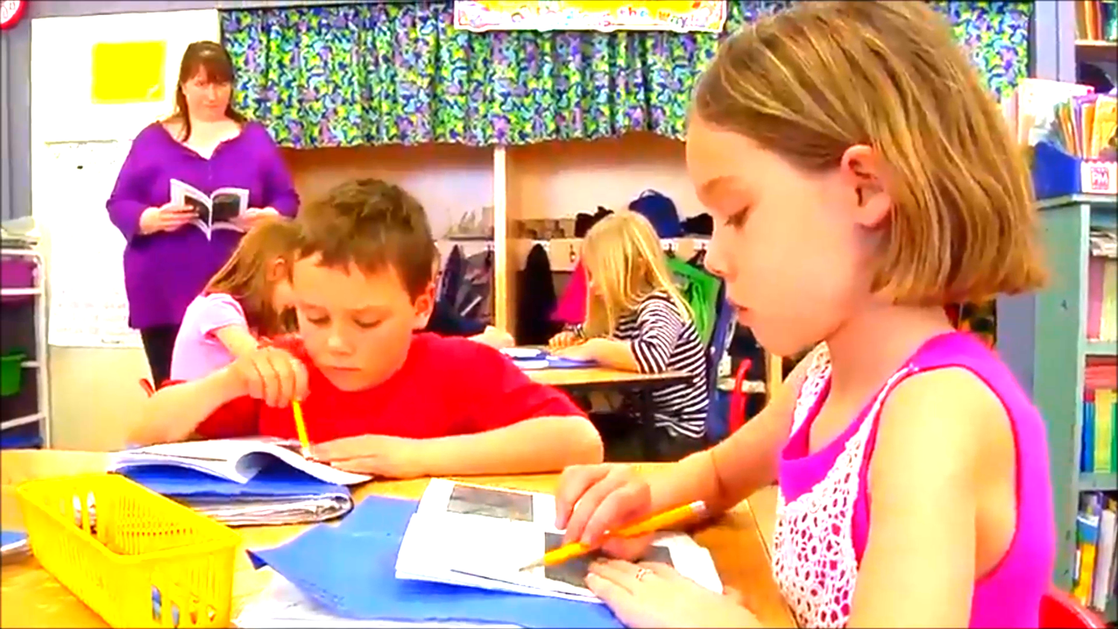
Activity 4

Slide 15
Activity 4: CCS Instructional Shift 3
Part 2: Regular Practice with Complex Text and its Academic Language
Reflect on the video you have just seen, and refer to the samples of complex text (from Appendix B) on your table. On your chart paper, write “Shift 3: Regular Practice with Complex Text and its Academic Language” Divide the paper into 3 sections. Label these sections: Observations, Supports, and Questions. In the top section answer: What would you observe (see and hear) in a classroom aligned with Shift 3? In the second section answer: What supports will teachers need to implement Shift 3 effectively? In the third section, jot down any questions you have about Shift 3. Place your anchor chart on the wall designated Shift 3.
Activity 4
Notes:
(Allow 10 minutes for anchor chart.)
The point of an anchor chart is to anchor the teaching and learning that is happening in the classroom. We will create anchor charts to note the key points or “take-aways” from our work with each of the three shifts today. Later on, you’ll have the opportunity to see and comment upon what others have written.

