Slide 1


Connecticut Core Standards for English Language Arts & Literacy
Systems of Professional Learning
Module 1 Grades K–5:
Focus on Instructional Shifts
Activity 3
Notes:
(Slides 1-5 , including the pre-assessment, will take about 10 minutes total.)

Slide 2


Activity 3: Reading, Writing, and Speaking with Evidence
Page 14

Slide 3
#2 Shift in the Use of Evidence
Text-dependent answers
Writing from sources
Reading, writing, and speaking grounded in evidence from text
Activity 3
Notes:
(Slides 31 – 45 will take about 1 hour 5 minutes. Allow 10 minutes for slides 31 – 36.)
Participants may have heard or seen the shifts described as 6 shifts rather than three. This slide shows the relationship between two of the six shifts and Shift 2. When this shift is articulated as two shifts, it emphasizes the “text-dependent” nature of questions and answers. However, it leaves out the very important aspect of speaking. Speaking provides both a means of collaborating with others, learning from others, and rehearsing for writing with evidence.

Slide 4
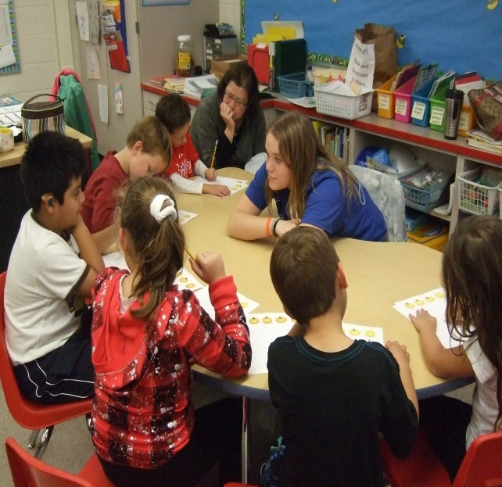
Reading, Writing, and Speaking Grounded in Evidence from Text – Why?
College and workplace writing requires evidence
ELA/Literacy standards focus on comprehending and communicating knowledge gained from text
Being able to locate and deploy evidence are hallmarks of strong readers and writers
Activity 3
Notes:
Ability to cite evidence differentiates strong from weak student performance on NAEP.
1st bullet: These standards are standards for college and career readiness, and most college and career writing requires students to take a position or inform others while citing evidence from text, not to provide a personal opinion. This is a sharp departure from much common, current practice where students are asked to relate the text to themselves in narrative expressive pieces, to share their views on various topics.
2nd bullet: Across the grades, and even across the content areas, students need to develop the skill of grounding their responses in evidence from the text. Requiring students to use evidence can and should occur during oral discussions with read aloud in the youngest grades and continue across all grades and content areas.
3rd bullet: Even when students are reading grade-level texts, they are too often being encouraged to write or discuss without using evidence from these texts. It is easier to talk about personal responses than to analyze what the text has to say, hence students - and teachers - are likely to engage in this type of dialogue before a text is fully analyzed. The unintended consequence of all of this? Less time in the text, more outside the text.

Slide 5

What is Close Reading?
“Close, analytic reading stresses engaging with a text of sufficient complexity directly and examining meaning thoroughly and methodically, encouraging students to read and reread deliberately.”
Source: Structure of the Model Content Frameworks for ELA/Literacy, 2012, p. 7
Activity 3
Notes:
Ask a volunteer to read the quote. The standards require that students read carefully to grasp information, arguments, ideas, and details based on textual evidence. Students should be able to answer a range of text-dependent questions in which answers require inference based upon careful attention to the content of texts as well as to language choices (see Shift 3 for more about text complexity and language choices).

Slide 6

Text-Dependent Questions
Not Text-Dependent
Text-Dependent
Alice in Wonderland: How would you react if you saw a talking rabbit?
In “Casey at the Bat,” Casey strikes out. Describe a time when you failed at something.
The Talking Cloth: Did you ever take a trip to a far-off country? What did you bring back from your trip?
How did Alice react when she saw the talking rabbit?
What makes Casey’s experiences at bat humorous?
We just learned that the cloth originated in Africa. Why does the author include this information?
Activity 3
Notes:
If time allows, ask participants in their table groups to discuss the difference between each pair of questions. Note that good text-dependent questions focus students’ attention on textual evidence to support their text-based answers. Ask volunteers for any insights gained through the conversation at their table. If the point is that “text-dependent” means that the reader needs to return to the text but also that responding to the question adds insight into the meaning of the text or the author’s use of language, then make this point.

Slide 7
Text-Dependent Questions
Trivial
Important
What was the color of Red Riding Hood’s cape?
What was the name of the girl who visited the three bears?
Where did Hansel and Gretel’s parents tell them to wait?
What did the fairy godmother turn into a coach?
Why did the fairy promise that Sleeping Beauty would one day prick her finger with a needle and die?
How did the stepmother and stepsisters treat Cinderella? Give examples from the text?
Why was it important that Cinderella lost her shoe?
From Shanahan, Timothy. “Letting the Text Take Center Stage: How the Common Core Standards will Transform English Language Arts” American Educator. Fall 2013.
Activity 3
Notes:
Shanahan, Timothy. Letting the Text Take Center Stage: How the Common Core Standards will Transform English Language Arts American Educator. Fall 2013.
Instruct participants in their table groups to discuss the difference between the questions in each column. Note that good text-dependent questions help students focus on key ideas and details that are important to comprehending the big ideas in the text. While there is a place for “right there” questions to check on basic comprehension and build confidence, most TDQ’s should be aimed at building independent comprehension of text and should be a rehearsal for the questions good readers ask themselves.

Slide 8
Creating Text-Dependent Questions
Phase 1: Read the text closely before creating text-dependent questions
Step 1: Identify core content and ideas
Step 2: Identify vocabulary and language structures
Phase 2: Create coherent sequences of text- dependent questions
Step 4: Start with easier questions
Step 3: Identify difficult sections
Step 5: Connect lesson standards and questions
Step 6: Create culminating assessment aligned with standards
Activity 3
Notes:
Creating text-dependent questions is a backward design process. See pages 20 of the Participant Guide for the handout, “Guide to Creating Text-Dependent Questions.” This is a resource to provide background knowledge for participants, but it will not be read during Activity 3.
Phase 1:
Read the text closely, taking careful notes as to the important content, concepts, and academic language. Identify the key concepts that students need to understand.
Specify the content vocabulary and academic vocabulary that will be examined in the lesson. These are words and grammatical choices that are connected to content and ideas. The teacher defines key words and phrases as part of questioning, but students should also be able to define many words in context.
Identify segments of the text that are most challenging to focus questioning.
Phase 2:
Create logical sequence of text-dependent questions for each lesson, starting small with easier questions to build confidence.
Make sure that the standards to be addressed in the lesson are addressed in the questions.
Create the culminating activity for the lesson, aligned to the standards. Note: Not all lessons need to have culminating activities. Culminating activities for lessons are typically formative. End of unit assessments are typically summative.

Slide 9
Text-Dependent Questions: Try it Out
Working in pairs, choose one of the content-rich texts on your table.
Select a short excerpt from the text (three or four paragraphs).
Determine something in the excerpt which might prove challenging to readers.
Write two or three text-dependent questions which will help students address that challenge.
Share with your table: What support will teachers need in writing text-dependent questions?
Activity 3
Notes:
(Allow 15 minutes for this activity.)
This activity is a quick, informal activity, using sticky notes to craft a short series of TDQ’s.

Slide 10

What is the Relationship Between Reading & Writing?
“When reading and writing instruction include significant opportunities for students to write about text, students have the potential to improve not only content knowledge, but also skills in reading comprehension.”
Graham & Hebert, 2010. Based on a meta-analyses of 93 studies of writing instruction.
Activity 3
Notes:
Ask a participant to read the quote aloud. Point out that the research is clear that reinforcing the reading-writing connection is imperative if we are going to develop proficient independent readers and writers of complex text across content areas.

Slide 11
Writing Grounded in Evidence from Text
Narrative
Research
Argumentative/
Opinion
Explanation
Activity 3
Notes:
Have participants discuss at their tables which of these they routinely see in classroom ELA/Literacy instruction – and in science and social studies and technical classes. Ask participants which of these types of writing can be grounded in evidence? What does that look like?

Slide 12
Purposeful Writing Emphasizes
Writing to Sources
Increase attention to writing that requires use of evidence from texts
Careful analyses
Well-defended claims
Clear information
Narrative writing to convey personal experience is still important, but comprises far less of instructional time than does argument and informational writing
Activity 3
Notes:
Purposeful writing with evidence:
Writing to narrate is important, but decreases in emphasis as students advance through the grades.
Writing to inform and to defend a point of view or claims increases in emphasis through the grades. Writing with sources means that students are expected to support their written arguments with sources.

Slide 13
Speaking Grounded in Evidence
Oral language is the foundation for reading and writing
Integrate spoken and written language to advance communication, collaboration, and cognitive skills
Engage students in active discussion in which they use evidence from text
Activity 3
Notes:
The big idea is that there is a reciprocal relationship between language and literacy. Strong language skills support literacy development, and strong literacy development enhances language skills.

Slide 14

Activity 3: Instructional Shift 2
Part 1: Reading, Writing, and Speaking with Evidence, K–5
In table groups of K-1, 2-3, and 4-5 educators, coaches will reflect on a video of a lesson that is aligned with Shift 2: Reading, writing, and speaking grounded in evidence from text, both literary and informational. Pay careful attention to how the teacher supports students in using evidence. FOCUS: Text-dependent questions Video: Grade 4, ELA/Science
Video: http://commoncore.americaachieves.org/module/20
Activity 3
Notes:
This slide introduces Activity 3. Before participants begin, make sure everyone knows where the directions are located in the Participant Guide for watching and discussing the video exemplar. This time the focus is on reading, writing and talking about the text
View a video of instruction related to Shift 2 and discuss your observations (20 minutes total).
Tell participants that they are going to view a video lesson that shows a fourth grade class reading closely, Discovering Mars: The Amazing Story of the Red Planet by Melvin Berger. The lesson plan and text-dependent questions for the video lesson are included in the resources for this activity. We are focusing on the text-dependent questions that the teachers asks and the student’s text-based answers focused on content-rich text.
Video exemplar lesson plans and student worksheet
Video: Video: http://commoncore.americaachieves.org/module/20
Grade 4, English Language Arts/Science
Segment- 1:30 – 8:30, 7 minutes total
Tell participants that as they watch the video, they should take notes on the text-dependent questions that the teacher poses and the students’ responses to the questions. Do the questions specifically address content-rich material in the text? What types of questions does the teacher ask? Are students successful in responding to the questions with textual evidence? Ask participants to pay special attention to the way that the teacher helps students become close readers as they build content knowledge (7 minutes to watch the video).
2. After watching the video, ask participants to “Turn-and-Talk” to their neighbor to discuss what they observed in the video that exemplifies the value of text-dependent questioning in close reading of meaningful content. Peer pairs then share their ideas with others at the table (10 minutes to discuss).
3. One volunteer will share an idea from the table with all participants (3 minutes to share).

Slide 15
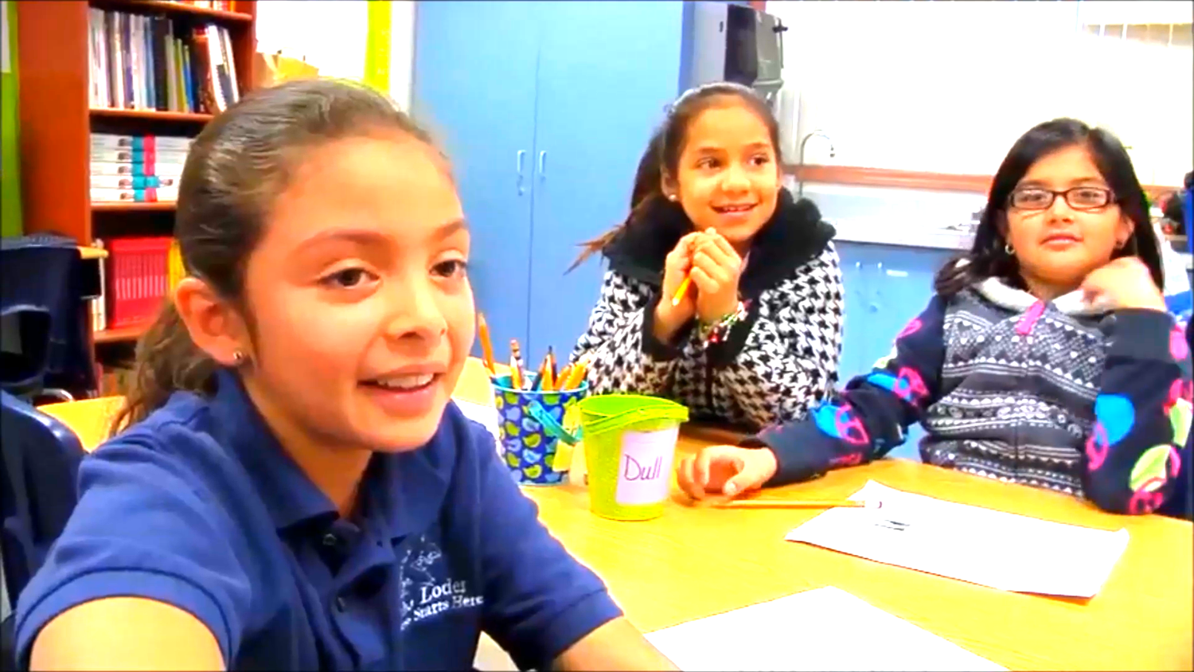
Activity 3
Notes:
Play video from link or from flash drive.

Slide 16
Activity 3: CCS Instructional Shift 2
Part 2: Reading, Writing, and Speaking Grounded in Evidence from Text
On your chart paper, write “Shift 2: Reading, Writing, and Speaking Grounded in Evidence from Text Divide the paper into 3 sections. Label these sections: Observations, Supports, and Questions. In the top section answer: What would you observe (see and hear) in a classroom aligned with Shift 2? In the second section answer: What supports will teachers need to implement Shift 2 effectively? In the third section, jot down any questions you have about Shift 2. Place your anchor chart on the wall designated Shift 2.
Activity 3
Notes:
(10 minutes)
The point of an anchor chart is to anchor the teaching and learning that is happening in the classroom. We will create anchor charts to note the key points or “take-aways” from our work with each of the three shifts today. Later on, you’ll have the opportunity to see and comment upon what others have written.

