Slide 1


Connecticut Core Standards for English Language Arts & Literacy
Systems of Professional Learning
Module 1 Grades K–5:
Focus on Instructional Shifts
Activity 2
Notes:
(Slides 1-5 , including the pre-assessment, will take about 10 minutes total.)

Slide 2
Today’s Session
Common Core ELA & Literacy
Vertical Progressions
Instructional Shifts
Rigor
Classroom Practice
Activity 2
Notes:
Explain that now we will look carefully at the three instructional shifts associated with the CCS-ELA and related instructional practices. These shifts represent the primary changes in practice from previous standards in order to achieve the CCR goals.
In the next activities participants will explore the three major instructional shifts associated with the CCS-ELA & Literacy and instructional practices associated with each.
.

Slide 3
Three Instructional Shifts for
CCS-ELA & Literacy
1. Building knowledge through content-rich nonfiction
2. Reading, writing, and speaking grounded in evidence from text
3. Regular practice with complex text and its academic language
Activity 2
Notes:
(Slides 19 – 25, introduction to the shifts, should take about 10 minutes.)
These shifts are a “high level” view of the major instructional changes that are needed to actualize the standards.
The shifts point the way toward changes in curriculum, instructional practice, and assessment to achieve alignment with the standards. Disseminating information about the shifts and helping all educators implement the standards is fundamental to achieving the goal of CCS-ELA & Literacy aligned curriculum, instruction, and assessment.
In this section of today’s workshop, participants will look at aligned instructional practices and examine how a given practices supports the shifts and, in turn, the implementation of the standards.

Slide 4
#1 Shift in the Balance of Texts
Balance of fiction and nonfiction
Building knowledge in the disciplines through text
Building Knowledge through Content-Rich Nonfiction
Activity 2
Notes:
We are starting with Shift 1: Building Knowledge Through Content-Rich Nonfiction. This marks a shift in terms of the types of text emphasized in ELA classes instruction also is expected to have students use texts as a primary vehicle for learning.
Participants may have heard or seen the shifts described as 6 shifts rather than three.
This slide shows the relationship between two of the six shifts and Shift 1. When Shift 1 is articulated as two separate shifts, it emphasizes the difference between elementary and secondary grades. In elementary school the classroom teacher is expected to strike a balance between fiction and nonfiction, using reading in the content areas to build knowledge.
In the secondary grades, literacy is a shared responsibility of content teachers and ELA teachers. While ELA teachers increase their use of nonfiction as it pertains to their disciplines (e.g. essay, biography), each of the other disciplines is responsible for helping students build knowledge in their disciplines through texts rather than teacher talk.
Teachers can help students understand that text is a source of knowledge and that they can use content knowledge to learn from the past and solve today’s problems around the globe.

Slide 5
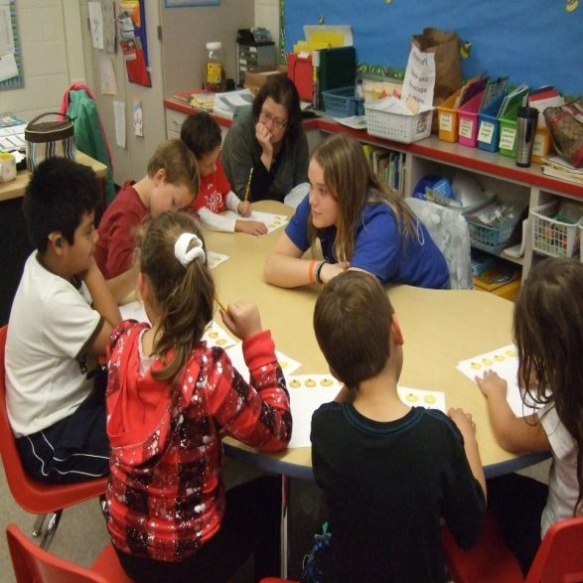
Building Knowledge through Content-Rich Nonfiction – Why?
Mostly informational reading in college/workplace
Minimal reading of informational text in elementary and middle school
Provides experience with informational text structure
Building knowledge through text, not teacher talk
Activity 2
Notes:
The content literacy standards for grades 6–12 parallel the reading standards using discipline-specific content.
1st bullet: Even thought reading informational texts proves to be more difficult for students, it is a skill that must be developed for college and career readiness.
2nd bullet: The CCCS have followed the NAEP (National Assessment of Educational Progress) guidelines in establishing how much informational text students should read in schools. By high school, the standards call for a 30/70 split between literary texts and informational texts. The 70/30 split in grades 9-12 does not just refer to ELA/Literacy classes – it means the entire school experience for students, across the day, week, year. This is displayed most prominently in two ways: 1) At every grade level, there are a set of standards for informational text and a set for literary standards. Each discipline has specific guidelines for the type of text to be read; 2) Reading Standard 10 calls for students to read a wide range of informational text. It is actually a standard to read informational text.
3rd bullet: Even thought reading informational texts proves to be more difficult for students, it is a skill that must be developed for college and career readiness.
4th bullet: Background knowledge has long been connected to comprehension. Reading informational text is essential in building background knowledge. Reading a coherent sequence of texts designed to develop content knowledge is also the best way to grow academic vocabulary because students have multiple exposures to words.

Slide 6
Why Does Content-Rich
Nonfiction Matter?
Reciprocal Relationship
Deepen language and literacy skills by reading, writing about, and discussing meaningful content | Deepen content knowledge using language and literacy skills
Activity 2
Notes:
This slide addresses the reciprocal relationship between deepening language and literacy skills while simultaneously building content knowledge.
Build background knowledge to prepare students for post-secondary reading in college and careers.
In ELA, blend literature and informational text in multi-modal, multi-genre text sets, so texts inform on the content knowledge that is the focus of instruction.
In the content disciplines, read textbooks, journals, data including scientific experiments, primary source documents.
In English, blend literature and literary nonfiction – speeches, essays, literary nonfiction, biography.
Text is a source of knowledge.
The stronger one’s reading skills, the easier it is to learn independently through reading text.

Slide 7
Instructional Practice Aligned with
Shift 1: Connected Text Sets
Literature
Primary source documents
Multimodal, multi-genre text sets
Literary nonfiction and informational text
Digital Text
Based on Cappiello & Dawes, 2013, p. 22.
Activity 2
Notes:
Instructional practice aligned with Shift 1: Texts Talking to Each Other.
To deepen students’ content knowledge, use an integrated, interdisciplinary approach in which informational and literary nonfiction informs the themes of literature and vice-versa. This slide presents one model of how text sets might be organized. (See Cappiello & Dawes, 2013, p. 22 for examples of texts:
Literature: Realistic fiction, fantasy, historical fiction, mystery, science fiction, poetry, traditional literature, drama.
Literary nonfiction and Informational Text: Biography, literary criticism, essays, textbooks, newspapers, journals and magazines
Digital Text: webcasts, podcasts, photographs, websites, online government reports, works of art and music, interviews, blogs
Primary source documents: speeches, documents, photographs, historical artifacts, newspapers
(See Cappiello & Dawes, 2013, pp. 254-257 for examples of text set structures)

Slide 8
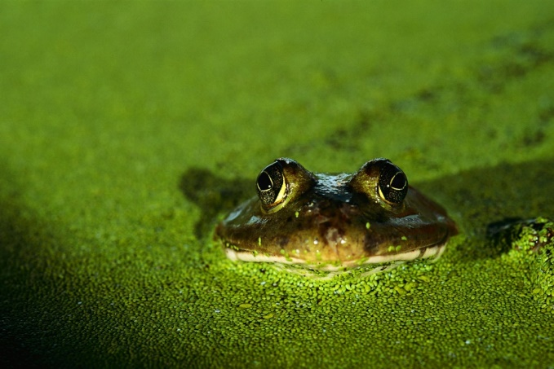
Text Set: Adaptations and the Wide World of Frogs
Deborah Dennard, Bullfrog at
Magnolia Circle
Carmen Bredeson, Poison Dart
Frogs Up Close
Everything You Need to Know about Frogs and Other Slippery Creatures
Lincoln James, Deadly Poison Dart Frogs
Valerie Worth, All the Small Poems and Fourteen More
Douglas Florian, Lizards, Frogs, and Polliwogs
Source: http://www.engageny.org/sites/default/files/resource/attachments/3m2a.module.pdf
Activity 2
Notes:
This is an example of a text set. This text set is used in Grade 3, Module 2A, Researching to Build Knowledge, written by Expeditionary Learning for EngageNY. Students learn about a “typical” frog in the central text, then research frogs with special adaptations in the other texts. Students will demonstrate their expertise through a “freaky frog trading card”—a research-based narrative that highlights their research and educates others about the amazing diversity of frogs, with a focus on how their freaky frog survives.
Notes:
Not random reading – Text sets should be sequenced to build knowledge
Students learning to read should exercise their ability to comprehend complex text through read-aloud texts.
Reading aloud texts that are well-above grade level should be done throughout K–5 and beyond.
If time allows, participants may offer examples of text sets they use now.

Slide 9
Examples of Content-Rich Text, K–5
See Appendix B: Text Exemplars for exemplars of
content-rich, grade appropriate texts.
Grades K-5
  Stories: Label, Arnold. Frog and Toad at Home (K-1)
  Poetry: Sandburg, Carl. “Fog” (4-5)
  Read-Aloud Stories. Kipling, Rudyard. “How the Camel Got His Hump” (2-3)
  Read-Aloud Poetry: Hughes, Langston. “Over in the Meadow” (K-1)
  Informational: Lauber, Patricia. Hurricane: Earth’s Mightiest Storms (4-5)
  Read-Aloud Informational Texts: Russell Freedman. Lincoln: A Photobiography (2-3)
Source: www.corestandards.org/assets/Appendix_B.pdf
Activity 2
Notes:
One source of multi-genre text exemplars (and related performance tasks) is Appendix B of the CCS-ELA & Literacy. Note: We will use excerpts from Appendix B in other Activities.
Reference:
National Governors Association Center for Best Practices & Council of Chief State School Officers (2010). Common Core State Standard for English Language Arts and Literacy in History/Social Studies, Science, and Technical Subjects. Washington, D.C.: Authors. Retrieved from http://www.corestandards.org/ELA-Literacy/; National Governors Association Center for Best Practices & Council of Chief State School Officers (2012). See Appendix B: Text Exemplars and Sample Performance Tasks. http://www.corestandards.org/assets/Appendix_B.pdf.

Slide 10


Examples of Content-Rich Nonfiction
On your tables are selections of nonfiction texts from Common Core Appendix B
Examine the books, considering why they may have been chosen as exemplars.
Talk with others at your table:
  Why might each of these texts be considered examples of content-rich nonfiction?
  How might these texts be used alone or as text sets to “build knowledge” on a topic?
Activity 2
Notes:
Prior to starting this activity, encourage participants to move to table groups of K–1, 2–3, and 4–5 coaches.
(Allow 15 minutes to examine the texts and talk about them.)
Direct participants to examine the texts on their table and then choose one (or an identified excerpt from Appendix B) to read more thoroughly (15 minutes).

Slide 11

Activity 2
Building Knowledge through Content-Rich Nonfiction
Page 10

Slide 12
Activity 2: Building Knowledge through Content-Rich Nonfiction
Building Knowledge through Content-Rich Nonfiction K–5
On your chart paper, write “Shift 1: Building Knowledge through content-rich nonfiction. Divide the paper into 3 sections. Label these sections: Observations, Supports, and Questions. In the top section answer: What would you expect to observe (see and hear) in a classroom aligned with Shift 1? In the second section answer: What supports will teachers need to implement Shift 1 effectively? In the third section, jot down any questions you have about Shift 1. Place your anchor chart on the wall designated Shift 1.
Activity 2
Notes:
(10 minutes) The purpose of an anchor chart is to anchor the teaching and learning that is happening in the classroom and to keep it visible for reference.
We will create anchor charts to note the key points or “take-aways” from our work with each of the three shifts today. Later on you’ll have the opportunity to see and comment upon what others have written.

