Slide 1


Connecticut Core Standards for English Language Arts & Literacy
Systems of Professional Learning
Module 1 Grades 6–12:
Focus on Instructional Shifts
Notes:
(Slides 1-5, including the Pre-assessment, will take about 10 minutes total.)

Slide 2


Closing Activity
Post-Assessment
Session Evaluation
Page 46
Notes:
Remind participants that they will have an opportunity at the beginning of Module 2 to share successful PD activities or challenges related to Module 1 at their schools.
Post-Assessment
Session Evaluation

Slide 3

Post-Assessment
Where Are You
Now?
Assessing Your
Learning
Notes:
The post-assessment will be the same as the pre-assessment they took in the beginning of the session. This assessment is to gauge their learning based on the activities of the morning. They will find the post-assessment on page of the participant guide. 3-4 min Ask volunteers to share out any insights about the CCS- ELA & Literacy that they gained from this morning’s session.

Slide 4


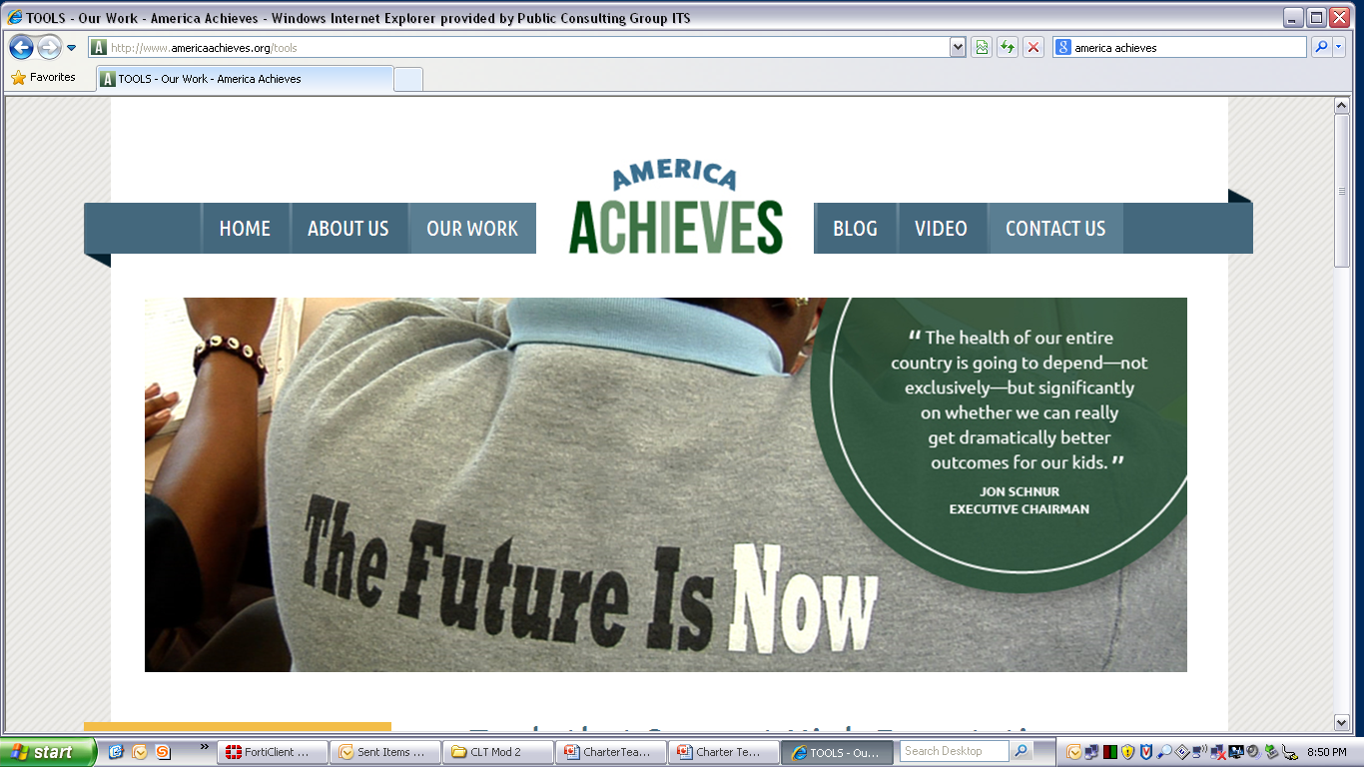


Some Key Resources
ctcorestandards.org
engageny.org
achievethecore.org
americaachieves.org

