Slide 1

Connecticut Applicants’ Briefing
DR- 4410-CT
Declared 5 December, 2018
Incident Period 25-26 September, 2018

Slide 2

Federal Emergency Management Agency
Public Assistance Program
April 2018
Recovery Division
Notes:
This briefing is designed to present an overview of the Public Assistance Program. The Public Assistance Program is authorized by the Robert T. Stafford Disaster Relief and Emergency Assistance Act, Public Law 93-288 as amended. It provides supplemental financial assistance to State, local governments, and certain private non-profit organizations for response and recovery activities required as a result of a Presidentially declared disaster or emergency.

Slide 3
FEMA’s MISSION STATEMENT
Helping people before, during, and after disasters.

Slide 4
Major Disaster Declaration
INCIDENT PERIOD: 25-26 September, 2018
    Middlesex County (PA)
    New London (PA)

Slide 5
What’s New
New Application Process
  Same Basic Information
  Internet Based
  Applicants must establish an account
  Documentation to be uploaded to site
  FEMA will provide assistance
  Applicants are eligible for Management Costs
  Changes to Direct Administration Costs

Slide 6
What’s New
Alternative Procedures for Debris Removal
  Reimbursement of straight time for FA labor
  Must notify FEMA of decision before obligation of 1’st PW or within 60 days of scoping meeting
  File Appendix A form
Management Costs replace DAC
  Costs associated with development and implementation of PA projects
  Captured in separate Cat Z PW
  Max 5 % of total eligible costs for all PWs
  All costs must be documented and PW closed out

Slide 7
Alternative Procedures
Debris Removal
Acknowledgement

Slide 8
The Public Assistance Process
Disaster
Event
Funding
State
IDA/PDA
Applicant
Complete
PW
Applicant's
Briefing
Scoping / Kickoff
Meeting
Submission
Exploritory
of
Request
Call
Notes:
This slide outlines the multi-step funding process under the Public Assistance Program. The disaster event triggers the declaration process which for some applicants may or may not include a Preliminary Damage Assessment (PDA). All potential applicants will attend an Applicant’s Briefing. Applicants will submit the Request for Public Assistance which is available at the applicant’s briefing and through electronic means such as the Internet, to officially apply for funding. Each Applicant will be assigned to a Program Delivery Manager PDMG and the PDMG will hold a Recovery Scoping Meeting with the applicant to begin the process of documenting disaster recovery projects. The PDMG will assist the applicant in completing Project Worksheets for all projects. Project Worksheets will be approved after validation. The funding will be made available to the State. The State then disburses the funding to the applicant according to State regulations.
FEMA’s goal is to provide the funding as efficiently and expeditiously as possible to allow a quick recovery of communities affected by disaster or emergency events.

Slide 9
Time Limits
FEMA has established Time Limits for requesting assistance and for completing work using Public Assistance Program grants.
Requesting Assistance
An applicant must submit a Request for Public Assistance within 30 days of the date that the area was designated a disaster area
Information on damaged facilities must be submitted to FEMA within 60 days of the first substantive meeting, usually the Kickoff Meeting/Recovery Scoping Meeting
An applicant may appeal any FEMA decision to the State within 60 days of being notified of that decision.
Completing Work
The time frames for completing eligible work are also measured from the date of declaration of the disaster and vary depending on the type of work.
References: 44 CFR §206.202, §206.204, and §206.206(c)
Type of Work | Months After Designation
Debris Clearance | 6
Emergency Protective Measures | 6
Permanent Work | 18
Notes:
FEMA has established Time Limits for requesting assistance and for completing work using Public Assistance Program grants.
Requesting Assistance
 An applicant must submit a Request for Public Assistance within 30 days of the date that the area was designated a disaster area
 Information on damaged facilities must be submitted to FEMA within 60 days of the first substantive meeting, usually the Kickoff/Recovery Scoping Meeting Meeting
 An applicant may appeal any FEMA decision to the State within 60 days of being notified of that decision.
Completing Work
The time frames for completing eligible work are also measured from the date of declaration of the disaster and vary depending on the type of work.
Time Extensions
All time frames are set by regulation; however, if extenuating circumstances or unusual project conditions exist, a time extension may be requested through the State. If not changing the scope of work or cost, the State has the authority to extend the time frames for completion of debris removal and emergency work by 6 months and permanent work by 30 months. For all other extensions, the State must request the extension from FEMA. The Regional Administrator may extend the time limitation beyond the State authority.
The Regional Administrator also may extend the time limitations for submitting a Request for Public Assistance and for identifying and reporting damage to FEMA if the State justifies and makes the request in writing. A justification must be based on extenuating circumstances beyond the State’s or applicant’s control.
References: 44 CFR §206.202, §206.204, and §206.206(c)
Public Assistance Guide, FEMA 322, pages 38-39, 113, 138-139, 141

Slide 10
Time Limits
Time Extensions
All time frames are set by regulation; however, if extenuating circumstances or unusual project conditions exist, a time extension may be requested through the State.
If not changing the scope of work or cost, the State has the authority to extend the time frames for completion of debris removal and emergency work by 6 months and permanent work by 30 months.
For all other extensions, the State must request the extension from FEMA. The Regional Administrator may extend the time limitation beyond the State authority.
The Regional Administrator also may extend the time limitations for submitting a Request for Public Assistance and for identifying and reporting damage to FEMA if the State justifies and makes the request in writing. A justification must be based on extenuating circumstances beyond the State’s or applicant’s control.
References: 44 CFR §206.202, §206.204, and §206.206(c)

Slide 11
Factors of Eligibility
Facility
Applicant
ELIGIBILITY
Cost
Work
Notes:
The Public Assistance Program provides assistance for eligible projects.
Four factors are considered to determine eligibility of a project.
1. Eligible applicants include State and local governments, Native American Tribes and tribal organizations, certain private non-profit organizations.
2. To be eligible a facility must:
Be damaged as a result of the disaster event.
Be located within a designated disaster area.
Be the legal responsibility of an eligible applicant.
Be in active use at the time of the disaster event.
Not be under the authority of any other Federal agency to fund.
3. To be eligible the work must be authorized in the Stafford Act.
4. To be eligible a cost must:
Be reasonable and necessary to accomplish eligible work.
Be in compliance with Federal, State, and local laws and regulations.

Slide 12
Eligible Applicants
Native American Tribal Governments and Tribal Organizations
State
County
City / Town / Village
Other political subdivision of the State
Certain Private Non-Profit Organizations
A grantee/recipient is a State or tribal government that is responsible for administering Public Assistance grants.
A sub-grantee/sub-recipient is an eligible applicant that receives a Public Assistance grant as reimbursement for performing eligible disaster work.

Slide 13
Private Non-Profit Entities
PNP facilities that provide the following CRITICAL services are eligible for Public Assistance:
    Educational- Primary, Secondary, Higher Ed.
    Medical- Hospitals & related, Clinics, Outpatient, Rehab
    Emergency- Ambulance, Fire, Rescue
    Utilities- Power, Water, & Sewer, Communications

Slide 14
Private Non-Profit Entities
The following NON-CRITICAL service facilities are eligible for Public Assistance for emergency work. However, the PNP must first apply to the Small Business Administration (SBA) for a disaster loan for permanent repair work before applying to FEMA.
▪ Museums ▪ Community Centers
▪ Special Group Services ▪ Libraries
▪ Homeless Shelters ▪ Educational Enrichment
▪ Zoos ▪ Art Services (authorized)
▪ Senior citizen/Day-care centers
▪ Other facilities that provide health and safety service of a governmental nature

Slide 15
Facility Eligibility
To be eligible, the facility must:
    Be the legal responsibility of an eligible applicant
    Have been in active use at the time of the disaster
    Be damaged as a result of the declared disaster
    Be located in the designated disaster area

Slide 16
Work Eligibility
To be eligible, the work must:
    Be direct result of declared event
    Be located in the designated disaster area
    Be the applicant’s responsibility
    Not be fundable by another federal agency

Slide 17

Types of Eligible Work
Emergency Work
Permanent Work
Notes:
All projects fall into one of two types of work:
Emergency work, includes debris removal and emergency protective measures. Eligible emergency work must eliminate or reduce immediate threats to life, health, safety or improved property.
Permanent work, includes permanent repair or restoration of eligible facilities. Examples of permanent work include roads, bridges, water control facilities, buildings, utility systems, and parks.
Again work must be required as a result of the declared disaster event and be located within an area designated by the President.

Slide 18
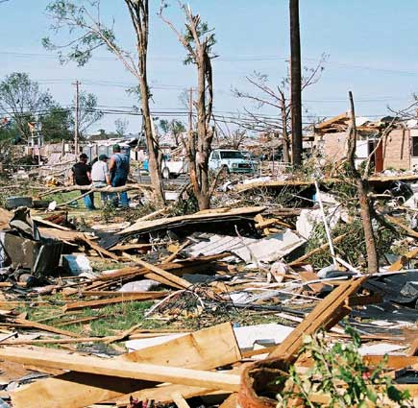
Emergency Work
Category A – Debris Removal
Debris removal is eligible when:
It eliminates an immediate threat to life, health, and safety
It eliminates an immediate threat of significant damage to improved property
It ensures economic recovery of the community and provides a benefit for the community-at-large

Slide 19
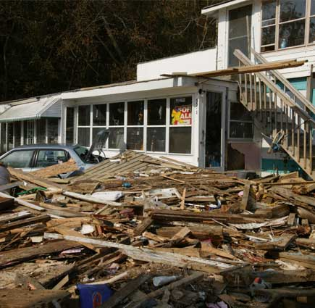
Debris Removal
Private Property
Debris removal is generally the responsibility of the property owner.
However, if debris is so widespread that public health, safety, or economic recovery of the community is threatened, the actual removal of debris from private property may be eligible. (ASK FIRST)

Slide 20
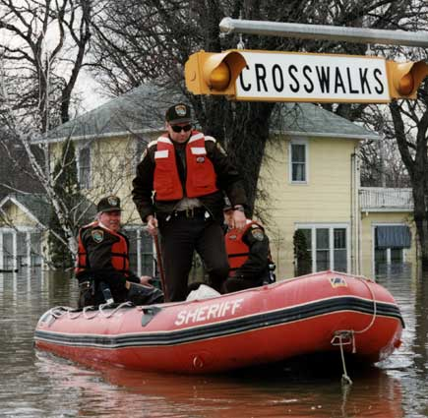
Emergency Work
Category B – Emergency Protective Measures
Emergency Protective Measures are actions taken by a community before, during, and following a disaster to save lives, protect public health and safety, or eliminate immediate threat of significant damage to improved public and private property through cost effective measures.

Slide 21
Permanent Work
Work Categories C - G
  Eligible permanent work:
    Must repair, restore or replace disaster-damaged facilities in accordance with all regulations
    Must restore to pre-disaster design, capacity and function in accordance with applicable codes and standards
    Must be required as a result of the disaster
    May include cost effective hazard mitigation measures

Slide 22
Cost Eligibility
To be eligible for reimbursement, costs must:
    Be reasonable and necessary to accomplish eligible work
    Comply with federal, state, and local laws and regulations
    Include deductions of insurance proceeds, salvage value, and purchase discounts.
    Follow Federal procurement 2 CFR

Slide 23
Small Project or Large Project?
<
>
Upper
Threshold
$128,900
<
>
Minimum
Threshold
$3,200
Annually updated, $128,900 is the FFY 2019 upper threshold amount for small projects.
Notes:
The term large project and small project relates to the cost threshold to complete the work. This cost threshold is defined by federal legislation and is adjusted annually. Small and large projects are processed differently under the Public Assistance Program.

Slide 24
Small Projects versus Large Projects
Public Assistance projects are processed as either small or large projects. If the project cost exceeds the annually updated cost threshold amount ($128,900 for FFY 2018) the project is processed as a large project.
Small Projects
Federal cost share is paid upon project approval.
Large Projects
Federal cost share is paid as work is accomplished.
Final assistance is based upon actual costs.
Note: All CAT Z Projects require closeout!

Slide 25
Project Completion Deadlines
Time limits for project completion begin on the disaster declaration date (5 DEC 2018).
  Emergency work must be completed within – 6 months
  Permanent work must be completed within – 18 months
For extenuating circumstances the Grantee may extend the emergency work deadline an additional 6 months and the permanent work deadline an additional 30 months on a project by project basis.
FEMA may also extend the time limits when sufficient justification is submitted. A justification must be based on extenuating circumstances beyond the State’s or applicant’s control.

Slide 26
Improved Projects
With State approval, the applicant may restore pre-disaster function, and make improvements (for which the applicant is financially responsible.)
SCHOOL
SCHOOL
Before
After
Notes:
The applicant may decide to perform work above and beyond that which is necessary to restore a damaged facility to its pre-disaster design, capacity and function. This is called an improved project. The State must approve the project and FEMA must ensure that its environmental and historic compliance responsibilities are met prior to project approval.
The grant money for the original disaster-related damage repairs can be applied towards the costs for the improved project. Your Public Assistance Coordinator can discuss these details further.
<<State input on how the state share will be calculated.>>

Slide 27
Alternate Projects
Funds used for a project other than repair of the damaged structure:
Must receive FEMA prior approval.
Require Environmental Assessment.
10% reduction of FEMA funding from original project estimate; (receive 90% of the approved Federal share).
SCHOOL
DAMAGED
Funding
NEW
WING
HERE
SCH
OO
L
Notes:
The applicant may decide that the community would best be served by not restoring a damaged facility or the function of that facility. As this slide depicts, the applicant decided that the disaster damaged building is no longer needed and the money could best be used by expanding another building.
This option, which is only available for permanent work, must be requested formally in writing prior to alternate project approval. It is not an option for emergency work or debris removal projects. Alternate projects must be reviewed to assure environmental and historical compliance.
FEMA funding will be 90 percent of the federal share of the approved federal estimate for the original eligible project without any added mitigation measures. Your Public Assistance Coordinator can discuss these details further.
<<State input on how the state share will be calculated.>>

Slide 28
Special Considerations
Hazard Mitigation
Environmental Requirements
Historic Preservation &
Cultural Resources
Special Flood Hazard Areas
Insurance Requirements
Notes:
FEMA uses the phrase “Special Considerations” to cover regulatory and policy compliance issues related to:
Hazard Mitigation
Floodplains or Coastal High Hazard Areas, which are also known as Special Flood Hazard Areas.
Environmental Requirements. These include, but are not limited to, the National Environmental Policy Act, the Endangered Species Act and the Coastal Barrier Resources Act.
Historic Preservation and Cultural Resources
Insurance
The applicant is responsible for ensuring that all special consideration issues are addressed prior to project approval. FEMA and the state have assembled a resource pool that can assist the applicant in all of the various special consideration areas. Failure to identify and resolve special consideration issues early in the recovery process has resulted in protracted delays in providing assistance to applicants. FEMA’s goal is to provide disaster assistance in a timely manner. Throughout the recovery process FEMA staff will ask questions to identify and resolve special considerations issues.
The next section of this briefing will address the various special considerations in more detail.

Slide 29
406 Hazard Mitigation
Cost effective measures that reduce or eliminate the potential for damages to a facility from a future event. For a hazard mitigation proposal to be eligible for funding under Public Assistance, the measure must apply only to the damaged elements of the eligible facility.
steel
angle
steel
straps
steel angle
wall anchor
Bracing Library Shelves

Slide 30







Environmental Requirements
Ensure that all practical means
are used to protect,
restore, and enhance
the environment
Notes:
FEMA must ensure that its funding actions are in compliance with the National Environmental Policy Act, as well as other environmental laws such as the Endangered Species Act, Coastal Barrier Resource Act (COBRA), and Wild and Scenic Rivers Act.
If you wish to repair or reconstruct a damaged facility in a manner that differs from the condition or location it was in prior to the disaster, then your Public Assistance Coordinator will work with you to obtain additional project information in order to ensure compliance with applicable environmental laws.
The applicant is responsible for identifying those projects that are intended to differ from their pre-disaster condition and for identifying any known environmental concerns. Failure to comply with environmental laws and regulations will jeopardize Federal funding on any project.

Slide 31
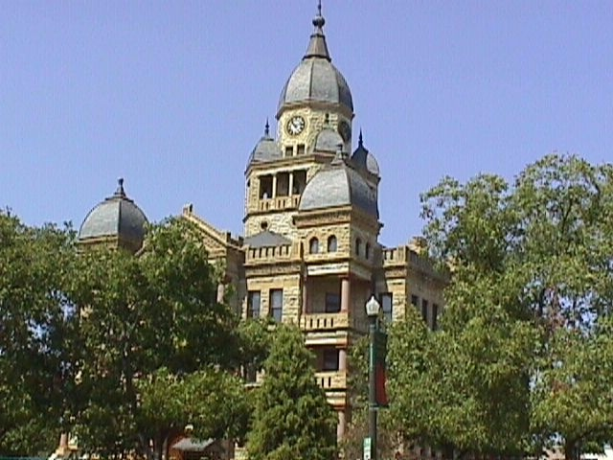
Historic Preservation
Property eligible for listing on the National Register of Historic Places requires special consideration under the National Historic Preservation Act.
Notes:
Property eligible for listing on the National Register of Historic Places requires special consideration, these properties are generally 50 years old or older.
The applicant will assist the Public Assistance Coordinator in identifying these historic resources. Keep in mind that they can include buildings, bridges, roads, Native American cultural heritage sites, and archeological sites.
The State Historic Preservation Officers are key to assisting FEMA in fulfilling its historic responsibilities defined in the National Historic Preservation Act.

Slide 32
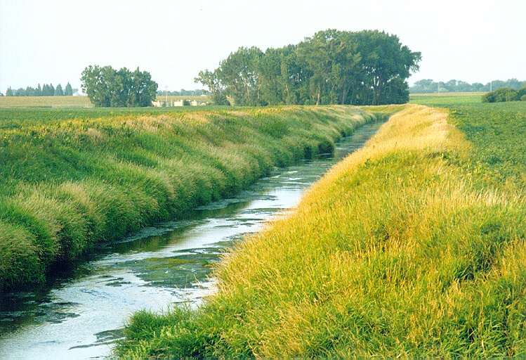
Special Flood Hazard Area
Any project within or affecting the floodplain must be reviewed to ensure that it meets the requirements of the Executive Orders on Floodplain Management and the Protection of Wetlands.
Notes:
The applicant must identify all projects within or affecting the floodplain/ wetland to the Public Assistance Coordinator for consideration of floodplain management and the protection of wetland resources.
Information on floodplain locations can be most readily obtained from your local building, planning or public works departments.

Slide 33
INSURANCE REQUIREMENTS
Actual or anticipated insurance proceeds will be deducted from the eligible project costs for facilities that are insured.
All applicants are required to obtain and maintain insurance coverage on all insurable facilities, as a condition of Public Assistance funding.
For flood damaged facilities located within a Special Flood Hazard Area that are not covered by flood insurance, Federal assistance will be reduced by the maximum flood insurance proceeds that would have been payable had the facility been insured.

Slide 34
Appeals
Any determination related to Federal assistance may be appealed.
The time limit for appeal submission is 60 days from receipt of notice of the action which is being appealed.
Notes:
The subgrantee or applicant may appeal any determination previously made related to federal assistance. The appeal shall be made in writing and submitted to the grantee or State within 60 days after receipt of notice of the action which is being appealed. There are two levels of appeal, one to the Regional Director and one to FEMA Headquarters.
<<State input>>

Slide 35
Record Keeping
Accurate records of expenses
must be maintained for at least 3 years beyond final closeout of DISASTER
Notes:
It is important to keep accurate records for all projects for which federal or state funds are provided. Project records must be maintained for three years.
Your Public Assistance Coordinator will discuss these requirements with you. They primarily involve labor, equipment, materials and contract cost records.
Your state may also have separate record keeping requirements that you will also be required to meet. Also, the State must certify that all approved work was accomplished. This may include review of all revenant documentation.

Slide 36
Progress and Financial Reports
Sub-grantee progress and financial reports must be obtained to monitor grant work status.
If you are unable to submit required reports, the State’s grant funding is jeopardized
Without information from sub-grantee reports, DEMHS cannot fulfill its reporting responsibilities to FEMA.

Slide 37
Quarterly Progress Report: PA
Quarters ending December 31, March 31, June 30 & September 30; (due within 30 days after end of quarter).
Describe the status of projects on which final payment of the Federal share has not been made to the State (44 CFR 206.204(f)).
        Projected completion date
        Time extensions granted
Outline any problems or circumstances expected to result in non-compliance with the approved grant conditions.

Slide 38
Public Assistance Summary
The Public Assistance Program assists in the restoration of community infrastructure.
It is a supplemental cost reimbursement program with specific eligibility requirements.
The FEMA share of eligible costs will be awarded to the State (Grantee/recipient) for disbursement to the applicant (sub-grantee/sub-recipient).
Notes:
The Public Assistance Grant Program assists in the restoration of community infrastructure.
Assistance is generally limited to restoration to pre-disaster design and function.
It is a supplemental cost reimbursement program with specific eligibility requirements.
The FEMA share of eligible costs will be awarded to the State for their disbursement to the applicant.
<<State input for non-federal share>>

Slide 39
DUNS/FEIN Numbers
Each Applicant needs to provide a DUNS number and a FEIN Number in order for FEMA to obligate any funding.
Notes:
The Public Assistance Grant Program assists in the restoration of community infrastructure.
Assistance is generally limited to restoration to pre-disaster design and function.
It is a supplemental cost reimbursement program with specific eligibility requirements.
The FEMA share of eligible costs will be awarded to the State for their disbursement to the applicant.
<<State input for non-federal share>>

Slide 40
Submission Time Limits
Request for Public Assistance -
30
days after declaration date ( 4 Jan 2019)
Project Worksheets -
60
days after Kickoff/Recovery Scoping Meeting
Notes:
All applicants under the Public Assistance Program must submit the required documentation in a timely manner. It is in the applicant’s best interest to submit complete and accurate documentation as soon as possible.
The Request for Public Assistance is required for an applicant to be considered for the Public Assistance Program. The request may be completed at the Applicant’s Briefing and must be submitted within 30 days of designation.
All Project worksheets must be submitted within 60 days of the Kickoff Meeting. Applicant are encouraged to complete Project worksheets as soon as possible. However, all Project Worksheets submitted to the Public Assistance Coordinator (PAC) greater than 30 days after the Kickoff Meeting will be validated, while only 20% of projects submitted within 30 days will be validated.

Slide 41
Project Completion Time Limits
Time limits for all Projects begin the date of the disaster declaration
  Emergency work - 6 months
  Permanent work - 18 months
Notes:
All disaster recovery projects must be completed within specific time limits. The completion time limits for all projects begin upon the date of disaster declaration. Emergency work must be completed within 6 months and permanent work within 18 months. Time extensions for justified reasons may be granted on a case by case basis.
The State is responsible for monitoring the progress of projects.

Slide 42
Remember...
These actions will help you obtain eligible funding in the shortest amount of time:
Submit a Request for Public Assistance TODAY The final deadline extended to 4 Feb 2019.
Review projects for eligibility and Special Considerations.
Provide accurate project data to include prices and scope.
Work closely with your FEMA Program Delivery Manager.
Have documentation available and organized.
Be aware of all potential recovery funding streams.
Check all permitting requirements (debris, Flood CERT)
Notes:
To obtain eligible funding in the minimum amount of time be sure to do the following: Submit a Request for Public Assistance as soon as possible after the disaster. Review projects for eligibility and Special Considerations. Provide accurate project data in the scope of work on the Project Worksheets. Work closely with your Public Assistance Coordinator (PAC) to insure all damages are identified and fully documented on Project Worksheets. Have all project documentation available, organized and up to date for final inspection, review and audit.

Slide 43
Additional information can be obtained from:
  FEMA’s Web Site: http://www.fema.gov/public-assistance-local-state-tribal-and-non-profit
  CT-DEMHS Web Site: https://portal.ct.gov/DEMHS/Grants/FEMA-Public-Assistance
  CT-DEMHS Public Assistance Staff EMail: demhs.pa@ct.gov
  Your FEMA Program Delivery Manager
J. Ward 11/20/97

Slide 44
Trip HAZARDS
Failure could endanger eligibility
Meet Deadlines
Stay within Period of Performance (POP)
Follow Scope of Work
Permitting
Procurement
Document
Read Guidance carefully
Refer to reference material
Consult local experts
When in doubt ASK!

Slide 45
Questions?

