Slide 1
Family First Prevention Services Act:
Leveraging the Opportunity to Support Families and Prevent Foster Care
Miranda Lynch, Policy Fellow
Chapin Hall at the University of Chicago

Slide 2


Family First Prevention and Services Act: A transformational opportunity
Prevention
High Quality Group Care
Evidence Based Interventions
Other Major Provisions

Slide 3
Prevention Option
Beginning Oct 1, 2019, states will have the option to use title IV-E federal funds for evidence-based preventive services/programs (EBPs) for:
  children at imminent risk of foster care entry, their parents and/or kin caregivers (e.g., “candidates”)
  pregnant and parenting teens in foster care
Prevention services are for children/parents/kin caregivers regardless of income, and defined as:
  Skill based parenting programs – individual and family counseling, parenting skills and parent education
  Substance abuse treatment and prevention
  Mental health treatment
Prevention

Slide 4
Prevention Option – Potential Populations
Prevention
Who is at imminent risk of entering foster care?
Families in community areas with high confluence of known community level risks
Families with known risks for child welfare involvement, including substance use or housing instability, families receiving alternative response
Families receiving preventive services on a voluntary basis, including unfounded investigations
Indicated/substantiated investigations not resulting in removals
Narrow Medium Narrow Medium Broad Broad

Slide 5
Strategic Plan for the Prevention Option
To elect the option, states must seek approval from the federal government of a statewide five-year Prevention Plan that prompts careful consideration of:
Prevention
  selected EBPs
  target populations
  intended outcomes
  eligibility for services
  workforce development and prevention caseloads
  mechanism for assessing risk/safety of children served
  mechanism for prevention planning with families
  trauma-informed approach to prevention
  coordination and collaboration with partners to support a full continuum of care
  evaluation and continuous quality improvement for prevention programs

Slide 6
Evidence for Prevention Services
HHS will conduct a systematic review of services & rate the level of evidence via a Federal clearinghouse.
Initial programs reviewed by the Clearinghouse as of 11.13.19:
Evidence
Based Interventions
Parenting Skills
Nurse-Family Partnership (WS)
Substance Use Disorder
Motivational Interviewing (Pending - NYR)
Multisystemic Therapy (WS)
Mental Health
Parent-Child Interaction Therapy (WS)
Families Facing the Future (S)
Methadone Maintenance Therapy (P)
Multisystemic Therapy (WS)
Functional Family Therapy (WS)
Health Families America (WS)
Parents as Teachers (WS)
Trauma Focused-Cognitive Behavioral Therapy (P)
WS – Well Supported; S – Supported; P- Promising; NYR – Not Yet Rated;
X – Rated as not meeting evidence criteria

Slide 7
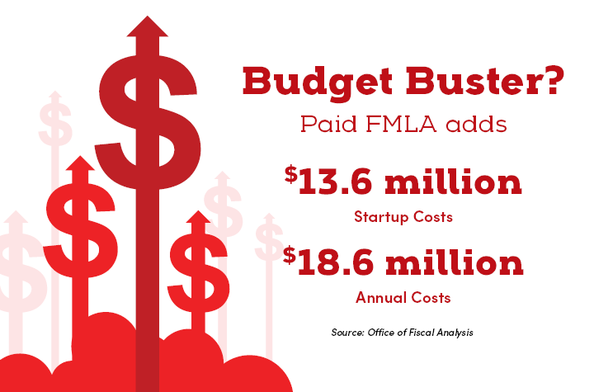
Fiscal Matters for the Prevention Option
No income test for federal $
Partial federal reimbursement for state expenditures on services, related administrative costs and training
Assurance not to replace state historical spending on prevention EBPs
Prevention program is payer of last resort
Requirement to spend on services at highest evidence level

Slide 8
Prevention Option Opportunities
Transforming the child welfare focus from foster care to prevention, increased family stability, and well-being.
Investing in evidence-based interventions.
Applying a trauma-responsive lens to the continuum of prevention services.
Partnering across systems (mental health, substance use disorder, juvenile justice, early childhood, health, etc.) to align prevention efforts.
Scaling up preventive service and de-scaling foster care.
Maximizing federal reimbursement of secondary/tertiary prevention to free up funding for primary prevention.

Slide 9






Framework for Assessment, Planning, Readiness: Domains of Inquiry
Transformation Framework
Practices, Service Array, and Policy
Sequencing and Jurisdictional Concerns
Data and Evidence
Implementation Capacity & Strategy
Administrative and Fiscal

Slide 10

Example: District of Columbia
“The District’s CFSA and its community partners have developed a plan that is grounded in a commitment to preventing child abuse and neglect and unnecessary removal of children from their families and to strengthen the ability of families to care for their children safely…The plan represents a thoughtful re-conceptualization of the way public child welfare agencies serve children and families…”
Jerry Milner, Associate Commissioner of the Children’s Bureau.

Slide 11
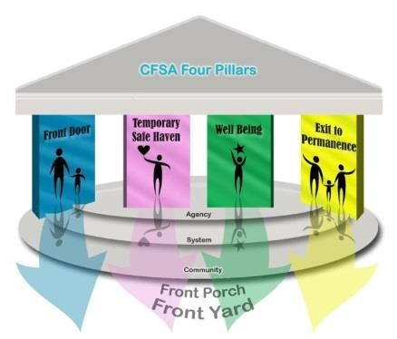
Family First Target Population
Below content created by the District of Columbia's Child and Family Services Agency for inclusion in its Prevention Plan
Target Sub-Population
Front Porch
Children served through the Healthy Families/Thriving Communities Collaboratives (the Collaboratives) following a CPS investigation or closed CFSA case.
Children who have exited foster care through reunification, guardianship, or adoptions.
Children born to mothers with a positive toxicology screening.
Front Door
Children served through CFSA’s In-Home Services program, which offers intensive case management and service referrals to families.
Pregnant or parenting youth in/recently exited foster care with eligibility for services ending five years after exiting foster care.
Non-ward children of pregnant or parenting youth in or recently exited foster care with eligibility for services ending five years after exiting.
Siblings of children in foster care who reside at home and have assessed safety concerns.
Target Sub-Populations
10

Slide 12


District of Columbia:
Leveraging Family First in a Prevention Continuum
Family First
  Evidence-based programs to support pregnant & parenting youth in foster care and foster care candidates
Families First DC:
Neighborhood-based strengthening approach
  Wraps around the narrow requirements of Family First to support and strengthen DC families in their own neighborhoods through primary prevention.

Slide 13
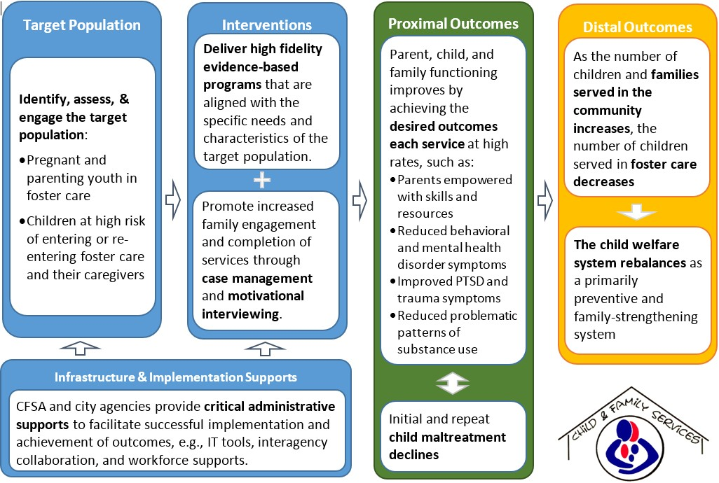
Theory of Change
Below content created by the District of Columbia's Child and Family Services Agency for inclusion in its Prevention Plan

Slide 14

Contact Information
Chapin Hall is an independent policy research center at the University of Chicago that provides public and private decision-makers with rigorous research and achievable solutions to support them in improving the lives of children, families and communities.
Miranda Lynch
Policy Fellow
Chapin Hall
mlynch@chapinhall.org
703-627-8420

